Slide 1
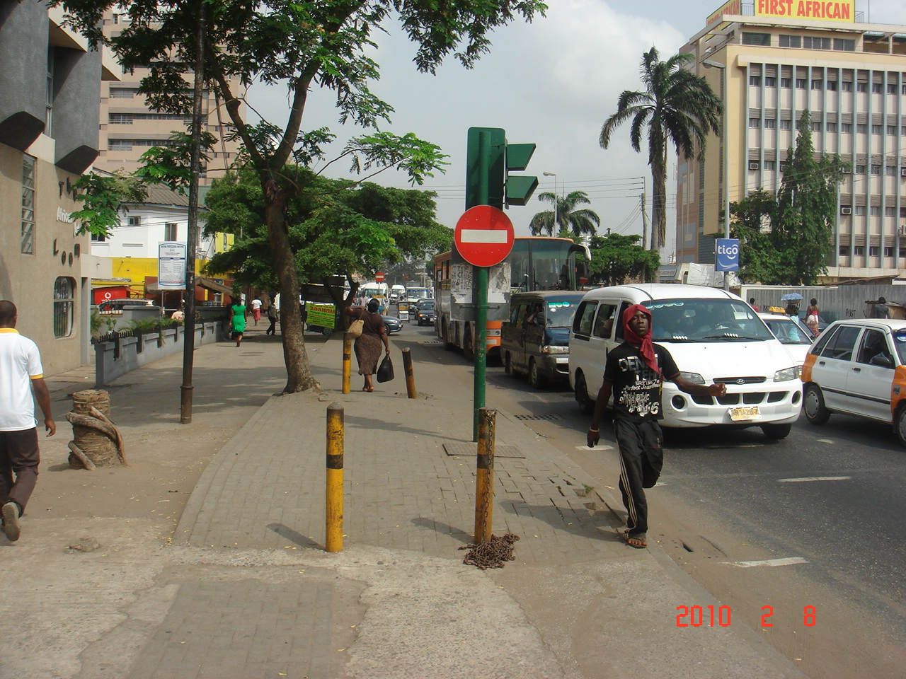
An overview from a business perspective on the knowledge economy
Elucidate knowledge as the centre of
economic growth and development
Lack of skills = lack of “know how”
Confidence of the business community

Slide 2
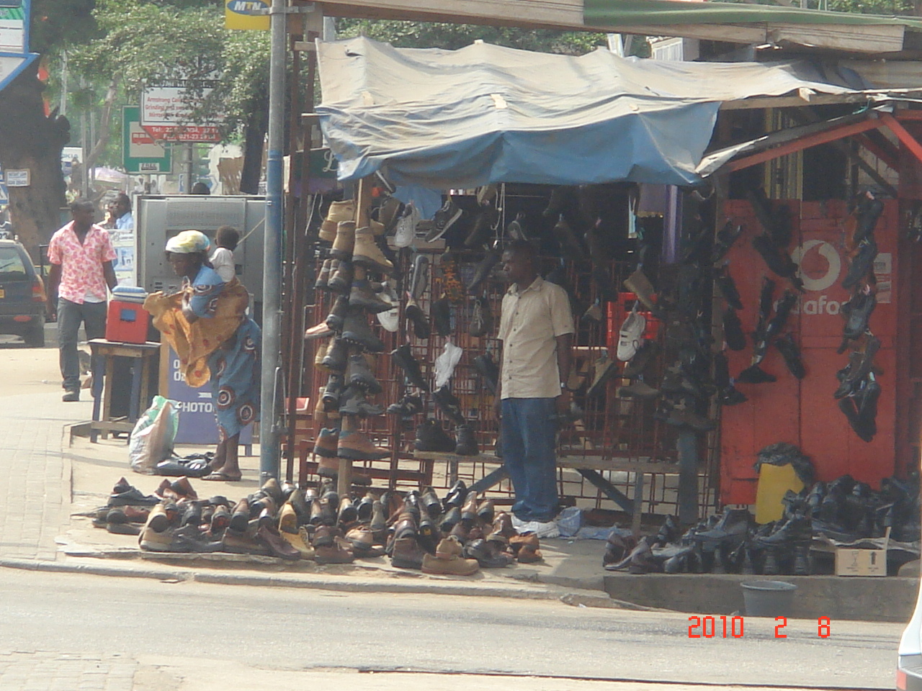
VIDEO CLIP
Clip 1
Clip 2

Slide 3
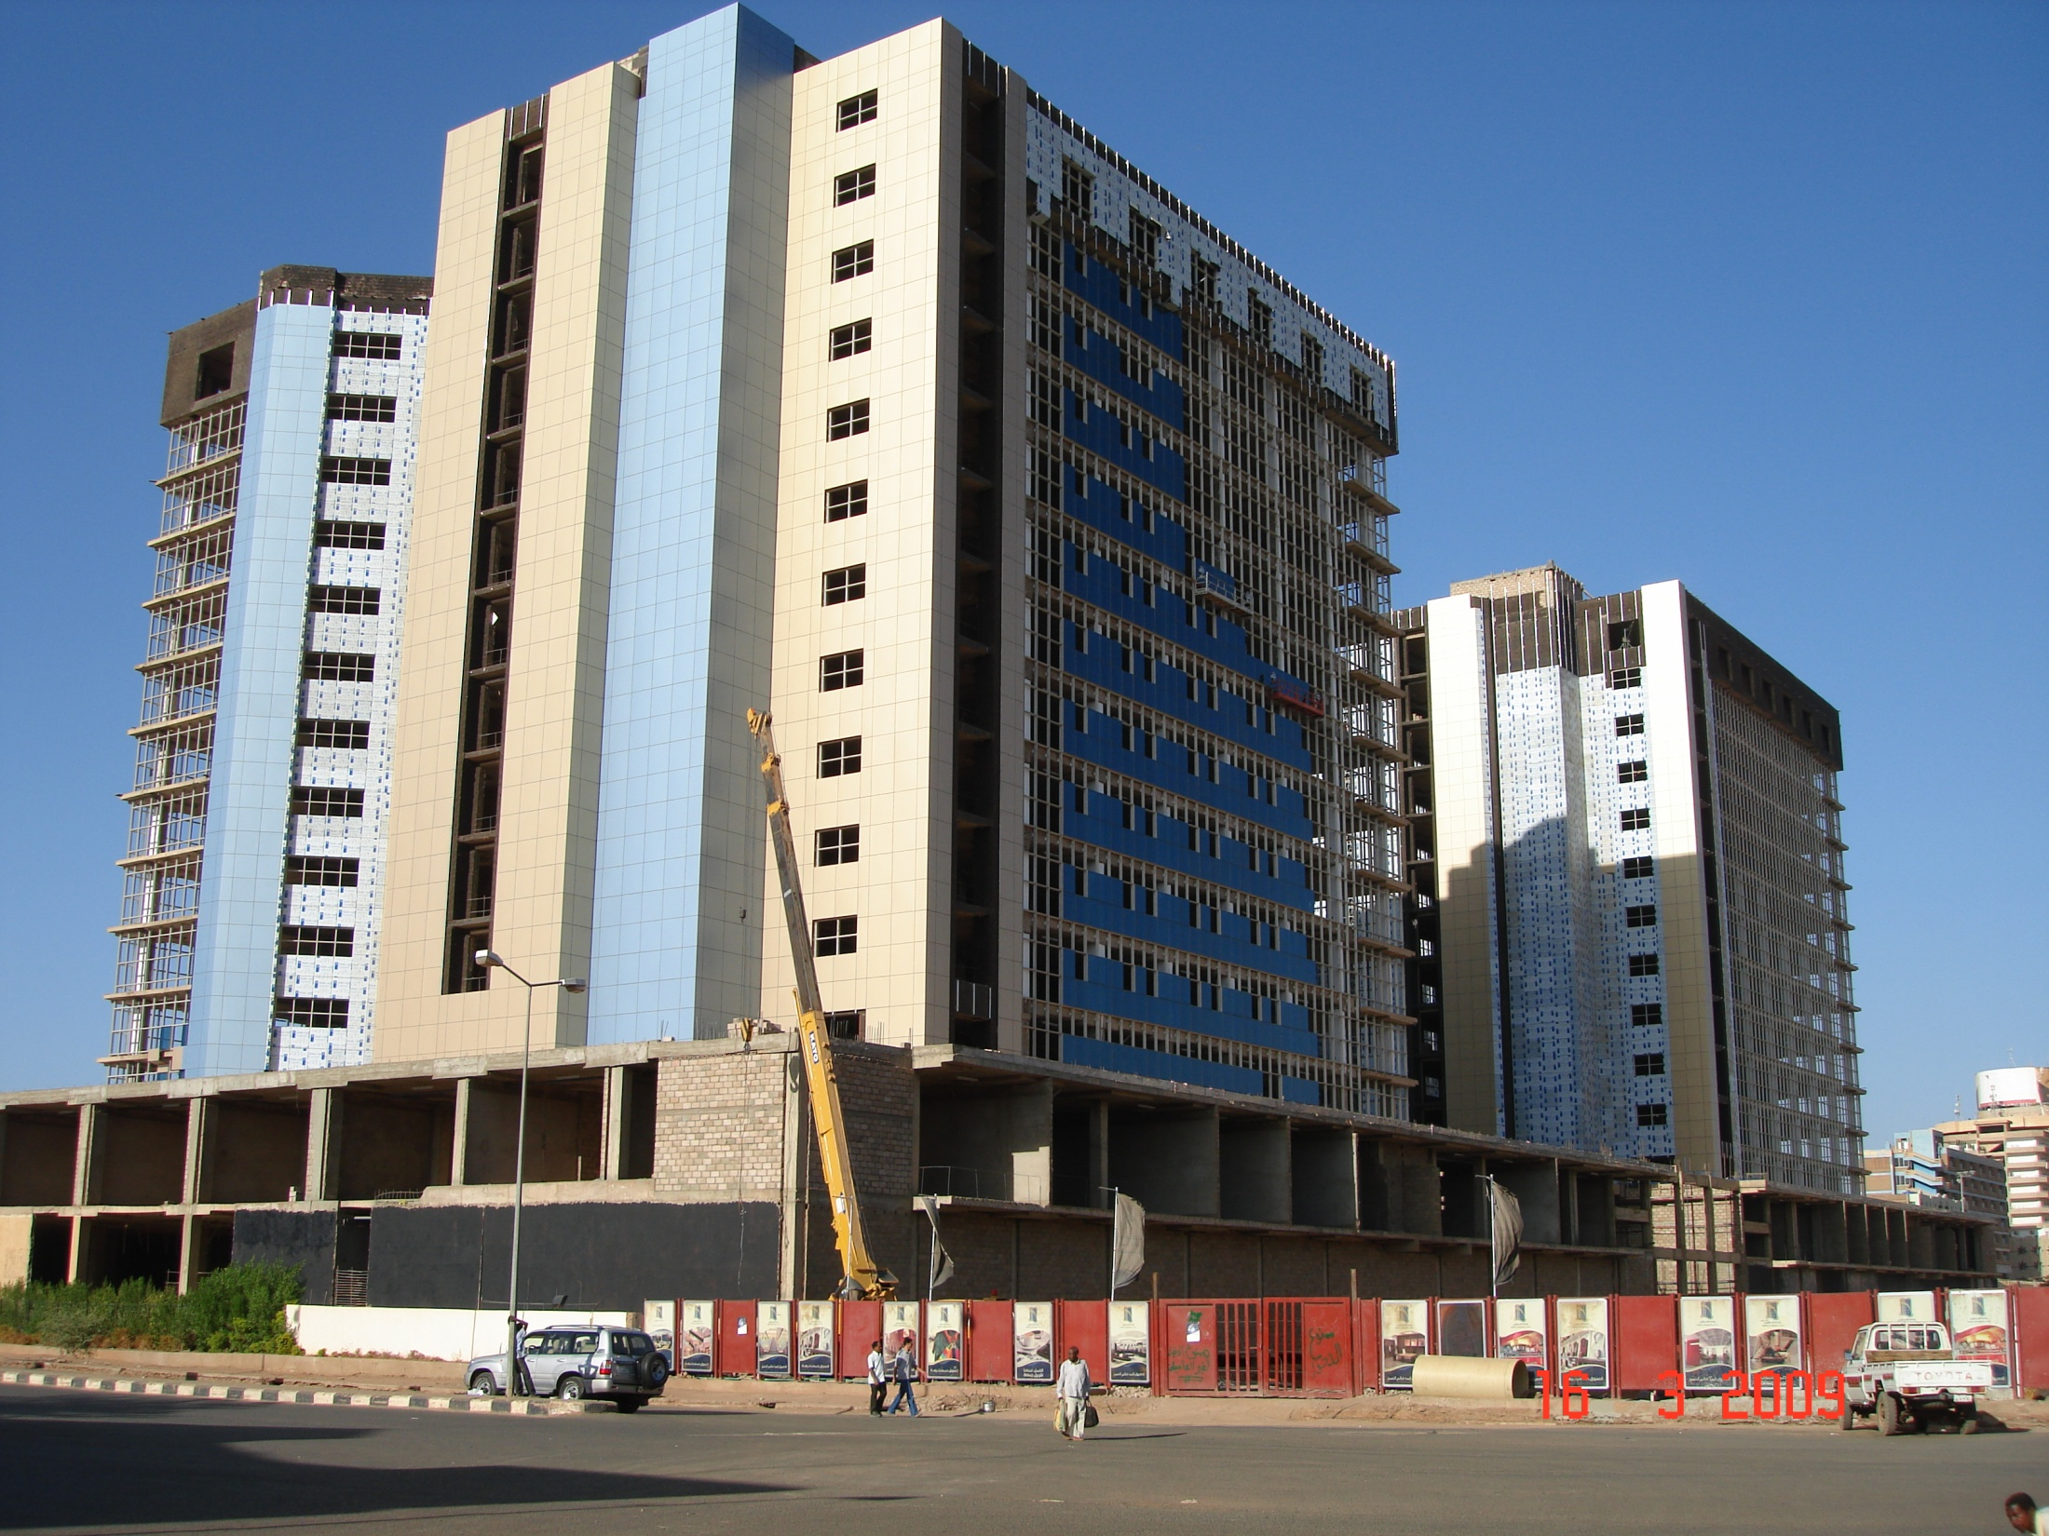
What happened here?
Irrespective – knowledge plays a crucial part
Knowledge feeds resource application
Skills in terms of engineering and
construction
In brief – what really happened here
  Military spend
  Expertise exodus
  Schooling
  Culminating in…
© Steyn Heckroodt

Slide 4
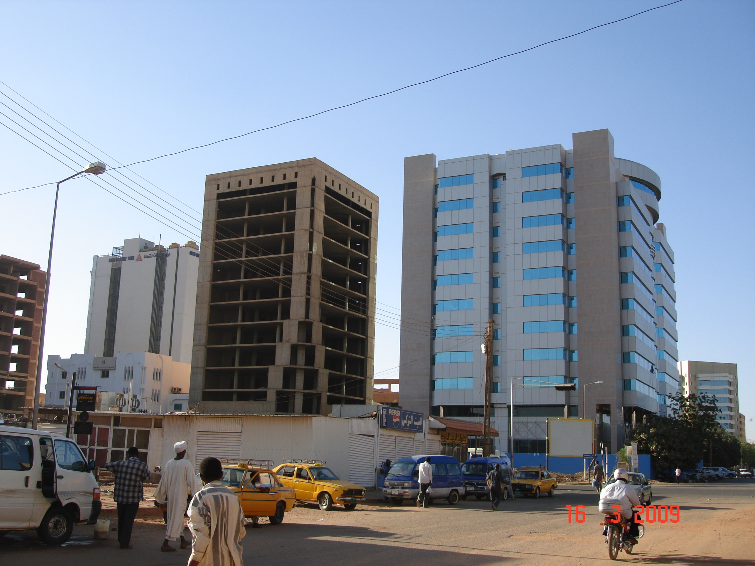
Data
Information
Knowledge
Understanding
Wisdom
© Steyn Heckroodt

Slide 5
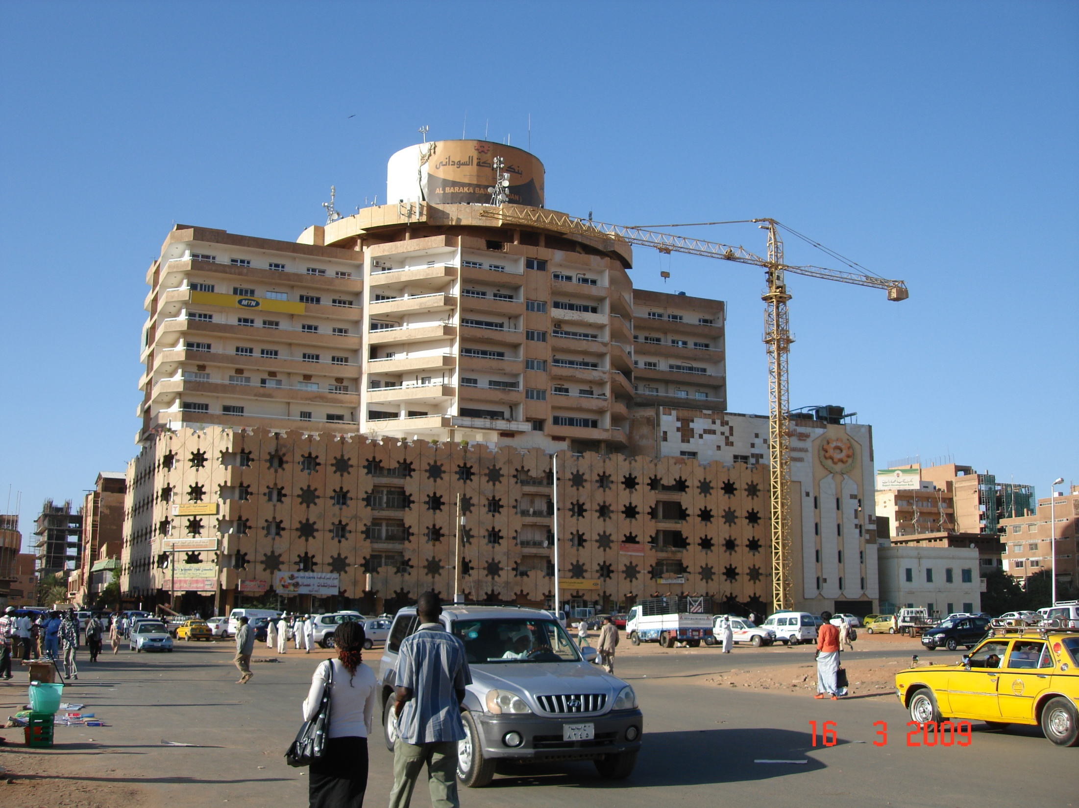
The concept that supports creation of knowledge by employees and helps them to better utilize this in line with company/organization goals
Whilst
A business has as one of its main objectives the receipt or generation of a financial return in exchange for work and acceptance of risk
© Steyn Heckroodt

Slide 6
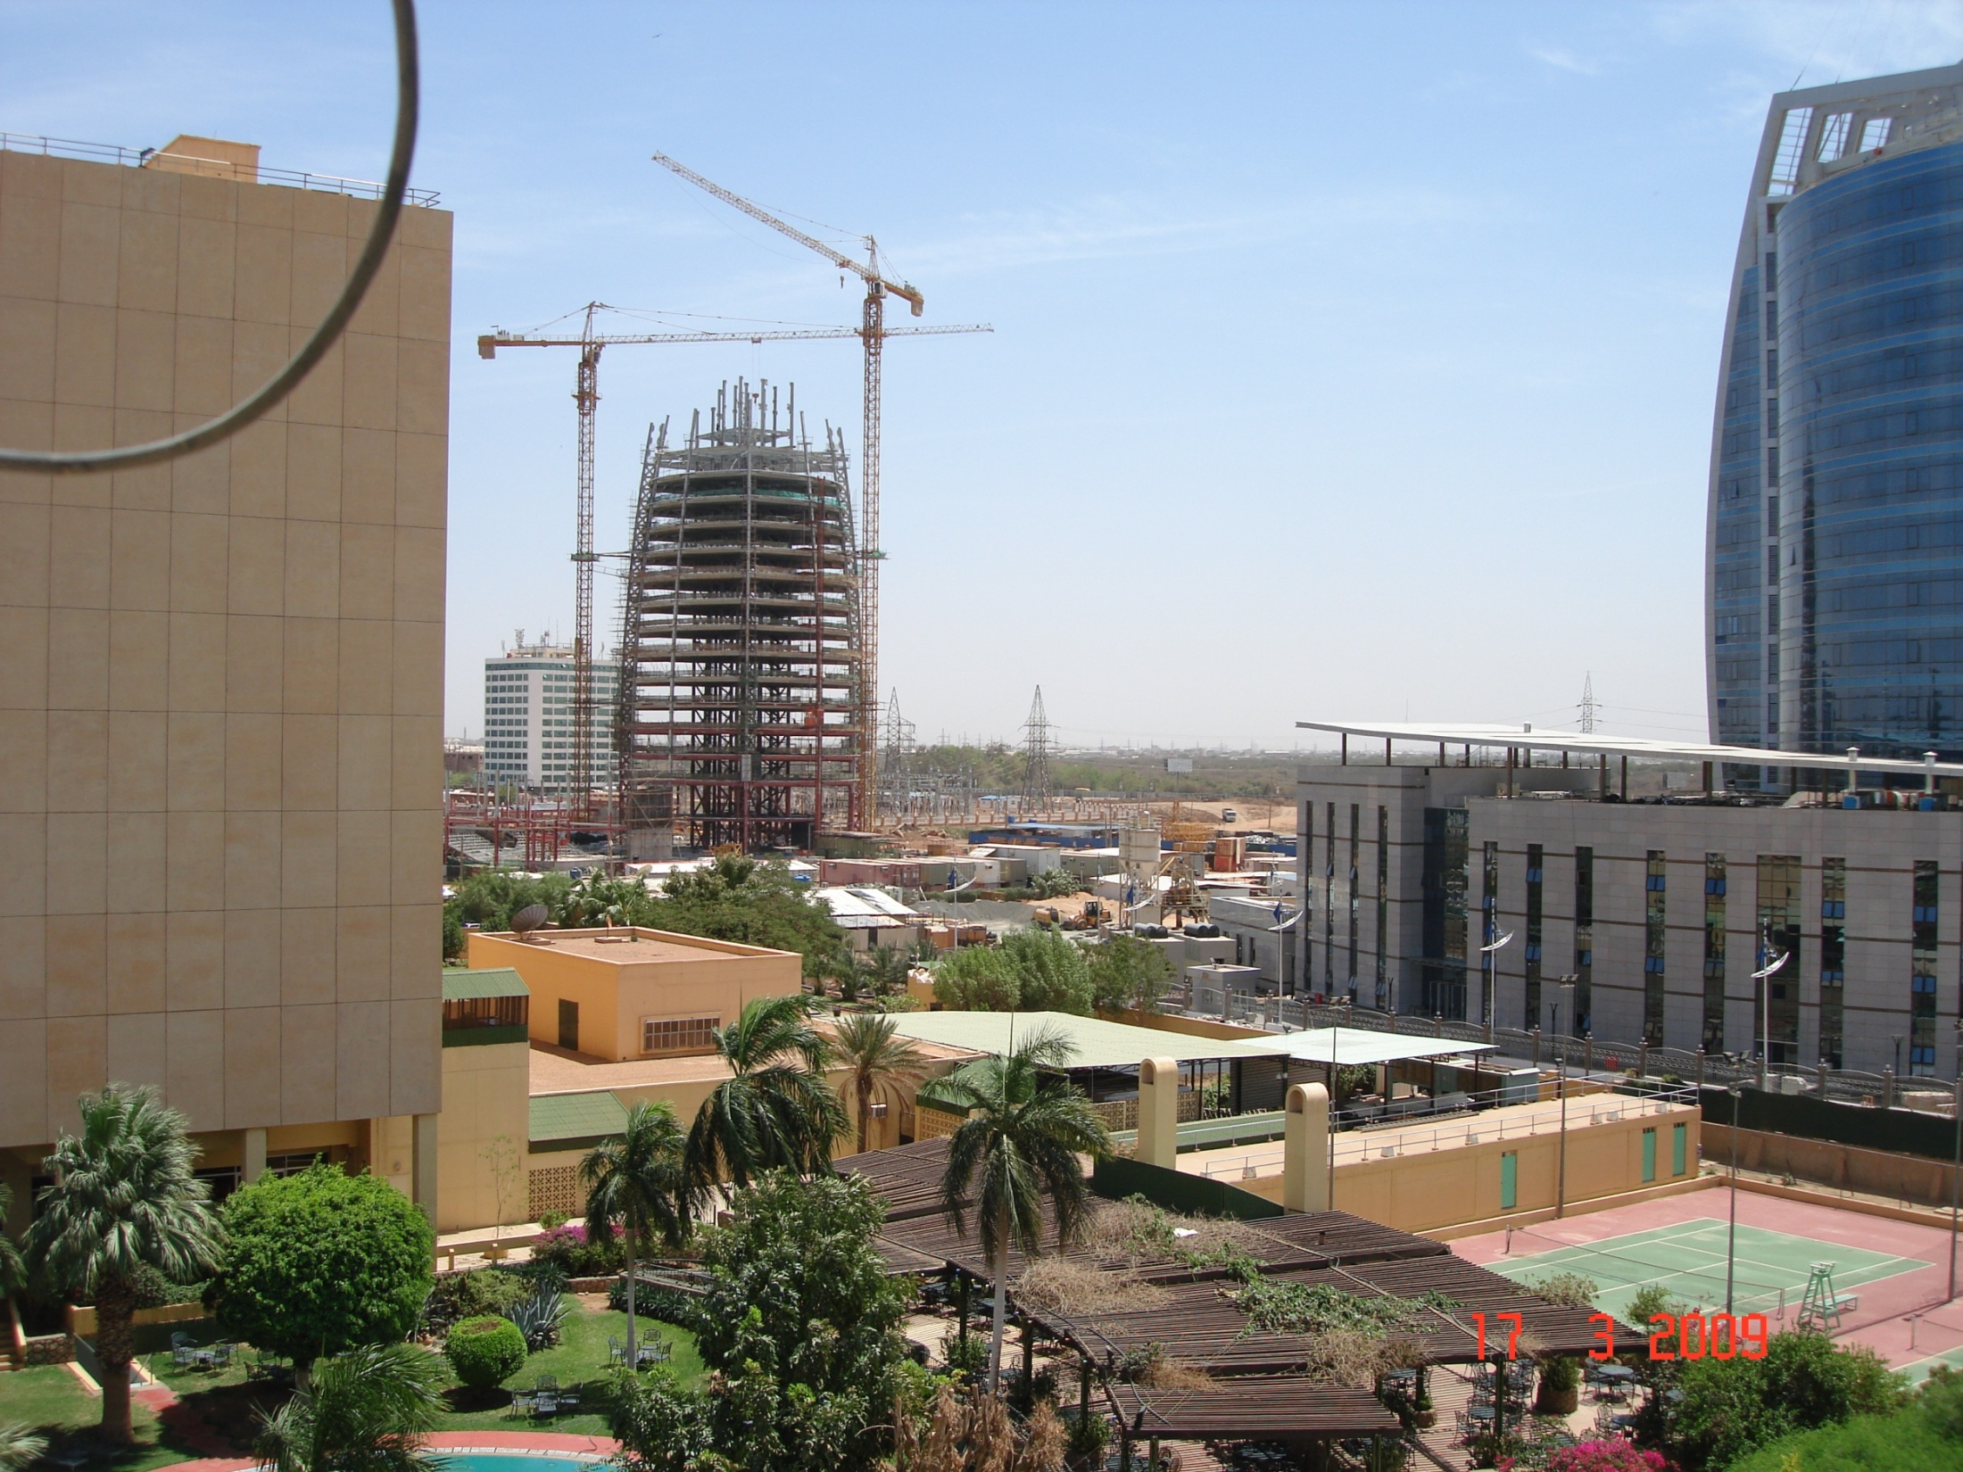
Risk and return
Invest – return – risk profile
Where is risk measured – conceptually or
physically
Where is risk mitigated – conceptually or
physically
© Steyn Heckroodt

Slide 7
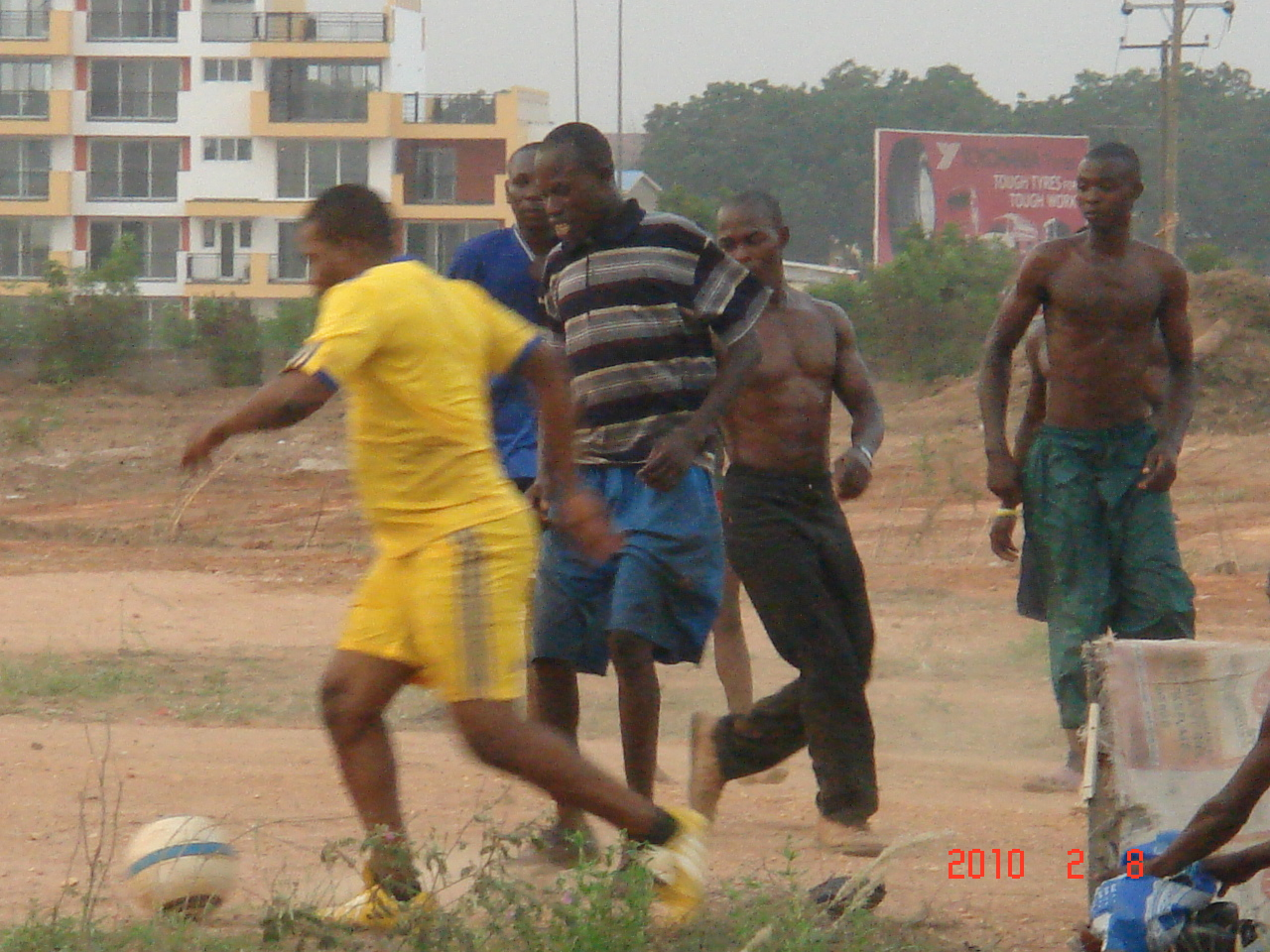
Conceptual – values, vision, mission, intent – where we PLAN things
Physical – processes, infrastructure, activities – where we DO things
© Steyn Heckroodt

Slide 8
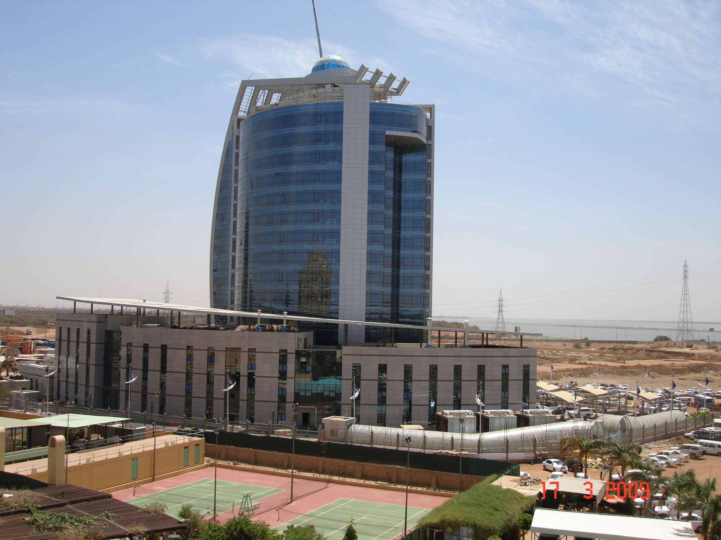
Risk measured in the physical reality
Mitigated in the physical reality
Critical path
Risk factor analysis
Decision then made against ROI
© Steyn Heckroodt

Slide 9
 | B | 185
6 | 180 | 186
 | E
187 | 13 | 200
222 | H
 | Collect money
222
 | A
 | Place order
0 | 5 | 5
 | C | 16
6 | 10 | 16
187 | F
187 | 9 | 196
197 | G | 221
197 | 24 | 221
 | D | 11
6 | 5 | 11
ES | ID | EF
SL | Description
LS | Dur | LF

Slide 10
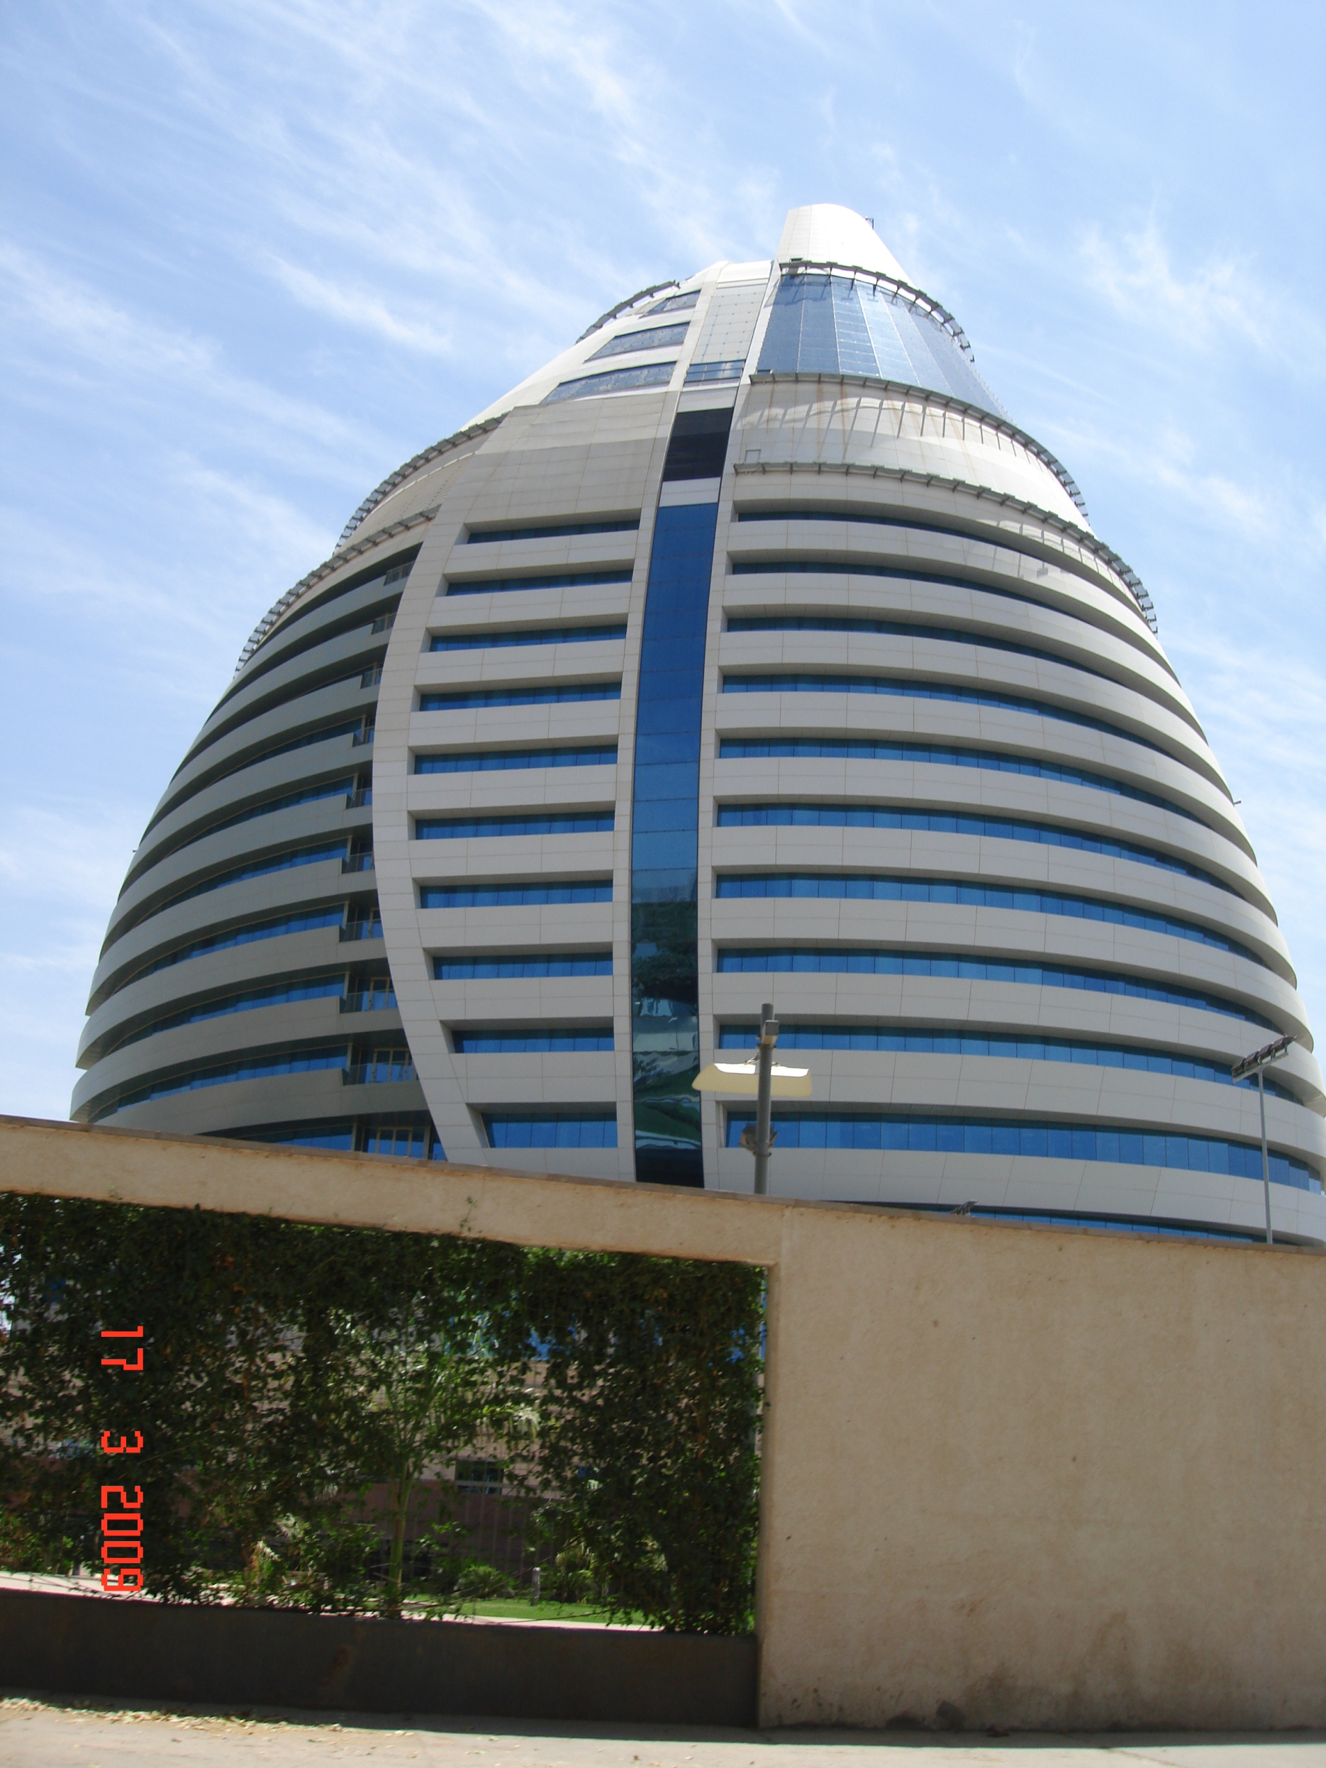
Risk mitigation and ex-pat labour
Higher cost of labour input
Typically in higher risk areas (knowledge-
wise)
Higher ROI expectations
Larger pull on foreign reserves
Country’s wealth and prosperity impacted
© Steyn Heckroodt

Slide 11
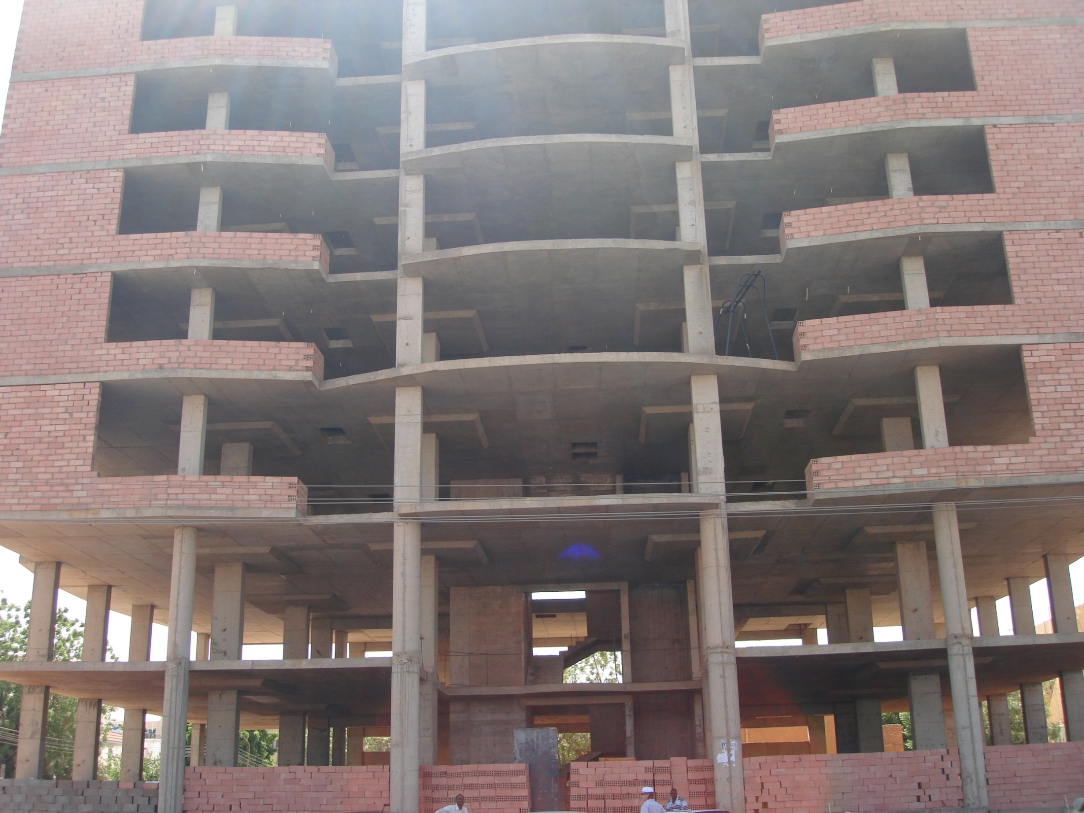
Conclusion
Business competitiveness measured in
terms of competitive ability
CA = application of resources
Resources = financial, infrastructural,
people, information and knowledge
Shortage of any of these = higher risk, lower
confidence and coinciding higher
© Steyn Heckroodt

Slide 12
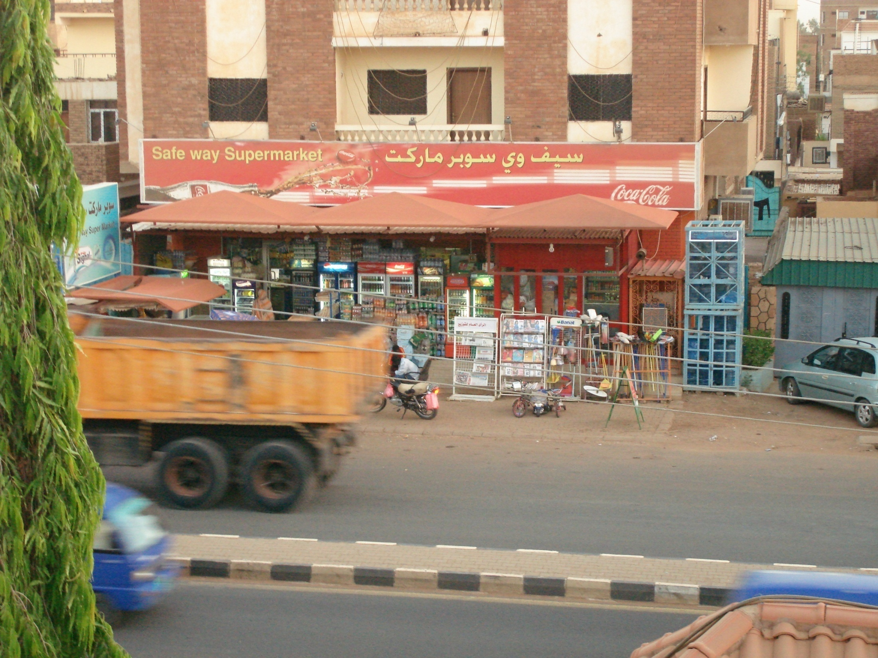
Two edged sword
Don’t have own knowledge = Sudan example
Higher reliance on FDI = stronger pull on exit
of foreign reserves in the form of dividend
payouts
© Steyn Heckroodt

