Slide 1

The Open Access Continuum:
Open Research and Altmetrics
Michelle Willmers
Scholarly Communication in Africa Programme
CC-BY-SA

Slide 2
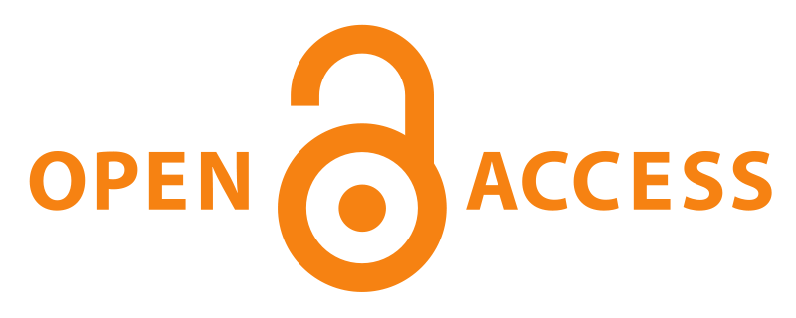

Slide 3
Gold Route
- Primary publication in open-access journals
- 7 070 journals (DOAJ 2011)
Open Access
Green Route
- Self-archiving of scholarly content prior to, in parallel with, or after publication
2085 repositories worldwide (DOAR 2011)
Notes:
Gold Route
- Primary publication in open-access journals.
- 7 070 journals (DOAJ 2011)
Green Route
- Self-archiving of scholarly content in open access repositories prior to, in parallel with, or after publication.
2085 repositories worldwide (DOAR 2011)

Slide 4
But it’s not only about journal articles.
There is an abundance of information online.
The internet has changed the way we consume information. No longer single source (journal, book). This changes how we locate, verify and measure new information.
“Rather than finding information, it is the filtering of relevant information that is hard to do on the internet.”
(David Weinberg)
Notes:
Weinberg (2012) http://www.toobigtoknow.com/

Slide 5
“Open access to this knowledge is critical if it is to
be shared between individuals and groups.
But sharing alone is not enough.
Knowledge only becomes useful when we can
distinguish between relevant and less relevant information,
when we can discuss aspects of the information,
when we can annotate and improve on ideas,
when we can devise new approaches
and collaborate online.”
(Olijhoek 2012)
Notes:
Scientific social networks are the future of science
Posted on March 20, 2012 by Tom Olijhoek
http://access.okfn.org/2012/03/20/scientific-social-networks-are-the-future-of-science/

Slide 6

Notes:
Open Research exploring space beyond the journal article and more dynamic system of open exchange of “research objects”. Promotes expansive, collaborative approach, which has had particular success in making progress in biomedical sciences, astronomy. Most notably, led to identification of biomarkers for alzheimers.

Slide 7
Open Research
Replicable (transparency - method)
Reusable (results free for re-use and appropriation)
Replayable (tools available for appropriation)
Collaborative
Interdisciplinary
Granular
Immediacy factor
Suited to addressing socio-economic imperatives and collaborative breakthrough
Notes:
A few commonly acknowledge characteristics.

Slide 8
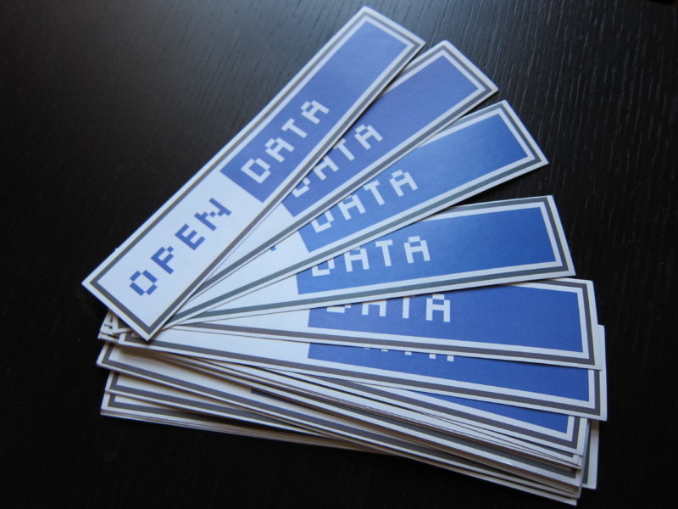
Notes:
Open research heavily contingent on open data practice.

Slide 9
Notes:
Significant challenges and barriers to sharing open data, particularly around metadata and curation considerations. Various large-scale organisations working at global interoperability of systems and standards.

Slide 10
Traditional Scholarship
Relatively contained disciplinary context.
Relatively clear scholarly community.
Relatively clear boundaries.
Particular points of engagement.

Slide 11
Traditional Scholarly Communication
Student
Literature reviews
Conceptual frameworks
Bibliographies
Conceptualisation
Data Collection
Findings
Engagement
Translation
Data Analysis
Proposals
Notes
Interview transcripts
Lectures
Data sets
Presentations
Images
Reports
Audio recordings
Community
Interviews
Books
Conference papers
Journal articles
Technical papers
Scholar
Image CC-BY-SA Laura Czerniewicz

Slide 12
Scholarship 2.0
New ways of describing content (and looking for it). Metadata as passport to participation.
New ways of tracking usage.
Aggregation crucial.
Blogging and social networking as mechanisms for research and collaboration.
Outputs of social web become part of the scholarly record.
Rise of the global networked scholar.

Slide 13
New Models of Scholarly Communication
Literature Reviews
Conceptual frameworks
Bibliographies
Conceptualisation
Data Collection
Findings
Engagement
Translation
Data Analysis
Proposals
Notes
Interview transcripts
Lectures
Data sets
Presentations
Images
Reports
Audio recordings
Interviews
Books
Conference papers
Journal articles
Technical papers
Image CC-BY-SA Laura Czerniewicz
Notes:
The whole PROCESS becomes open and shareable
Every step is opened up
Audiences all along the way

Slide 14
New questions arise…
What about peer review and quality control?
What does this mean for how we measure and reward research? (What does this mean for the notion of ‘impact’?)

Slide 15
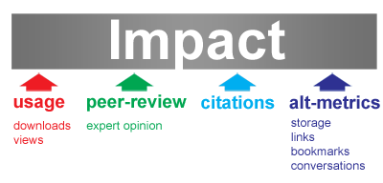
http://altmetrics.org/manifesto/
Notes:
Open, technologically-driven practice leads to a new, expanded conception of impact.

Slide 16


Slide 17
Bibliometrics mined impact on the first scholarly Web.
altmetrics mines impact on the next one.
Jason Priem

Slide 18
Altmetrics
1. Conventional outputs > unconventional measures
(Cameron Neylon)
The decoupled journal

Slide 24
Altmetrics
2. Unconventional outputs > conventional measures
(Cameron Neylon)
The social web

Slide 25
The social web and science
58k tweets mention scientific articles (with a DOI, PMID or arxiv ID), 1 – 31 July 2011.
http://buzzdata.com/stew/tweets-linking-to-scientific-papers-jul-2011#!/overview
Highly tweeted articles 11 times more likely to be highly cited than less-tweeted articles.
Tweets can predict highly cited articles within the first 3 days of article publication. Social media activity either increases citations or reflects the underlying qualities of the article that also predict citations
Eysenbach et al. 2011
Notes:
1. http://buzzdata.com/stew/tweets-linking-to-scientific-papers-jul-2011#!/overview
2. http://www.jmir.org/2011/4/e123/

Slide 26
New tools for exploring impact www.total-impact.org

Slide 31
How do we start?
SLOWLY.
Experimenting with tools.
Consider interoperability of systems (for tracking capacity).
Gather usage data and watch for trends/characteristics.
Engage with scholarly networks as important new commodity.

Slide 32
Conclusion: towards Expanded Open Access
Transparency in methodology, observation and collection of data.
Public availability and re-usability of data.
Public accessibility of scientific communication.
Using web-based tools to facilitate scientific collaboration.
Encouraging practices such as publishing open research, campaigning for open access, encouraging scientists to practice open notebook science, and generally making it easier to publish and communicate scientific knowledge.
Notes:
http://www.openscience.org/blog/?p=269

Slide 33
References
Czerniewicz C & Willmers M (2012) Open Education: Exploring Open in Higher Education. Presentation delivered at University of Cape Town Open Education Week 2012.
Olijhoek T (2012) Scientific social networks are the future of science. http://access.okfn.org/2012/03/20/scientific-social-networks-are-the-future-of-science/ [Posted 20 March 2012]
Priem J (2012) Toward a Second Revolution: altmetrics, total-impact, and the decoupled journal. Presented at Purdue University, 14 February 2012. https://docs.google.com/present/view?id=ddfg787c_362f465q2g5
Weinberg D (2012) http://www.toobigtoknow.com/

