Slide 1

Research @ Arts and Social Sciences
Cited more, Preserved forever
Presented to the Faculty of Arts and Social Sciences
4 June 2010
Ina Smith, Marleen van Wyk, Naomi Visser, Niel Mostert, Beulah Gericke

Slide 2

What is SUNScholar?
Strategic objective of library: Support, develop and contribute to high-level scholarly publication output
Full text digital research repository of the University of Stellenbosch
Provide open access where possible
Digitally preserve research output

Slide 3
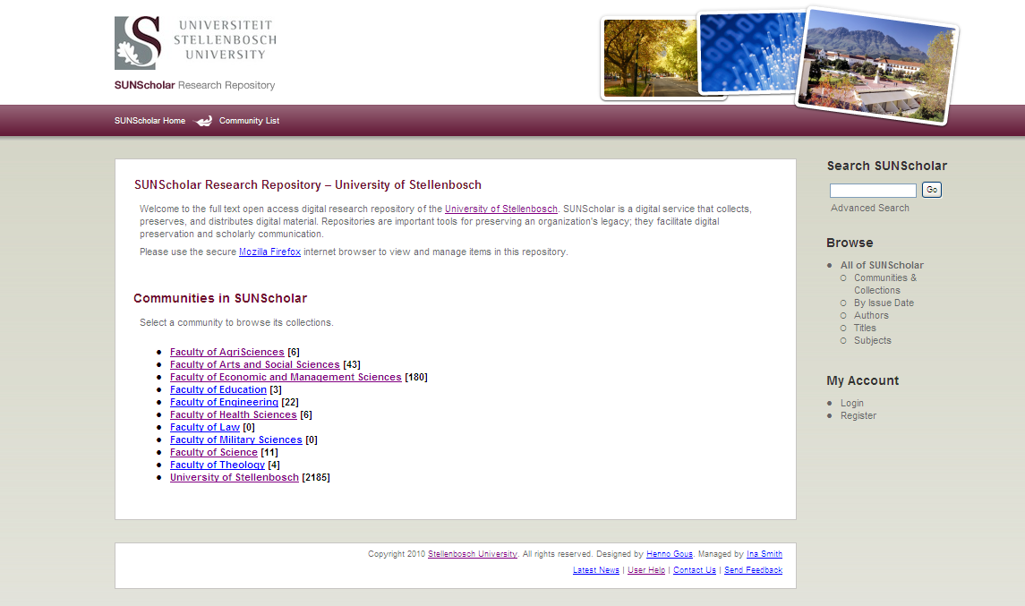
https://scholar.sun.ac.za
Top-Level Community:
Arts and Social Sciences

Slide 4
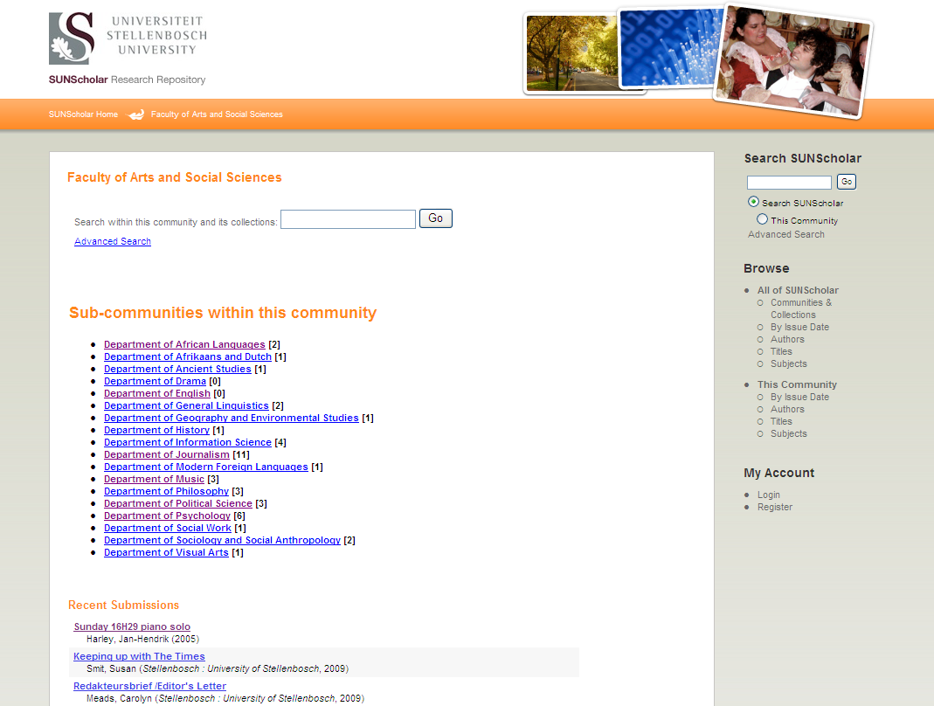
Customized per Faculty
Sub-Communities:
Departments

Slide 5
Research Output
Primary:
  Research Articles, Chapters in Books, Books, Conference Proceedings, Theses, Dissertations
Secondary:
  Inaugural Addresses, Conference Presentations & Posters, Images, Audio- & Audiovisual Clips, Seminars/Open Lectures, Conferences, and many more!

Slide 6
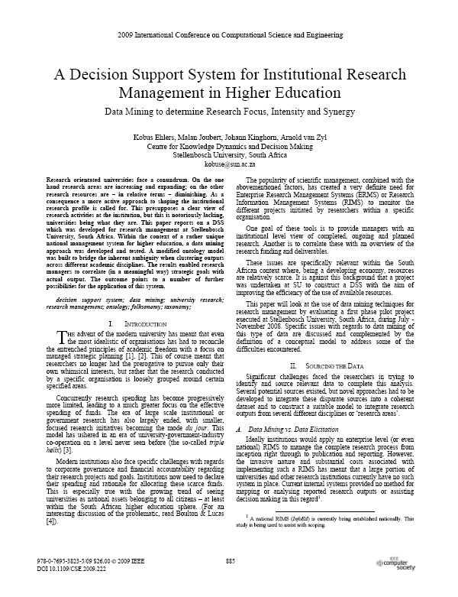
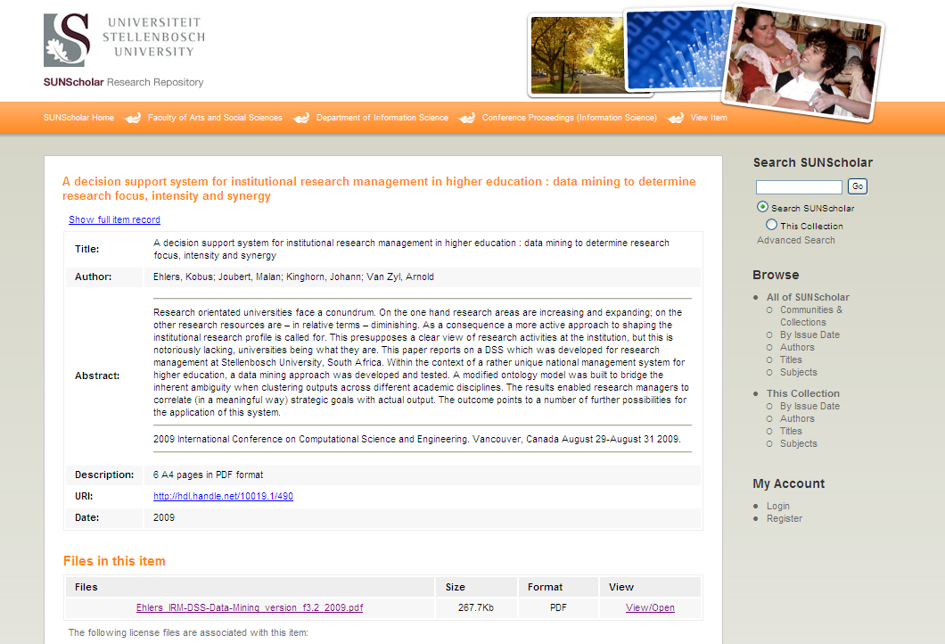

Slide 7
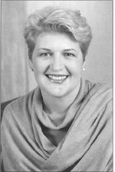
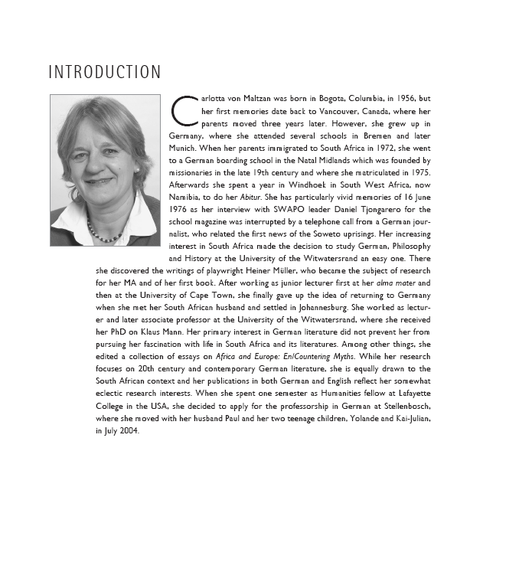

Inaugural Addresses
Modern Foreign Languages
Journalism

Slide 8

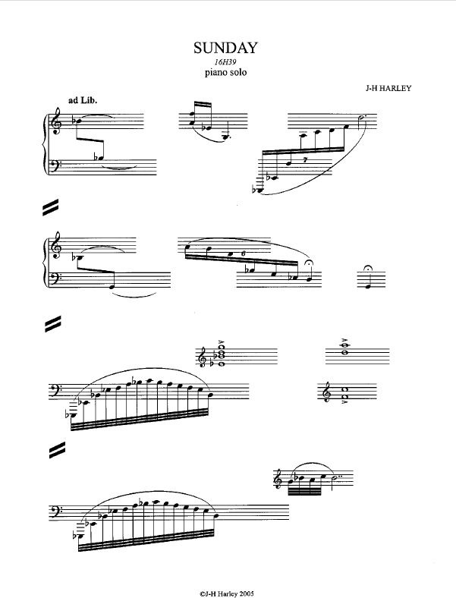
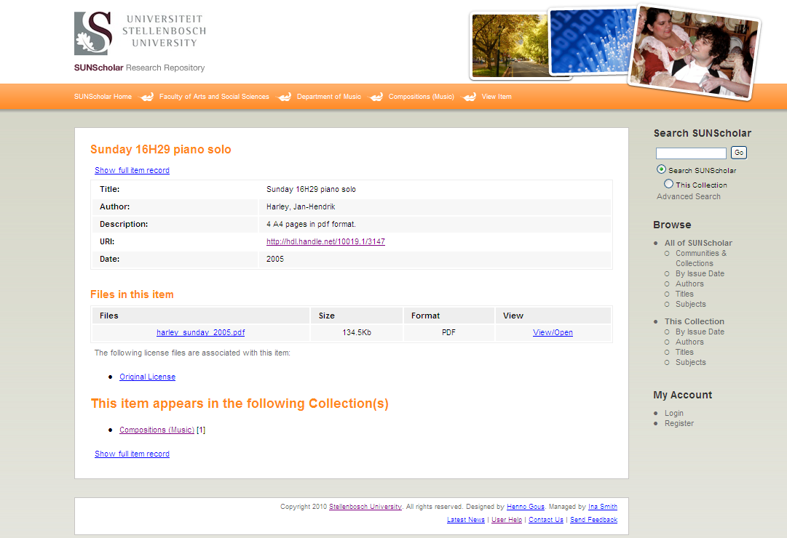

Slide 9
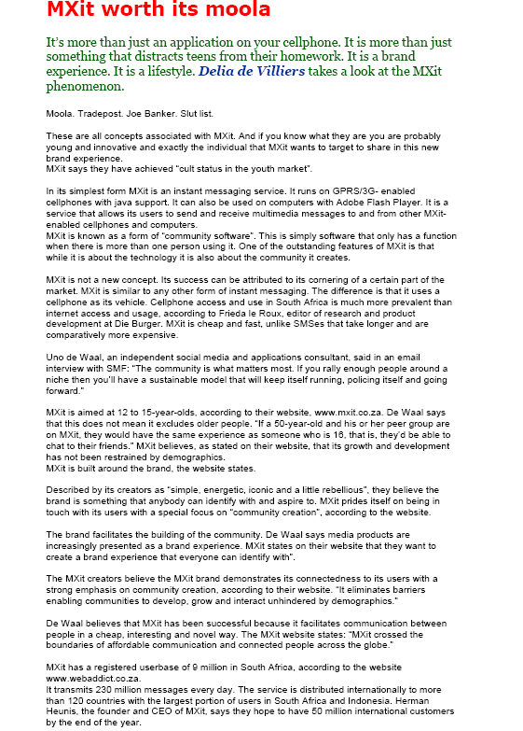
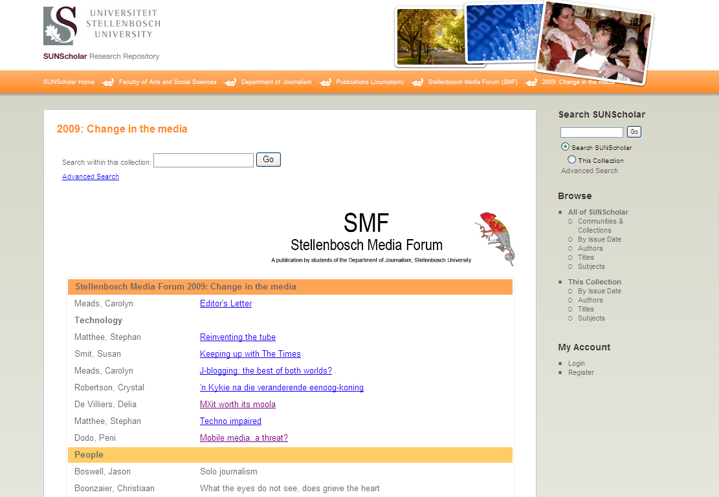

Slide 10
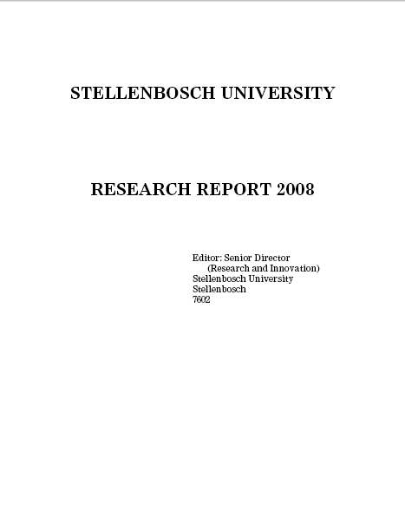
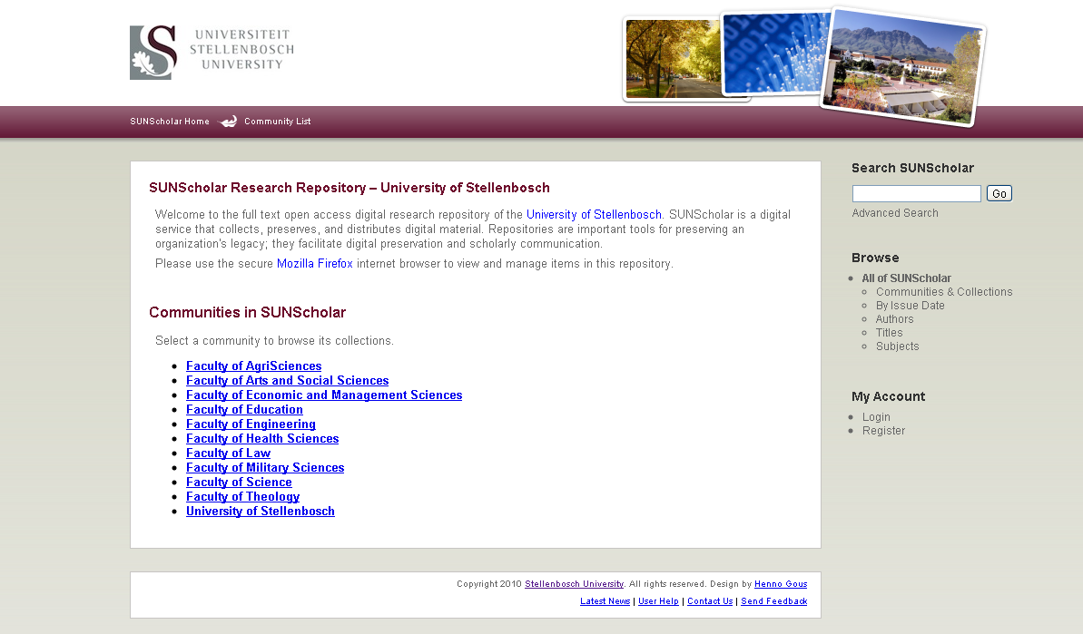
Research Output
Research Report System
With links to full text
Currently investigated

Slide 11
Benefits for Researchers
Research preserved – even after you have left US
Attracts researchers from other disciplines
May lead to better funding opportunities
Encourage dialogue between researchers
Presents complete research profile
Others can build on your research
Easier to detect plagiarism

Slide 12
Verify discoveries, discard ones that could not be replicated, avoid duplication of effort, integrate various lines of research (David 1998)
Research will be out in the open much sooner
Scholars worldwide read the latest research and enter the global economic conversation

Slide 13
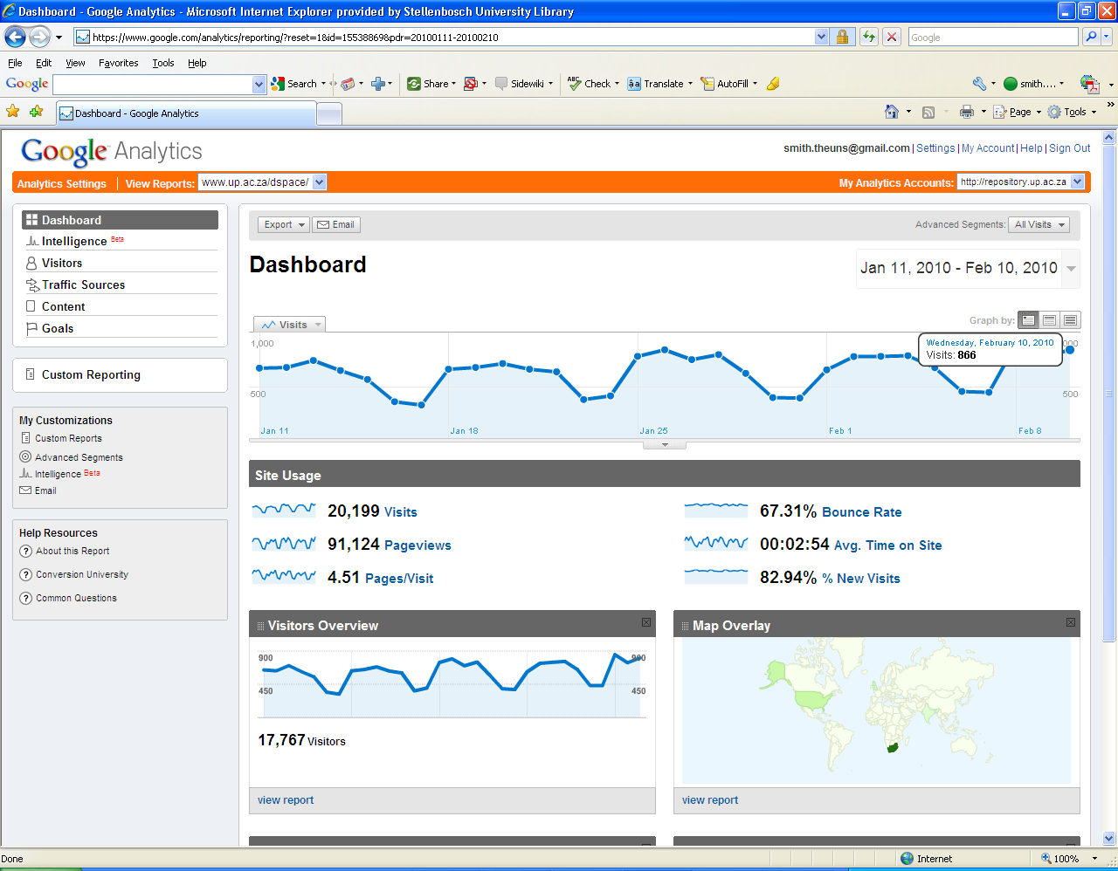
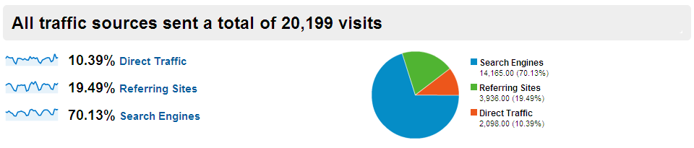
Vastly increases visibility, usage, impact of your research

Slide 14
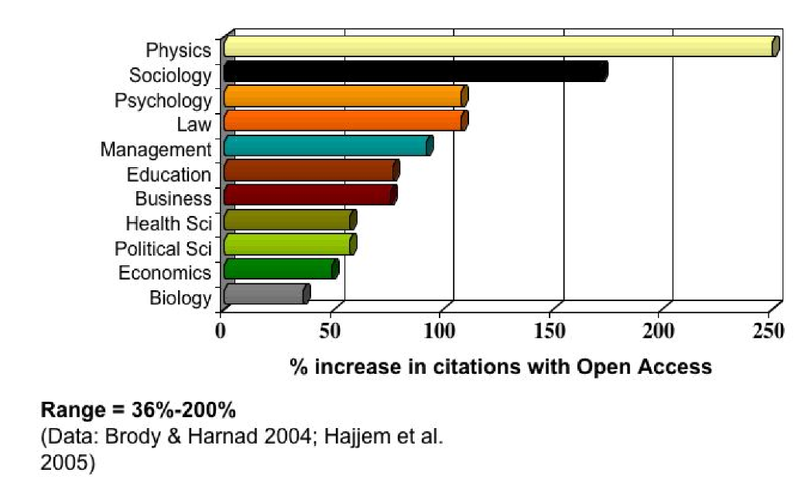
Open Access Increases Citations

Slide 15
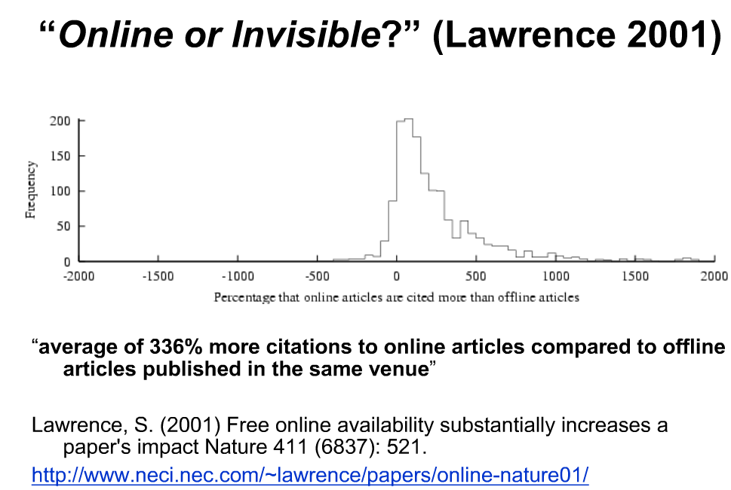

Slide 16
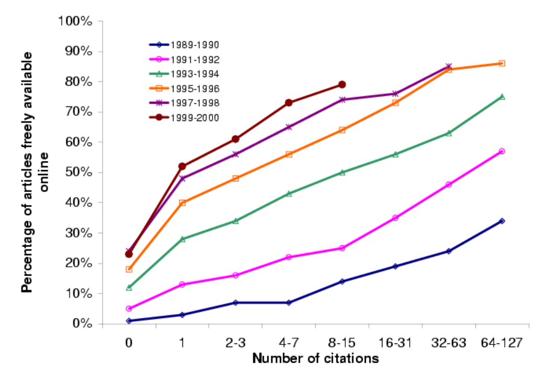
(Harnad, S 2009, ‘Mandates and metrics: how open repositories enable universities to manage, measure, and maximise their research assets)

Slide 17
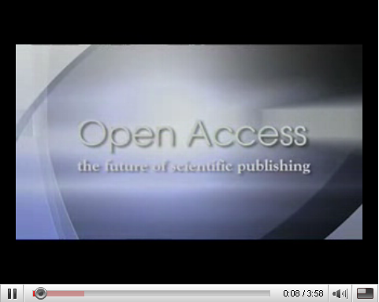
http://www.youtube.com/watch?v=g2JT23E1bRE
BioMed Central's authors and editors discuss the benefits of open access publishing

Slide 18
Benefits for the Stellenbosch University
Central archive/digital library of all SU research – most important asset
Preserve all research for years to come
Persistent URL’s
All items – incl. full text pdf – fully searchable
Require uploading on IR at no extra expense
Increase research profile of SU even more
Increase ranking on international lists of top universities

Slide 19
Our Commitment
Negotiate for and provide server space
Management on technical & operational level
Maintain SUNScholar for the long term
Add value (library cataloguers)
Training & Support
Marketing
Advise on digital matters etc.
Conduct surveys & research – state-of-the-art repository
Register SUNScholar with other search engines & harvesters

Slide 20
Workflow
Submit item
Reject
Review item
Notification to Submitter & Subscribers
Edit metadata
Available on IR

Slide 21
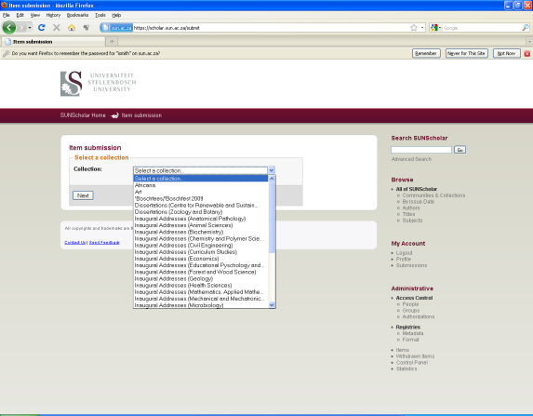
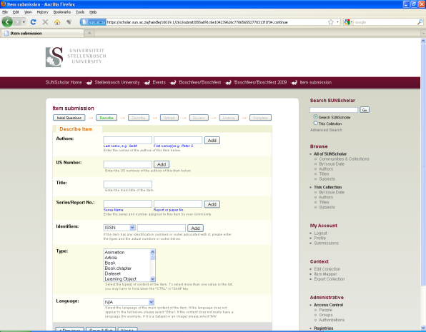
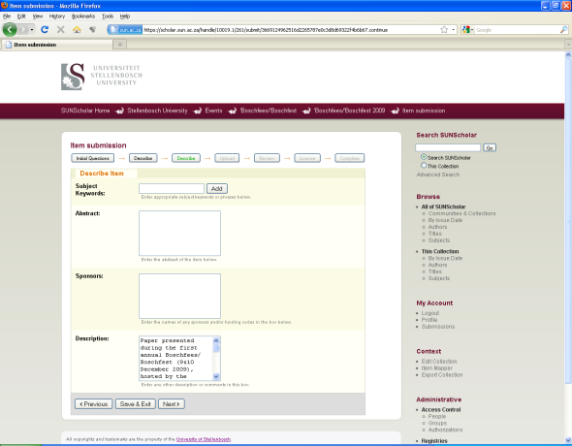
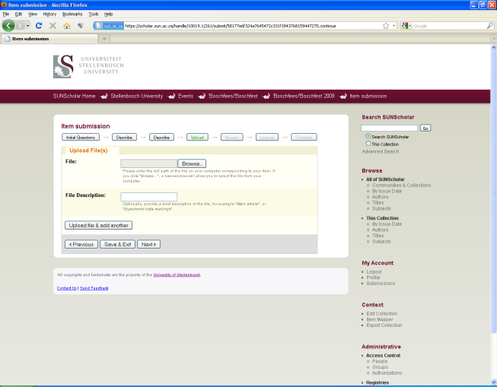
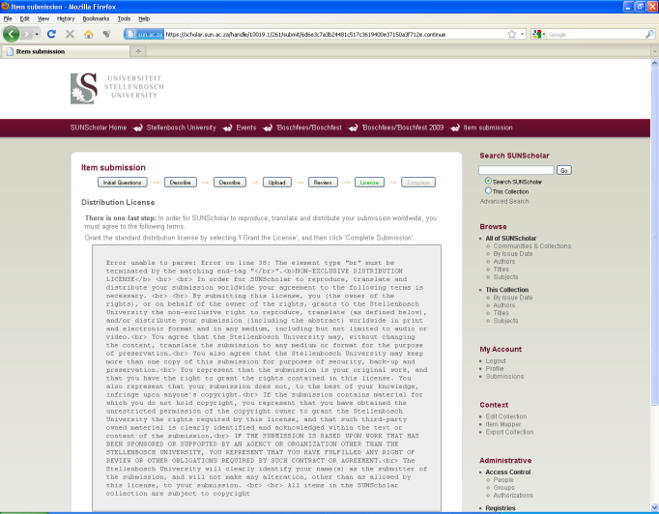
Submission Process
1
2
3
4
5

Slide 22
Become part of SUNScholar ….
Join our mailing list – e-mail: ismith@sun.ac.za
Attend training sessions
Collect full text of all research output
Future: obtain permission for 2nd copy on IR
Copyright clearance
Digitize if needed
Register as a Submitter
Submit in pdf
Start populating Arts & Social Sciences on SUNScholar!

Slide 23
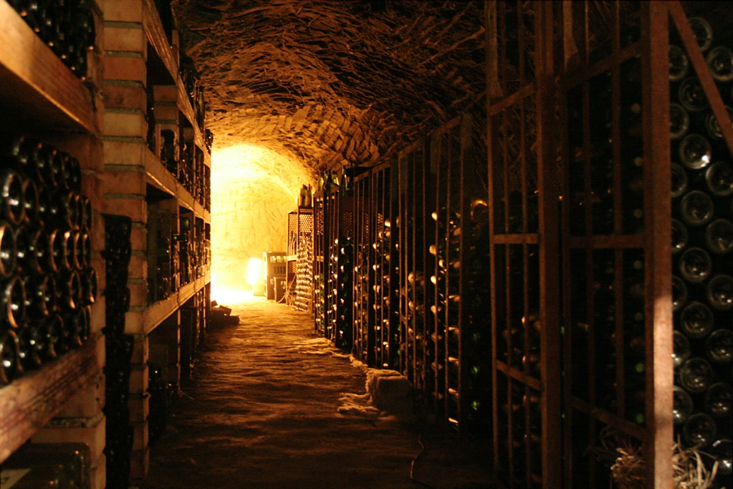
“The job of research is only half‐done if the results of that research cannot reach the widest audience.”
‐ Wellcome Trust ‐

