Slide 1
Knowledge creation, dissemination and implementation:
The Librarians role in today’s knowledge economy
18 February 2010
Stellenbosch Symposium /
IFLA Presidential Meeting 2010
Matt Goldner
Product & Technology Advocate

Slide 2
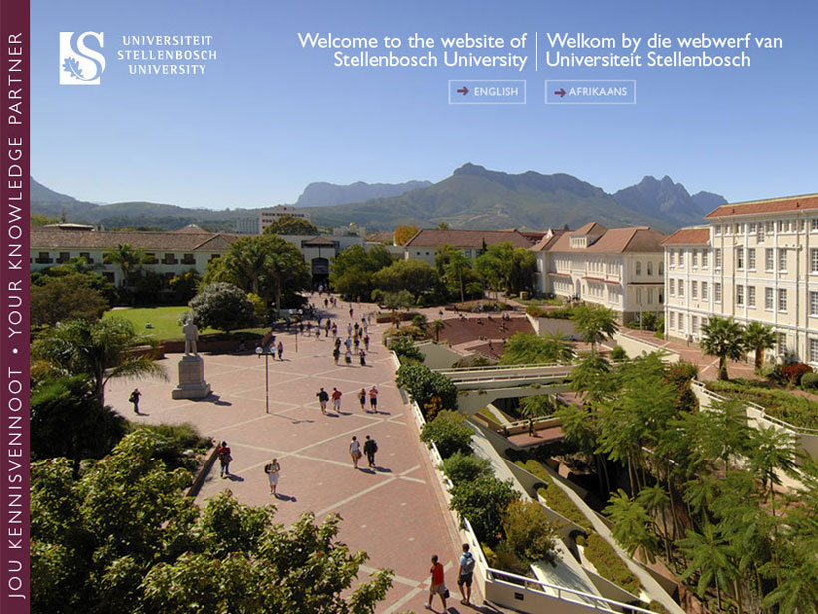
This building occupies the unique position of being underneath the centrally situated Jan Marais Square. The reason for this unique position is that in planning a new library it was found that, apart from the Jan Marais Square, no centrally situated building sites were available on campus. … It was therefore decide to build underground.

Slide 3
Today’s Knowledge Economy:
what has changed?

Slide 4
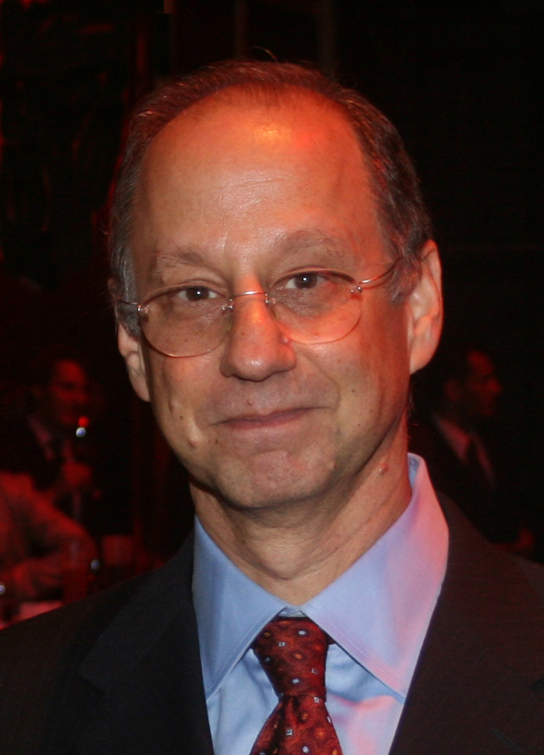
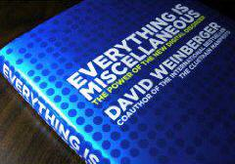
Picture of David Weinberger by: Ralf Roletschek
http://commons.wikimedia.org/wiki/File:David-weinberger-rr.jpg
Notes:
Last week while on vacation while switching between mohitos, mai tais and pina coladas, I worked my way through David Weinberger’s Everything is miscellaneous and it fueled many thoughts, perhaps alcohol induced, about the current state of findability and accessibility for library resources. By accessibility here I am meaning the ability to get access to or delivery of the found item.
One of Weinberger’s key premises is that with the Web information is now all piled in a heap and the way we order information to achieve knowledge is radically changing.

Slide 5
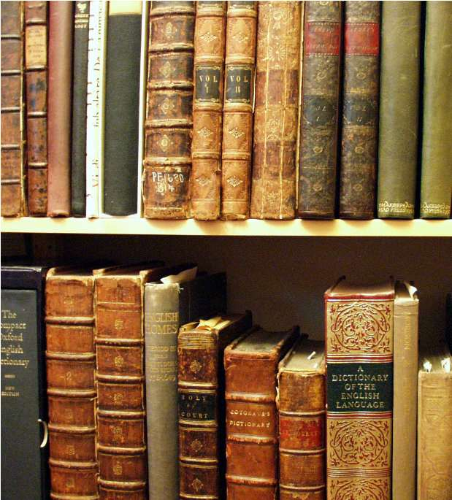
Notes:
CLICK 1: Here we see our most traditional form of library materials, books on the shelf. In Weinberger’s model of ordering information this is the First order of order, we are putting the objects themselves in a pre-determined order.

Slide 6
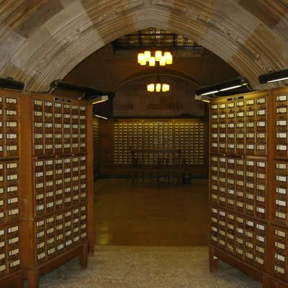
Notes:
CLICK 2: His second order of order is meta-data about the primary objects, e.g. our card catalog. But this meta-data still had to be ordered in a pre-determined manner which someone or group agreed upon. So whether it was alphabetic by author or subject, shelf list order by classification or shelf mark it was still a limited access finding aid.

Slide 7
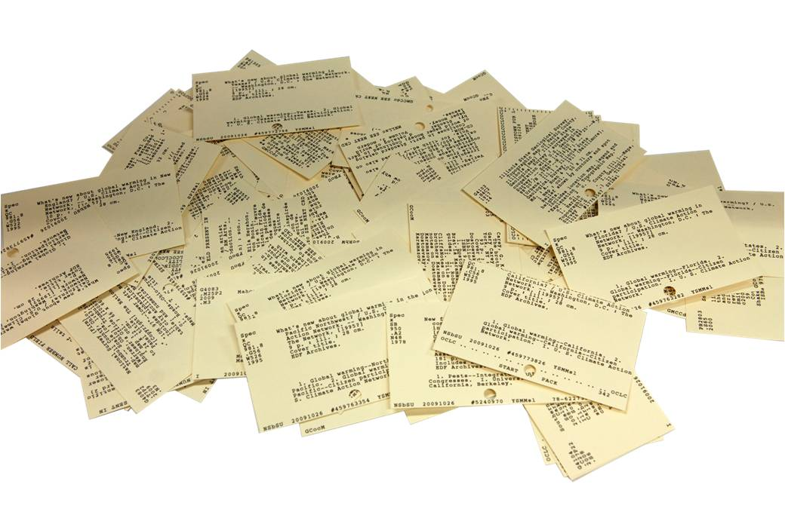
Notes:
CLICK 3: His third order of order can result from what he calls the heap. The premise is relationships and linkages can be found by mining the heap that cannot be found in the traditional catalog. But just putting our cards in a heap is not going to help us is it?

Slide 8

Notes:
CLICK 4: So in comes the Web, instead the meta-data of those cards goes into the binary heap of the internet.
Once converted and released into the wild of the internet, the Findability of our collections has the opportunity to increase exponentially. Relationships between information objects are formed in new ways beyond pre-determined categorizations.
This happens as users act on information they have found and interact with it on the Web. So they tag items, they write reviews, the create lists, they rate items, they buy and rent items. Then machines are able to act on what users have done to create new relationships not based on any pre-determined order.
A simple example CLICK TO NEXT SLIDE

Slide 9
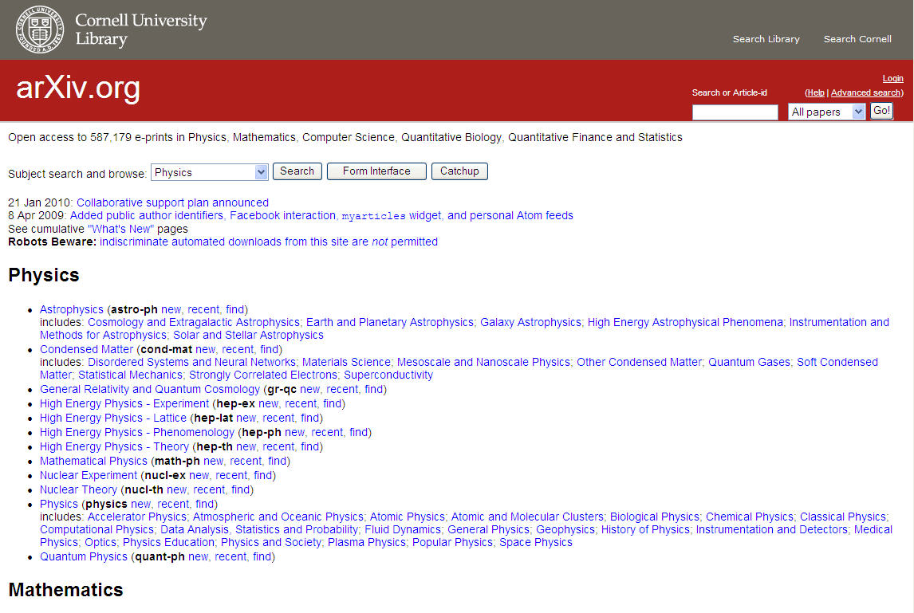

Slide 10
How do libraries respond?

Slide 11
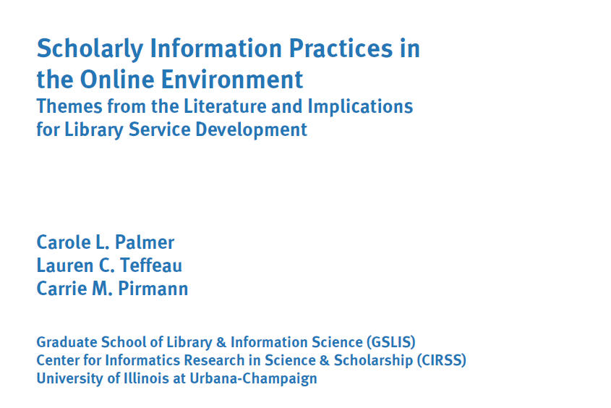

Slide 12
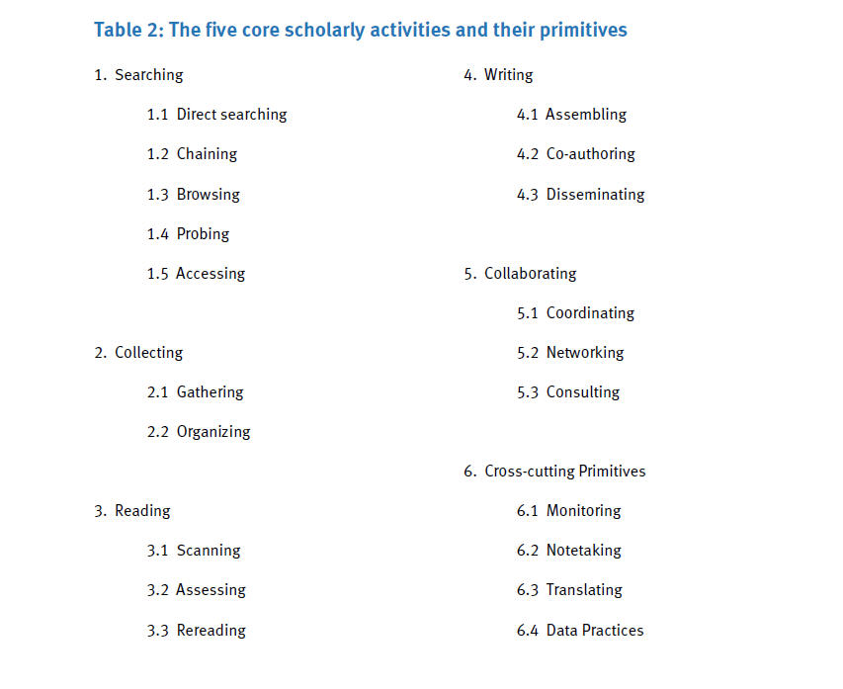

Slide 13
WorldCat.org traffic
Monthly traffic: 16.9 million
WorldCat API: .5 million
Linking: 2.9 million
Direct access: 6 million
Resulting in:
1 million+ clicks
to library services every month
Google
7.5 million

Slide 14
Research Support Library Group: Researcher’s Use of Libraries and Other Information Sources
“finding information electronically was deemed easiest to do; accessing the information was more difficult and using it more difficult still

Slide 15
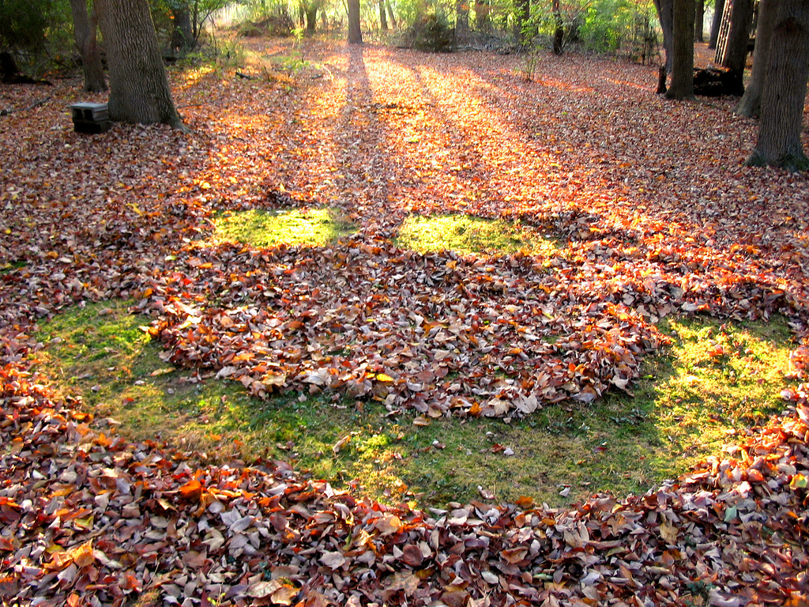

Slide 16
Embedded librarians
Bibliographers / research projects
Widgets
Smarter citation tools
Linked data
???

Slide 17
“Community Trumps
Technology”

Slide 18
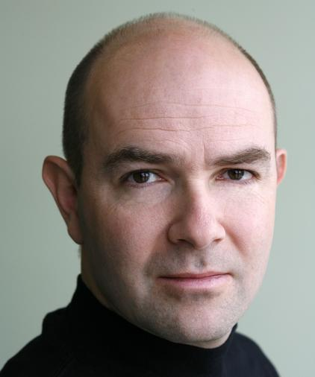
The Web is all about scale, finding ways to attract the most users for centralized resources…
Chris Anderson

Slide 19
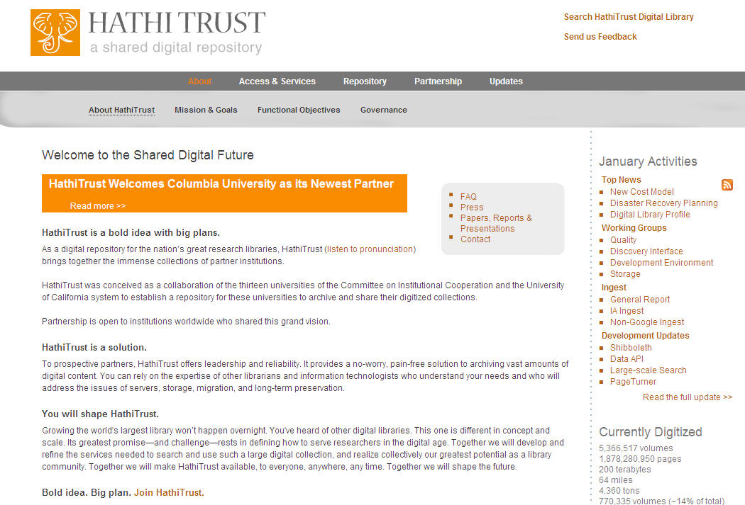
HathiTrust was conceived as a collaboration … to establish a repository for these universities to archive and share their digitized collections
… You’ve heard of other digital libraries. This one is different in concept and scale. Its greatest promise – and challenge – rests in defining how to serve researchers in the digital age. Together we will develop and refine the services needed to search and use such a large digital collection, and realize collectively our greatest potential as a library community.

Slide 20
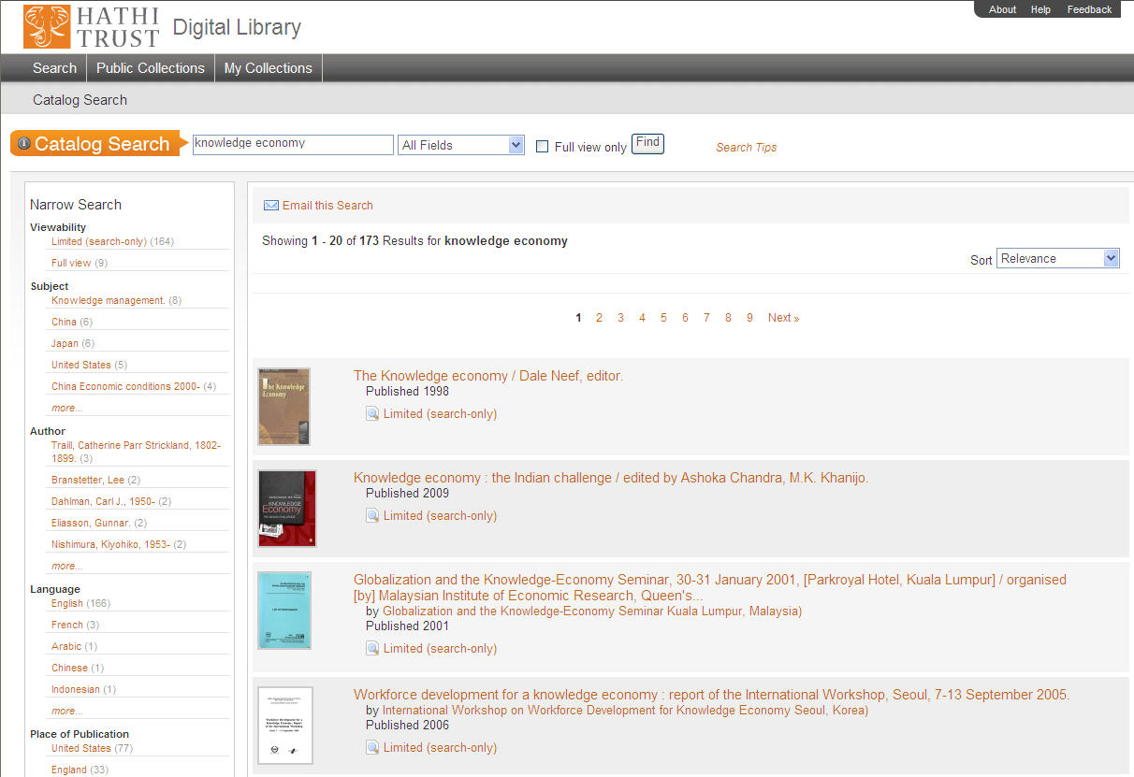

Slide 21
Tools for browsing and exploring sets of e-texts
Clearinghouse for tools for collection, storage and sharing resources
Support for downloading, storing and organizing e-texts
Tools to foster collaboration across institutions
Tools to support document reviewing

Slide 22
The Web is all about scale, finding ways to attract the most users for centralized resources, spreading those costs over larger and larger audiences as the technology gets more and more capable.
Chris Anderson

Slide 23
Palmer et al.:
In determining priorities for development, there are two kinds of service contributions that seem most worthy of investment:
1. Services that are most likely to actually advance the conduct of research, either by simplifying difficult tasks or by supporting new kinds of analysis with digital content; and
2. Services that provide economies of scale across institutions, disciplines or genres of information

Slide 24
Thank you

