Slide 1

Getting internationally published in the applied sciences
Louw Hoffman
Department of Animal Sciences
lch@sun.ac.za

Slide 2
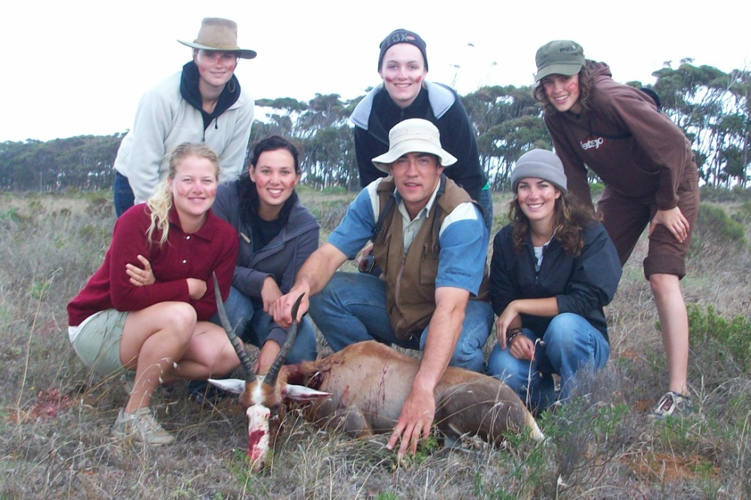
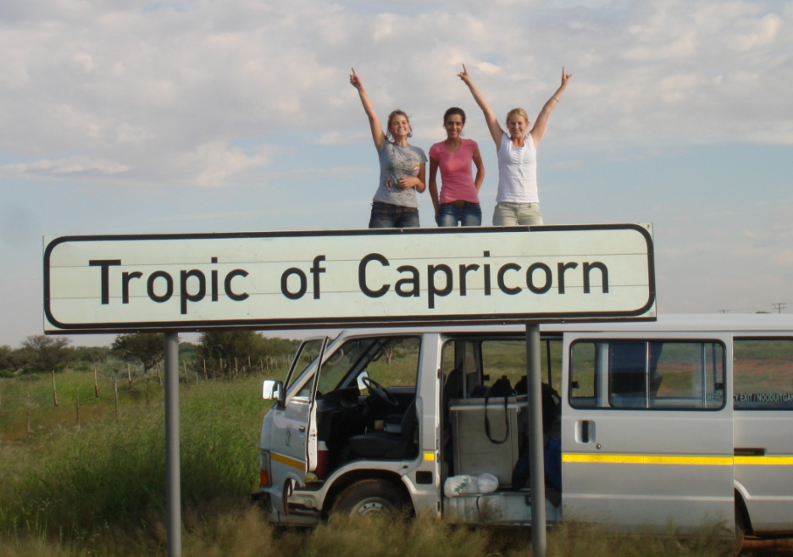
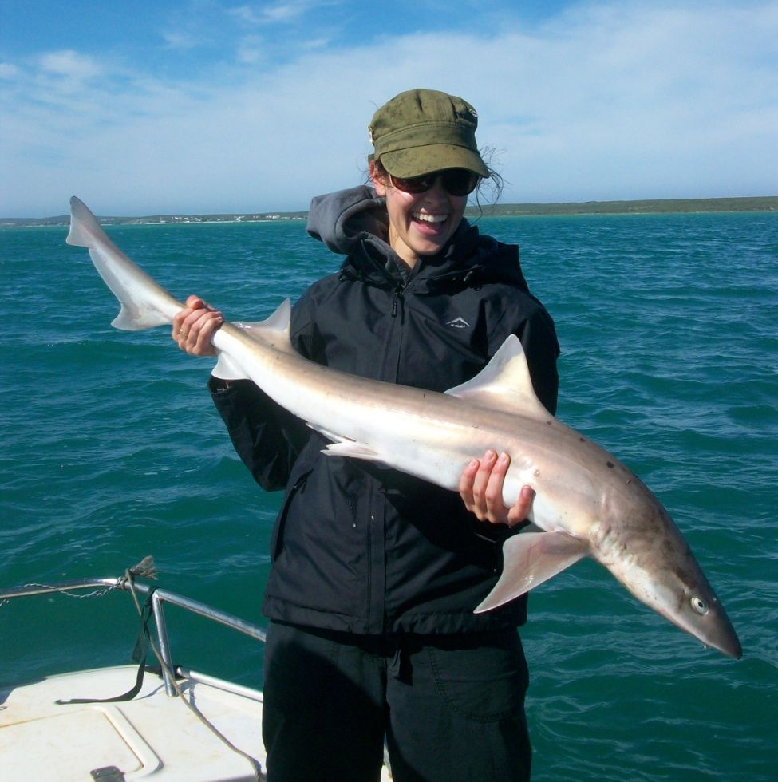
My research
Our program focus on animal products: meat

Slide 3
Food Security at SU
Production activities
Fresh meat
Processed meat

Slide 4
Research Focus
sustainable agricultural productivity
Production activities
Fresh meat
sufficient, safe and nutritious food
Processed meat
nutritional value
Increase production
Decrease losses along value chain

Slide 5
Research focus
Meat
Red
Traditionally Farmed species
Exotic meat
Poultry
Farmed
Fish / aquaculture
Wild fowl
Farmed
Wild
Crayfish / abalone
Production activities
Fresh meat
Processed meat

Slide 6
What are the drivers to getting published?
Publish or perish
  Government subsidy
  Student pass post graduate studies
  Staff promotion
  Department budget
  NRF rating
  Least publishable unit
Publish internationally
  But work local
  Comments “of more value in a local journal”
Publish in high impact journals
  ?

Slide 7
Own experience
 | Local | International
Exotic Game / ostrich | 26 | 42
Traditional Cattle / sheep / pigs / poultry | 18 | 14
Used a multi- disciplinary approach

Slide 8
Example
Hoffman, L.C., Kroucamp, M. & Manley. M. 2007. Meat quality characteristics of springbok (Antidorcas marsupialis). 1. Physical meat attributes as influenced by age, gender and production region. Meat Science 76: 755-761.
Hoffman, L.C., Kroucamp, M. & Manley, M. 2007. Meat quality characteristics of springbok (Antidorcas marsupialis) 2. Chemical composition as influenced by age, gender and production region. Meat Science 76: 762-767.
Hoffman, L.C., Kroucamp, M. & Manley, M. 2007. Meat quality characteristics of springbok (Antidorcas marsupialis) 3. Fatty acid composition as influenced by age, gender and production region. Meat Science 76: 768-773.
Hoffman, L.C., Kroucamp, M. & Manley, M. 2007. Meat quality characteristics of springbok (Antidorcas marsupialis) 4. Sensory meat evaluation as influenced by age, gender and production region. Meat Science 76: 774-778.

Slide 9
A typical paper
Start international significance,
end local
Introduction
Material & Methods
Results
Discussion
Conclusion
Local
But international standard
Local
International relevance
International

Slide 10
But that’s not all folks!
If your work is not cited, then it is also of little relevance
  Network ! Network!
  Use the reviewer system
  Use external examiners
  Make scientists aware of your work
Ultimately good science will get published

Slide 11
So where are we going?
Invitations to publish books
  Germany (thesis)
  India
Open access journals
  Price?
  Impact? – track record
African journals
Too much information – know what is of value
  www gives credibility to mediocrity

