Slide 1
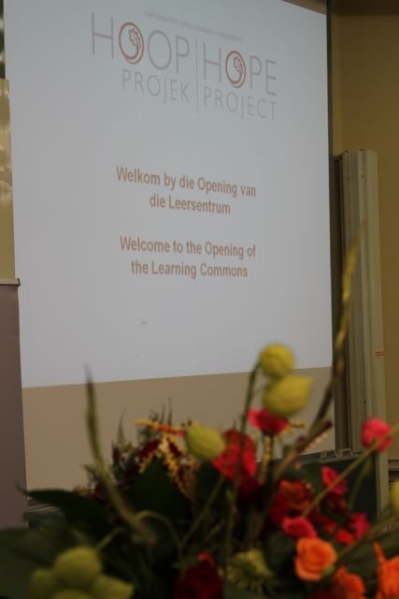
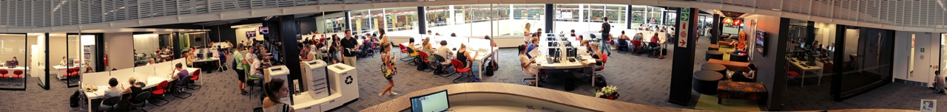
Official opening of the Learning Commons
16 February 2011

Slide 2
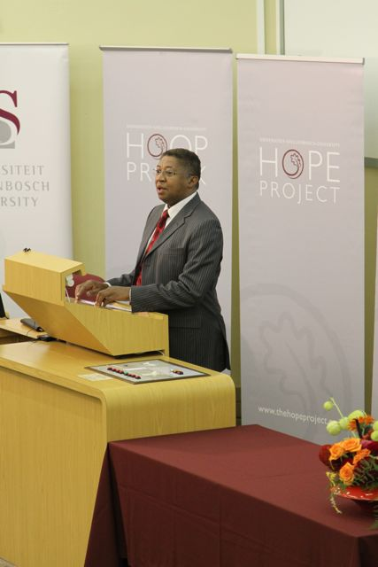
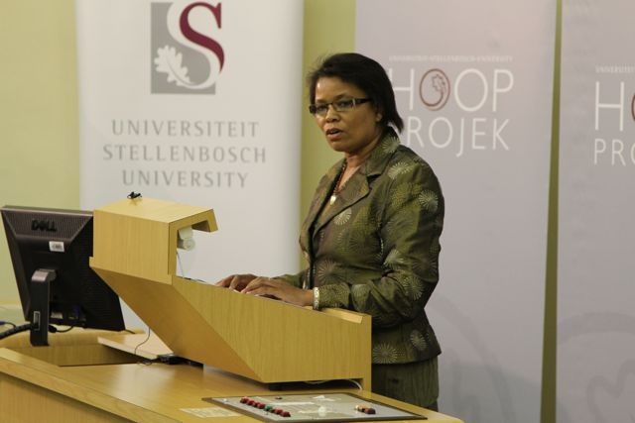
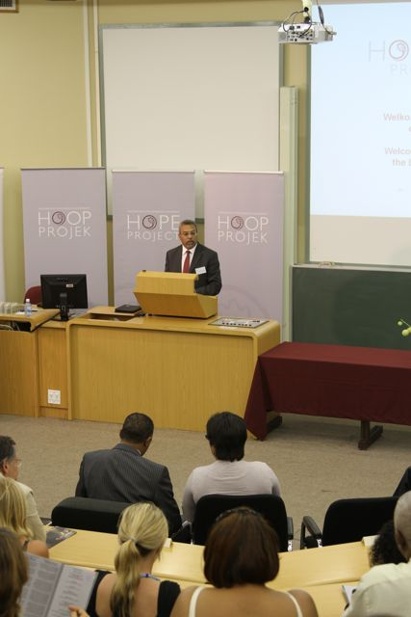
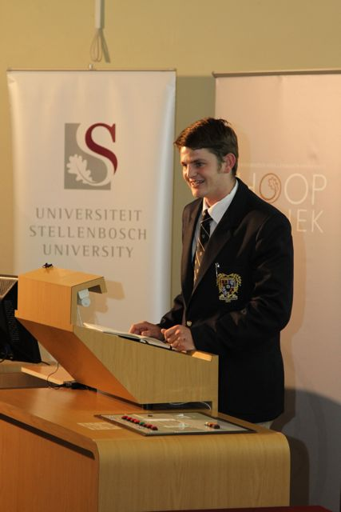
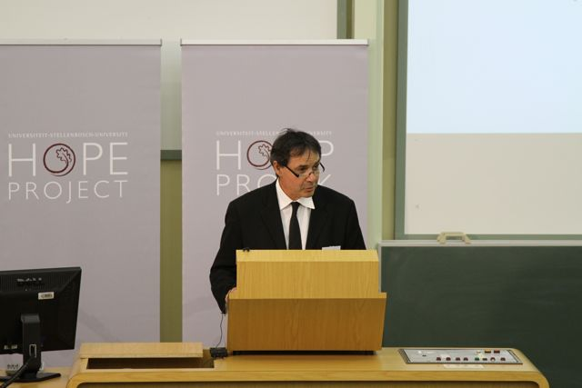
Programme
Program
Ms / Me ER Tise
Senior Director: Library & Information Service
Senior Direkteur: Biblioteek & Inligtingsdiens
Prof HR Botman
Rector & Vice-Chancellor
Rektor & Visekansellier
Mr / Mnr M Shaikh
Senior Director: Communication & Liaison
Senior Direkteur: Kommunikasie & Skakeling
Prof A van Zyl
Vice – Rector ( Research)
Visierektor (Navorsing)
Mr / Mnr J Greyling
Chair: Students Representative Council
Voorsitter: Studenteraad

Slide 3
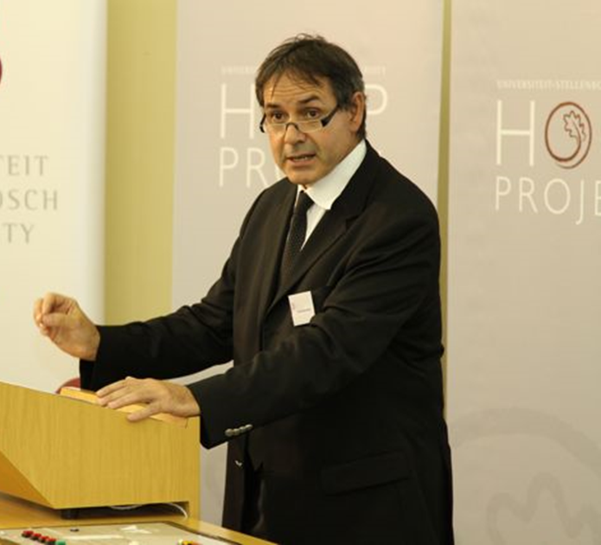
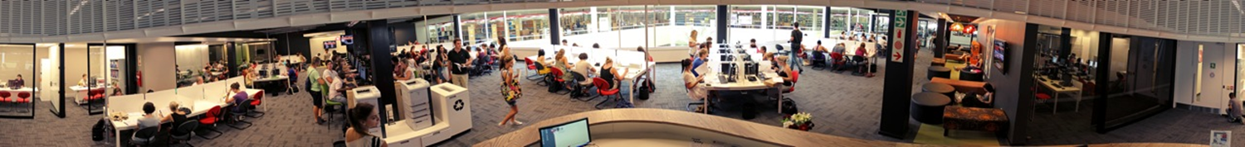
“
“Lekker om ‘n smartie
te wees!”
Prof Arnold van Zyl
Vise-Rektor: Navorsing
16 Feb. 2011

Slide 4
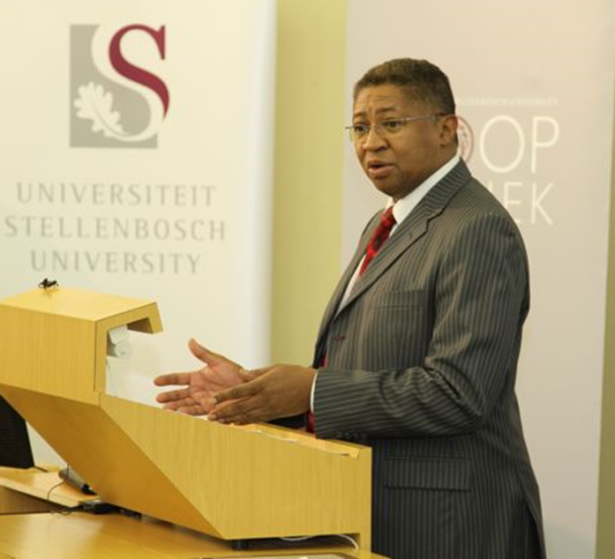
“The Learning Commons is an
investment in excellence,
which has always been the
cornerstone of Stellenbosch
University.”
Prof Russel Botman, Rector
16 Feb. 2011

Slide 5
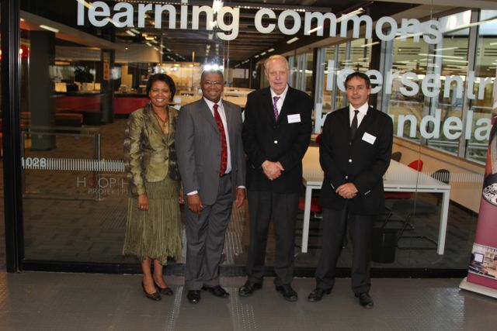
Me Ellen Tise, Senior Direkteur van die US Biblioteek- en
Inligtingsdiens, saam met prof. Russel Botman, Rektor en
Visekanselier, dr. Paul Cluver, Voorsitter van die US se Raad
en prof. Arnold van Zyl, Viserektor: Navorsing voor die
Leersentrum tydens die amptelike opening daarvan

Slide 6
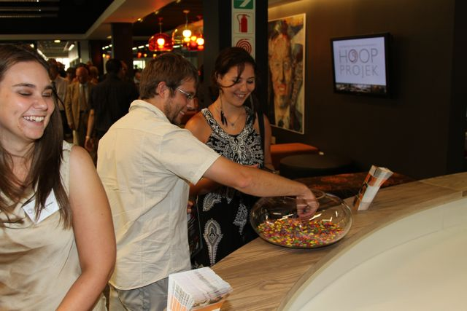
Elements derived from the architects’ Smartie box design
concept inspired the Library to adopt the motto “Be a SMART Matie”

Slide 7
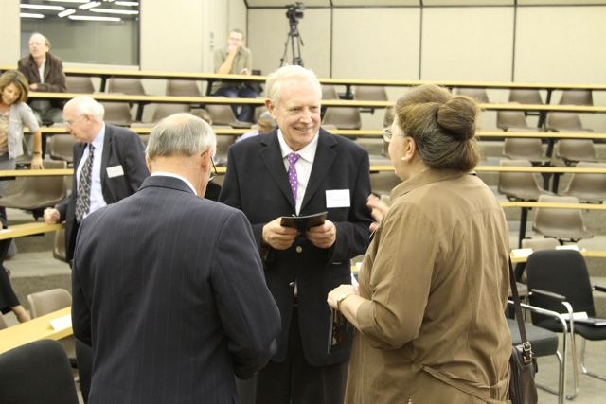
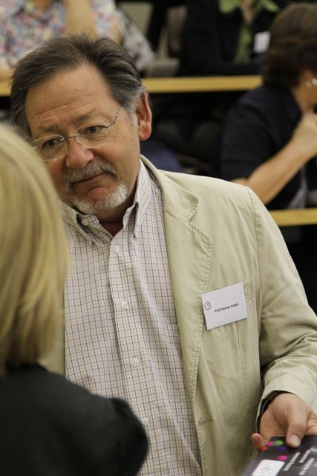
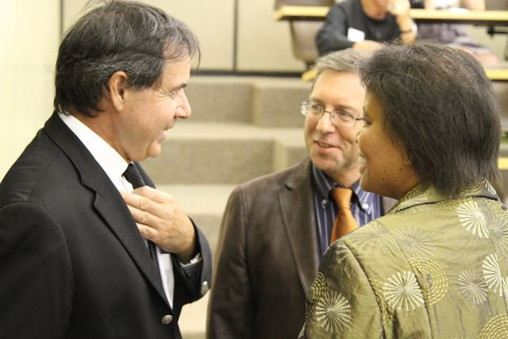
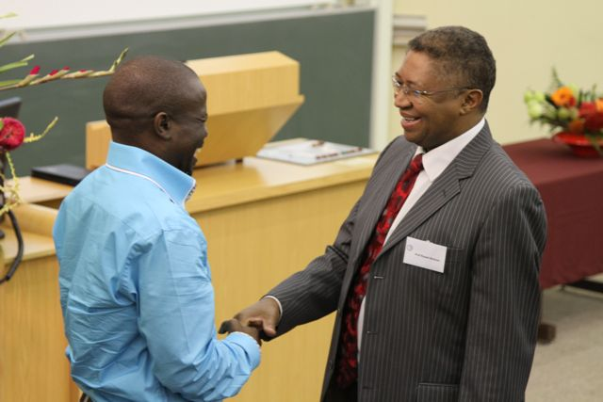

Slide 8
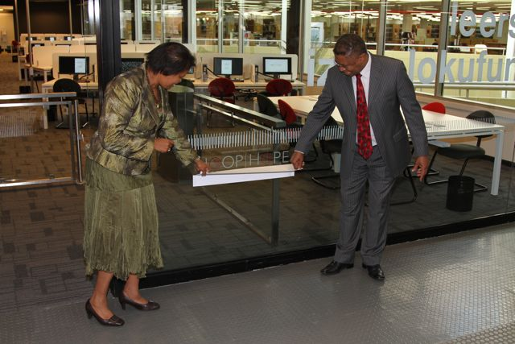
Unveiling of Hope Project plaque by Prof HR Botman
Onthulling van Hoop Projek plaket deur Prof HR Botman

Slide 9
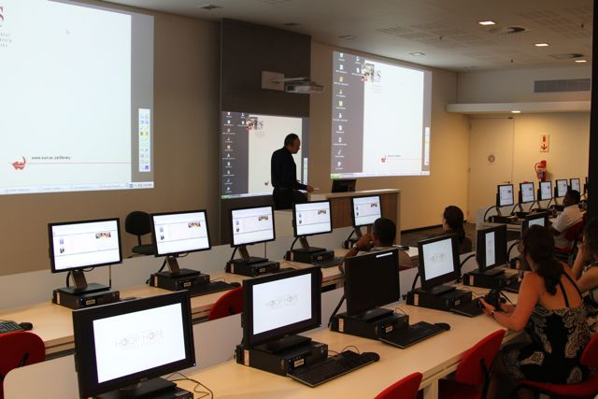
Mr. W Klapwijk demonstrate Smart board technology in the E-classroom
Mnr. W Klapwijk demonstreer Smart Board tegnologie in die E-Lokaal

Slide 10
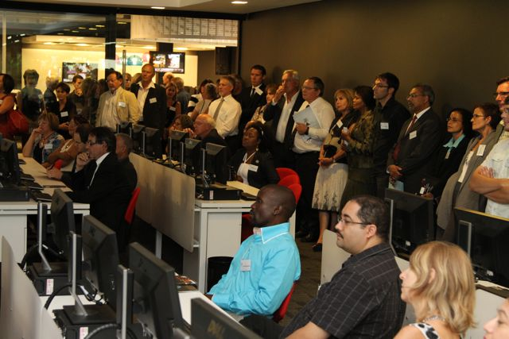
E-classroom E-lokaal

Slide 11
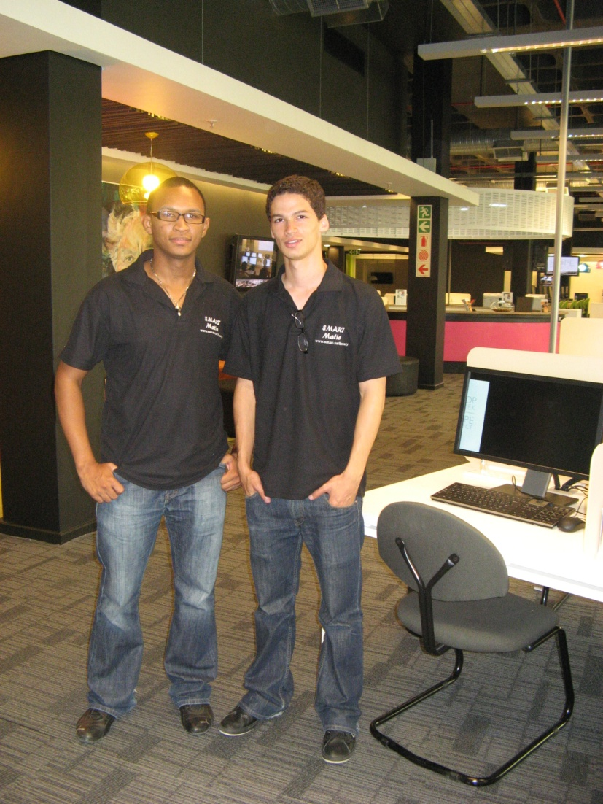
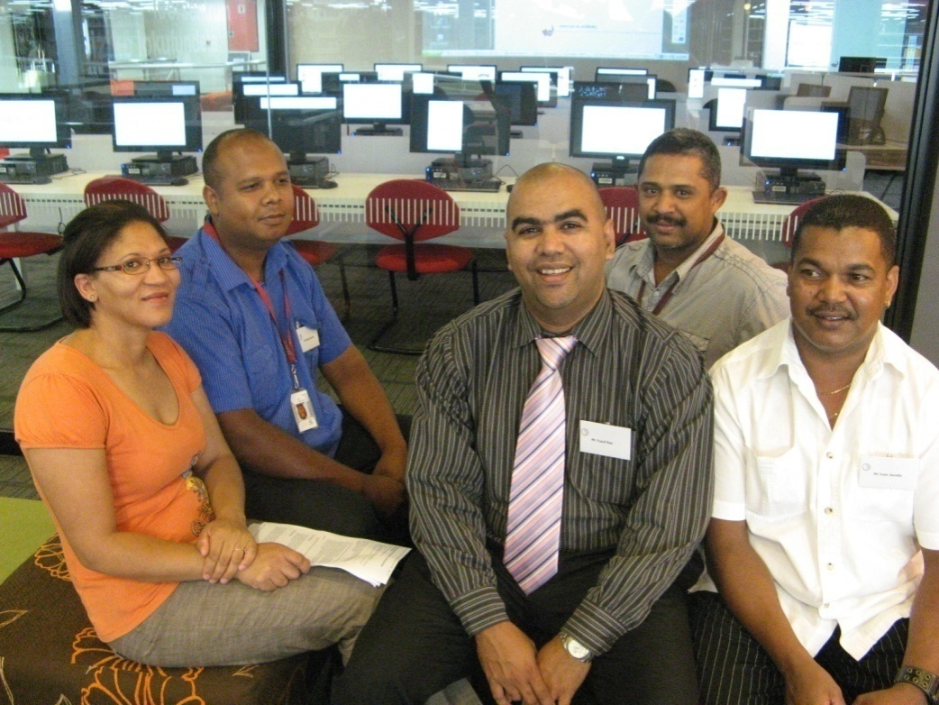
Library Staff / Biblioteek Personeel
Student Assistants / Studente-Assistente

Slide 12
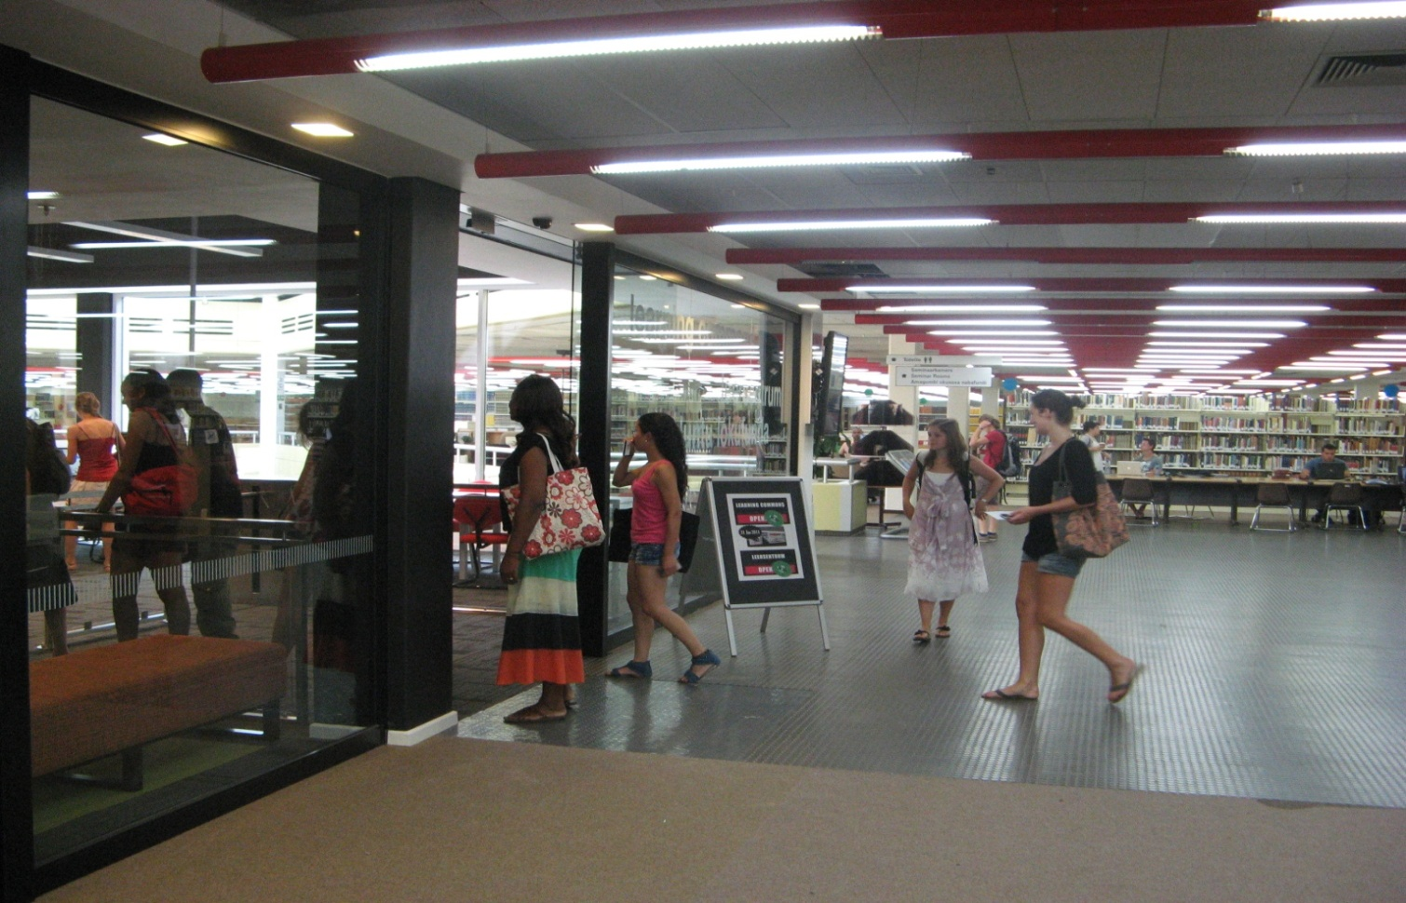
Gedurende die eerste twee weke nadat die Leersentrum op 31 Januarie 2011 sy deure oopgemaak het, was daar reeds 19 800 besoeke aan die Leersentrum met terugvoer wat oorweldigend positief is.
During the first two weeks after the opening on the 31st January 2011, there were already 19 800 visits to the Learning Commons. The feedback so far was very positive.

Slide 13
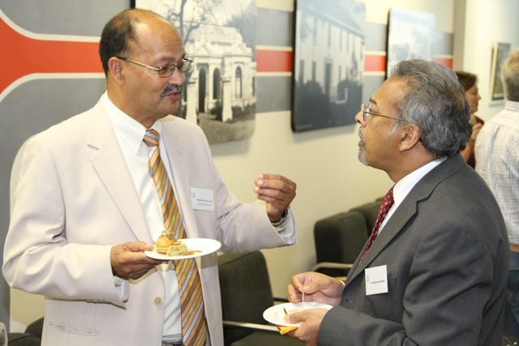
Cocktail Reception Skemeronthaal

