Slide 1
Observations on global trends in academic research
(and how top research institutions can manage these)
May 10, 2011
University of Stellenbosch, South Africa
JC Heyneke, Director of Strategy & Business Development, Elsevier S&T Sales

Slide 2

Introduction
Responsible for global strategy and business development of our sales groups in Elsevier Science & Technology
  ~30,000 customers in ~150 countries
  all research universities in the world, most of the top R&D companies, thousands of professionals (e.g. buying our books through Amazon)
  we publish 40% of all research output in South Africa
I will focus on trends in research output
  what we see in publications (with all publishers)
  what we hear from universities
Tony will focus on trends in publishing (e.g. Open Access, new article formats)
Notes:
Good morning. I’m delighted to have the opportunity to share with you some observations on research trends. Elsevier is one of two thousand science information companies and is part of Reed Elsevier. Introduce self.
Introduce Tony Roche.

Slide 3
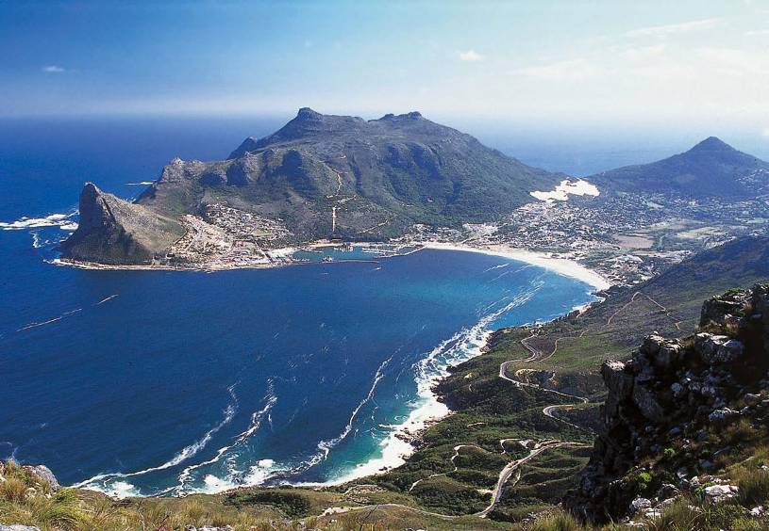
As a science information company, we have a unique vantage point on science
Each year we see (as an industry): 3 million articles submitted, 1.5 million articles published, 30 million readers, 2 billion article downloads, 30 million article citations
As Elsevier, we speak to every research university in the world – to their librarians, faculty, students and increasingly their management (we have spoken to >500 university research executives in the past 12 months)
Notes:
As one of the world’s leading science information companies we are fortunate to have a unique vantage point on the world of scientific and medical research. We publish and disseminate thousands of books and peer reviewed journals in print and electronic formats every year, and we manage terabytes of data in doing so. The science journals industry alone receives three million article submissions globally, each one seeking to advance science in its sub-field. We co-ordinate their peer review via relationships with 300,000 expert reviewers. We accept, edit, produce, disseminate and preserve around 1.5 million articles via electronic and print journals to a worldwide audience of 30 million researchers and practitioners. They download over 2 billion articles a year. We then record the citations that are made to those articles at the rate of 80,000 per day, or 30 million per year.
By managing the inputs, interactions and outputs of the global forum in which scientists report, debate and advance research, we get to see much of what is going on in that forum. And by having access to almost every university in the world, we also get to hear much of the issues universities deal with.
While we are fortunate to have a unique vantage point, it has limitations. Our view is weighted towards basic rather than applied research, and to academic rather than commercial outputs such as patents, licenses and spin-offs. While publications and citations are widely recognised measures of output and impact, they are proxy not absolute indicators. Publication impact is certainly not the same as societal impact even though the two are often associated.

Slide 4
What do we hear?
funding
OPEN ACCESS
publishing format
health
metrics
innovation
mobility
getting published
collaboration
challenges
infrastructure
interdisciplinary
authors & journals
Brazil
challenges
role of libraries
authors
nations
UK
USA
leading indicators
co-authored
networks
China
India
research maps
information
brain drain
global issues
ROI
quality
access
competition
decisions
Notes:
We see change – from unprecedented financial challenges in some markets like the UK, to the tremendous sense of momentum one feels and sees in markets like China (I was in China last month and it is amazing to see the impact of their R&D strategies based on “retunees”).
Globally we see the research environment becoming more output focused, with a growing need for metrics. Access remains an important topic in many markets, from alternative publishing models to securing blanket access to scientific informtation for all researchers in a country.

Slide 5

Three messages
Investment in a scientific base matters, and the global landscape is changing dramatically
Notes:
I have chosen to focus on three messages for the purpose of this morning’s discussion (but feel free to explore other topics also during the panel discussion)...
First, our recent analysis with the UK’s Royal Society found a clear link between funding inputs and research outputs, and looking at publication trends, we see the tables changing dramatically.

Slide 6
R&D funding vs. outputs
Articles published, 2008
LOGARITHMIC SCALES
Gross Expenditure on R&D ($Millions)
5
Notes:
Let’s look at the data. This chart shows R&D spend inputs (x-axis) vs. published outputs (y-axis) by country.
The US is still the both world’s leading spender on R&D and publisher of scientific output.
But let’s take a closer look at the BRICS countries. We find that Brazil, Russia, India and China all spend significant amounts on R&D, with corresponding high levels of output as measured by published articles. In fact, China, India and Brazil together accounts for a quarter of the world’s annual R&D spending.
5

Slide 7
Global R&D spending
China: 1.5% of GDP (increasing by 20% per year; stated goal of 2.5% of GDP by 2020)
India: 1.4% of GDP (stated goal of 2.5% of GDP by 2022)
Sub-Saharan Africa: 0.5% of GDP (stated goal of 1% of GDP by 2010)
South Africa: 0.9% of GDP
6
Notes:
Many countries have stated objectives to increase R&D spending, recognizing the direct link between a strong research base and economic growth. For example, China is increasing its already relatively high spend on R&D by 20% per year. As R&D spending rates by country change over time, they drive shifts in the share of research outputs and influence on the global research landscape. As a result, we are seeing challenges to established science leaders like the US, UK and Japan who are spending at a slower rate than others, and the emergence of new global research hubs and leaders like China, India and Brazil who are stepping up their rates of spending due to explicit government policies to support R&D.

Slide 8
Country share of global published journal articles
Share of total global articles published
(annual increase in total number of articles of 5.3%) (percent)
(Bold indicates in global top 10)
32
30
28
Publications CAGR
26
24
22
20
USA
1.6%
China
19.5%
12
10
UK
3.2%
Germany
3.5%
8
Japan
1.8%
6
India
8.1%
4
Brazil
12.5%
2
Russia
0.7%
South Africa
6.1%
0
7
Source: Scopus
Notes:
How is this changing the global research landscape? Take China for example: in 1996 China had a 3% share of global published articles. By 2009 this was 14% and because it continues to increase R&D spending by over 20% per year it is expected that China will become the world’s leading publisher of scientific articles (ahead of the USA) possibly as early as 2013.
India, who has grown its publication output by an average of 8% per year since 1996, became a global top 10 publisher of scientific information in the last 5 years. South Africa has also managed to increase its publications by over 6% per year since 1996, against a global total growth rate of 5.3%. (South Africa is current 34th in share of publications, just after Romania.)

Slide 9
Three messages
Investment in a scientific base matters, and the global landscape is changing dramatically
Science is increasingly global, driven by you
Notes:
This brings me to my second message for today: collaboration.

Slide 10
International collaboration is increasing rapidly
International collaboration rate
Percent
36
26
Primary driver is the scientists themselves – seeking to work with the best people, institutions and equipment, wherever they may be
Year
Source: Scopus
Notes:
Overall, the percentage of journal articles that were co-authored by researchers residing in separate countries has increased from 26% in 1996 to 36% in 2008. There are of course many factors driving this. One of these factors is you – scientists like yourself who seek to work with the best people, best institutions and best equipment globally.

Slide 11
International collaboration correlates strongly with publication impact
4
2000
2008
Citations per article
Domestic articles (‘1’, no international collaboration partners) have around 3 times fewer citations per article than those with four collaborating countries (‘5’)
Number of collaborating
countries
(where 1 = domestic)
1
2
3
4
5
Source: Scopus
Notes:
The general trend of international collaboration is good news because international collaboration is associated with higher publication impact. Articles that have four co-authors residing in separate countries are cited around three times more than articles with no international co-authors.
As a result, international collaboration is emerging as a strategy for smaller research nations and institutions to sustain excellence in the face of bigger R&D spenders. For example: I was in Mexico earlier this year and it is interesting to note that Mexico has improved its publication impact by collaborating with Germany and Italy.

Slide 12
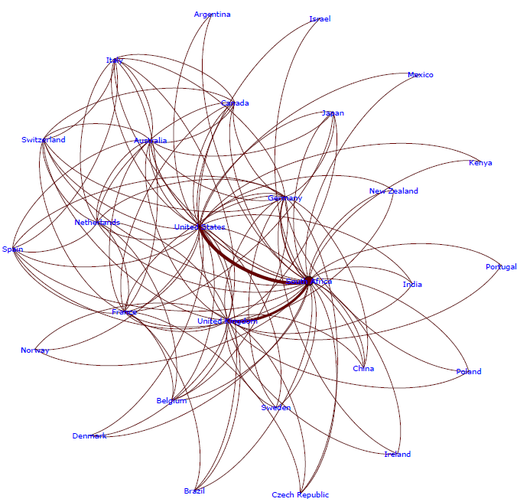
South African research collaboration map
Note: Collaboration relationships are shown for papers authored by South African researchers counted in a 5-year window 2005-09 and are represented as variable-thickness lines (edges) between nodes. Line thickness represents the share of collaboration to or from the connected . Visualisation is by the Force Atlas algorithm, which treats the network of edges as a system of interconnected springs and seeks to satisfy the tension of all edges simultaneously in a 2D rendering; hence, countries sharing a collaborative relationship tend to group together, while those that do not are placed further apart.
Source: Scopus
11
Notes:
However, we also see that collaboration between developing countries is still minimal. For example, a recent study showed that out of all African biomedical research papers published from 2004-2008, 77% were produced with international partners, but just 5% were the result of collaborations with another African country.
This collaboration map shows the major collaboration partners of South Africa, at a country level, based on co-authored articles. The thicker the line connecting the nodes, the higher the volume of co-authored articles.
Not surprisingly, the US accounts for the largest number of co-authored articles reflecting the size of its research base. We also see that the UK, Germany, Australia, Canada are all important collaboration partners. But, although further out on the collaboration map, we also see increased collaboration with other developing countries.

Slide 13
Three messages
Investment in a scientific base matters, and the global landscape is changing dramatically
Science is increasingly global, driven by you
Managing this requires data, metrics and tools
Notes:
My third message is that managing research policy in this increasingly complex environment requires better data, metrics and tools to allow for optimal decision making.

Slide 14


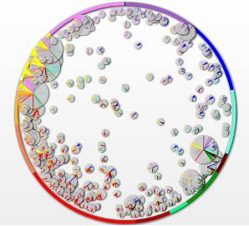
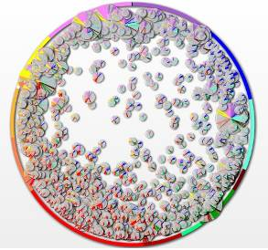


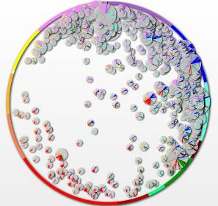
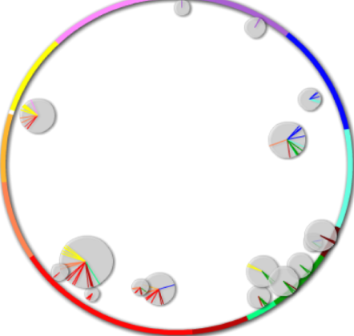
Tools to map national strengths to focus and co-ordinate R&D investments (country level – South Africa - 16 strengths)
Math & physics
Chemistry
Engineering
Earth Sciences
Biology
Biotechnology
Infections Diseases
Medical Specialties
Health Sciences
Brain Research
Humanities
Social Sciences
Computer Science
Other
Note: Each small circle represents a strength; all color strips within the circle refer to the specific disciplines composing the strength. Multi-disciplinary strengths are pulling towards the centre of the Wheel of Science
Source: SciVal Spotlight
Notes:
In order to help focus and co-ordinate R&D investments within and between nations, or within or between institutions, data and tools are needed to identify current and emerging research strengths.
For example, here are three maps of national research strengths for the world’s four most prolific countries in terms of articles published, US, China, the UK, as well as for South Africa. Each map shows its country’s distinctive research strengths and is based on articles published in 18,000 journals globally. Each bubble represents an area of research in which its county’s researchers are especially prolific or highly cited. The larger the bubble, the more articles there are in that area of research. Bubbles on the edge of the circle fit neatly into traditional subject classifications such as Maths, Physics, Chemistry, Biology and Engineering. However, bubbles close to the centre are more inter-disciplinary in nature.
For example, the UK map shows that there are about 400 areas of research in which the UK is distinctively strong by international standards. South Africa as 16 areas of distinctive research, with a focus on health and medicine.

Slide 15
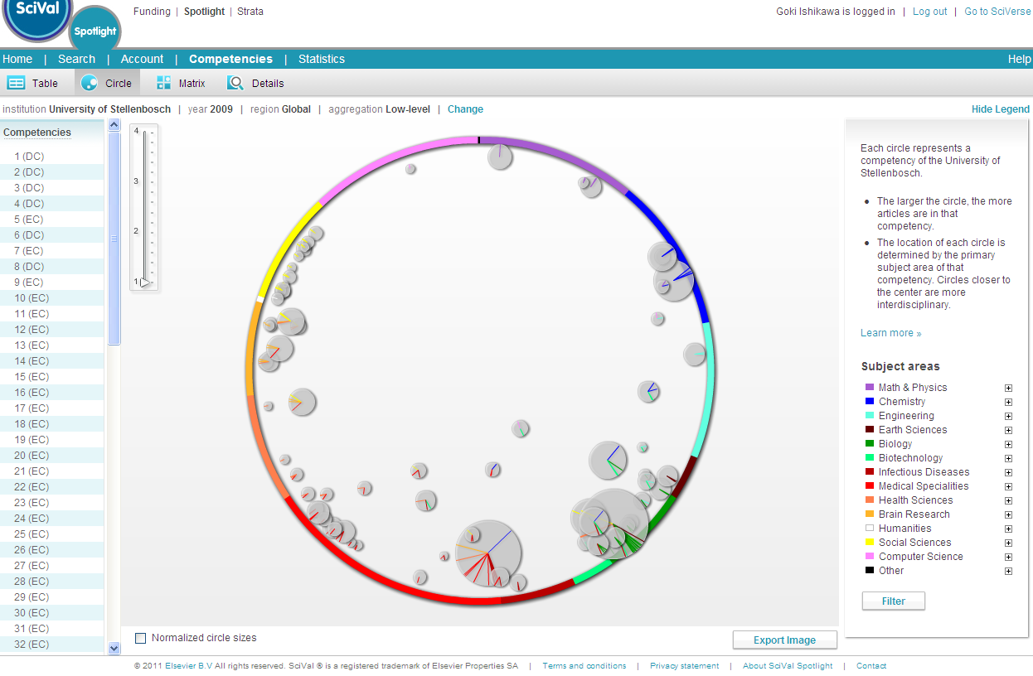
Tools to map national strengths to focus and co-ordinate R&D investments (university level – Stellenbosch – 75 strengths)
Computer Science
Physics/Math
Social Science
Chemistry
Brain Research
Engineering
Earth Science
Health Science
Biology
Medical Specialties
Biotechnology
Infectious Disease
Source: SciVal Spotlight
14
Notes:
Here is the map for Stellenbosch, showing 75 distinctive research areas as compared to all institutions globally.
Staying with the theme of collaboration, we might ask ourselves who we could collaborate with to advance these strengths further.

Slide 16
How extensively does Stellenbosch collaborate domestically within these strengths?
Collaboration seen today
Opportunitues
Number of Competencies (‘strengths’)
University of Cape Town
University of Pretoria
University of the Witwatersrand
University of Kwazulu-Natal
South African Medical Research Council
University of the Western Cape
Cape peninsula University of Technology
Nelson Mandela Metropolitan University
North West University
University of Johannesburg
Domestic collaboration rate within overlapping strengths is 60%
Source: SciVal Spotlight
Notes:
If we first look within South Africa, we see that in 60% of the cases we’re already collaborating with other South African institutes who share similar research strengths.

Slide 17
How extensively does Stellenbosch collaborate internationally within these strengths?
0
Opportunitues
Collaboration seen today
Number of Competencies (‘strengths’)
Harvard University
U.S. Department of agriculture
University of Toronto
University of Oxford
Johns Hopkins University
University College London
Centers for disease control and prevention
Columbia university
London school of Hygiene & Tropical medical
Universidade de Sao Paulo
International collaboration rate within overlapping strengths is 32%
Source: SciVal Spotlight
Notes:
However, if we look internationally, we see that in only 32% of the cases we’re already collaborating with other international institutes who share our research strengths.

Slide 18
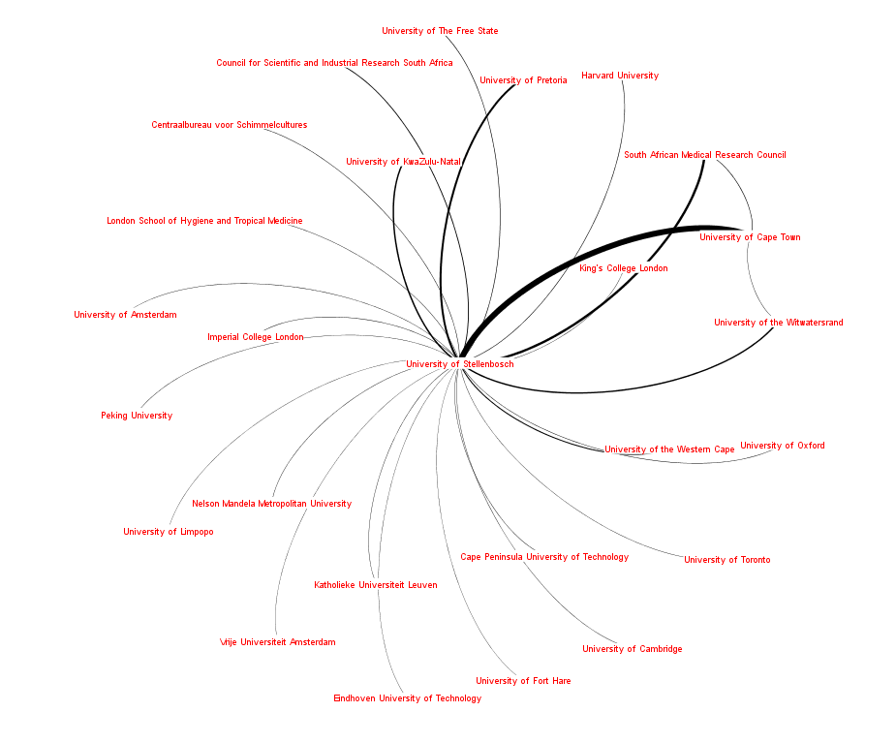
Tools to map collaboration networks to strengthen existing ones and identify new opportunities (Stellenbosch)
Source: Scopus
17
Notes:
This map shows Stellenbosch’s main collaboration partners - reflecting geographic proximity such as UCT, and a wide range of other South African and international institutions.

Slide 19
Tools to manage the natural networks – The Scientific Diaspora (South Africa)
Top countries importing “South African” scientists (based on publications)
Other
Ghana
France
8%
Israel
2%
New Zealand
1%
2%
2%
Canada
USA
4%
Netherlands
7%
Australia
UK
Germany
Source: Scopus
Notes:
One way to pursue increased collaboration is through the global movement of scientists. As science becomes more collaborative, scientists are moving from nation to nation to develop their careers, to expand their networks, to pursue funding opportunities and to work with the best faculty and equipment. For example, this chart illustrates the top countries currently hosting South African scientists (defined as a scientist who published his/her first paper at a South African institute).

Slide 20
Where do they go?
Importing Institutions: All subject Areas – Researchers
Deutsche Elecktronen-Synchrotron Desy
Universitat Erlangen -Nurnberg
University of Amsterdam
Ohio State University
Delft University of Technology
Wheaton College-Illinois
Max Planck institut fur Kernpysik
Liverpool school of tropical medical
Princeton University
Julius- Maximilians-Universitat Wurzburg
Imperial College London
Radboud University Nijmegen
Centers for disease control and Prevention
University of california, Santa Cruz
Queensland and Department of primary industries and Fishe
California Institute of Technology
Atkinson Morley’s hospital, London
Universitat de Barcelone
University of Sheffield
Cranfield University
Source: Scopus
Notes:
Next we might want to drill down to indentify the specific institutions people went to....

Slide 21
Which institutes did they come from?
0
Exporting Institutions – Research
University of Cape Town
University of Witwatersrand
Universiteit van Pretoria
The Council for Scientific and Industrial Research
Intensive Care Unit
South African Medical Research Council
Hlabisa Hospital
Universiteit Stellenbosch
Rhodes University
National Physical Research Laboratory
Groote Schuur Hospital
South African Astronomical observatory
University of the Western Cape
Mintek
Johannesburg Hospital
National Accelerator Centre
Centre for the AIDS Programme of Research in South…
Epidemiology research Unit
Human Sciences Research Council of South Africa
University of KwaZulu-Natal, Westville Campus
Source: Scopus
Notes:
Or who the top exporting institutions are...

Slide 22
What fields are they active in?
0
Brain Drain Per subject area – Research
Multidisciplinary
Agricultural and Biological Sciences
Arts and Humanities
Biochemistry, Genetics and Molecular Biology
Business, Management and Accounting
Chemical Engineering
Chemistry
Computer Science
Decision Sciences
Earth and Planetary Sciences
Economics, Econometrics and Finance
Energy
Engineering
Environmental Science
Immunology and Microbiology
Materials Science
Mathematics
Medicine
Neuroscience
Nursing
Pharmacology, Toxicology and Pharmaceutics
Physics and Astronomy
Psychology
Social Sciences
Veterinary
Dentistry
Health Professions
Source: Scopus
Notes:
... Or the subject fields these foreign researchers are most active in.

Slide 23
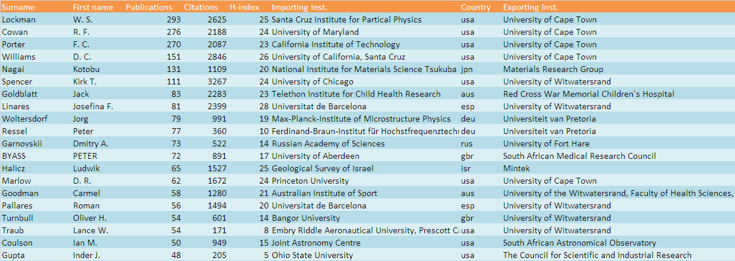
Who are they?
Notes:
And of course we’d like to identify the individual scientists.

Slide 24
Three messages
Investment in a scientific base matters, and the global landscape is changing dramatically
Science is increasingly global, driven by you
Managing this requires data, metrics and tools
Notes:
In summary, we’ve seen that investing in a scientific base matters on the global R&D landscape, and that the next 5 years will see China becoming the world’s largest publisher of scientific research. We’ve explored the increasingly global nature of science, with increased collaboration driving higher impact. Lastly we explored how data and tools could enable more optimized decision making in this environment.
Thank you.

Slide 25


