Slide 1
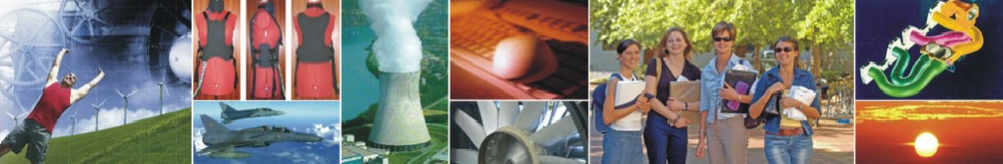
Research @ Mechanical & Mechatronic Engineering
Cited more, Preserved forever
Presented to the Dept. of Mechanical and Mechatronic Engineering
19 July 2010
Ina Smith, Hilton Gibson, Paulette Talliard, Corinna Truter

Slide 2

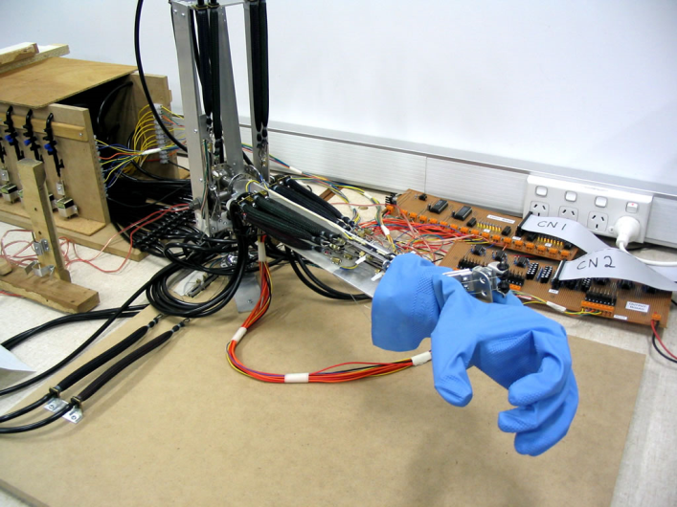
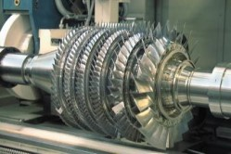
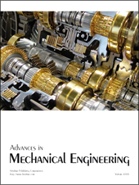
Research Life Cycle
3. Leads to more research
Improve products etc.
1. Conduct research
2. Publish research – journals, books, conferences etc.

Slide 3
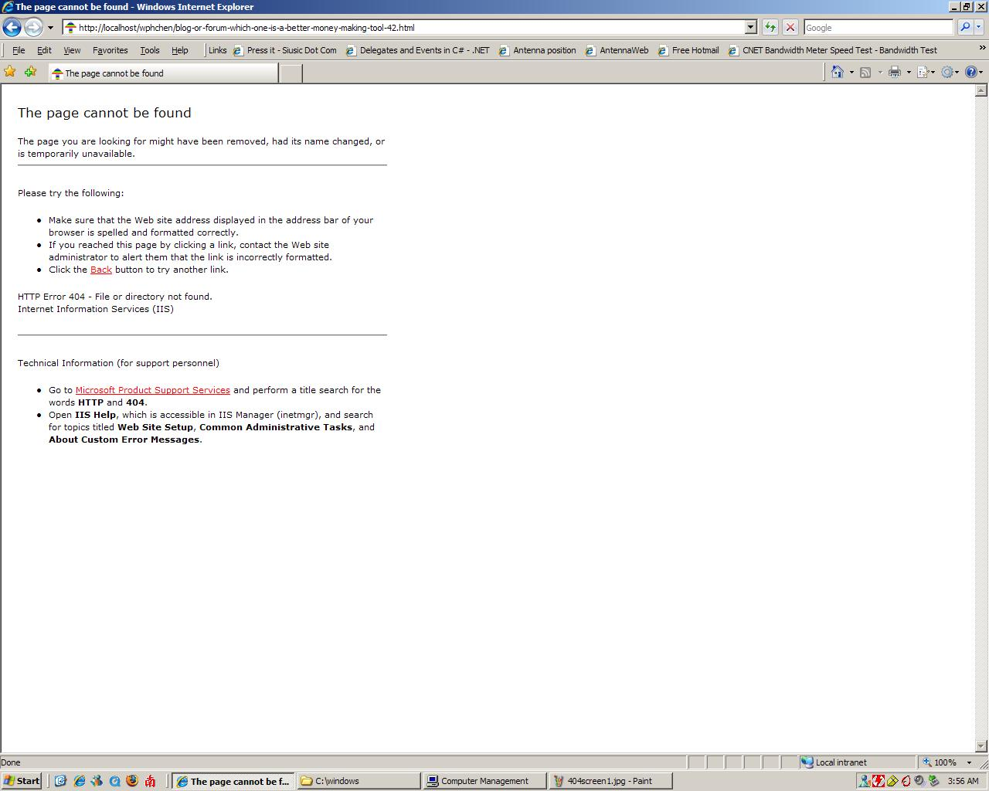
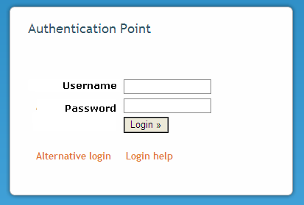
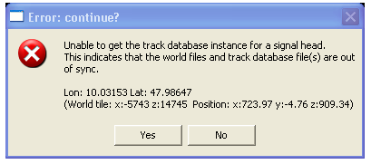

Slide 4

Open Access
“By "open access" to literature, we mean its free availability on the public internet, permitting any users to read, download, copy, distribute, print, search, or link to the full texts of these articles, crawl them for indexing, pass them as data to software, or use them for any other lawful purpose, without financial, legal, or technical barriers other than those inseparable from gaining access to the internet itself. The only constraint on reproduction and distribution, and the only role for copyright in this domain, should be to give authors control over the integrity of their work and the right to be properly acknowledged and cited.”
(Budapest-Bethesda-Berlin or BBB definition of open access
http://www.earlham.edu/~peters/fos/newsletter/09-02-04.htm )
Acknowledgement – image: http://openreflections.files.wordpress.com/2010/01/open20access-seal.gif

Slide 5


Two approaches to Open Access
Golden route - publish in Open Access journals
Green route – publish in an Institutional Repository
Acknowledgement image: http://lgimages.s3.amazonaws.com/data/imagemanager/7037/mllerustad.gif

Slide 6
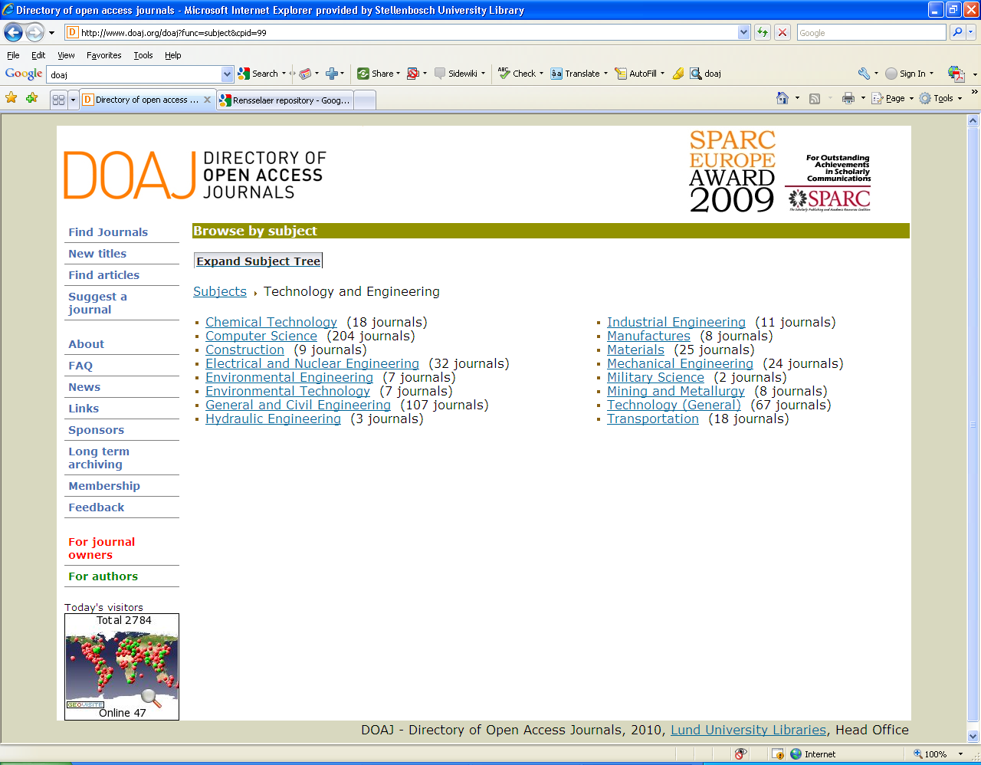
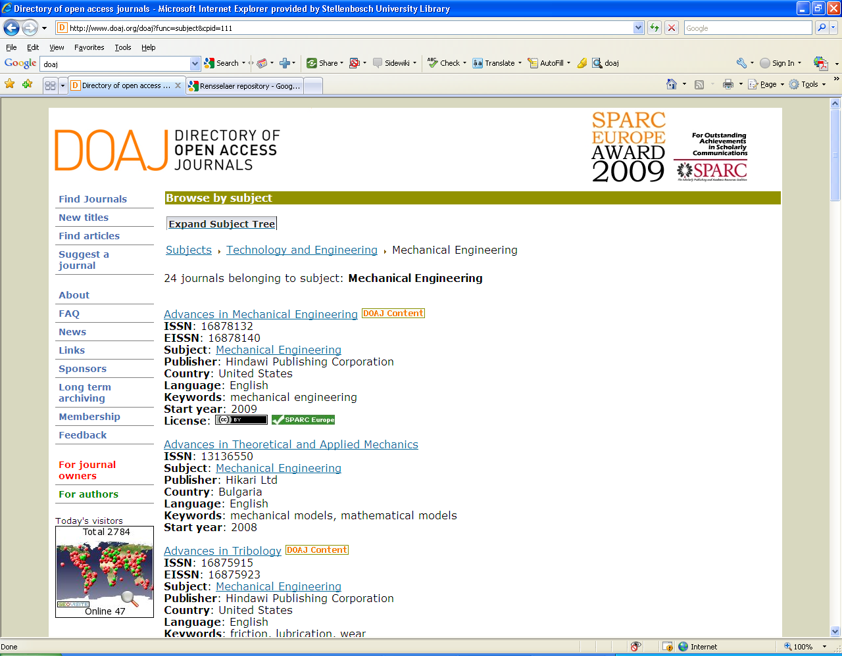
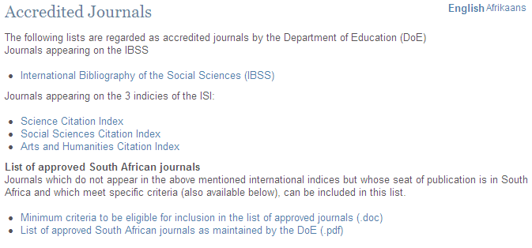
DoE Accredited Journals

Slide 7
What is a research repository? (“green” route)
Set of services
Management & dissemination of digital materials
Organizational commitment
Stewardship
Long-term preservation
Organization
Open access/ distribution
(Clifford A. Lynch, "Institutional Repositories: Essential Infrastructure for Scholarship in the Digital Age" ARL, no. 226 (February 2003): 1-7)

Slide 8
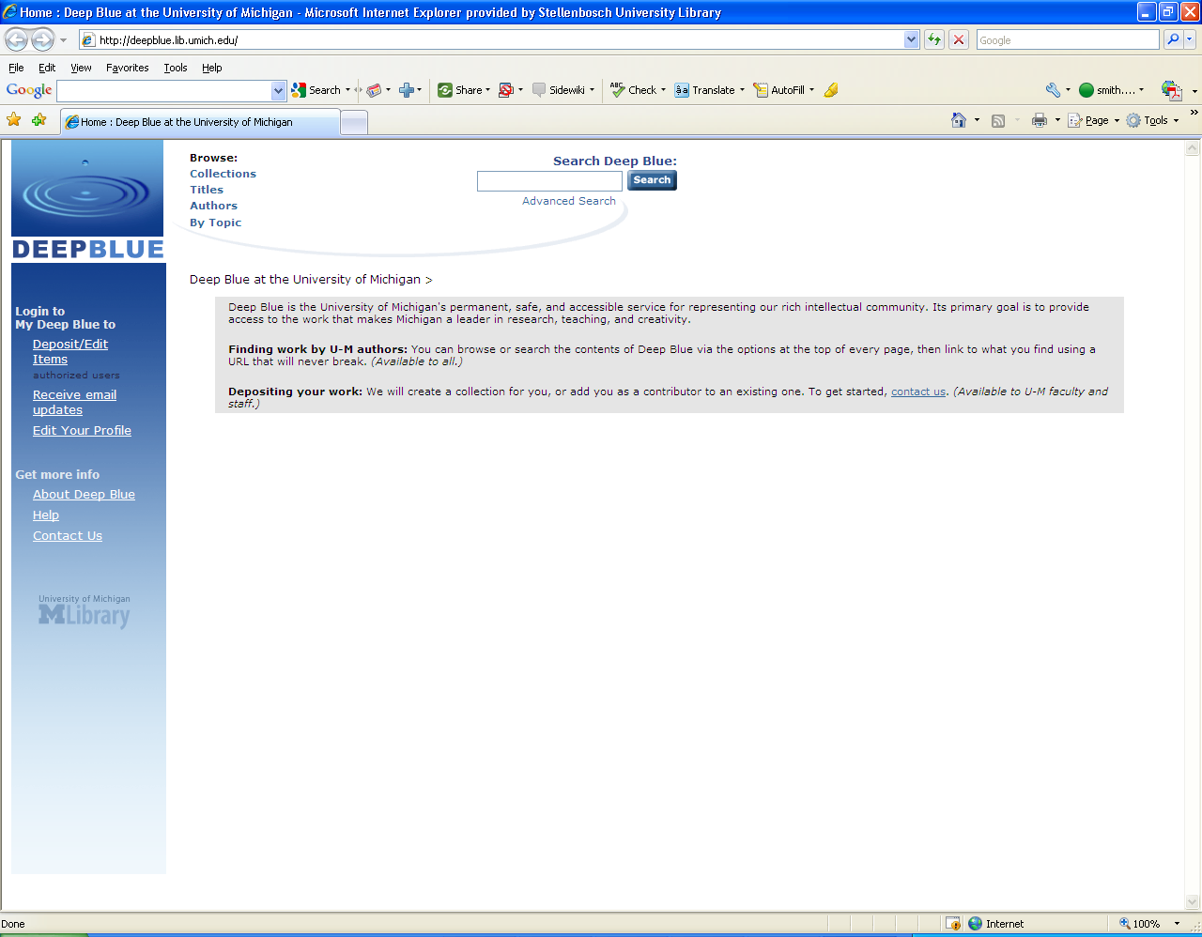
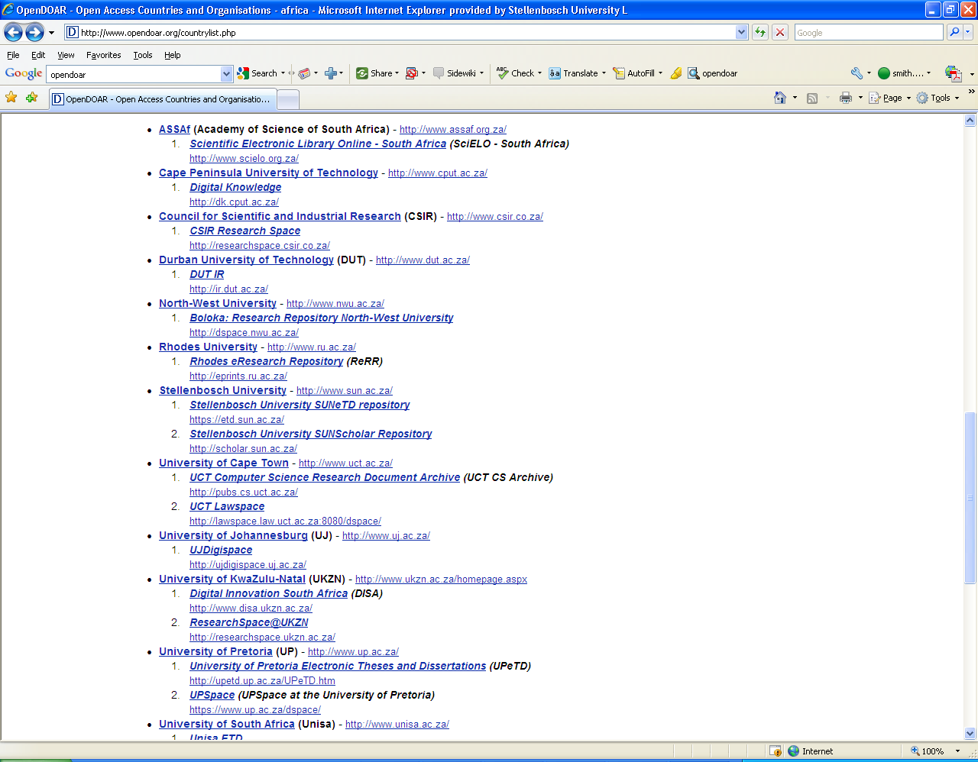
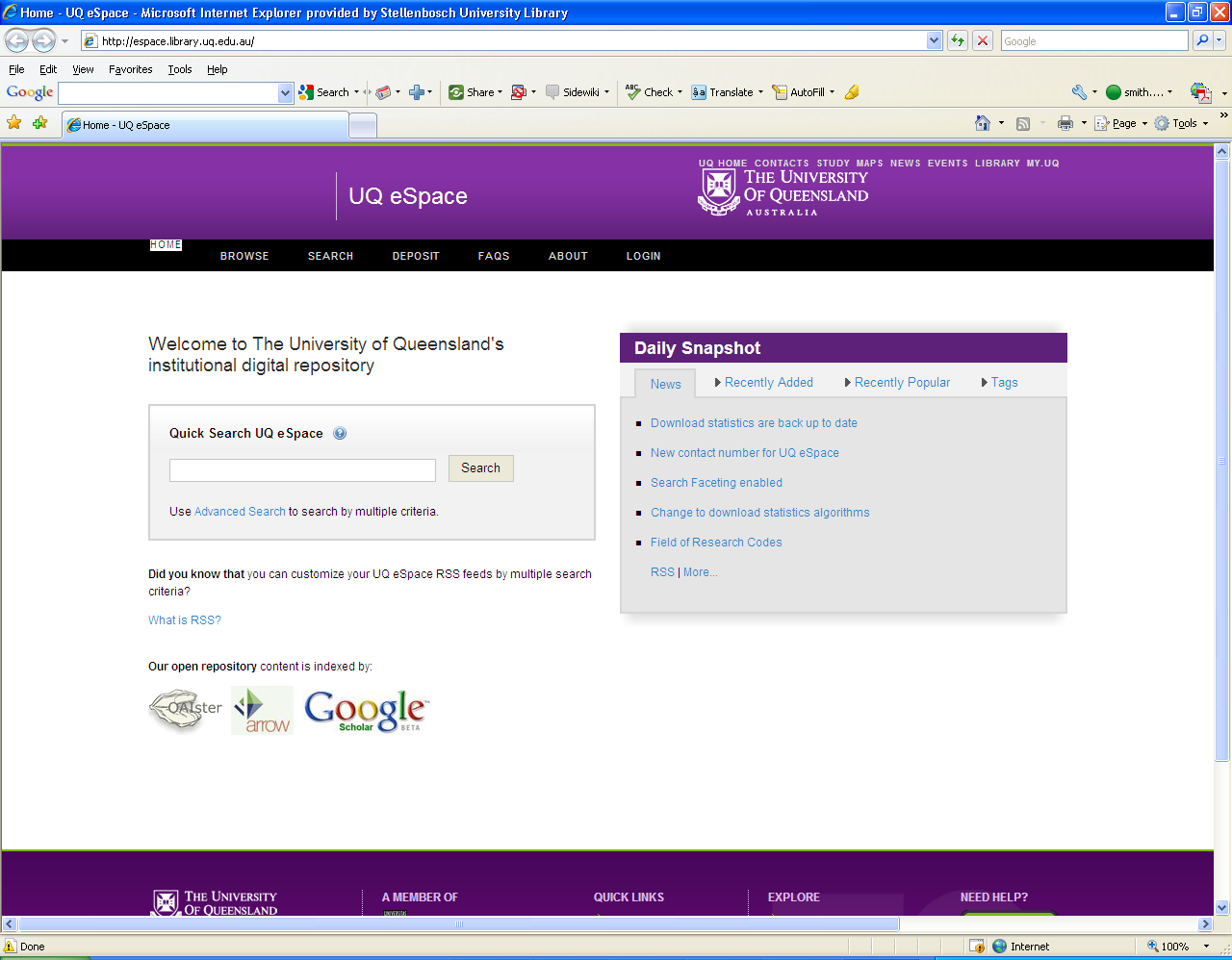
National & International Landscape
Africa (35)
South Africa (23)
1 650+ internationally

Slide 9
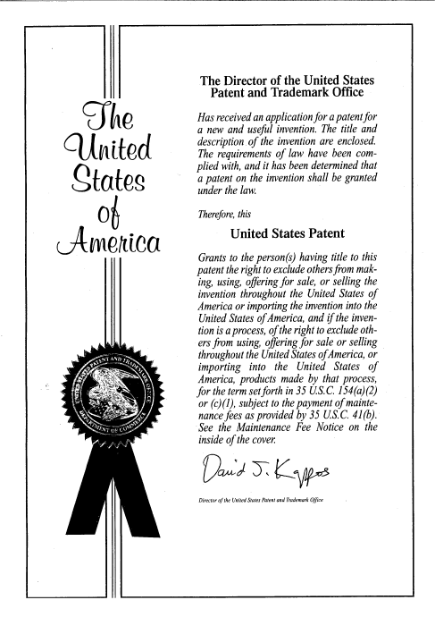
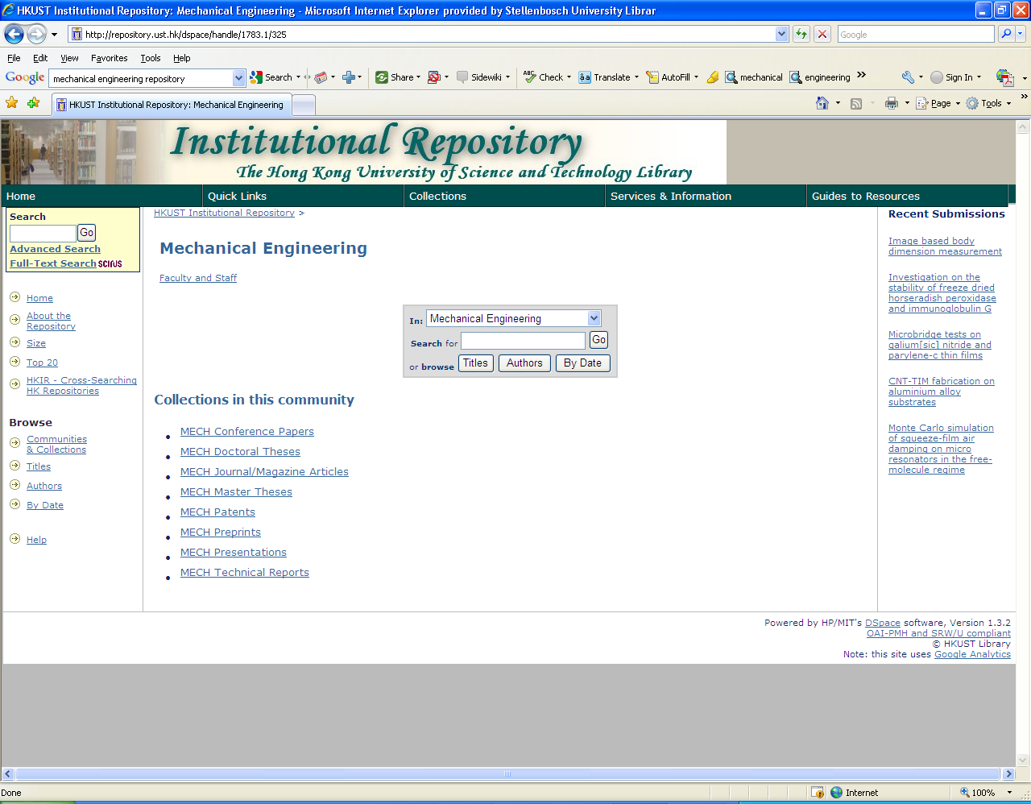

Slide 10
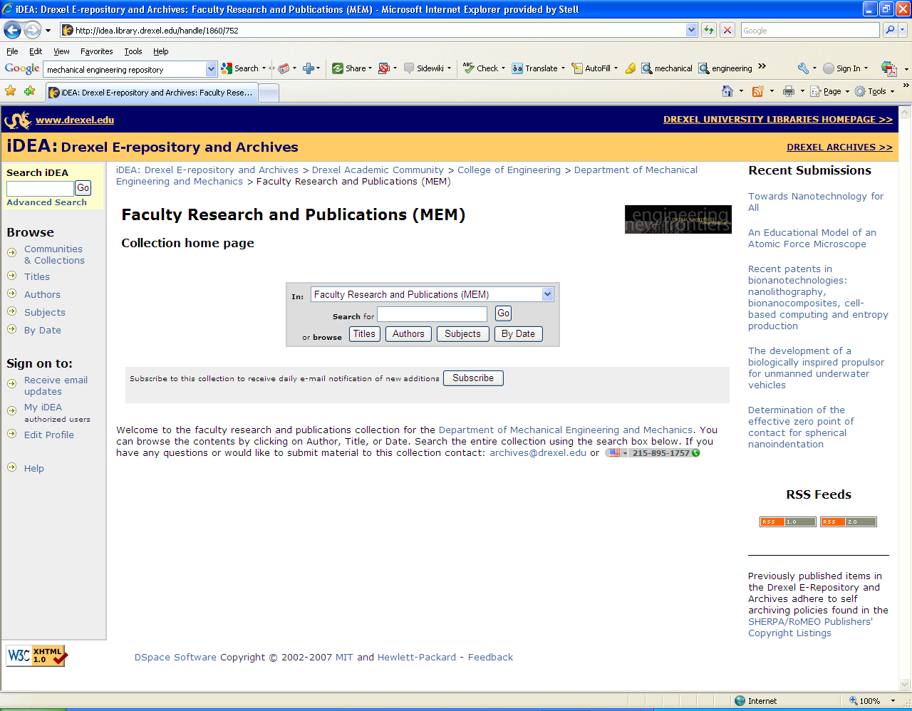

Slide 11
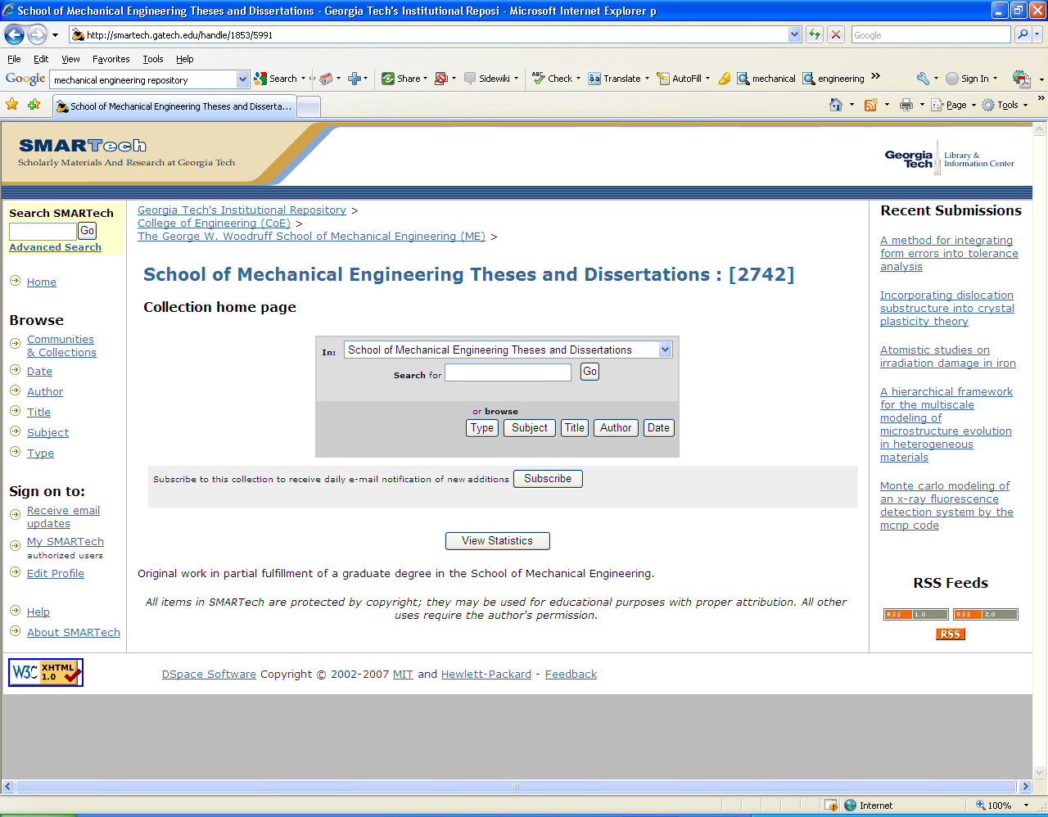

Slide 12
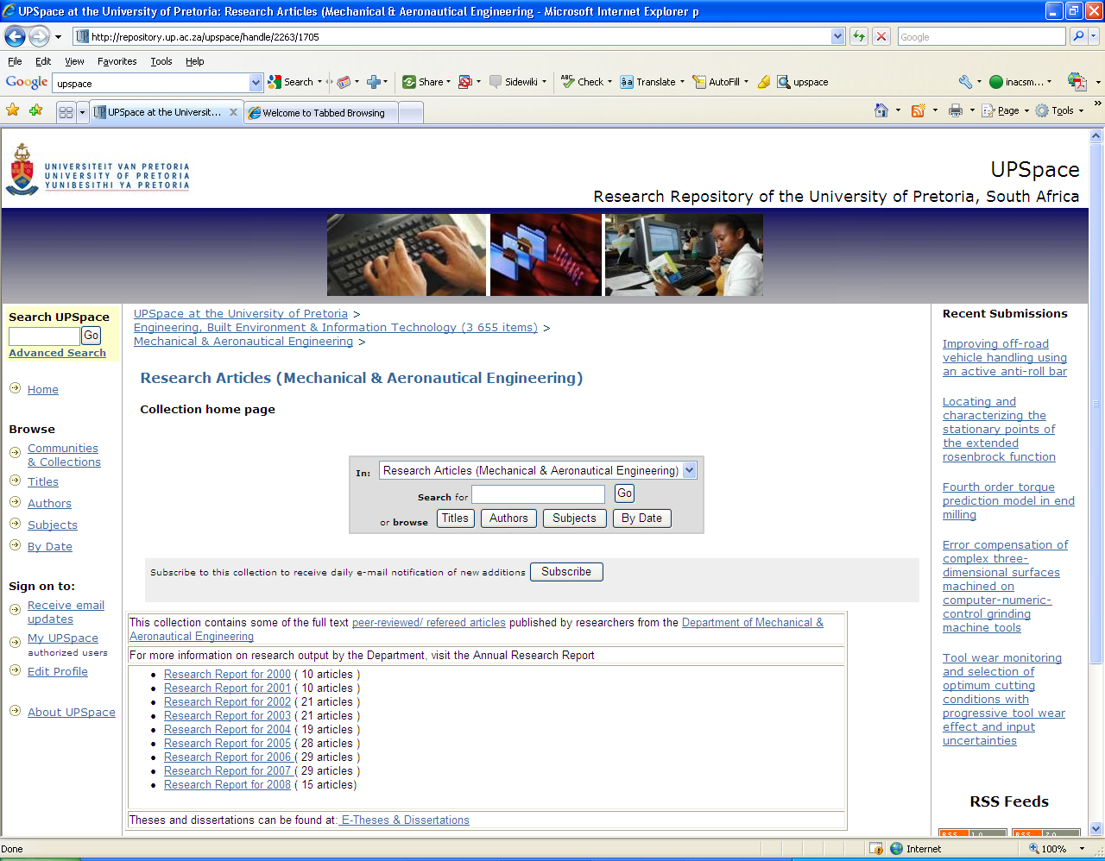

Slide 13
What is SUNScholar? https://scholar.sun.ac.za
Strategic objective of library: Support, develop and contribute to high-level scholarly publication output
Full text central digital research repository of the University of Stellenbosch
Provide open access where possible
Digitally preserve research output

Slide 14
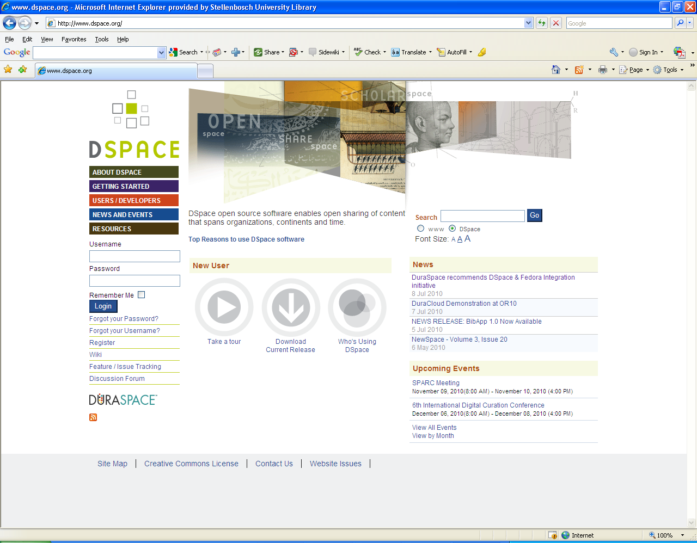
http://dspace.org
907 instances
Notes:
DSpace preserves and enables easy and open access to all types of digital content including text, images, moving images, mpegs and data sets. And with an ever-growing community of developers, committed to continuously expanding and improving the software, each DSpace installation benefits from the next.

Slide 15
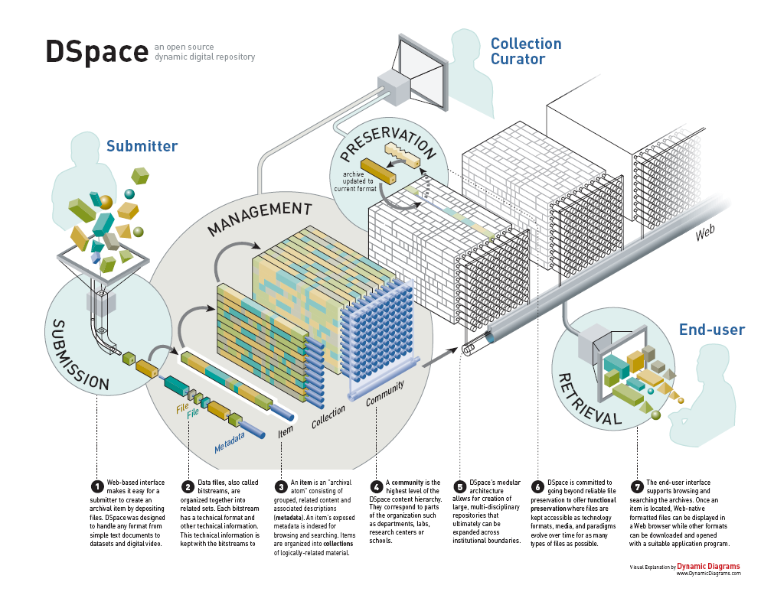

Slide 16
Research Output
Primary:
  Research Articles, Chapters in Books, Books, Conference Proceedings, Theses, Dissertations
Secondary:
  Inaugural Addresses, Conference Presentations & Posters, Images, Audio- & Audiovisual Clips, Seminars/Open Lectures, Conferences, Experiments, Data sets, and many more!
Notes:
28 articles
14 proceedings international
4 proceedings national

Slide 17
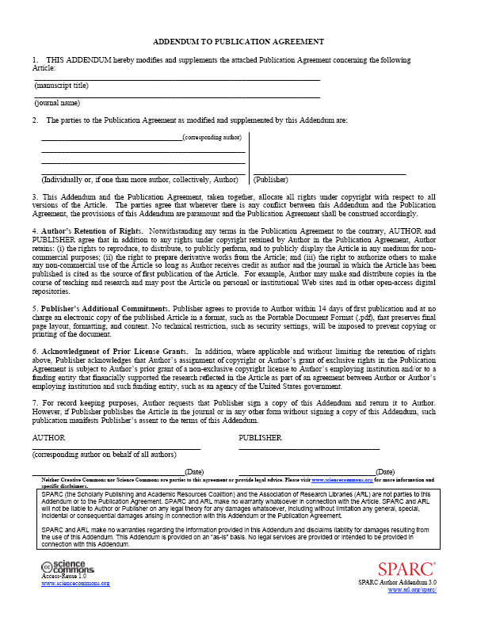
Research Articles
Clear copyright (SUNScholar Office)
  Negotiate pro-actively – 2nd copy on SUNScholar
  Add SPARC Addendum: http://www.arl.org/sparc/author/addendum.shtml
Digitize
Submit pdf file (or using other
open standard) to SUNScholar
More info: http://wiki.lib.sun.ac.za/index.php/SUNScholar
Notes:
Your article has been accepted for publication in a journal and, like your colleagues, you want it to have the widest possible distribution and impact in the scholarly community. In the past, this required print publication. Today you have other options, like online archiving, but the publication agreement you’ll likely encounter will actually prevent broad
distribution of your work.
You would never knowingly keep your research from a readership that could benefit from it, but signing a restrictive publication agreement limits your scholarly universe and lessens your impact as an author.
Why? According to the traditional publication agreement, all rights —including copyright — go to the journal. You probably want to include sections of your article in later works. You might want to give copies to your class or distribute it among colleagues. And you likely want to place it on your Web page or in an online repository if you had the choice. These are all ways to give your research wide exposure and fulfill your goals as a scholar, but they are inhibited by the traditional agreement. If you sign on the publisher’s dotted line, is there any way
to retain these critical rights?
Yes. The SPARC Author Addendum is a legal instrument that modifies the publisher’s agreement and allows you to keep key rights to your articles. The Author Addendum is a free resource developed by SPARC in partnership with Creative Commons <http://www.creativecommons.org> and Science Commons <http://science.creativecommons.org>, established non-profit organizations that offer a range of copyright options for many different creative endeavors.

Slide 18
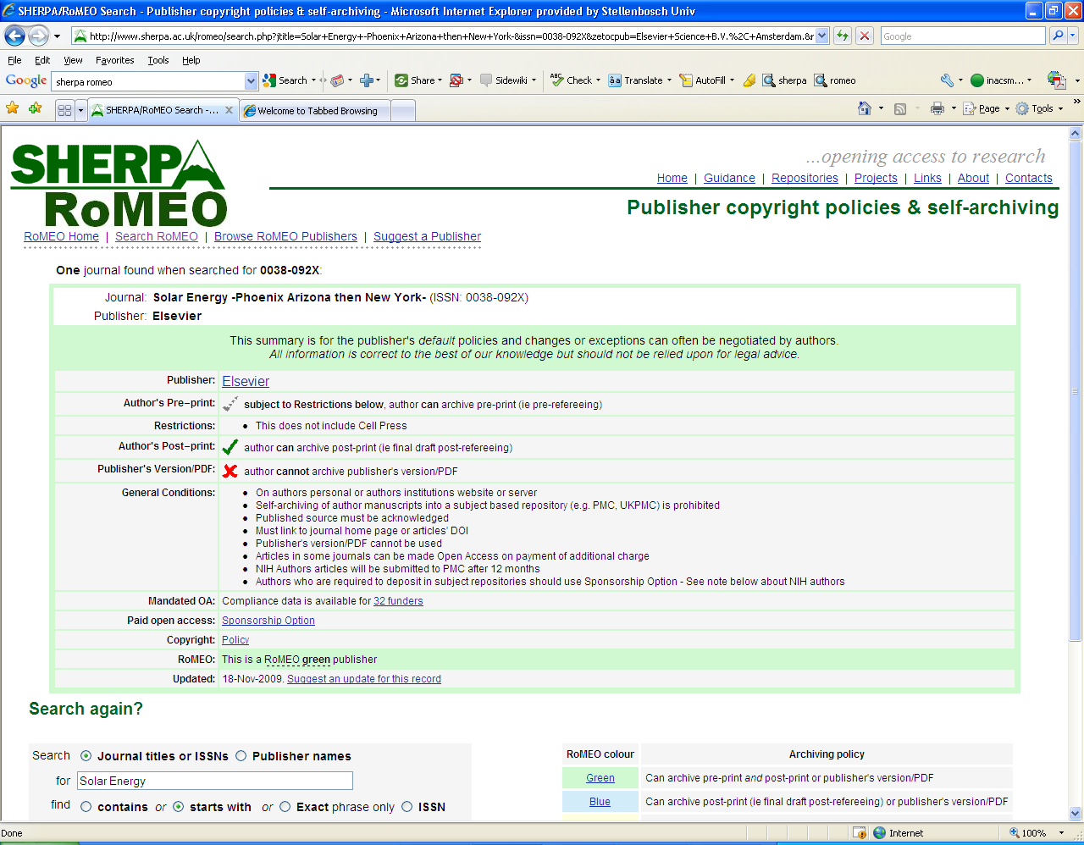
Solar Energy

Slide 19
Theses & Dissertations
Submission is mandatory
See guidelines on web
Nominations for December graduation ceremony – starts 1 September 2010
  Supervisor nominates
  Student receives an e-mail
  Student submits to IR
Notes:
Your article has been accepted for publication in a journal and, like your colleagues, you want it to have the widest possible distribution and impact in the scholarly community. In the past, this required print publication. Today you have other options, like online archiving, but the publication agreement you’ll likely encounter will actually prevent broad
distribution of your work.
You would never knowingly keep your research from a readership that could benefit from it, but signing a restrictive publication agreement limits your scholarly universe and lessens your impact as an author.
Why? According to the traditional publication agreement, all rights —including copyright — go to the journal. You probably want to include sections of your article in later works. You might want to give copies to your class or distribute it among colleagues. And you likely want to place it on your Web page or in an online repository if you had the choice. These are all ways to give your research wide exposure and fulfill your goals as a scholar, but they are inhibited by the traditional agreement. If you sign on the publisher’s dotted line, is there any way
to retain these critical rights?
Yes. The SPARC Author Addendum is a legal instrument that modifies the publisher’s agreement and allows you to keep key rights to your articles. The Author Addendum is a free resource developed by SPARC in partnership with Creative Commons <http://www.creativecommons.org> and Science Commons <http://science.creativecommons.org>, established non-profit organizations that offer a range of copyright options for many different creative endeavors.

Slide 20
Workflow
Submit item
Reject
Review item
Notification to Submitter & Subscribers
Edit metadata
Available on IR

Slide 21
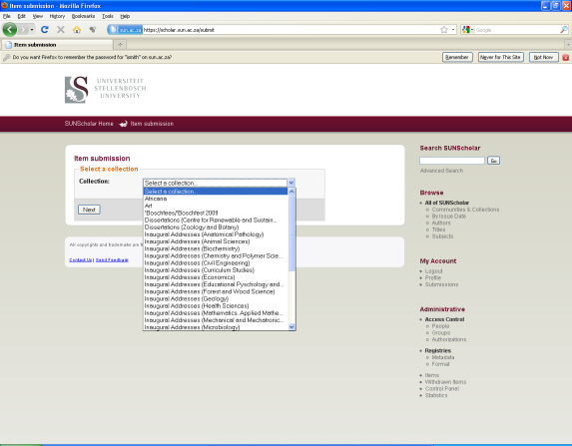
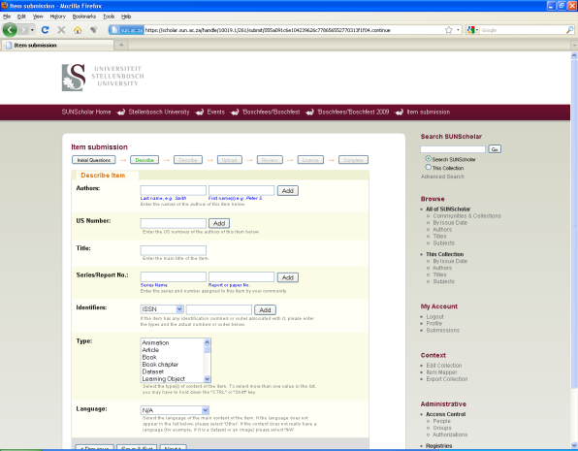
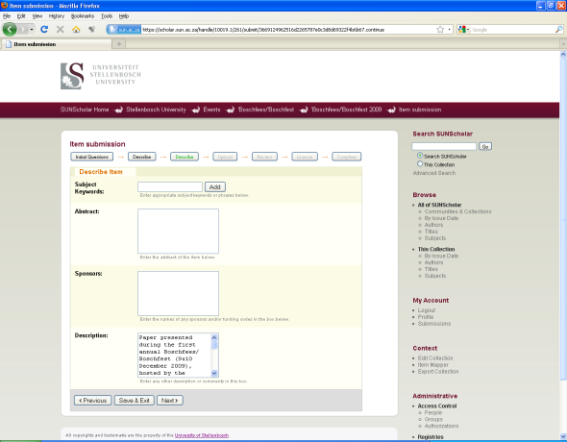
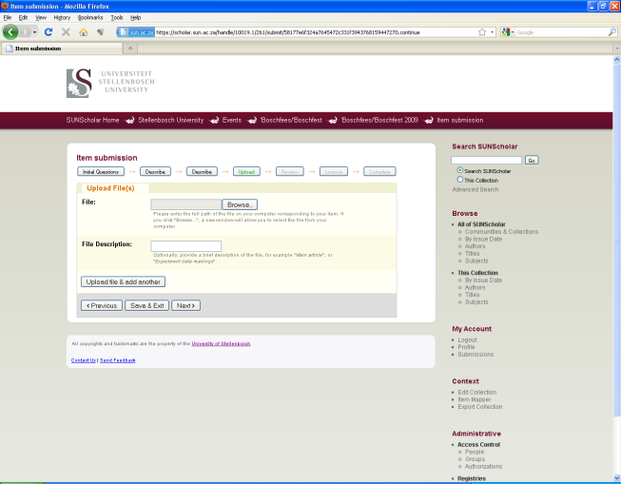
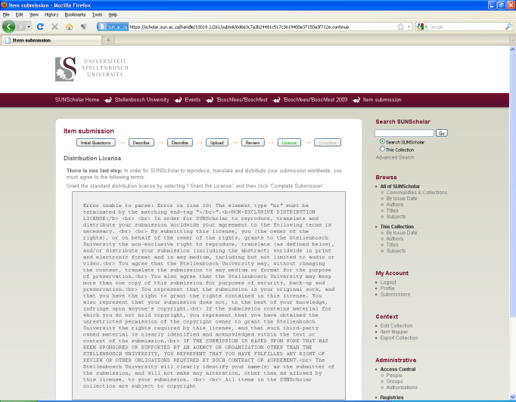
Submission Process
1
2
3
4
5

Slide 22
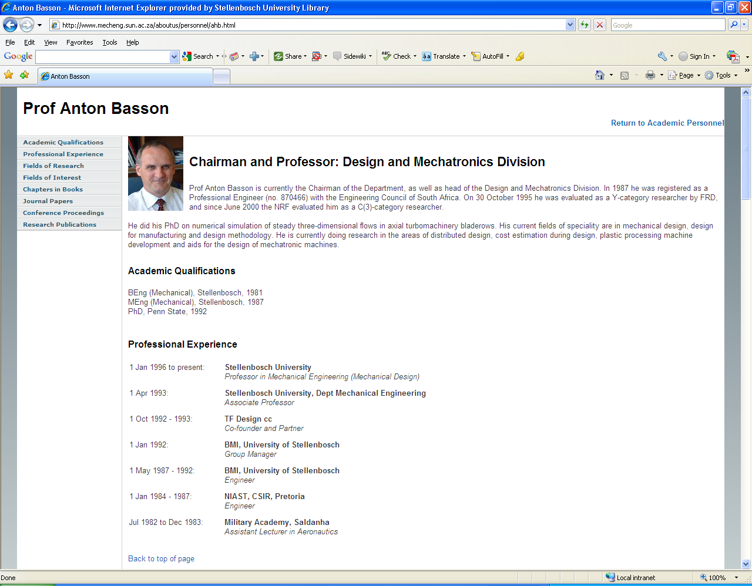
Research Articles
Conference Proceedings
Chapters in Books
Theses/Dissertations supervised
SUNScholar

Slide 23
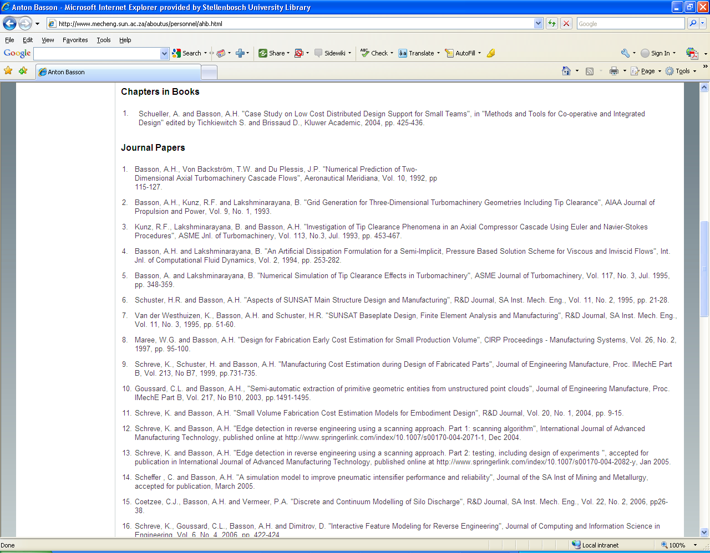
Links from web page to full text on SUNScholar

Slide 24
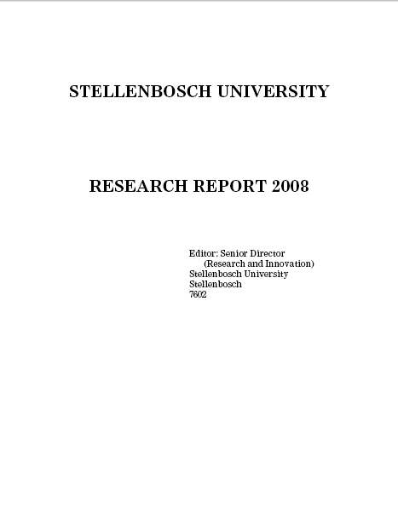
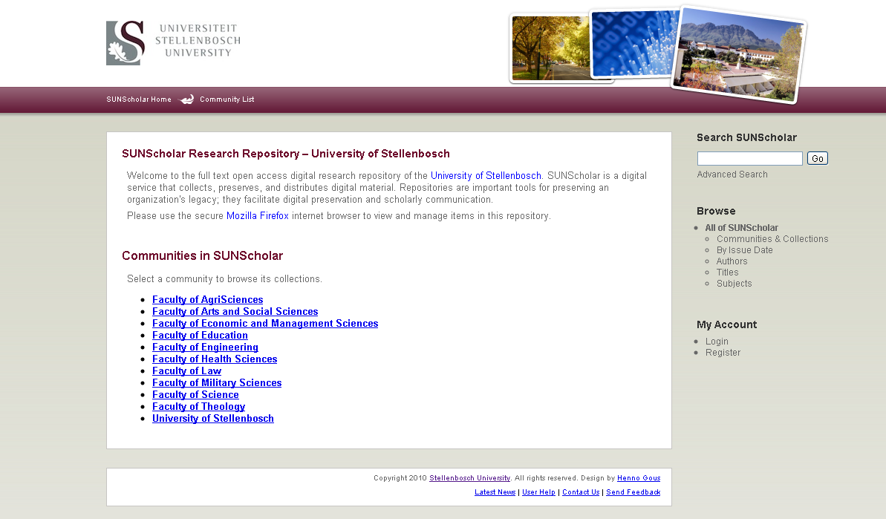
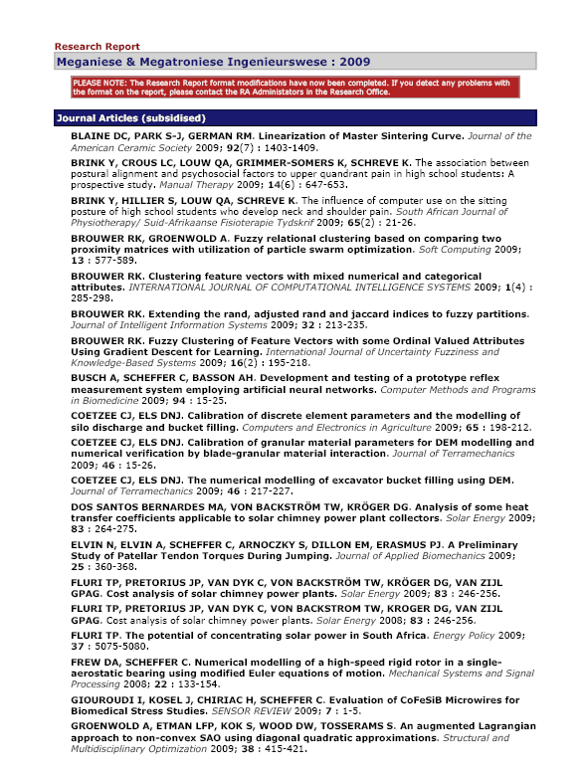
Research Output
Research Report System
With links to full text
Currently investigated

Slide 25
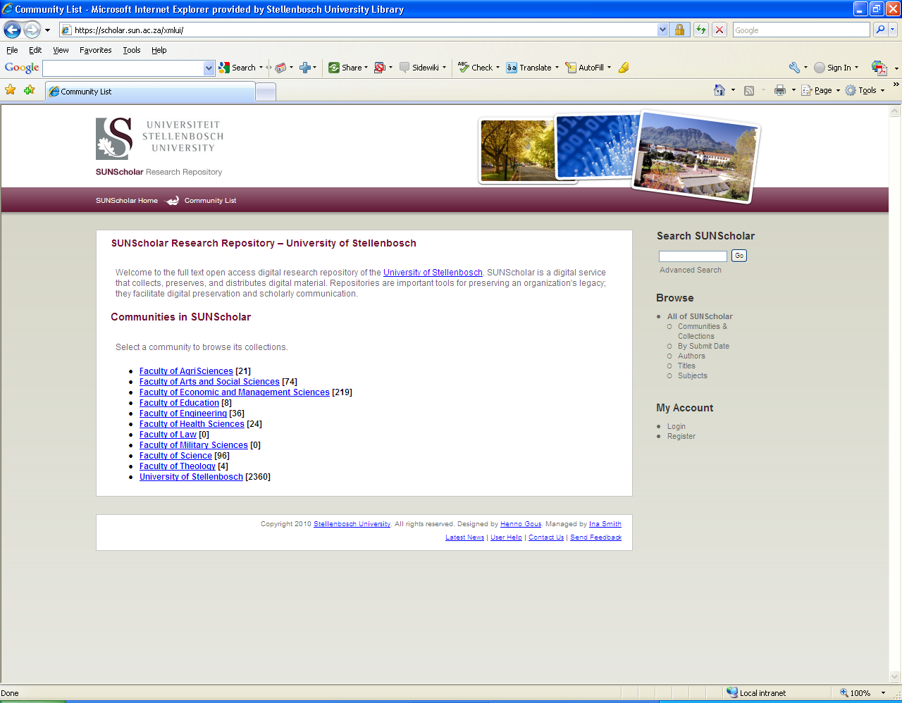
Top-Level Community:
Engineering

Slide 26
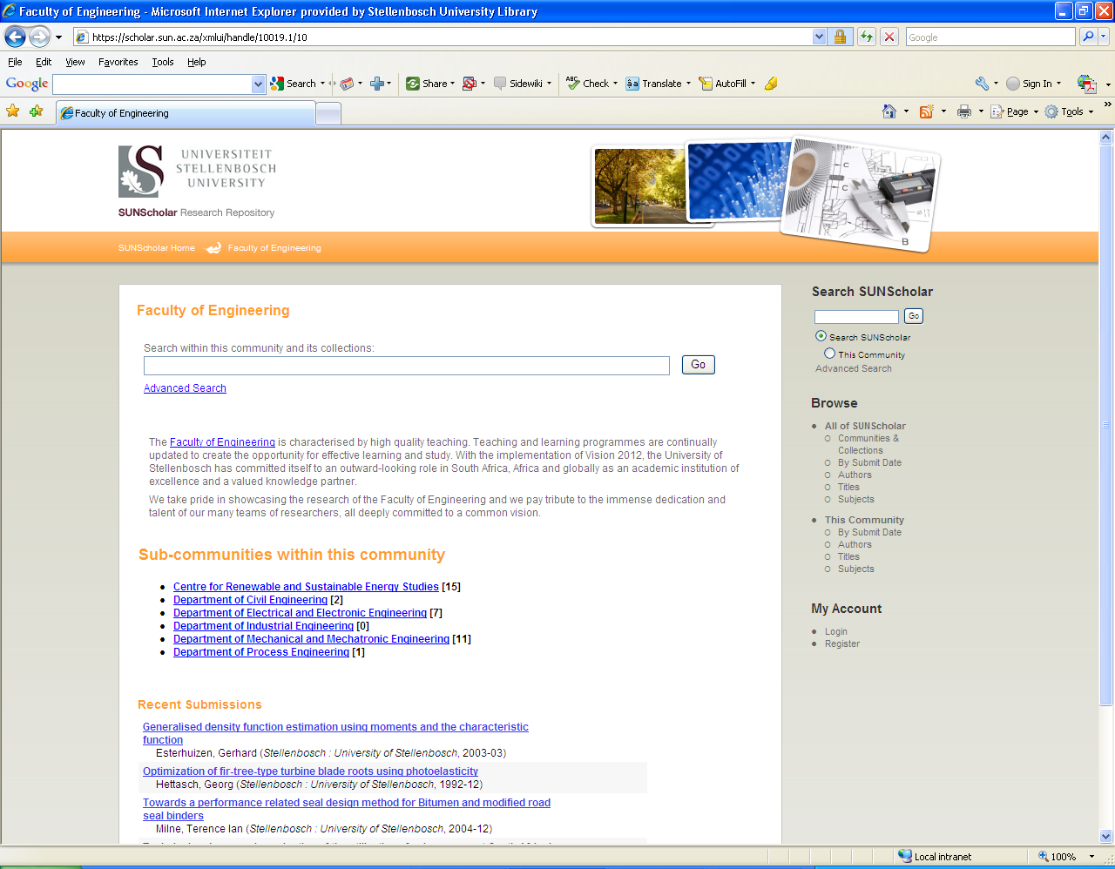
Customized per Faculty
Sub-Communities:
Departments

Slide 27
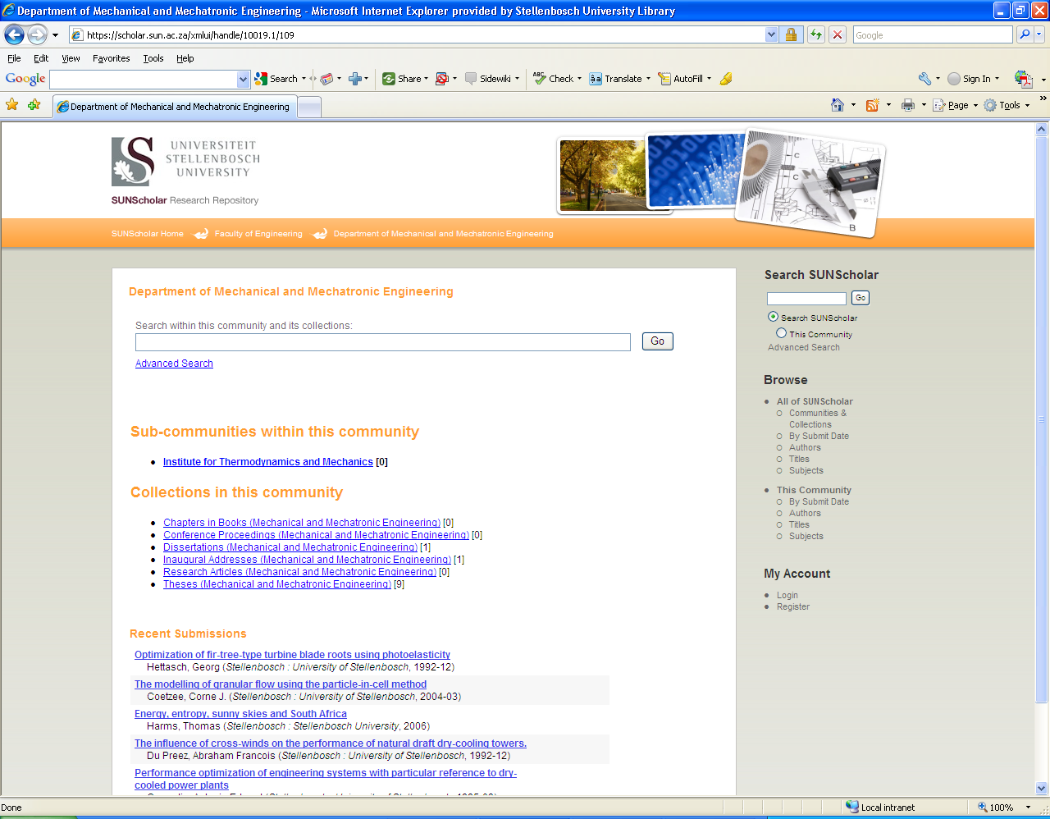
5 most recent submissions listed on Collection home page

Slide 28
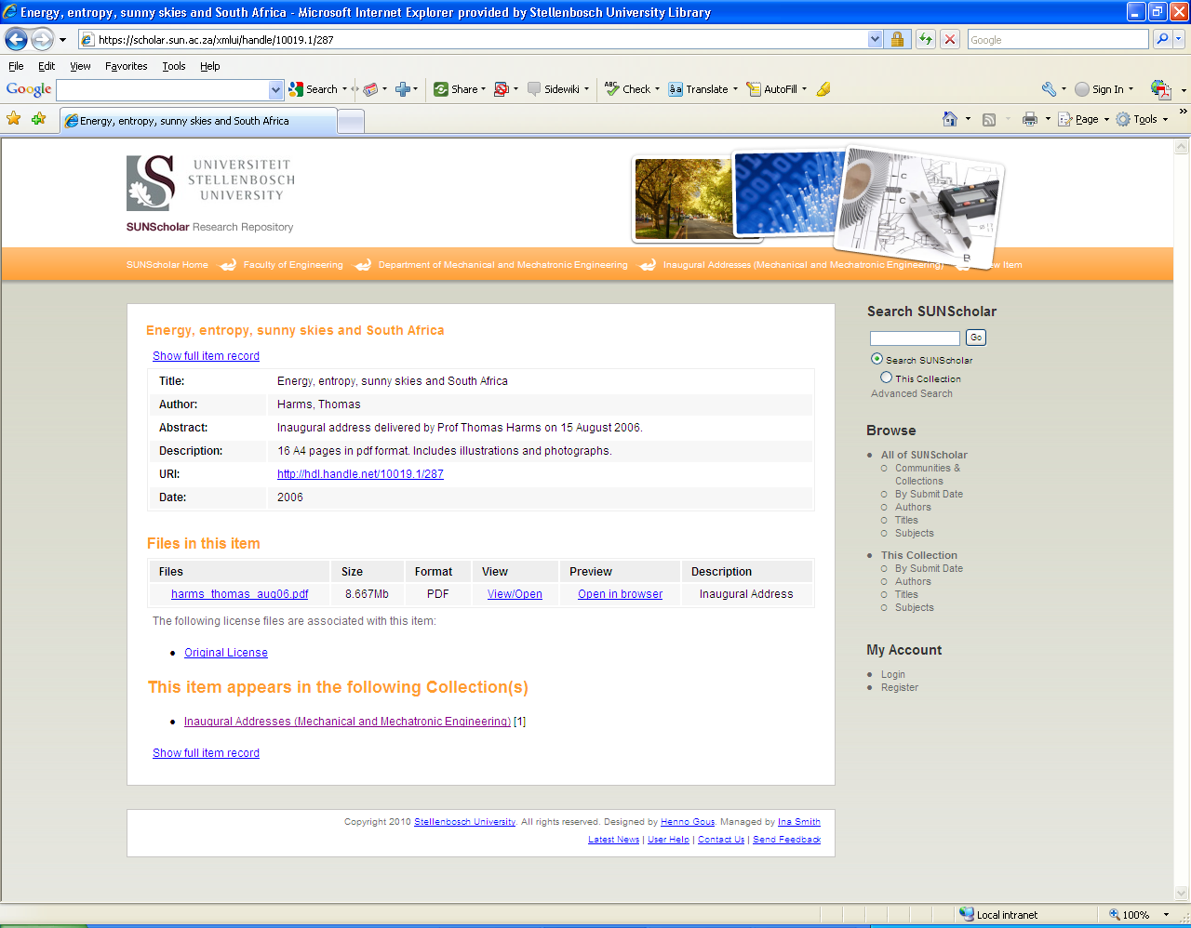
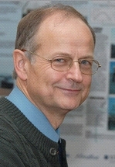

Slide 29
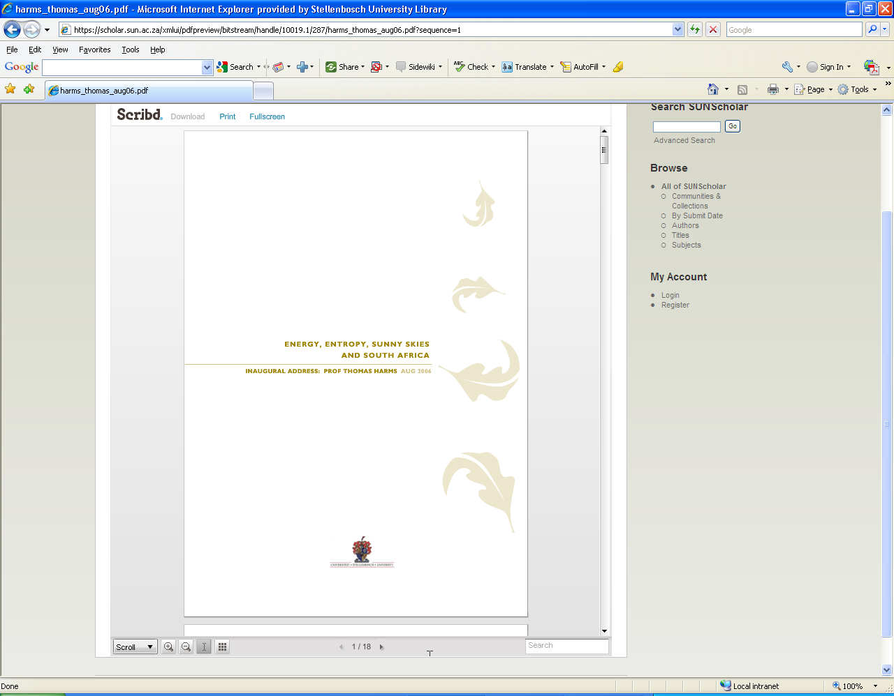
Document Streaming Module
Also: Audiovisual Streaming Module,
Image Zoom Module
Enables in-browser viewing of document files for a wide variety of document formats

Slide 30
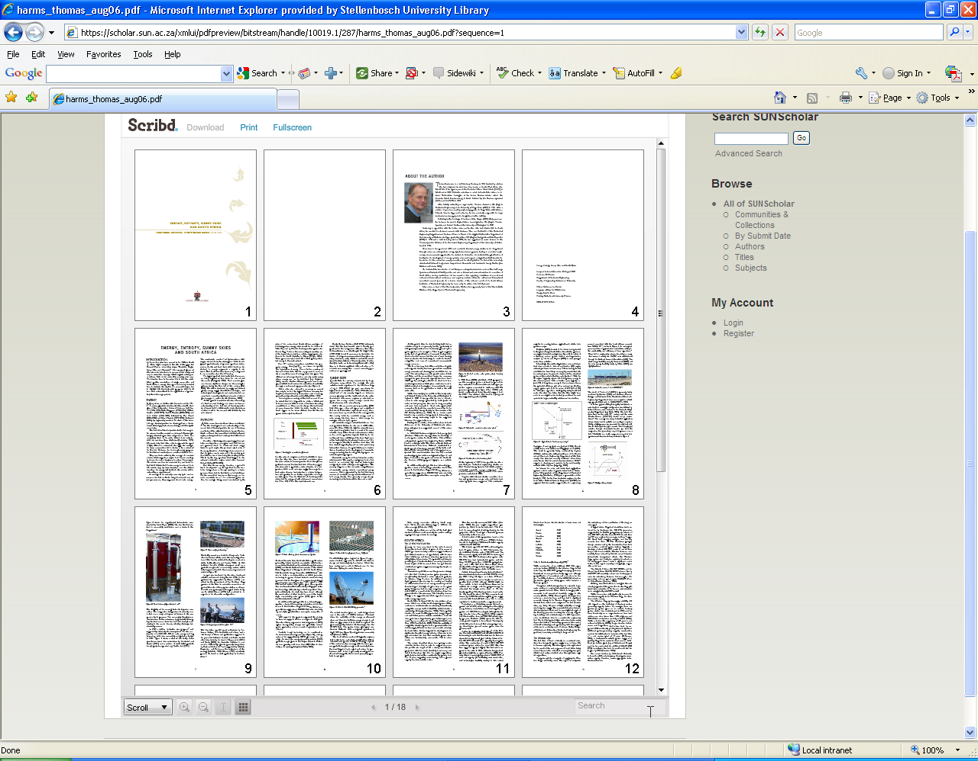

Slide 31
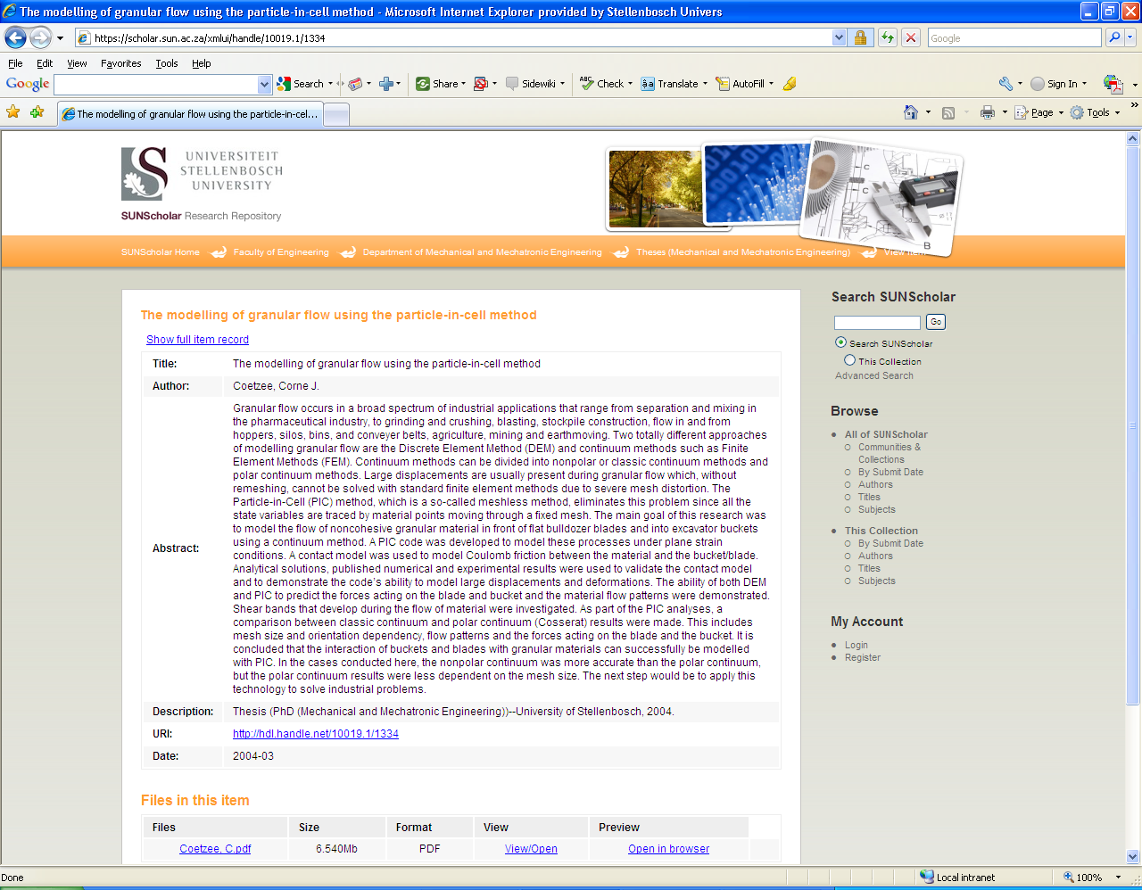
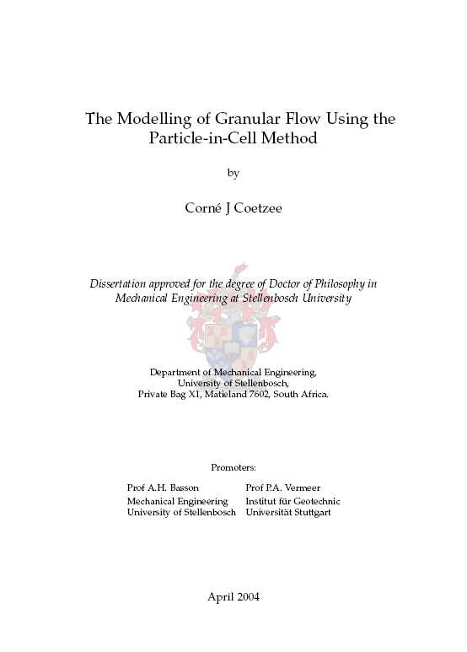

Slide 32
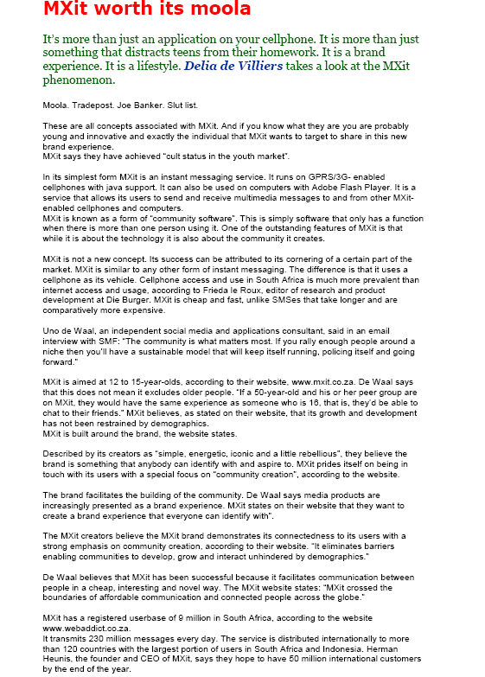
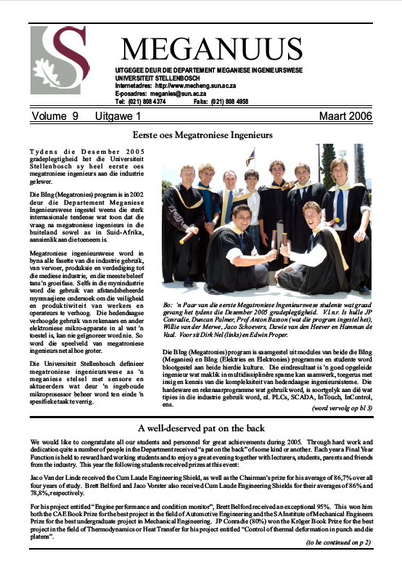
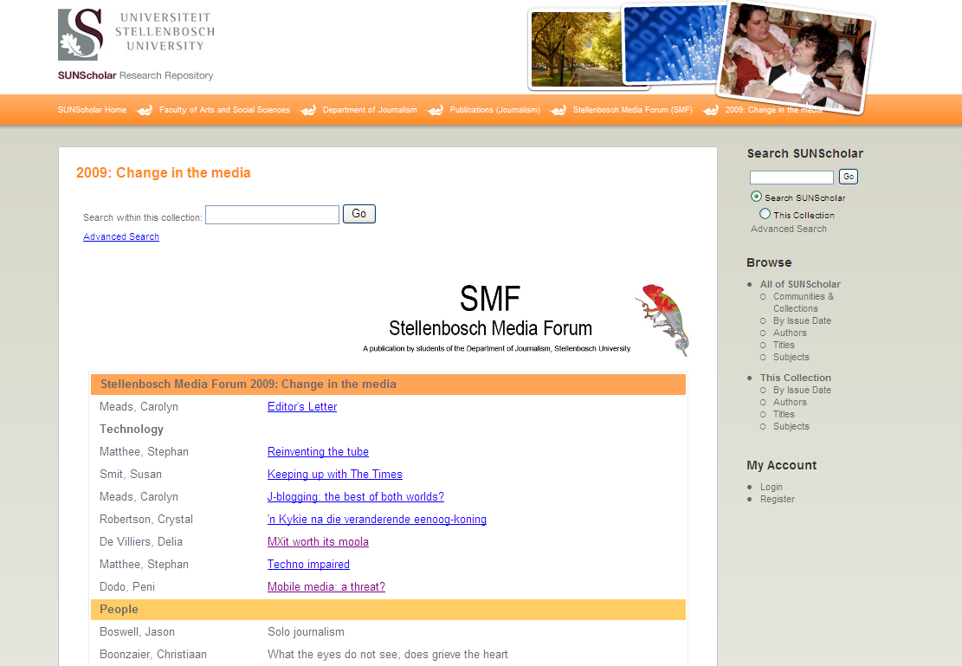

Slide 33

Research Articles
Images
Learning Objects
Technical Reports
Working Papers
E-mails
Web-pages
Conferences
Sound clips
Video clips
Books
Chapters from books
Conference proceedings
Data sets
Anything in digital format …

Slide 34
Benefits for Researchers
Research preserved – even after you have left US
Attracts researchers from other disciplines
May lead to better funding opportunities
Encourage dialogue between researchers
Presents complete research profile
Others can build on your research
Easier to detect plagiarism

Slide 35
Verify discoveries, discard ones that could not be replicated, avoid duplication of effort, integrate various lines of research (David 1998)
Research will be out in the open much sooner
Scholars worldwide read the latest research and enter the global economic conversation

Slide 36
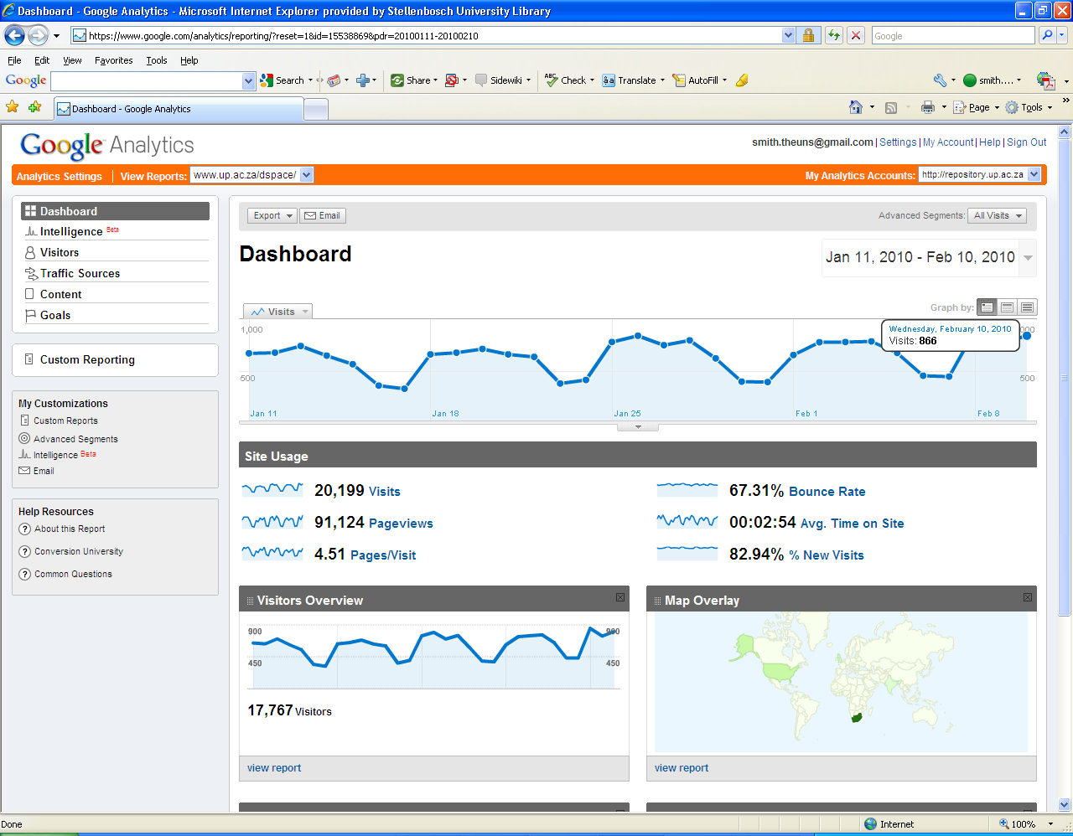
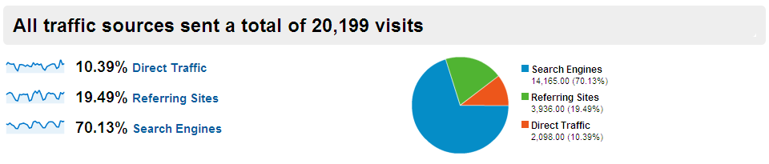
Vastly increases visibility, usage, impact of your research

Slide 37
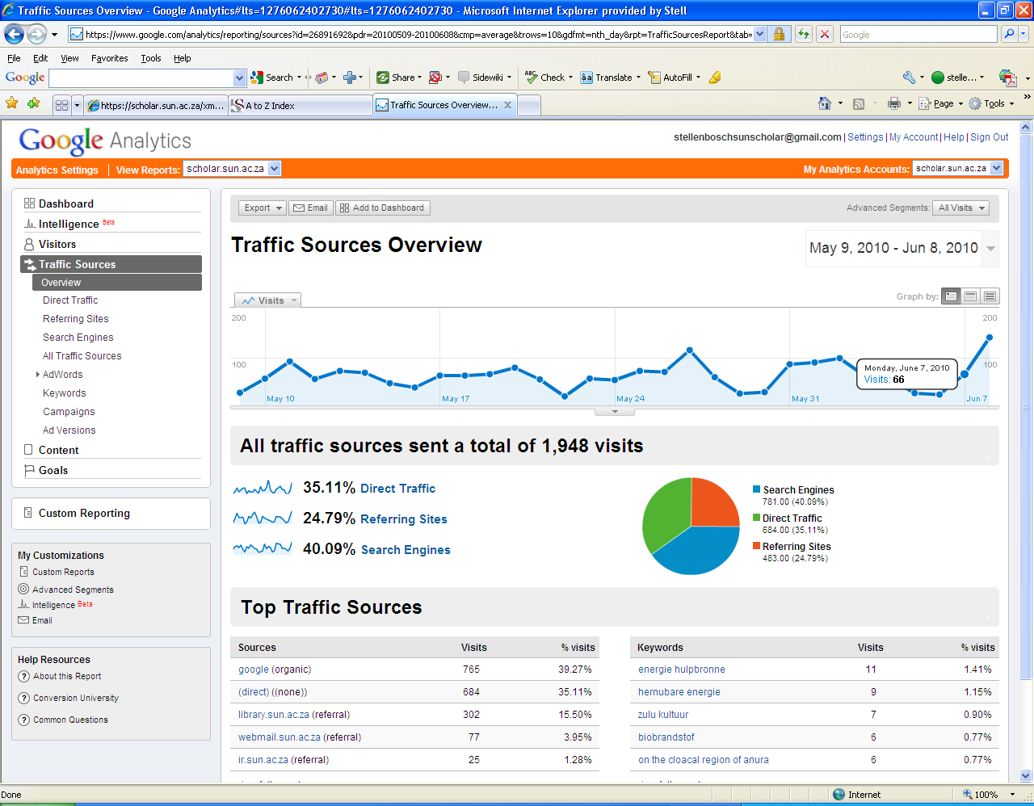

Slide 38
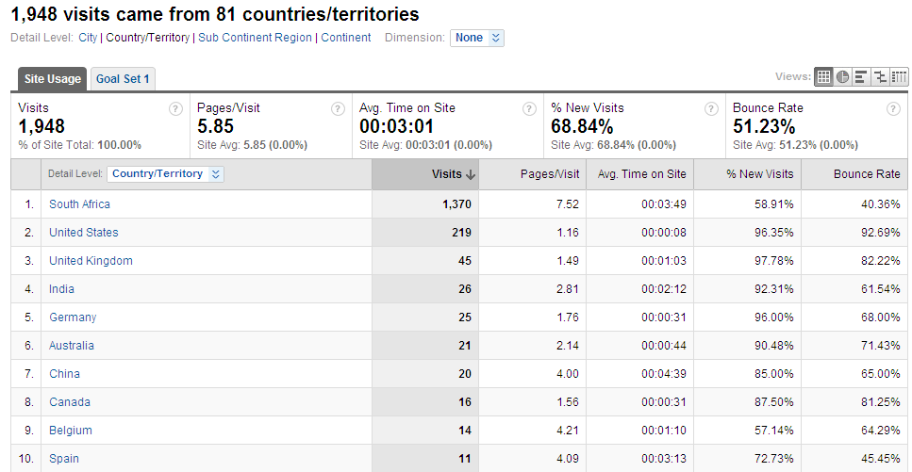

Slide 39
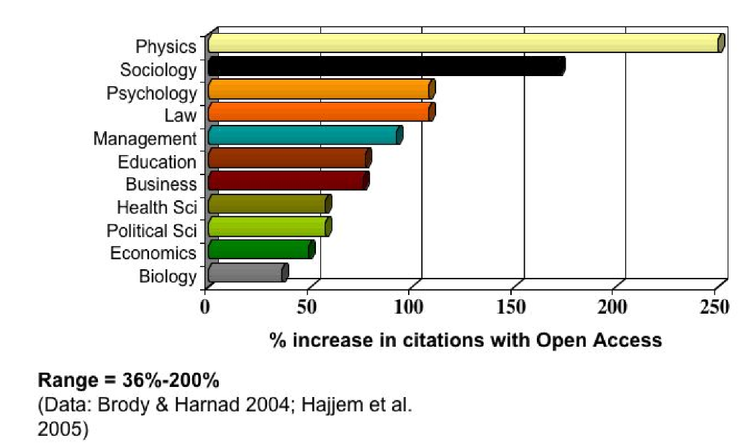
Open Access Increases Citations

Slide 40
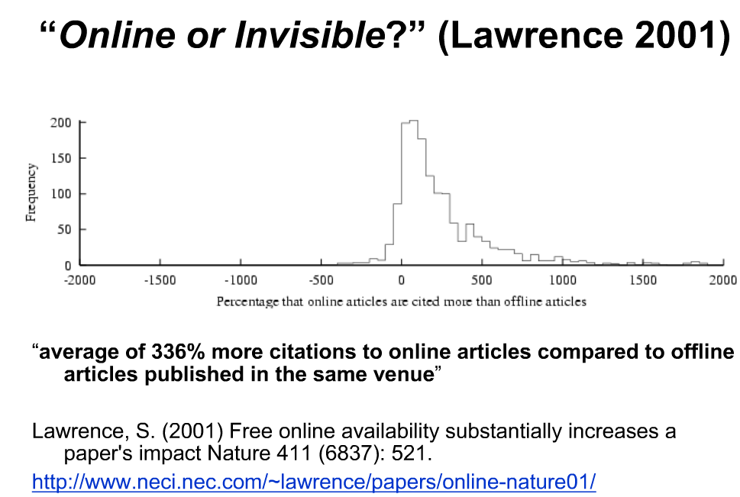

Slide 41

(Harnad, S 2009, ‘Mandates and metrics: how open repositories enable universities to manage, measure, and maximise their research assets)

Slide 42
Benefits for the Stellenbosch University
Central archive/digital library of all SU research – most important asset
Preserve all research for years to come
Persistent URL’s
All items – incl. full text pdf – fully searchable
Require uploading on IR at no extra expense
Increase research profile of SU even more
Increase ranking on international lists of top universities

Slide 43
Our Commitment
Negotiate for and provide server space
Management on technical & operational level
Maintain SUNScholar for the long term
Add value (library cataloguers)
Training & Support
Marketing
Advise on digital matters etc.
Conduct surveys & research – state-of-the-art repository
Register SUNScholar with other search engines & harvesters

Slide 44











International Harvesters & Registries
Currently negotiated

Slide 45
Become part of SUNScholar ….
Join our mailing list – e-mail: ismith@sun.ac.za
Attend training sessions
Collect full text of all research output
Future: obtain permission for 2nd copy on IR
Copyright clearance
Digitize if needed
Register as a Submitter
Submit in pdf
Start populating Collections on SUNScholar!

Slide 46

“The job of research is only half‐done if the results of that research cannot reach the widest audience.”
‐ Wellcome Trust ‐
SUNScholar: https://scholar.sun.ac.za
Contact Us: scholar@sun.ac.za
More info: http://wiki.lib.sun.ac.za/index.php/SUNScholar

Slide 47
Acknowledgement images
http://www.vcu.edu/cte/programs/small_grants/2005/robot.jpg
http://www.davisvibration.com/images/mechanical_engineering_placeholder-2a.jpg
http://www.ghsteched.com/MechanicalEngineering.jpg
http://mech-eng.curtin.edu.au/staff/lindsay/teaching_interests/pneumatichand/pneumatic_hand.jpg

