Slide 1

Access to information has no boundaries
Stellenbosch University engaging Open Access to information
Ina Smith
Open Access Africa 10-11 November 2010
Kenyatta University, Nairobi, Kenya

Slide 2
Agenda
Strategic Objectives
Institutional Repositories
SUNScholar
BioMed Central and SUNScholar
Open Access Awareness
Conclusion

Slide 3
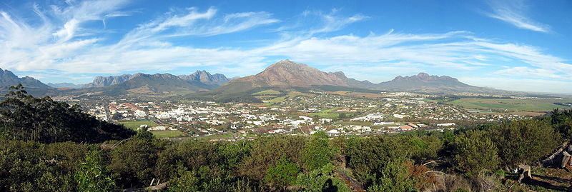
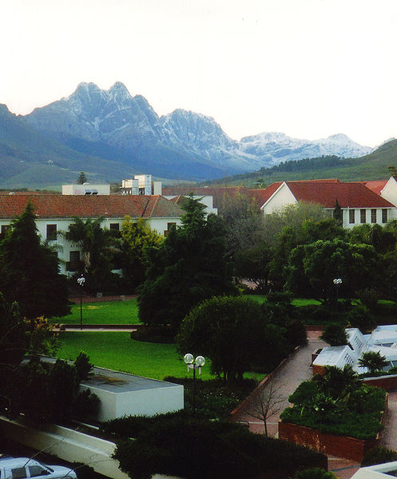
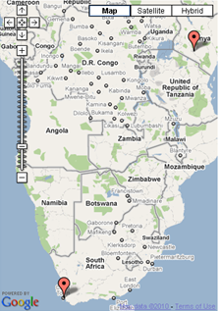
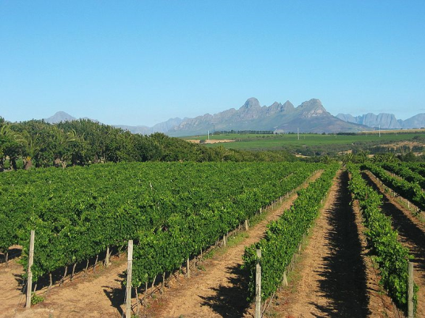
Town in Stellenbosch, Western Cape
Centre of SA Wine industry
24 000+ students
800 lecturers
50 research bodies
10 faculties
Library is notable for being subterranean

Slide 4
The HOPE Project
Long-term strategic plan
Responsibilities as a University (Botman 2010)
  Moral
  Historical
  Embrace challenges of 21st century, new generations, new ways of learning, new opportunities for research, harnessing emerging technologies
Various projects incl. institutional repository (SUNScholar)

Slide 5
Leave a scientific footprint in Africa
High-level scholarly publication output, sharing data and results
Central Open Access fund
eRepository Research System
African Conference on Open Access and Scholarly Communication
Notes:
Strategic objectives
Strategic objective of Vice Rector Research
Leave a scientific footprint in Africa
Action plans associated with this strategic objective
􀂾Supporting, developing and contributing to high-level scholarly
publication output and sharing research data and results with the rest
of the world, especially with researchers from the developing world
􀂾Establishing a Central Open Access fund to support and facilitate the
University’s Open Access mandate
􀂾Establishing an e-Repository Research system (for primary data,
research output, Open Access publication based content, digitized special
collections, and rich media content types) to ingest, preserve and
disseminate the intellectual output of the institution
􀂾Organising an African Conference on Open Access and Scholarly
Communication
The University has positioned itself as a builder of hope by aligning its core activities with the following development themes from the international Millennium Development Goals:
Eradicating poverty and related condition
Promoting human dignity and health
Promoting democracy and human rights
Promoting peace and security
Promoting a sustainable environment and a competitive industry

Slide 6
Institutional Repository (Green)
Set of services
Management & dissemination of digital materials
Organizational commitment
Stewardship
Long-term preservation
Organization
Open access/ distribution
(Lynch 2003)
Notes:
Comments by Lor (2007)
Aptly describes the path followed by academic and
research institutions in developing repositories.
States that:
an old tradition, a new technology and a new role have
converged to make possible an unprecedented public
good. The old tradition is the willingness of scientists
and scholars to publish their research in scholarly
journals without payment, for the sake of inquiry and
knowledge. The new technology is the internet. And, the
new role is that of the librarian as the publisher of the
scholarly information for public good.

Slide 7
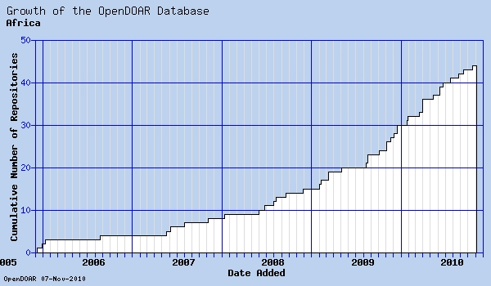
Growth in Africa
http://www.opendoar.org/onechart.php?cID=Africa&ctID=&rtID=&clID=&lID=&potID=&rSoftWareName=&search=&groupby=r.rDateAdded&orderby=&charttype=growth&width=600&height=350&caption=Growth%20of%20the%20OpenDOAR%20Database%20-%20Africa

Slide 8
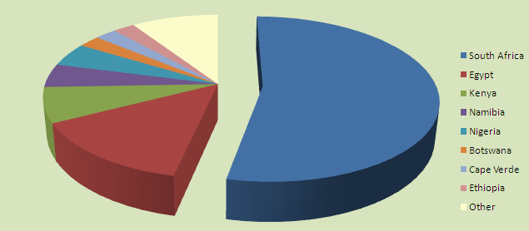
Distribution in Africa (44)
Internationally = 1 705+
24
http://www.opendoar.org/onechart.php?cID=Africa&ctID=&rtID=&clID=&lID=&potID=&rSoftWareName=&search=&groupby=c.cCountry&orderby=Tally%20DESC&charttype=pie&width=600&height=300&caption=Proportion%20of%20Repositories%20by%20Country%20-%20Africa
Notes:
Implementation of strategy
􀂾Growth of the repository into SUNScholar
􀂾Exploitation of technology
􀂾Cataloguers creating expert metadata
􀂾Use of cell phone technology and satellite television
technology
􀂾BioMed Central
􀂾Berlin 10 Conference

Slide 9
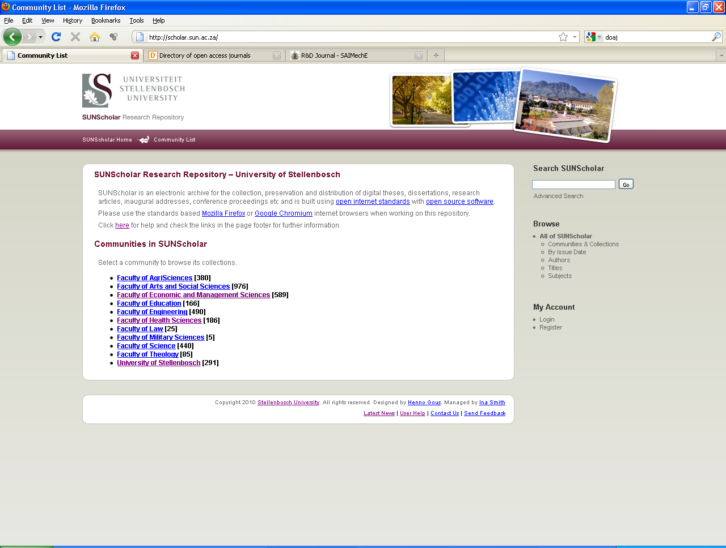
SUNScholar
http://scholar.sun.ac.za
3 602 items
Notes:
Strategic objective of library: Support, develop and contribute to high-level scholarly publication output
Full text central digital research repository of the University of Stellenbosch Dspace open source software 907 instances
Provide open access where possible
Digitally preserve research output

Slide 10
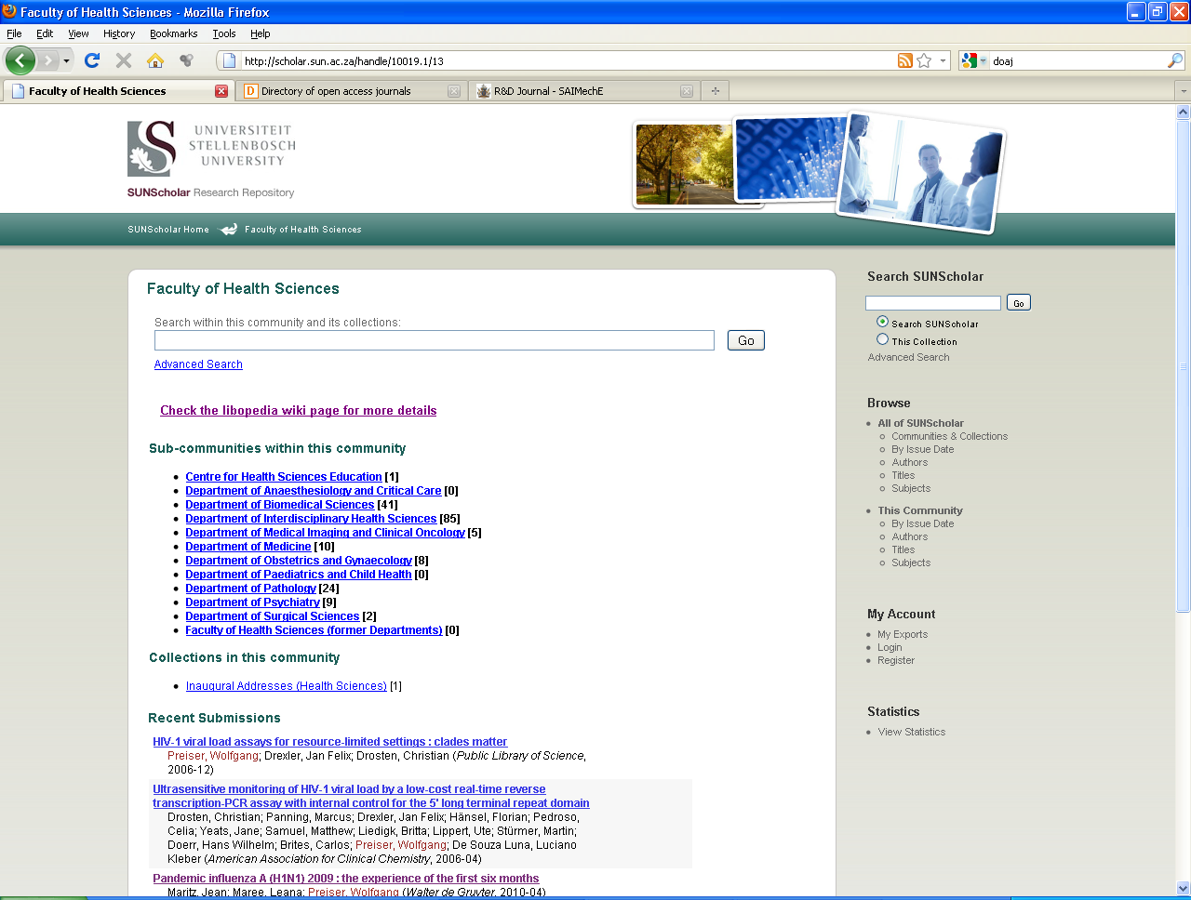

Slide 11
SUNScholar
2008: SUNeTD (2 300 items)
Dec. 2009: SUNScholar Office
2010 (3 600 items):
  Merging repositories
  Structure
  Metadata
  Workflows
  Roles & responsibilities
  Marketing
  Training
  Upgrade to 1.6.2
  Manakin interface
  Plug-in’s

Slide 12
Items on SUNScholar
Primary:
  Research Articles, Chapters in Books, Books, Conference Proceedings, Theses, Dissertations
Secondary:
  Inaugural Addresses, Conference Presentations & Posters, Images, Audio- & Audiovisual Clips, Seminars/Open Lectures, Conferences, Experiments, Data sets, and many more!

Slide 13
Workflow: Theses
Portal
Nominated
ETD Loader
Submit
Portal
Accept
SUNScholar
Reviewed
Metadata edited
Made available

Slide 14
Workflow: Articles
Submitter
Submitter submits
Reviewer
Clear copyright
Basic metadata editing
Metadata Editor
Edits metadata
Commits to archive

Slide 15
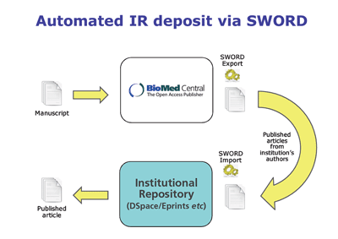
BioMed Article Deposit
http://www.biomedcentral.com/info/libraries/sword
Notes:
BioMed Central is committed to providing immediate and barrier-free access to all the research they publish. We work with many institutes around the world that advocate open access to their intellectual output and help them to make the most of an integrated OA policy, involving both open access publishing and policies encouraging or mandating open access deposit.
Repositories are now rapidly gaining pace as institutes start to feel the benefits that they bring, although many organizations find populating their repositories a challenge. BioMed Central's Automated Article-Deposit helps institutes populate their repositories remotely with the SWORD (Simple Web-service Offering Repository Deposit) protocol.
What is SWORD?
The SWORD vision is 'lowering the barriers to deposit'. BioMed Central's Automated Article-Deposit is a standard protocol for transferring complete article content (including PDFs, additional files, and article metadata) from one repository to another.
How does BioMed Central's Automated Article-Deposit work?
As soon as the official final version of an article is published in a BioMed Central journal, we will automatically populate the author's institutional repository with the published article. (Articles are transferred on a nightly basis.)
Automated Article-Deposit feeds are offered as standard, at no additional charge to:
BioMed Central Members
Open Repository Enhanced Customers
Automated Article-Deposit feeds are also available as a separately-chargeable service to non-Members - please contact our institutional sales team for more information.
Effortless ~ Reliable ~ Flexible ~ Cost-effective
Open Repository is available in two editions, Standard and Enhanced, offering different levels of service depending on the needs of your organisation.
Standard:
Complete set-up within 3 months
Standards-based Open Source technology platform: DSpace
Nightly back-up of all data files
Technical support
Training materials for users and administrators
Content is organised in a hierarchical manner
Multiple ways to browse and search the content
All data entries can use the full uniform character set
Any file format can be submitted
Interface customization options
RSS feeds and email alerts for new submissions
Enhanced:
The Enhanced edition includes all of the above Standard features plus:
Batch uploading of content to pre-populate repository for customers
Automatic conversion of proprietary file formats to PDF and other formats, e.g. html
Institutional authentication integration
Datafeeds to automatically populate repository with new open access articles' metadata from your organization

Slide 16
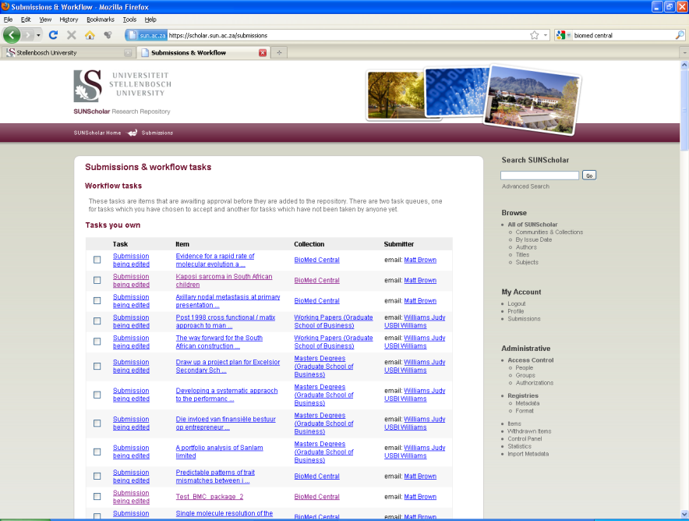
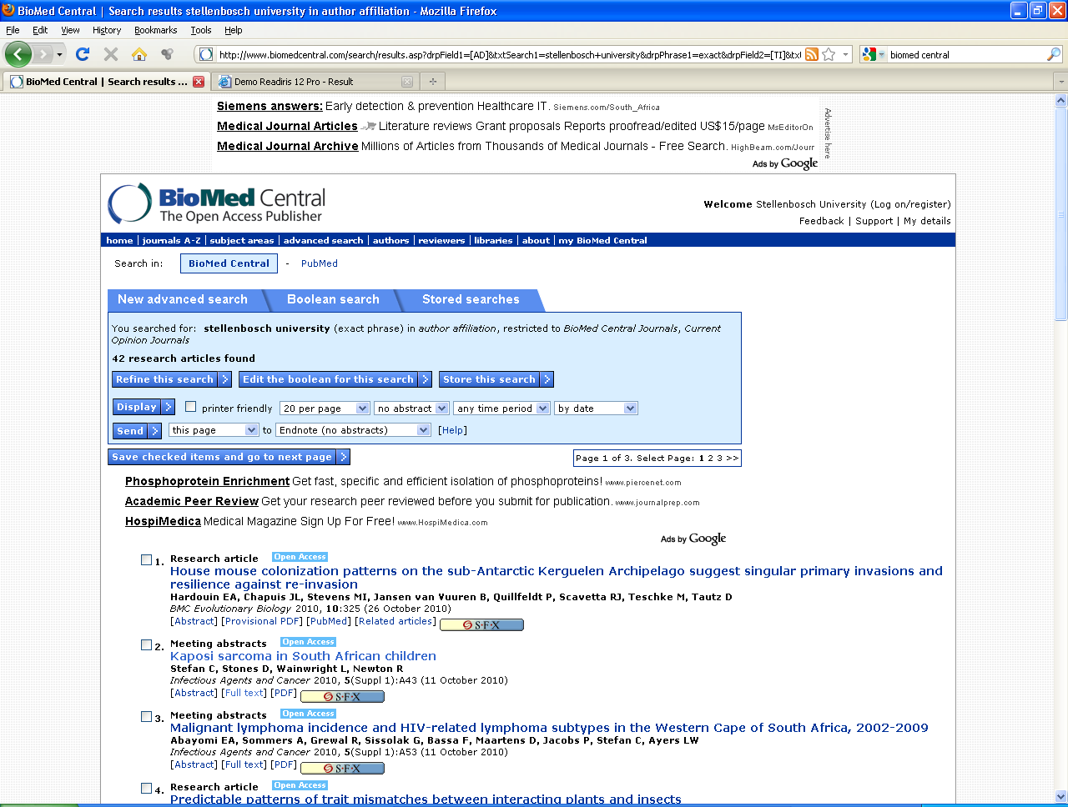
Notes:
That sounds correct – you should also have received another dozen or so articles this afternoon. I’m glad the deliveries are coming through fine, I will continue to trawl our historical archive for Stellenbosch authored articles until I have reached year zero! Will let you know once the whole process is complete.
Automated delivery will now be up and running, so the next time an article by one of your researchers is published with us, you will receive it automatically.
Our database will have recorded successful delivery for the articles we have previously reported as being delivered, but following a clean up of that data I will also be able to arrange delivery of historical articles that have been published with us.
I’ll speak to our developers tomorrow and see when we can arrange it.

Slide 17
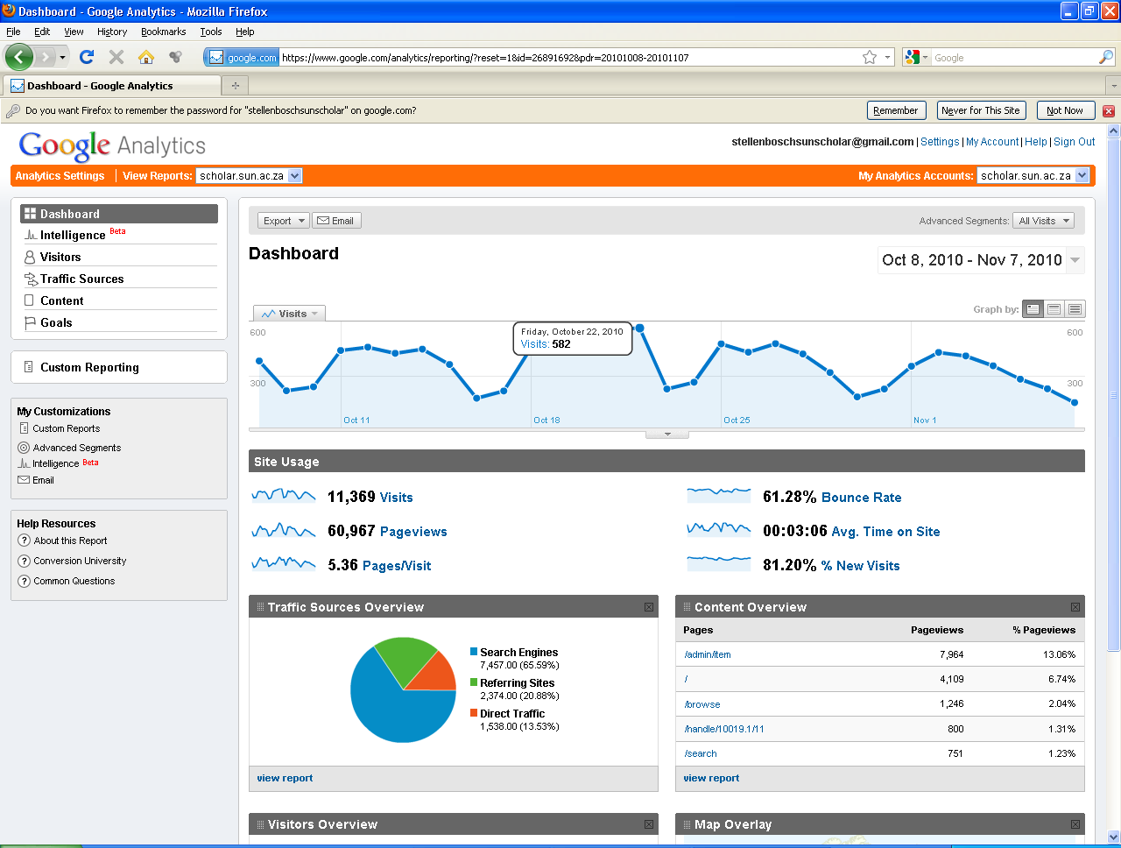
Notes:
“Thank you very much for staging this great event. I watched the whole session and think it can be a best practice for other organizations contemplating signing the Berlin Declaration. Thanks again to you and all who helped organizing this event!” – Christoph Bruch, Head of Open Access, Max Planck Digital Library (MPDL) (Berlin)
“Congratulations on all the achievements and excellent presentation of the event.” – Rima Kupryte, Director: eIFL.net (25/10/2010)
“Congratulations to Stellenbosch University for signing the The Berlin Declaration on Open Access to Knowledge in the Sciences and Humanities.” – Prof Pierre de Villiers, AOSIS (22/10/2010)
“Good News for world research and open source accessible﻿ education which must be use to implement activities to improve comprehensive community and social progressive advancement in the spirit of﻿ ubuntu.” – Khuluma, YouTube
“Finally! We are heading in the right direction:) This is a huge milestone for the continent . I expect the transaction cost of acquiring information to be reduced significantly. Shuttleworth for Ministry of﻿ Science and Technology. Forget Ms﻿ Pandor! The future is right here. Now:).” – daHumbleOne, YouTube
“Open strategy steers profound collaborations in the research sciences through information technology for﻿ future institutional and﻿ communities progressive social advancement via both Open Access and Open Source.” – mandysauls1, YouTube
“What an excellent idea. Sharing information, whether on a small project with colleagues or on a massive scale such as this, is a vital requirement for success for both the individual/organization sharing and the whole team. For SU to be adopting this great trait, greater success is headed their way and more and more collaborative opportunities will be created to better the country, the continent and the world as a whole. Well done SU!” – Masike Malatji
“This is a big step for South Africa and Maties are leading the way in this regard.” – David Duarte (social media expert for the show), Good Hope FM
Jane H Smith & Peter Millington, SHERPA Services, Centre for Research Communications, University of Nottingham:
“We just received this praise for your repository.”
“Just a heartfelt word of thanks for this product. In local government you have to share knowledge and continuously search for best practise and insight that can better service delivery. Access to SUNScholar is one of the best things to happen in this respect. Thank you.” - A. Vorster

Slide 18
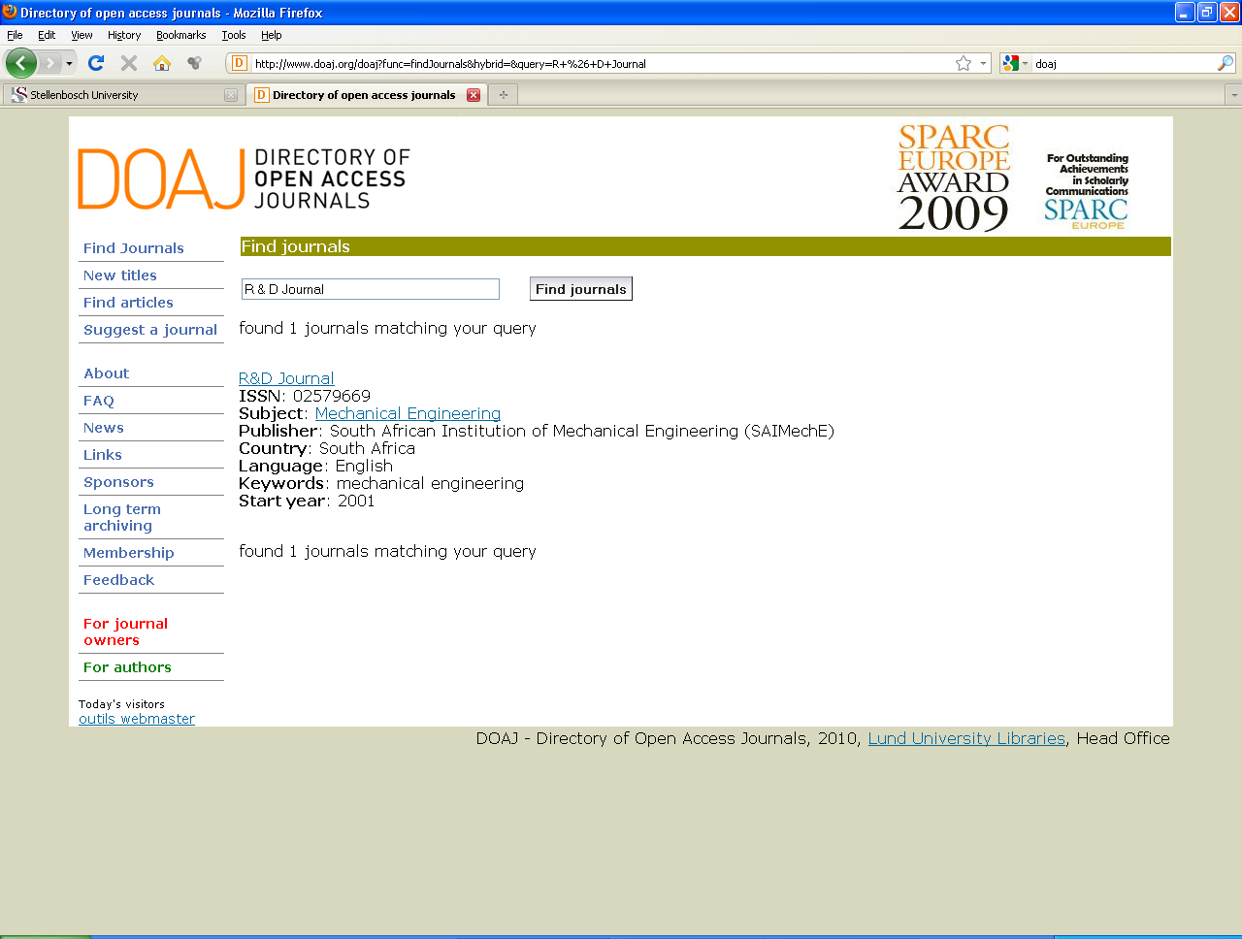
Open Access Journals (Gold)

Slide 19

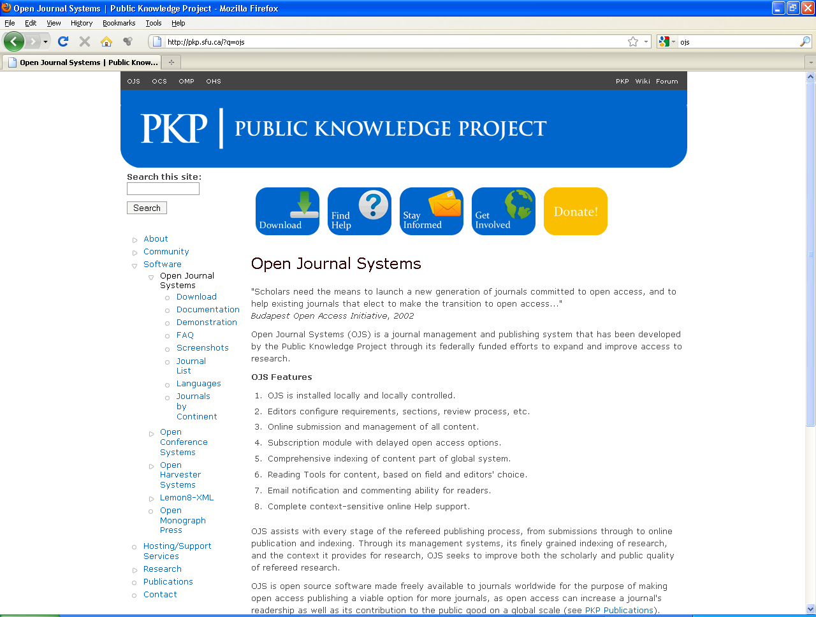
Increase impact factor

Slide 20
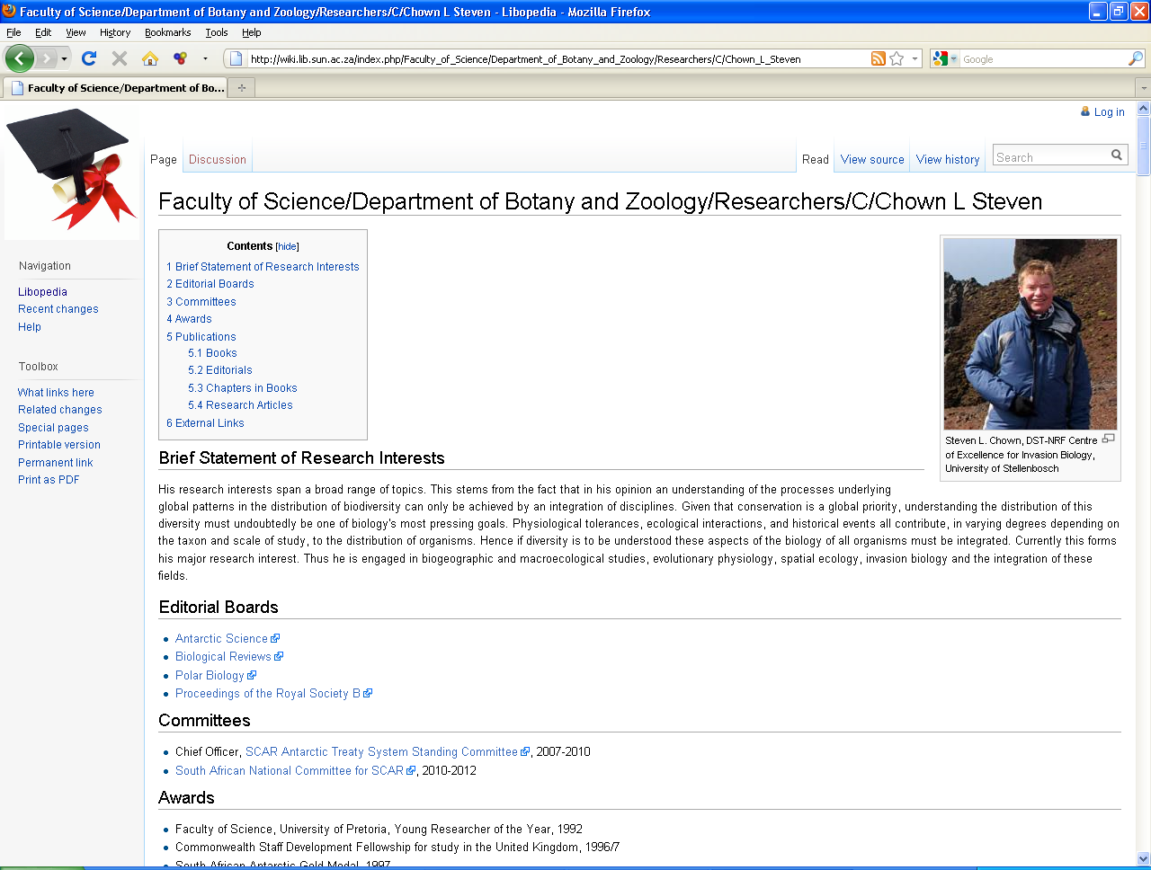

Slide 21
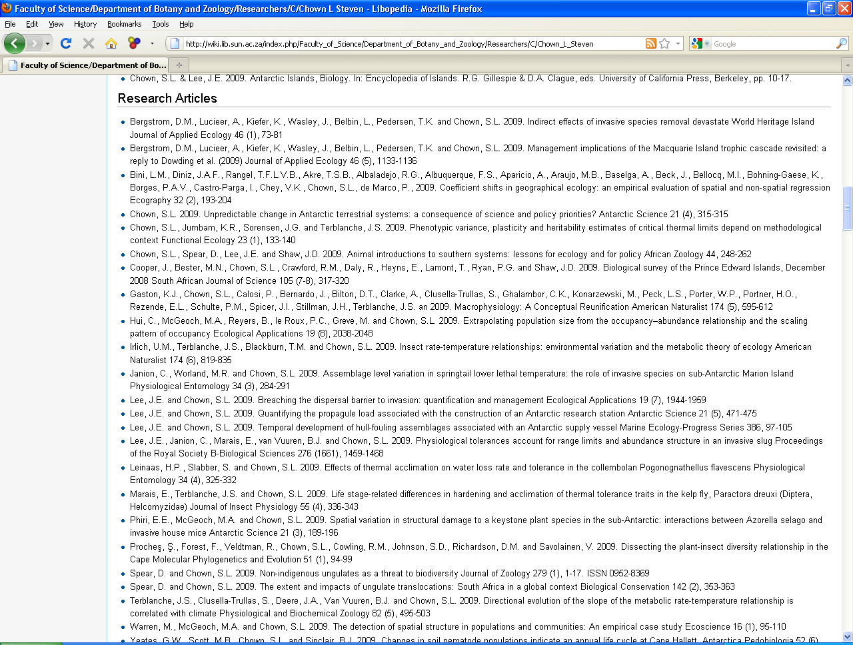
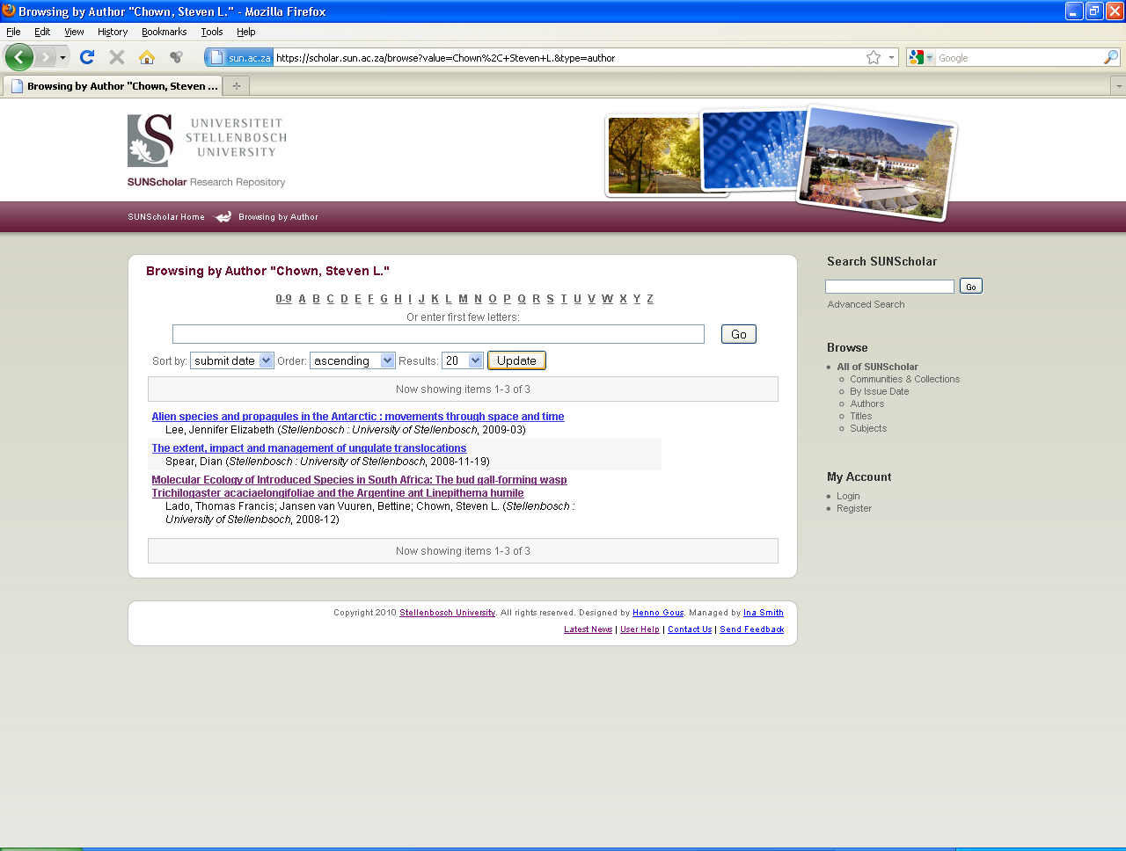

Slide 22
Creating an OA awareness
2nd copy of article on SUNScholar
Publish in OA journals
Alternative ways of licensing
SPARC Addendum, The Scholar’s Copyright Addendum Engine
Workshops (for editors, DSpace)
Pool of expertise re Open Source
Open Access Initiatives e.g. OA Week – OA Seminar http://oa.sun.ac.za
Explored new technologies – ways to share and communicate research
Notes:
“Thank you very much for staging this great event. I watched the whole session and think it can be a best practice for other organizations contemplating signing the Berlin Declaration. Thanks again to you and all who helped organizing this event!” – Christoph Bruch, Head of Open Access, Max Planck Digital Library (MPDL) (Berlin)
“Congratulations on all the achievements and excellent presentation of the event.” – Rima Kupryte, Director: eIFL.net (25/10/2010)
“Congratulations to Stellenbosch University for signing the The Berlin Declaration on Open Access to Knowledge in the Sciences and Humanities.” – Prof Pierre de Villiers, AOSIS (22/10/2010)
“Good News for world research and open source accessible﻿ education which must be use to implement activities to improve comprehensive community and social progressive advancement in the spirit of﻿ ubuntu.” – Khuluma, YouTube
“Finally! We are heading in the right direction:) This is a huge milestone for the continent . I expect the transaction cost of acquiring information to be reduced significantly. Shuttleworth for Ministry of﻿ Science and Technology. Forget Ms﻿ Pandor! The future is right here. Now:).” – daHumbleOne, YouTube
“Open strategy steers profound collaborations in the research sciences through information technology for﻿ future institutional and﻿ communities progressive social advancement via both Open Access and Open Source.” – mandysauls1, YouTube
“What an excellent idea. Sharing information, whether on a small project with colleagues or on a massive scale such as this, is a vital requirement for success for both the individual/organization sharing and the whole team. For SU to be adopting this great trait, greater success is headed their way and more and more collaborative opportunities will be created to better the country, the continent and the world as a whole. Well done SU!” – Masike Malatji
“This is a big step for South Africa and Maties are leading the way in this regard.” – David Duarte (social media expert for the show), Good Hope FM
Jane H Smith & Peter Millington, SHERPA Services, Centre for Research Communications, University of Nottingham:
“We just received this praise for your repository.”
“Just a heartfelt word of thanks for this product. In local government you have to share knowledge and continuously search for best practise and insight that can better service delivery. Access to SUNScholar is one of the best things to happen in this respect. Thank you.” - A. Vorster

Slide 23
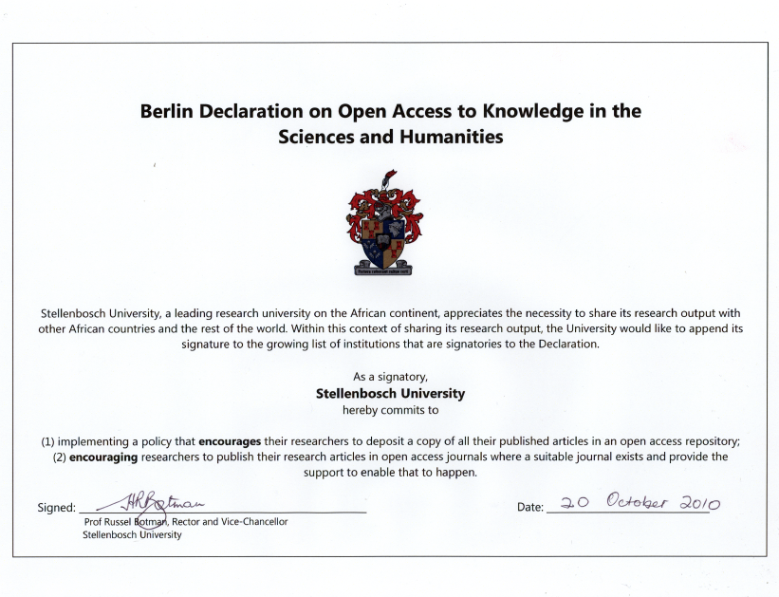
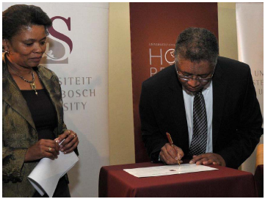

Slide 24
“The fewer people know about your research, the less it is worth. We’d like to think that the best ideas win, but the truth is that the best communicated ideas win. An author put it very clearly to me. He said: ‘My greatest fear is not piracy; the stealing of my content. My greatest risk is obscurity.’ ”
– Mark Shuttleworth, 20 October 2010

Slide 25
Thank you!
ismith@sun.ac.za
Skype: smith.ina
Facebook: usscholar
Twitter: #usscholar

Slide 26
Bibliography
Botman, HR, 2010, Public launch of Stellenbosch University’s Hope Project, http://www.sun.ac.za/university/management/rektor/speeches.html
Lynch, CA, 2003, Institutional Repositories: Essential Infrastructure for Scholarship in the Digital Age, ARL, no. 226 (February 2003): 1-7
Stellenbosch University, 2000, A strategic framework for the turn of the century and beyond, http://www.sun.ac.za/university/StratPlan/index.htm

