Slide 1
Stellenbosch University
Research Material
SUNScholar
Cited more, preserved forever
Ina Smith, Paulette Talliard, Hilton Gibson
Library and Information Service
12 February 2010

Slide 2
SUNScholar – strategic objective of the library
Support, develop and contribute to high-level scholarly publication output
  Establish a Central Open Access fund to support and facilitate the University’s Open Access mandate
  Establish an e-Repository Research system (for primary data, research output, Open Access publication-based content, digitized special collections, and rich media content types) to ingest, preserve and disseminate the intellectual output of the institution
  Develop a digital curation and preservation policy
  (Library & Information Service Strategy 2010)

Slide 3
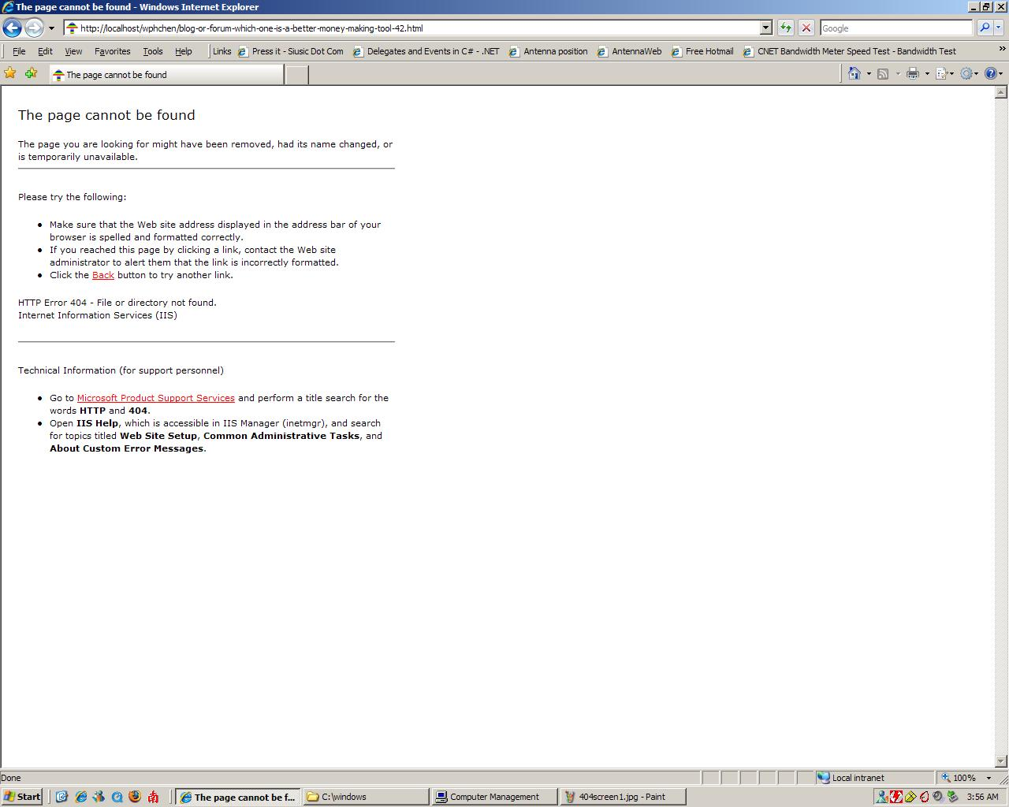
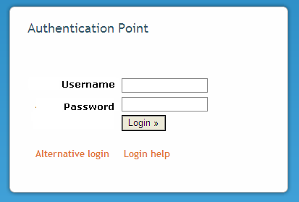
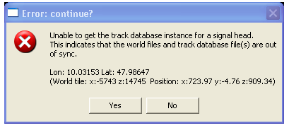

Slide 4
What is Open Access?
Free
Immediate
Permanent
Full text
Online access
(Harnad, S 2009, ‘Mandates and metrics: how open repositories enable universities to manage, measure, and maximise their research assets’)

Slide 5
Why Open Access?
Uptake, usage, applications, impact
Measure and reward (research metrics)
Collect, manage, preserve, showcase
(Harnad, S 2009, ‘Mandates and metrics: how open repositories enable universities to manage, measure, and maximise their research assets)

Slide 6
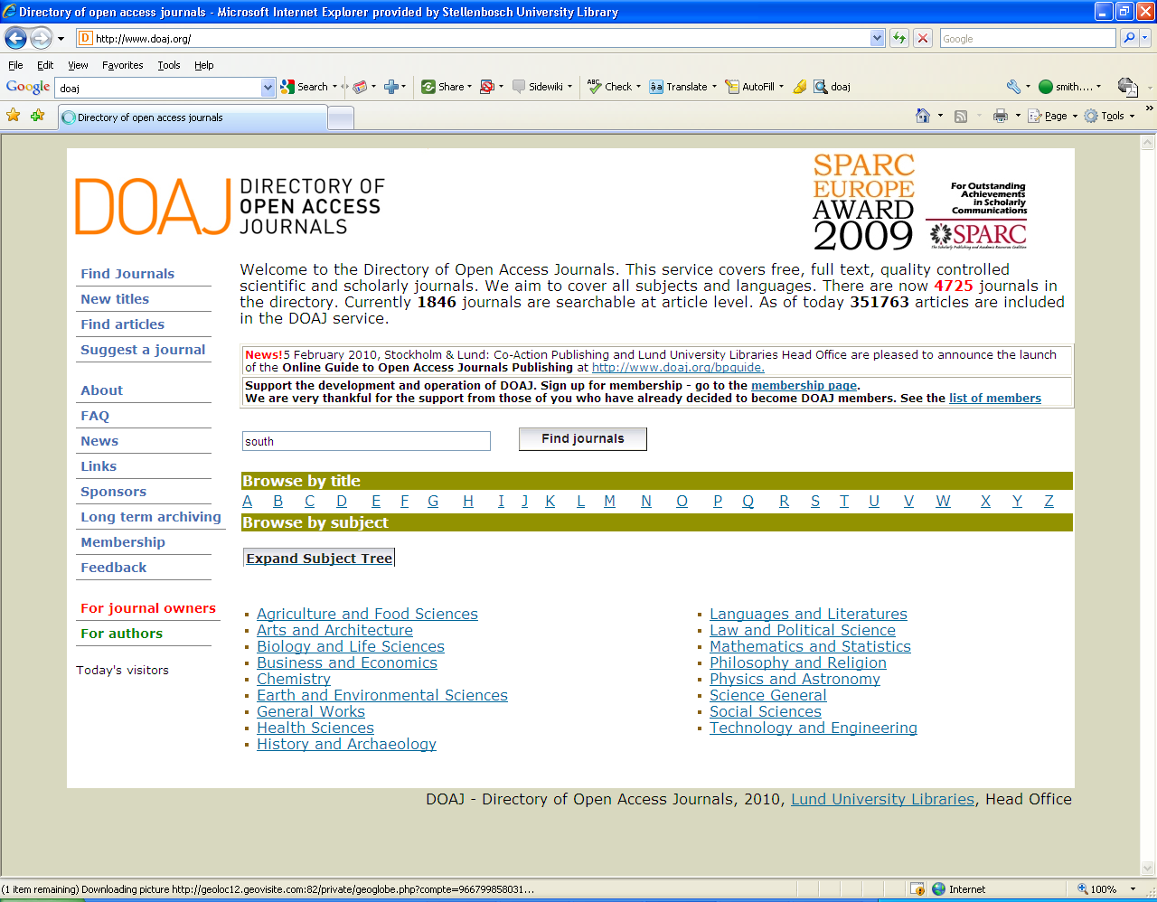
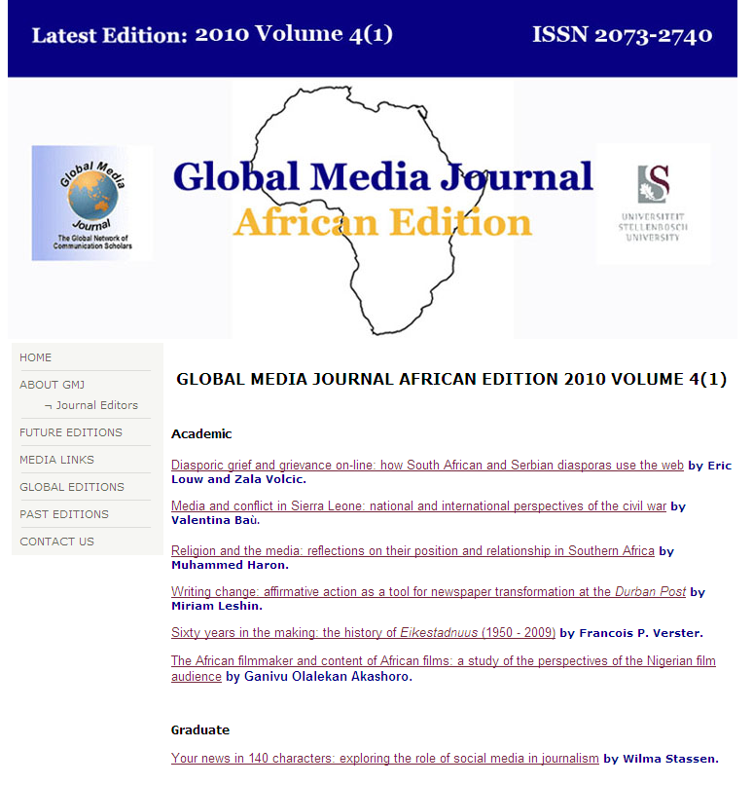
OA Journals (DOAJ) (“gold” route)
OA papers are peer-reviewed; some accredited by DoE
Review quicker
Output not dated to quickly

Slide 7
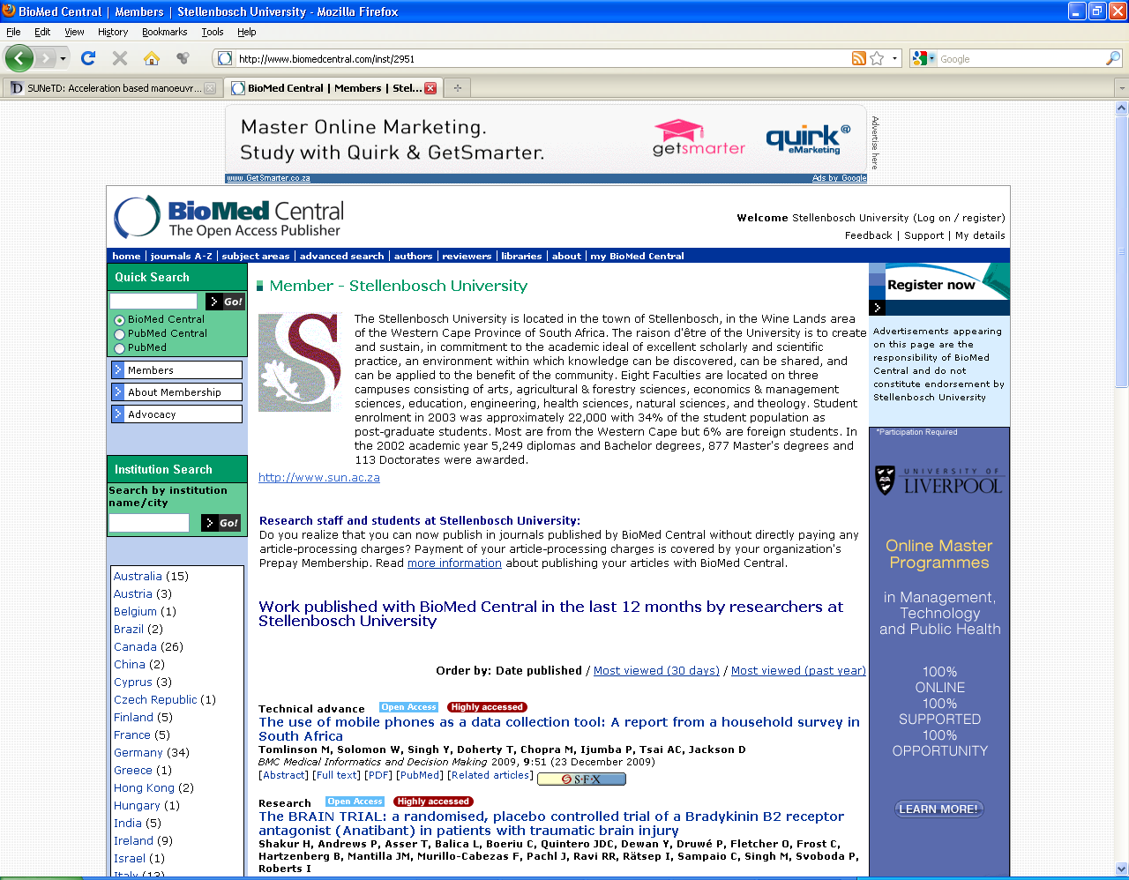

Slide 8
What is SUNScholar? (“green” route)
Set of services
Management & dissemination of digital materials
Organizational commitment
Stewardship
Long-term preservation
Organization
Open access/ distribution
(Clifford A. Lynch, "Institutional Repositories: Essential Infrastructure for Scholarship in the Digital Age" ARL, no. 226 (February 2003): 1-7)

Slide 9
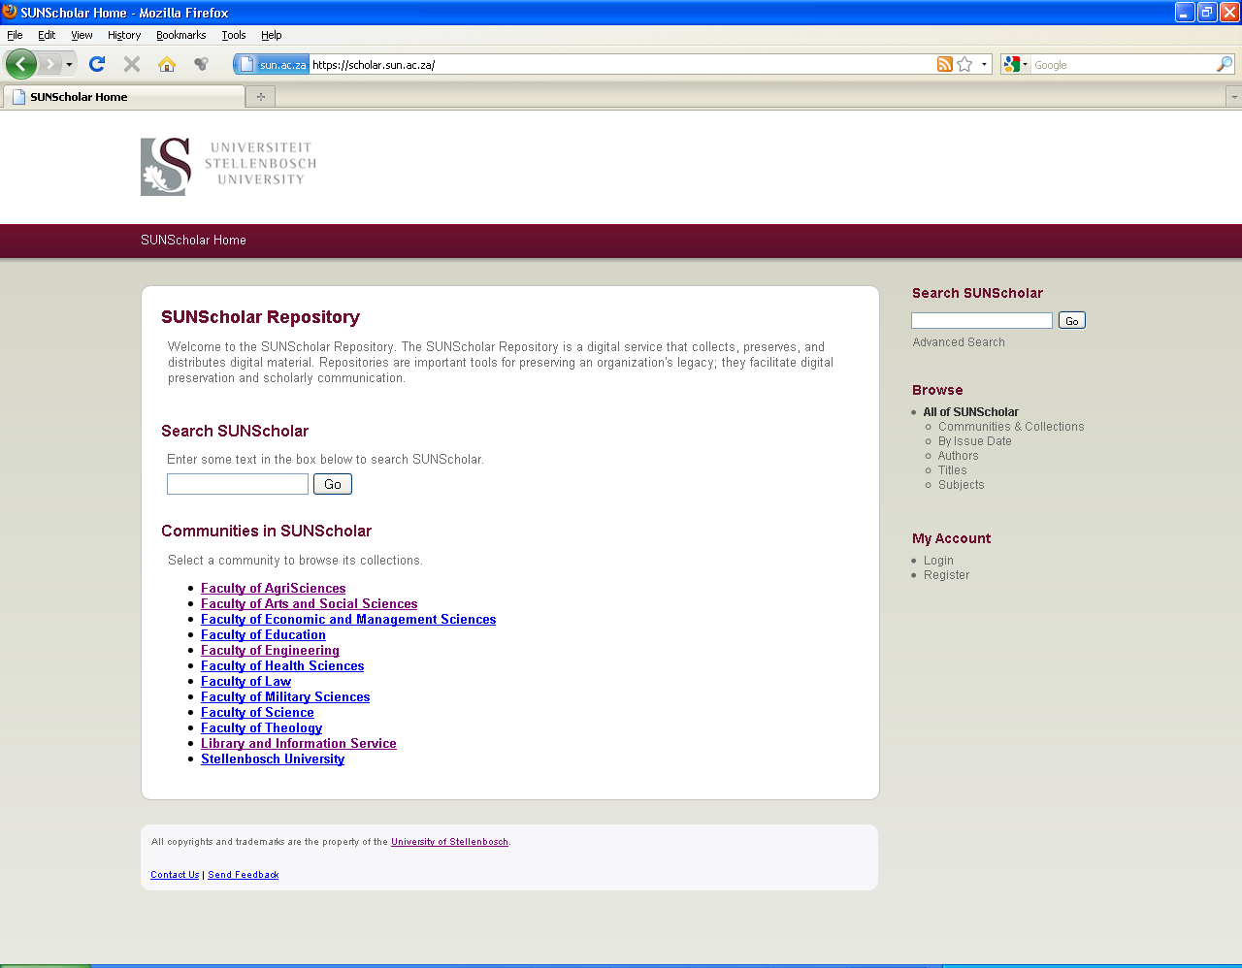
Beta Mode

Slide 10
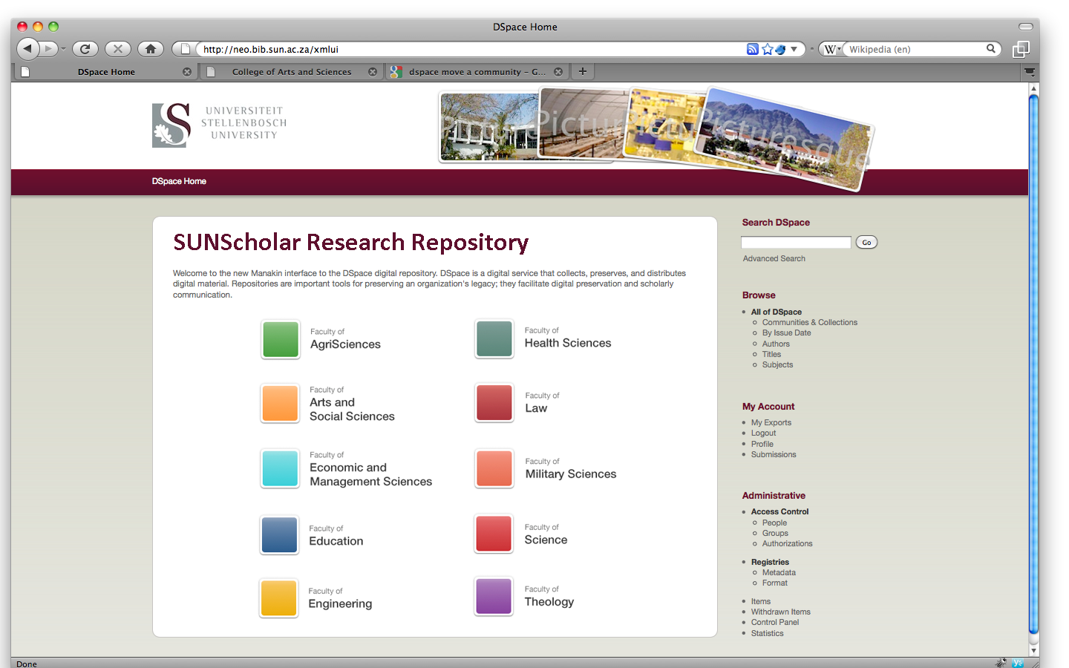

Slide 11
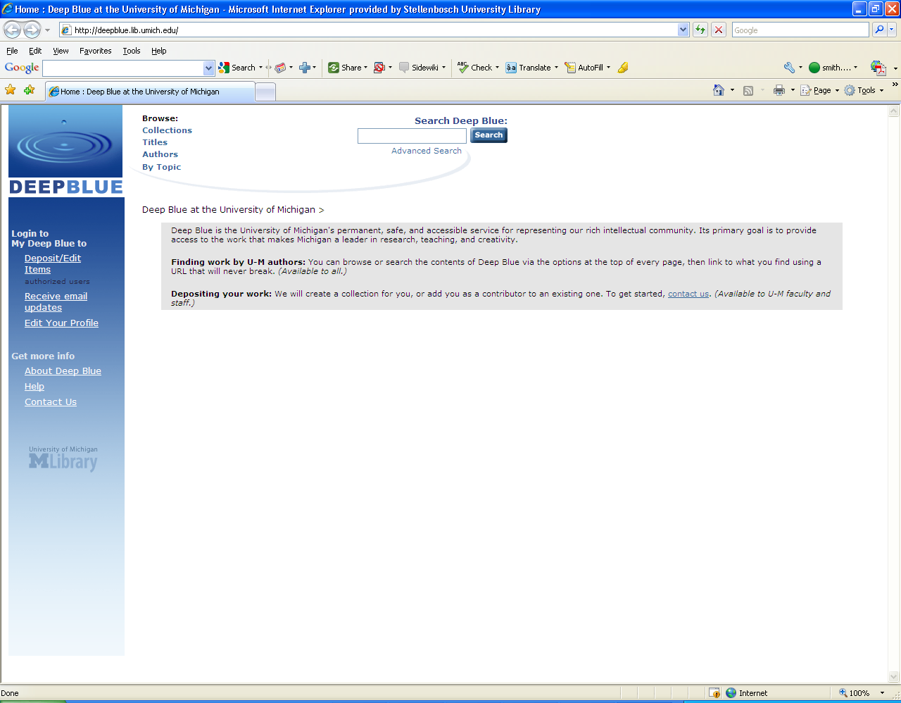
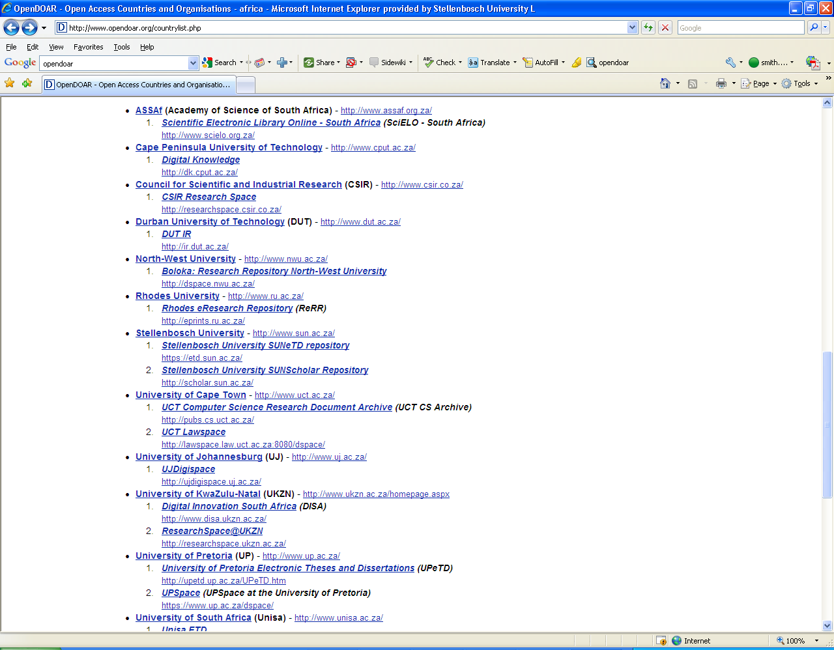
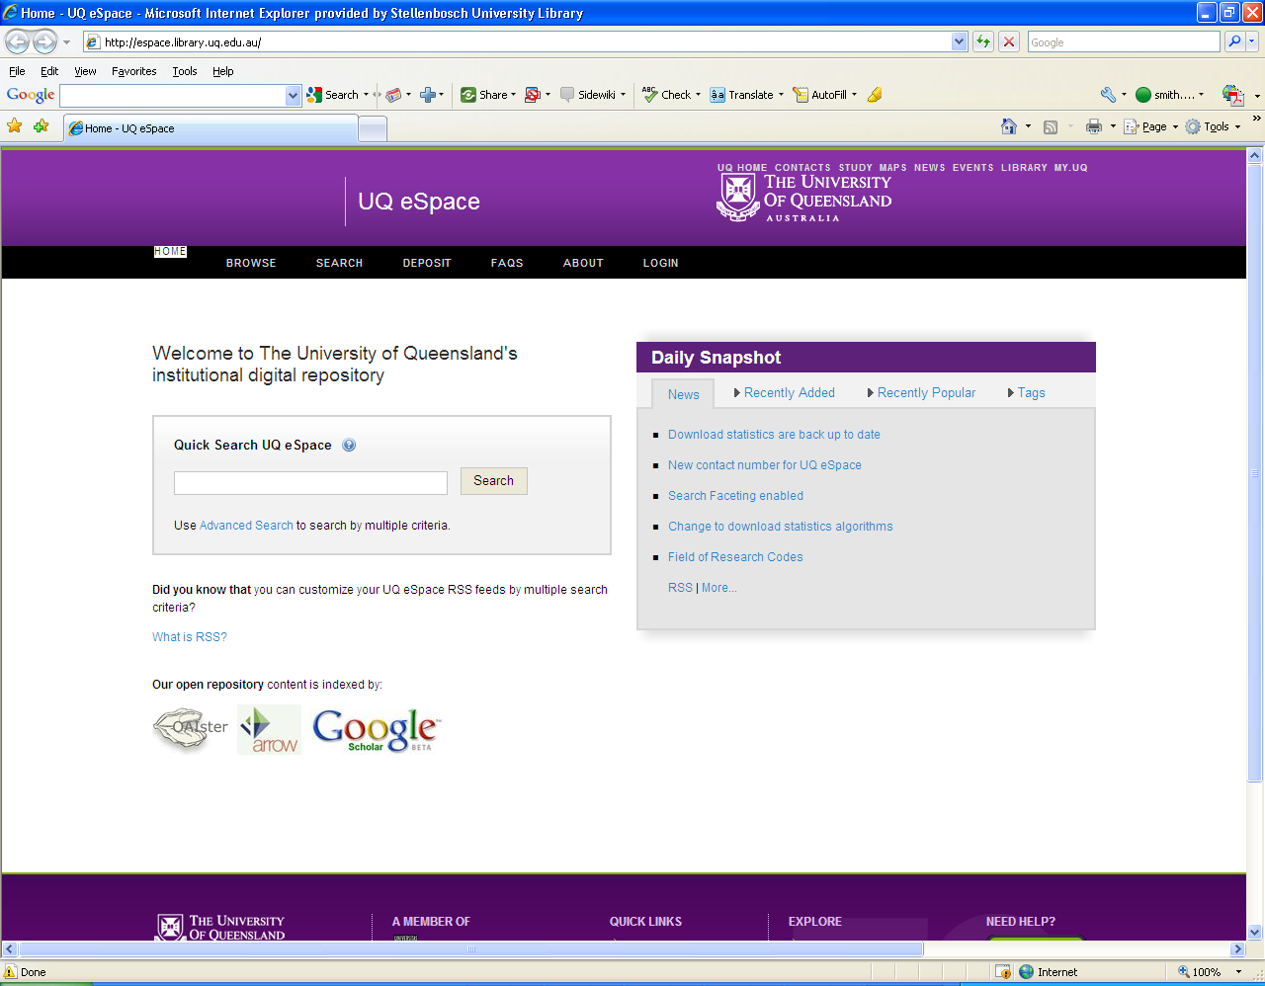
National & International Landscape
Africa (28)
South Africa (23)
1 500+ internationally

Slide 12
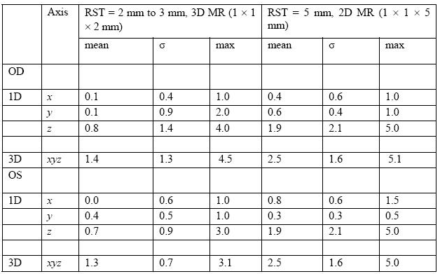
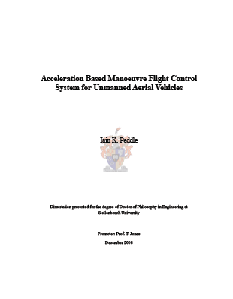
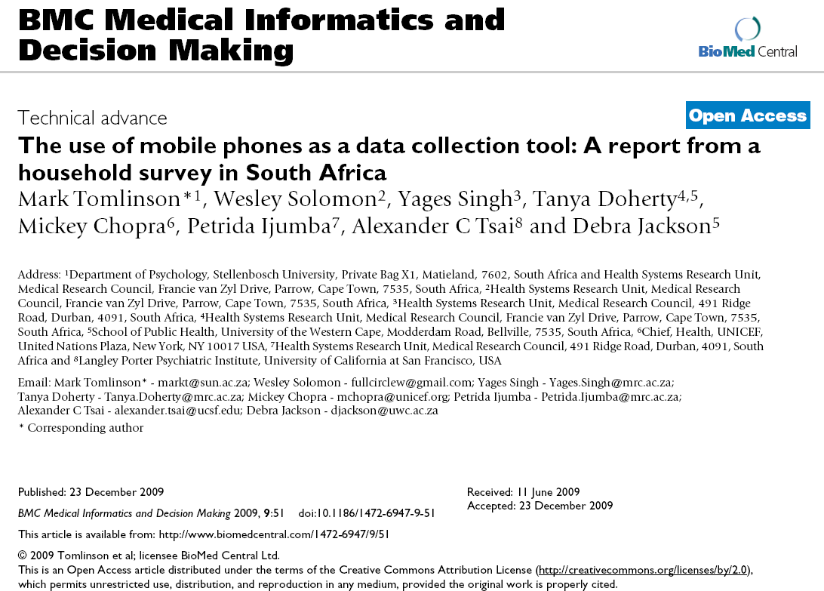

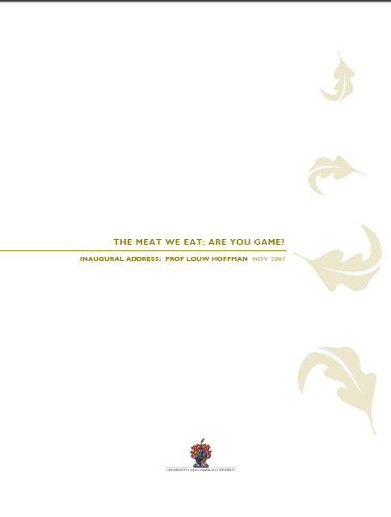


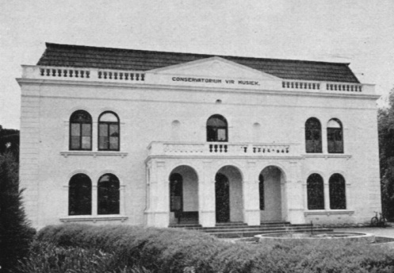
Items in SUNScholar

Slide 13


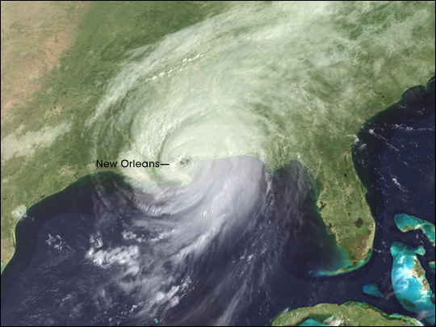
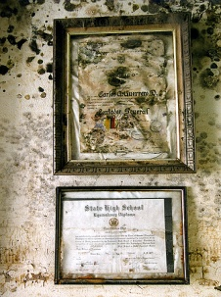
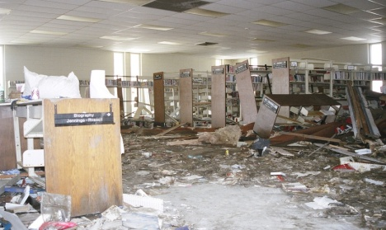
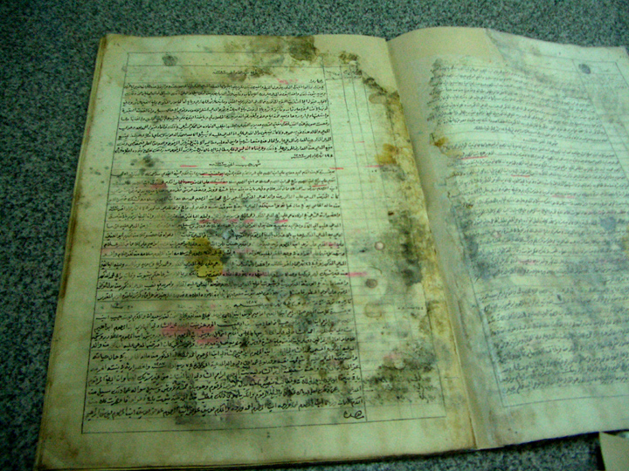
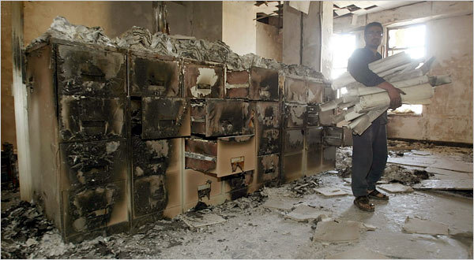
Preserve the priceless & timeless

Slide 14
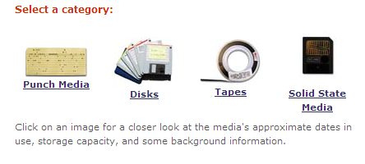
Digital Preservation
Long term maintenance
Continued accessibility
Digitally info – easily lost
Chamber of Horrors ...

Slide 15

Copyright
Permission from copyright owner
Negotiate pro-actively
Research articles:
  SHERPA/ RoMEO
  Publisher’s web sites
  Directly contact copyright owner & negotiate

Slide 16
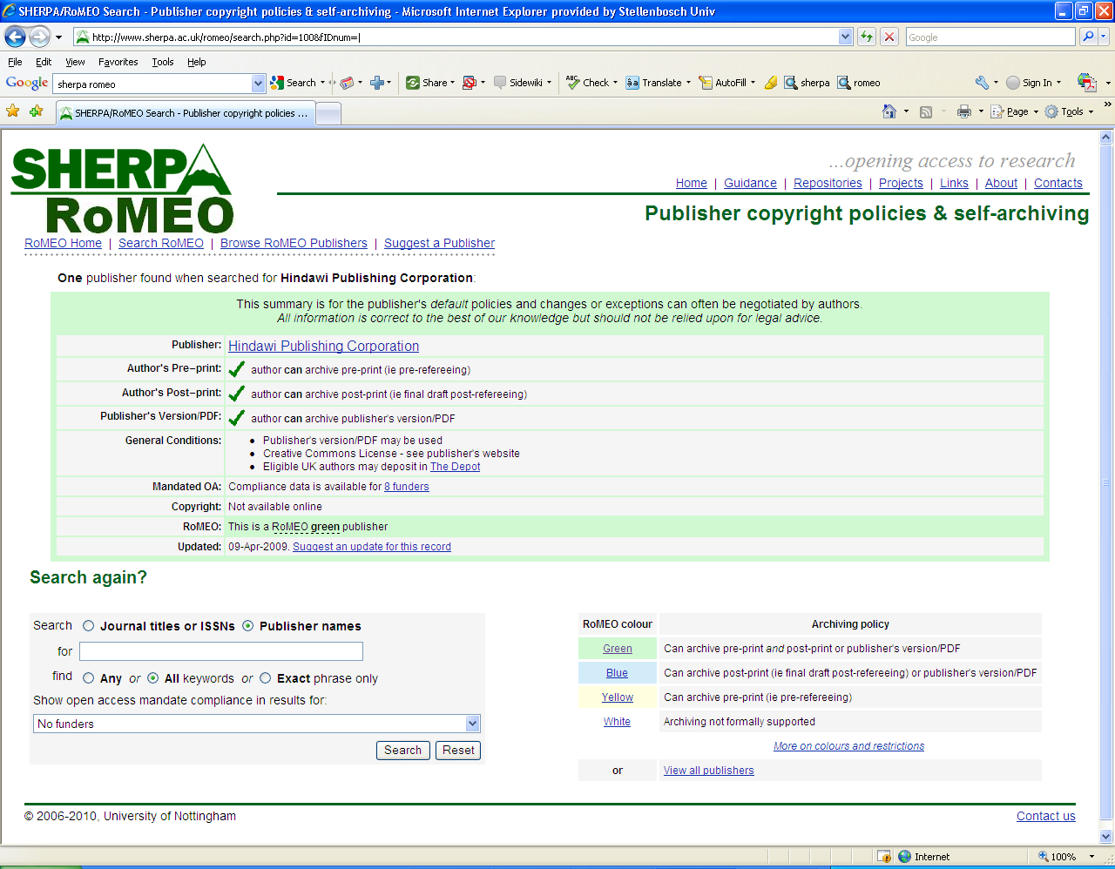

Slide 17
Workflow within SUNScholar
Contact scholar@sun.ac.za for submission rights
Submit item
Reject
Review item
Notification to Submitter & Subscribers
Edit metadata
Available on IR

Slide 18
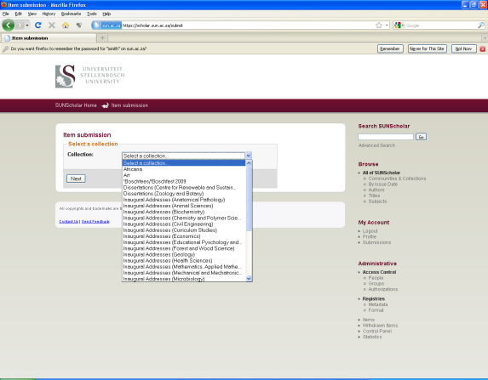
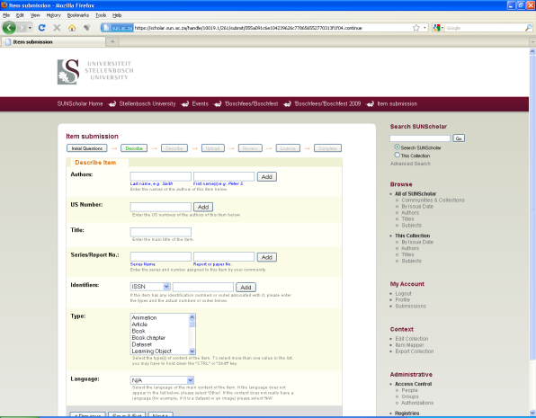
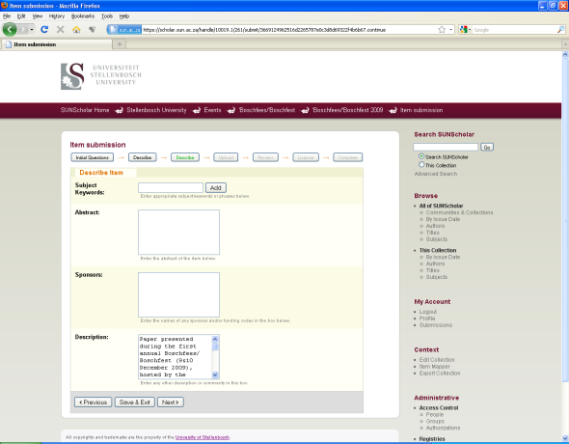
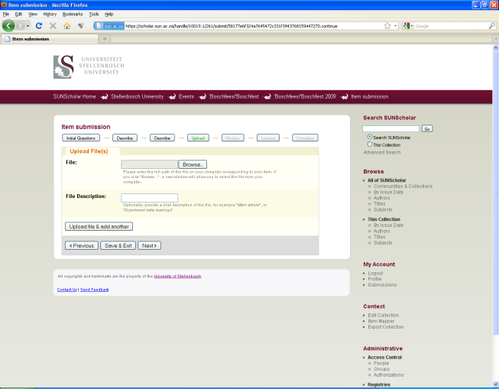
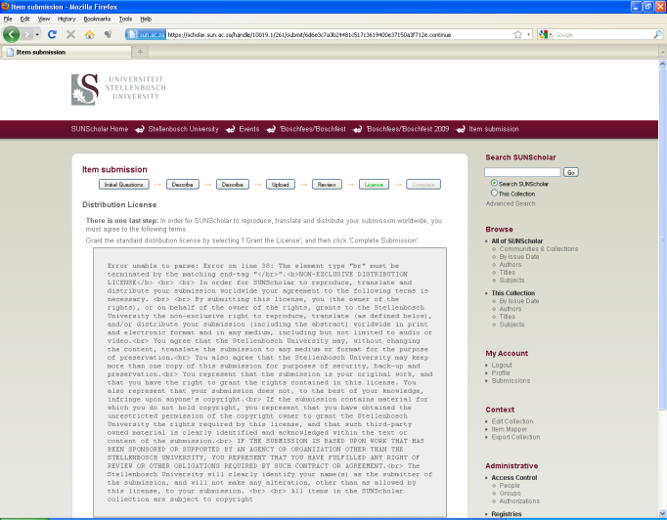
Submission Process
1
2
3
4
5

Slide 19
Benefits for Librarians
Digital collection development
Easy access to research by researchers
Stay current on research conducted by researchers
New skills by becoming part of the workflow
Closer collaboration with researchers

Slide 20
Benefits for Researchers
Research preserved – even after you have left US
Attracts researchers from other disciplines
May lead to better funding opportunities
Encourage dialogue between researchers
Presents complete research profile
Others can build on your research
Easier to detect plagiarism

Slide 21
Verify discoveries, discard ones that could not be replicated, avoid duplication of effort, integrate various lines of research (David 1998)
Research will be out in the open much sooner
Scholars worldwide read the latest research and enter the global economic conversation

Slide 22
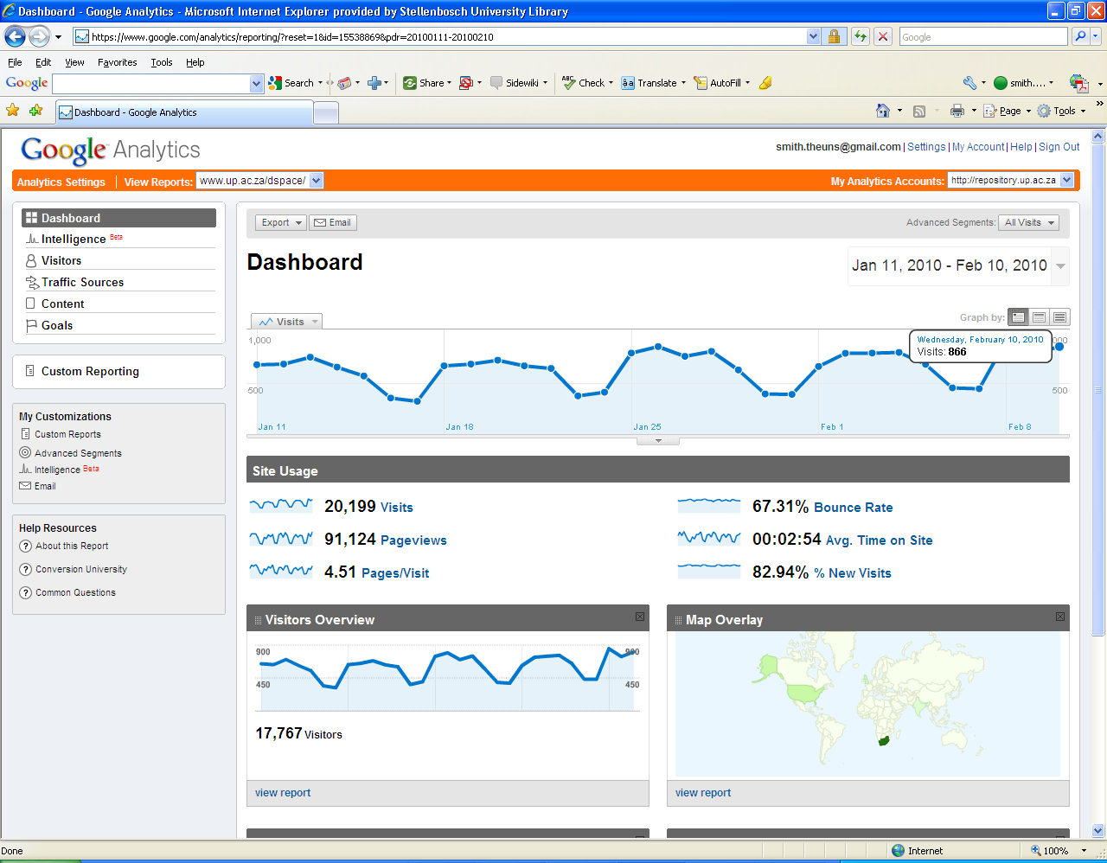
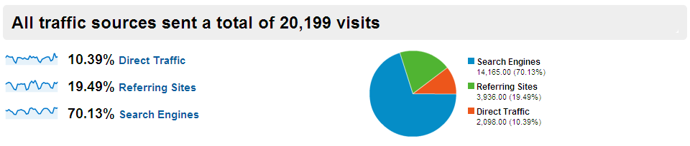
Vastly increases visibility, usage, impact of your research

Slide 23
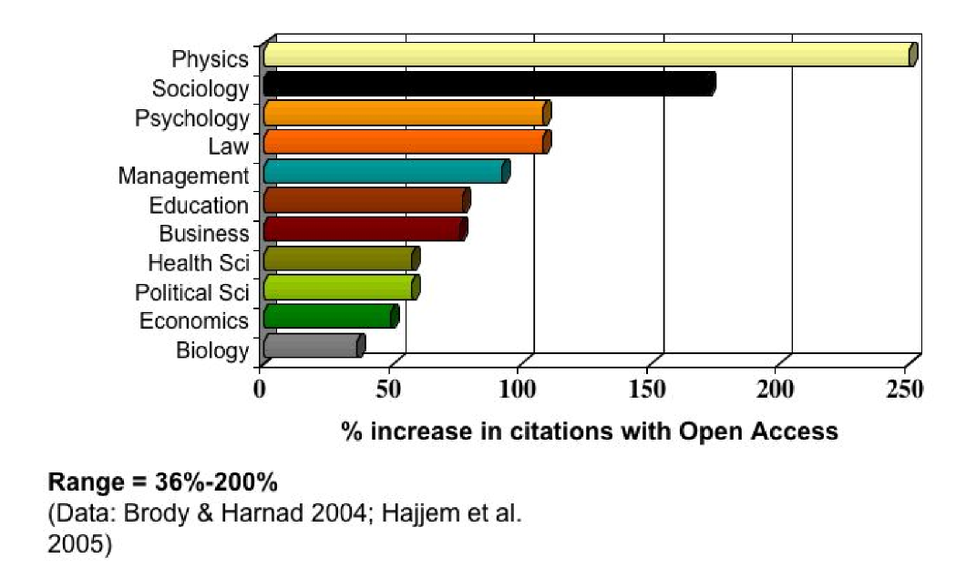
Open Access Increases Citations

Slide 24
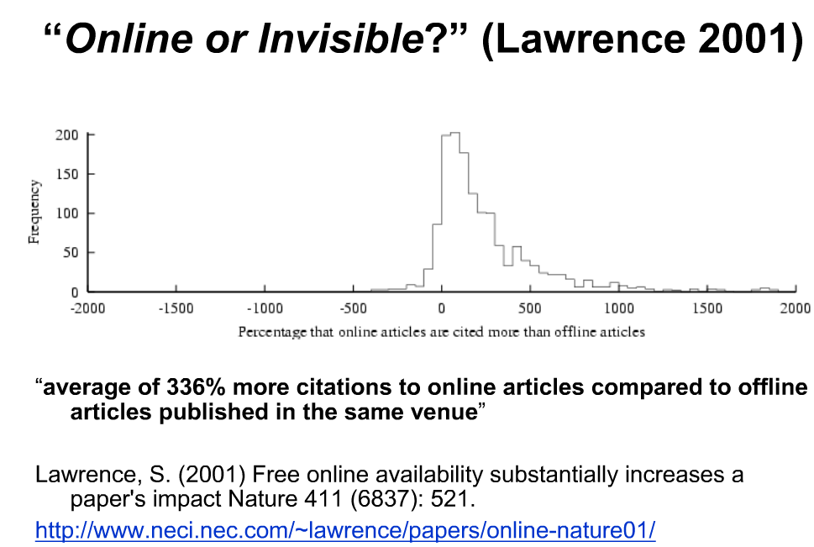

Slide 25
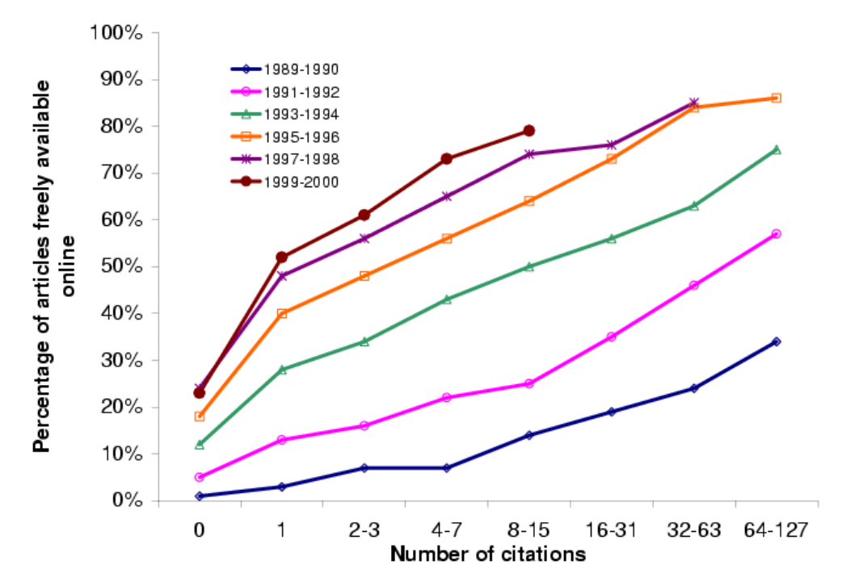
(Harnad, S 2009, ‘Mandates and metrics: how open repositories enable universities to manage, measure, and maximise their research assets)

Slide 26
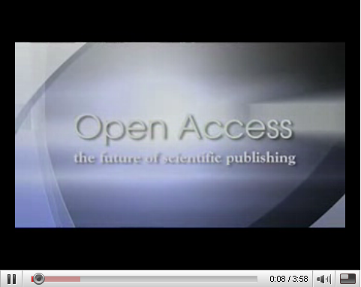
http://www.youtube.com/watch?v=g2JT23E1bRE
BioMed Central's authors and editors discuss the benefits of
open access publishing

Slide 27
Benefits for the Stellenbosch University
Central archive of all SU research – most important asset
Preserve all research for years to come
Persistent URL’s
All items – incl. full text pdf – fully searchable
Require uploading on IR at no extra expense
Increase research profile of SU even more
Increase ranking on international lists of top universities

Slide 28
Our commitment
Negotiate for and provide server space
Management on technical & operational level
Maintain SUNScholar for the long term
Add value (library cataloguers)
Training & Support
Marketing
Advise on digital matters etc.
Conduct surveys & research – state-of-the-art repository
Register SUNScholar with other search engines & harvesters

Slide 29










International Harvesters & Registries
Currently negotiated

Slide 30
How can you contribute?
Submit 2nd copy of all research output immediately (research articles after being accepted for publication)
Obtain consent to archive digital copies – submit consent with item
Use SUNScholar as the source of all your research web links
Digitize valuable material & submit

Slide 31
The way forward ....
Migration of SUNeTD, CIB to SUNScholar
Upgrade to most recent version of DSpace
Audiovisual Streaming Module, Document Streaming Module, Image Zoom Module (CIB)
Audit digitisation projects
Ranked by Webometrics (July)
Work with US Research Office
Work with other stakeholders on campus & outside

Slide 32
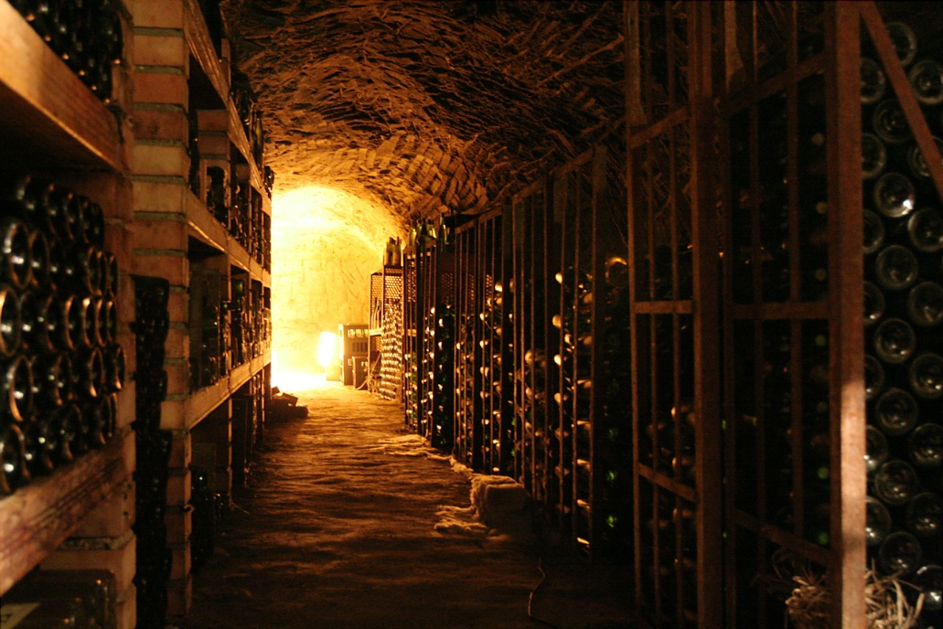
“The job of research is only half-done if the results of that research cannot reach the widest audience.”
- Wellcome Trust -

Slide 33
Thank you!
Library Management, IT Dept., Library Staff, other colleagues
Contact us:
scholar@sun.ac.za
https://scholar.sun.ac.za
Skype: usscholar

