Slide 1
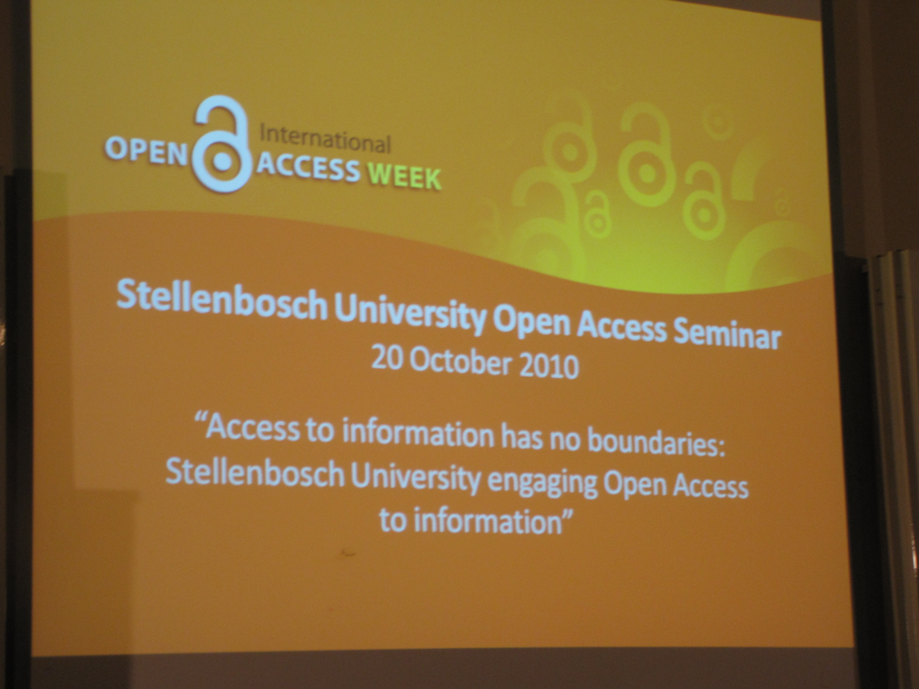

Slide 2
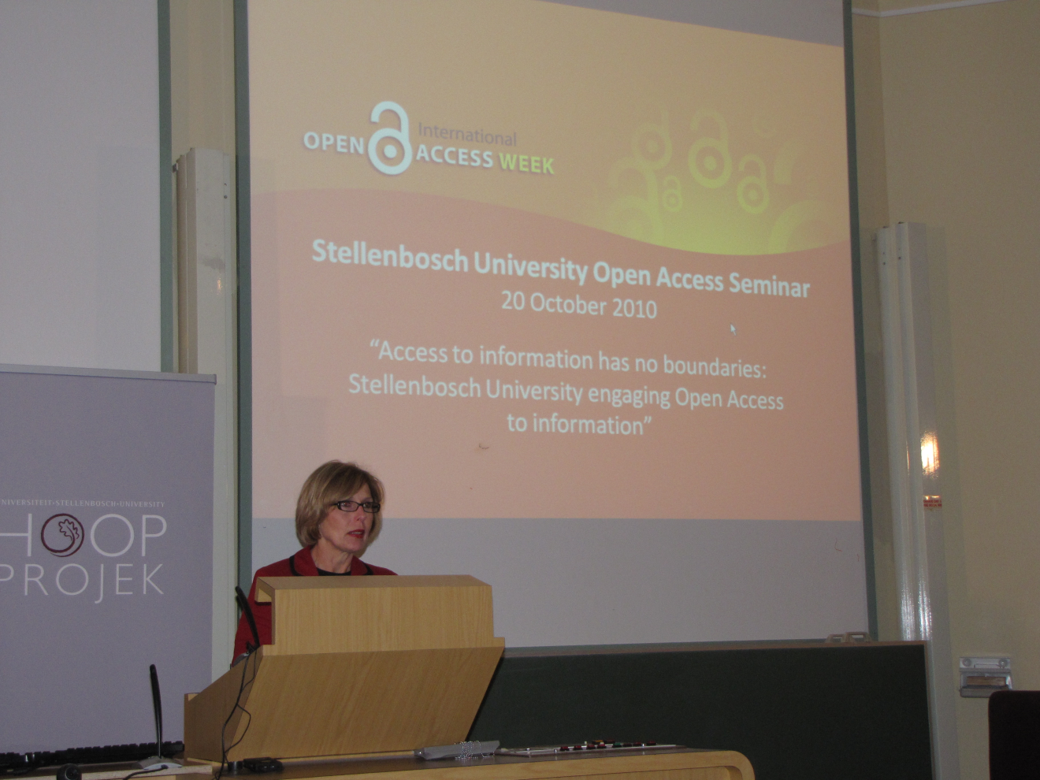
Prof Magda Fourie
Vice-Rector: Teaching, Stellenbosch University

Slide 3
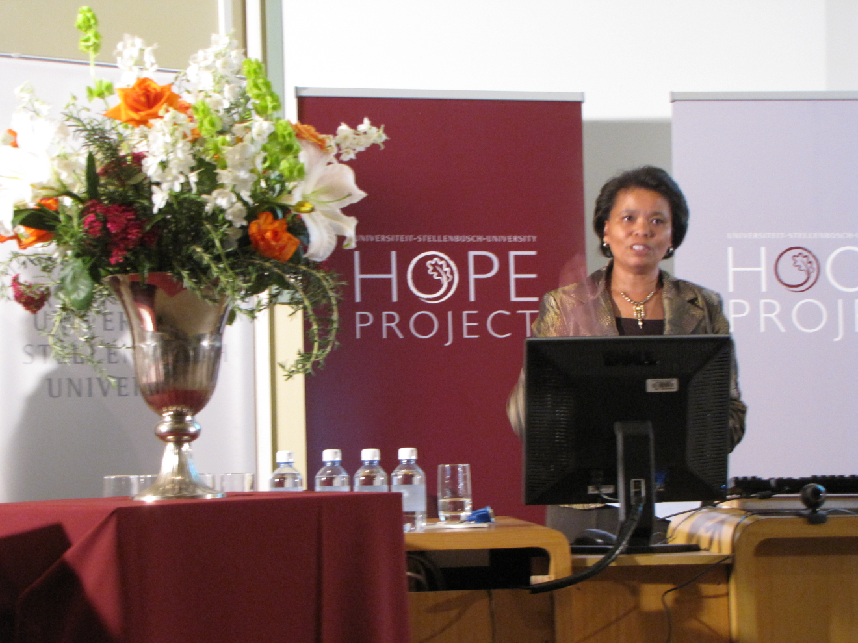
Ms Ellen Tise
Senior Director: Library and Information Service, Stellenbosch University

Slide 4
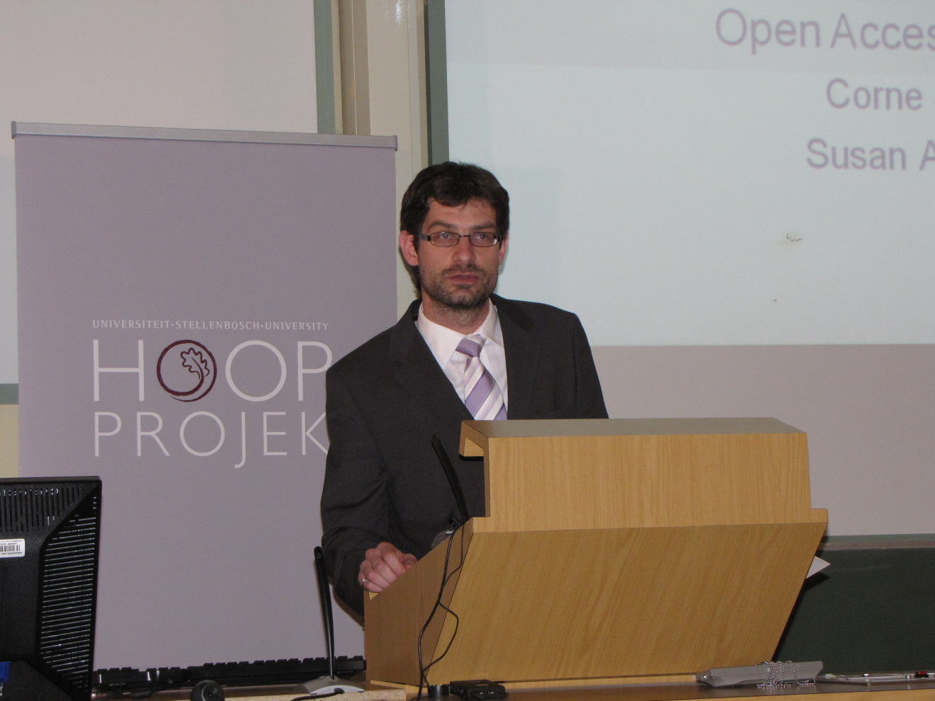
Prof Geo Quinot
Editor: Stellenbosch Law Review & Lecturer: Faculty of Law, Stellenbosch University

Slide 5
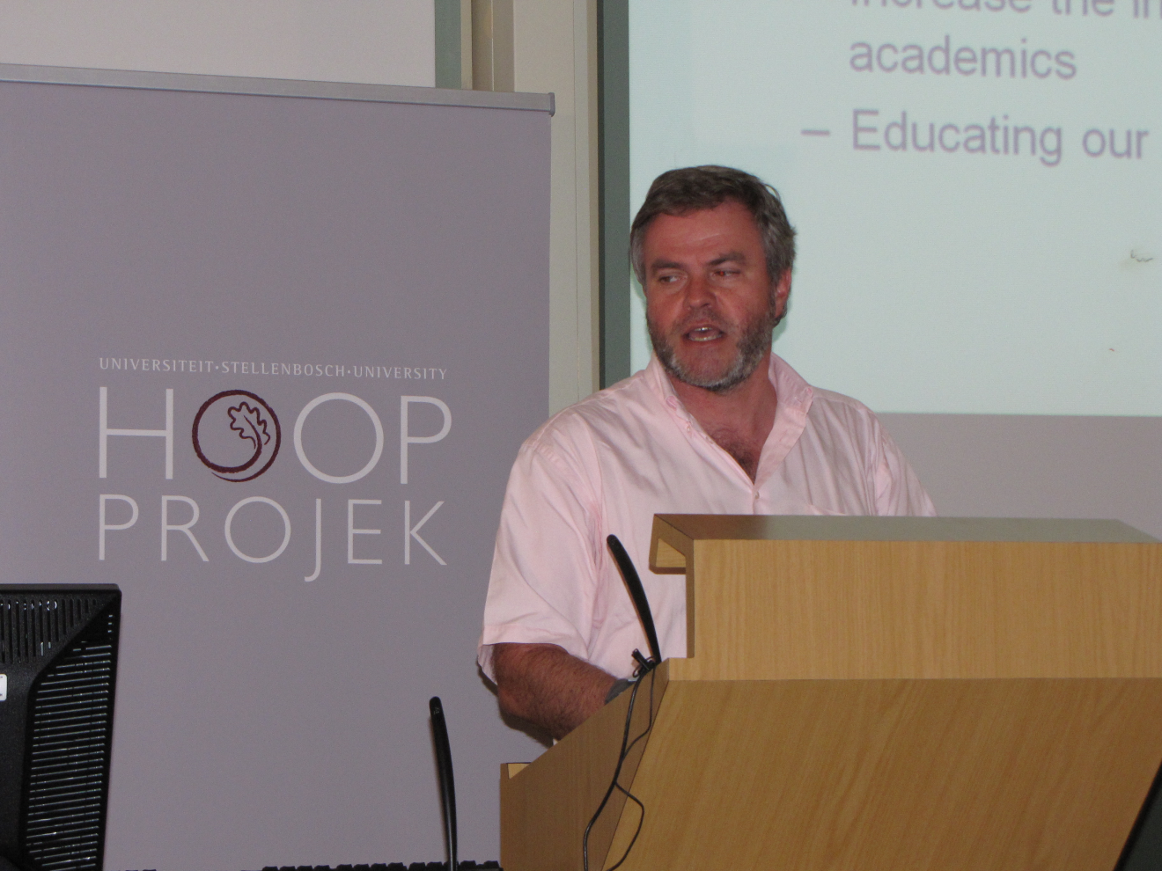
Dr Corné Schutte
Editorial Board Member: SA Journal for Industrial Engineering & Lecturer: Industrial Engineering, Faculty of Engineering, Stellenbosch University

Slide 6
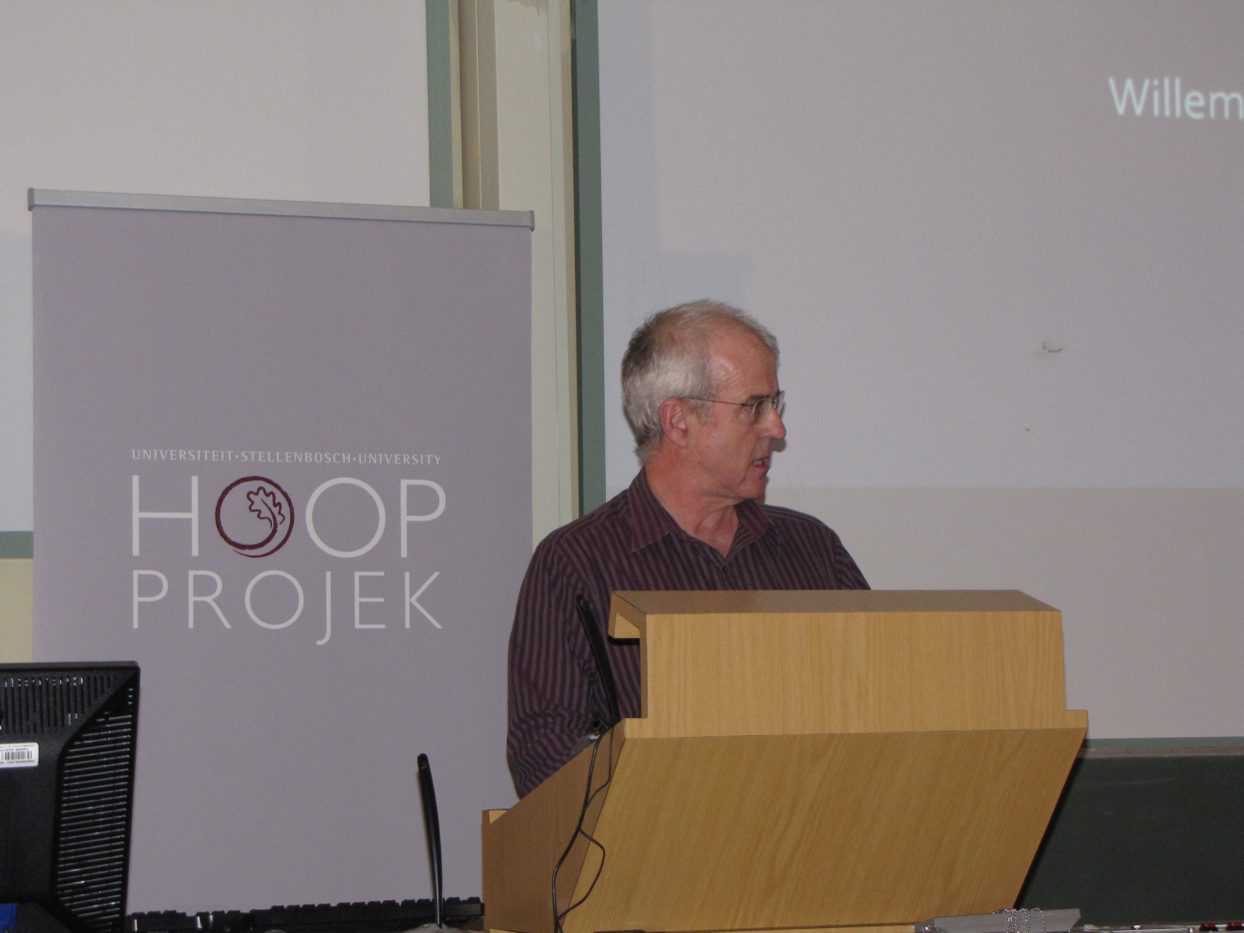
Prof Willie Perold
Vice-Dean: Research, Faculty of Engineering, Stellenbosch University

Slide 7
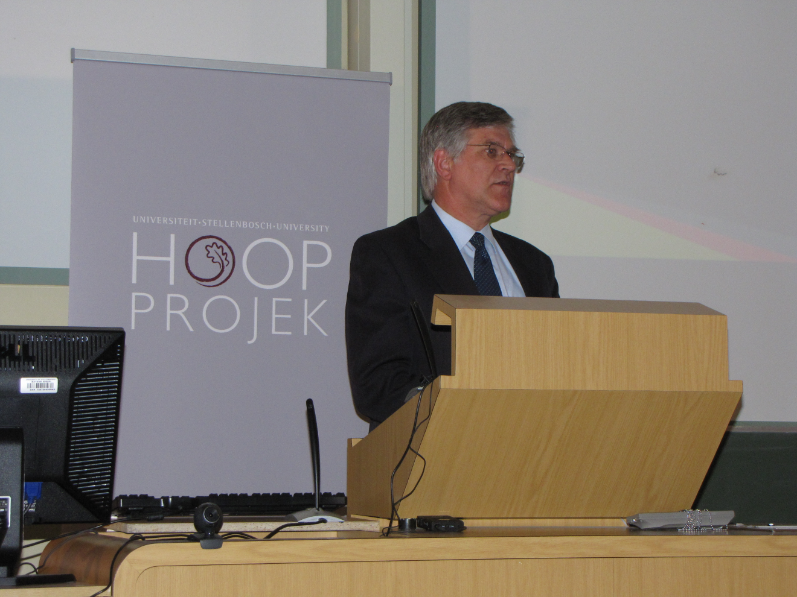
Prof Wim Gevers
Associate Director: Academic & Lecturer, University of Stellenbosch Business School

Slide 8
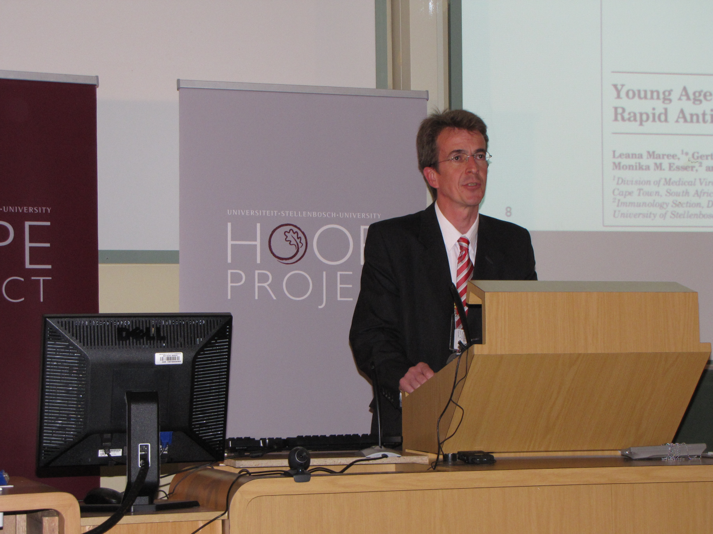
Prof Wolfgang Preiser
Professor and Head: Division of Medical Virology, Department of Pathology, Faculty of Health Sciences, Stellenbosch University

Slide 9
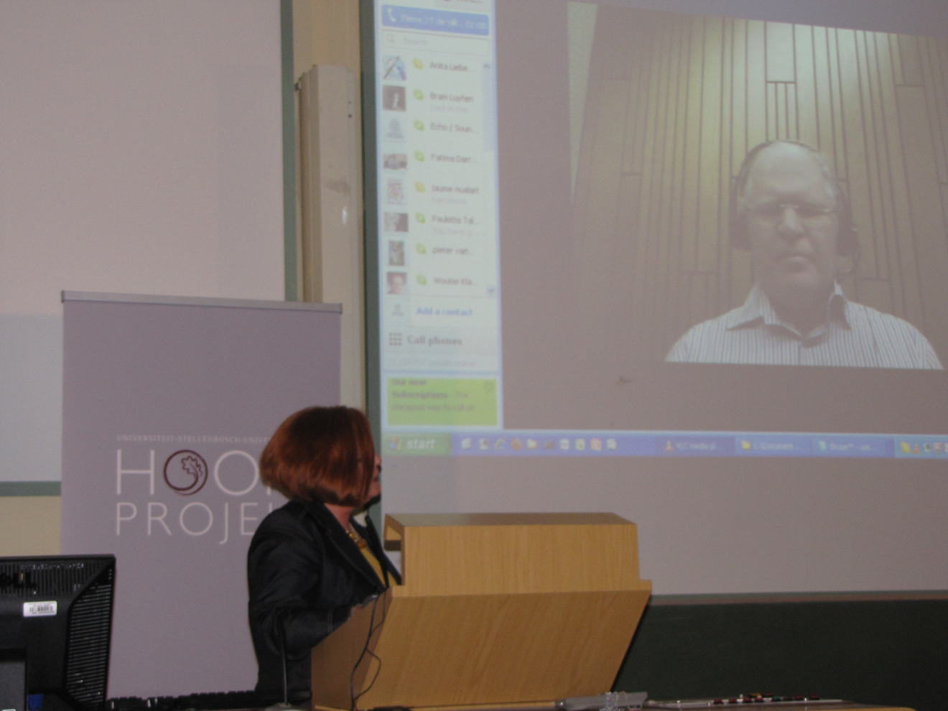
Ms Elda Nolte (Director: Client Services and Human Resource Management) introduces Prof Pierre de Villiers (Managing Director: AOSIS (Pty) Ltd.) via Skype, streamed from UNISA, South Africa

Slide 10
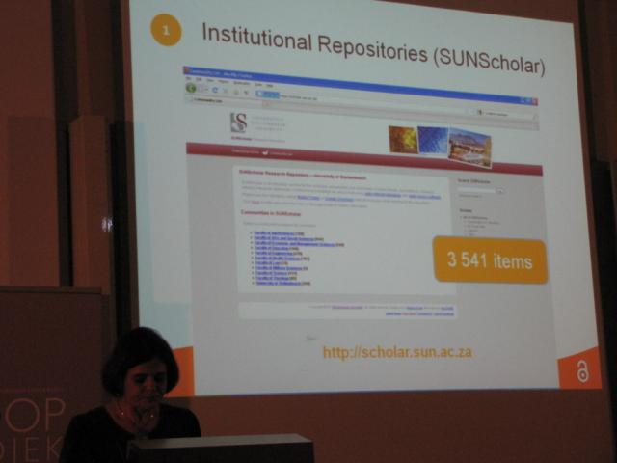
Mrs Ina Smith
E-Research Repository Manager, Library and Information Service, Stellenbosch University

Slide 11
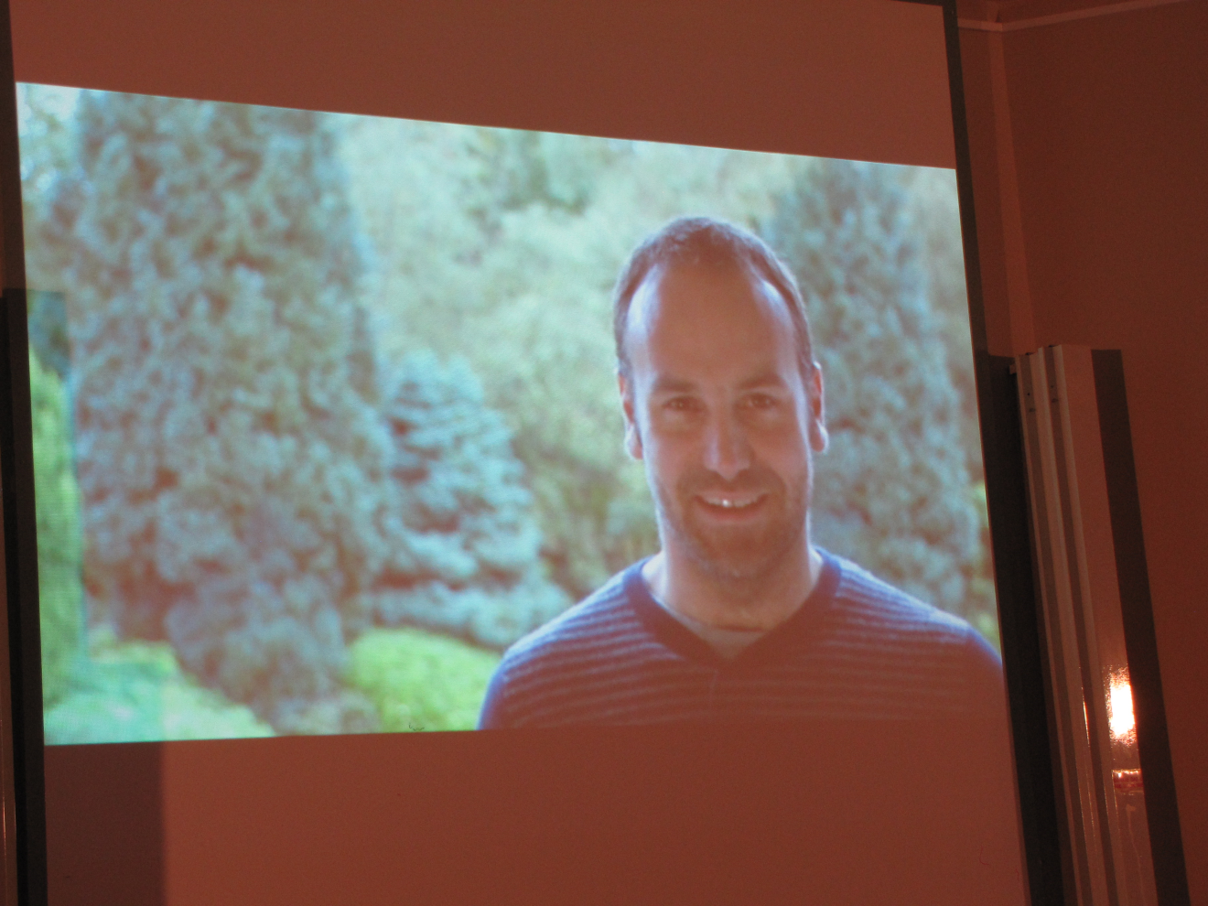
Mr Mark Shuttleworth
Open Source Software Community Leader http://www.markshuttleworth.com/biography

Slide 12
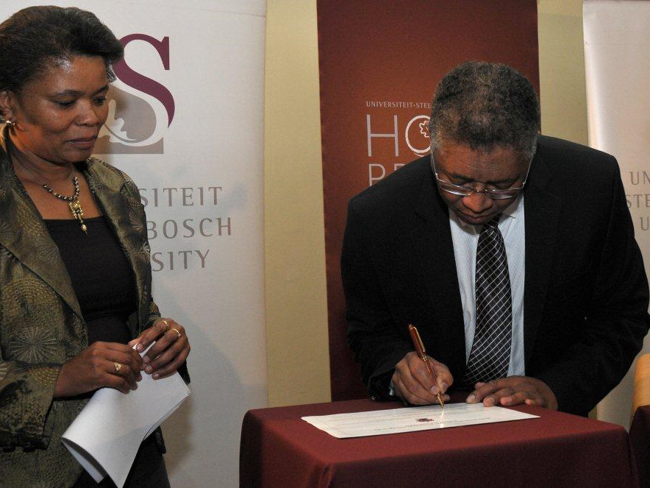
Ms Ellen Tise (Senior Director: Library and Information Service, Stellenbosch University) with Prof Russel Botman (Rector and Vice-Chancellor of the Stellenbosch University), signing the Berlin Declaration on Open Access to Knowledge in the
Sciences and Humanities
Photo: Anton Jordaan, SCPS

Slide 13
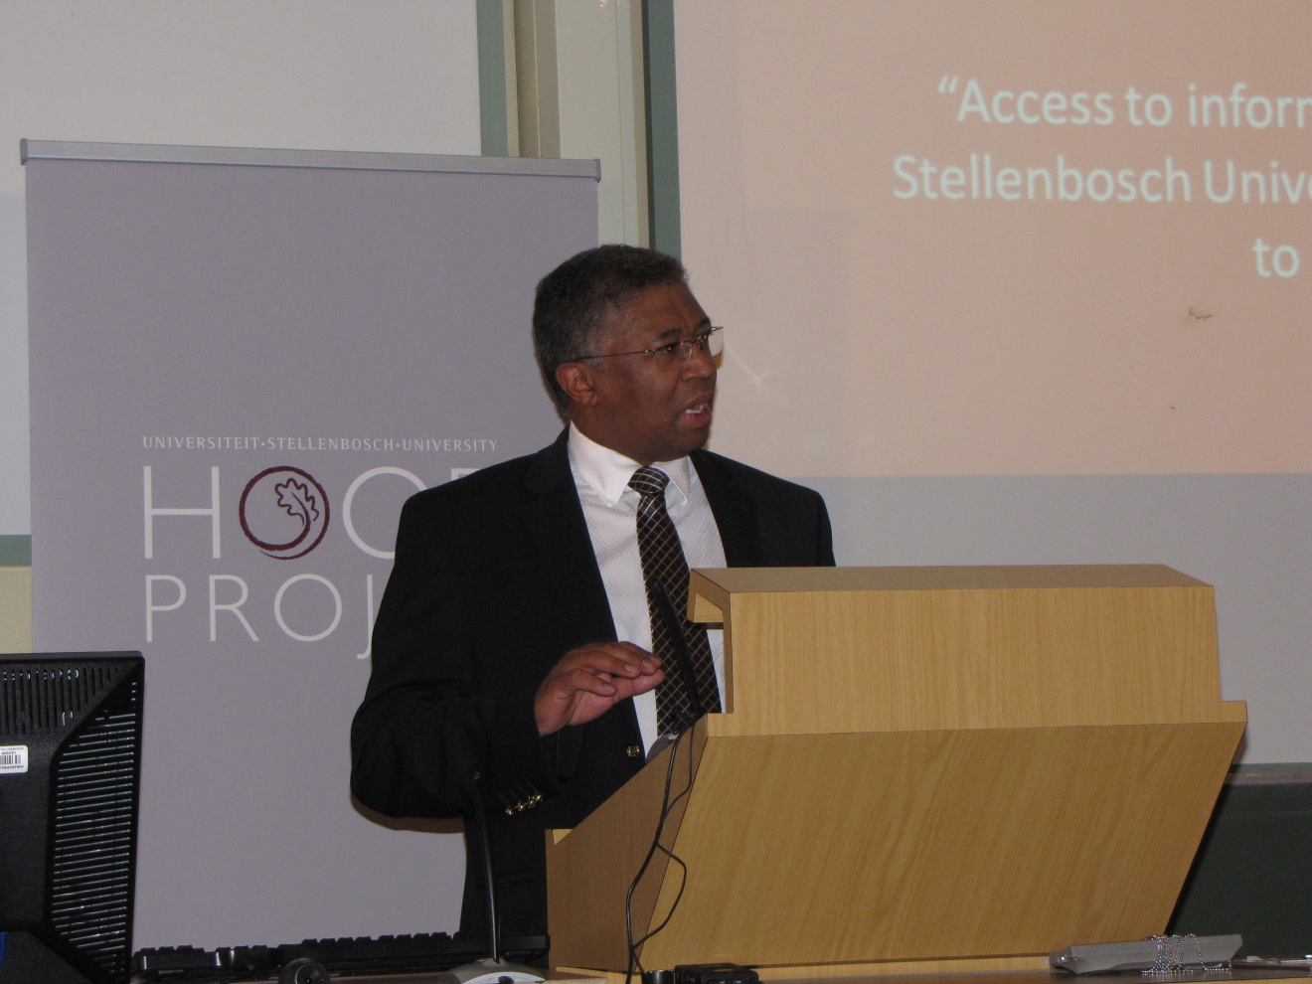
Prof Russel Botman
Rector and Vice-Chancellor, Stellenbosch University

Slide 14
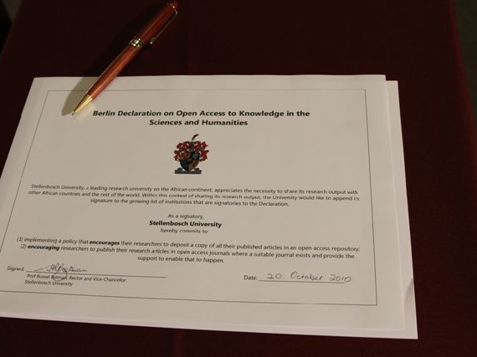
Photo: Desmond Thompson

Slide 15
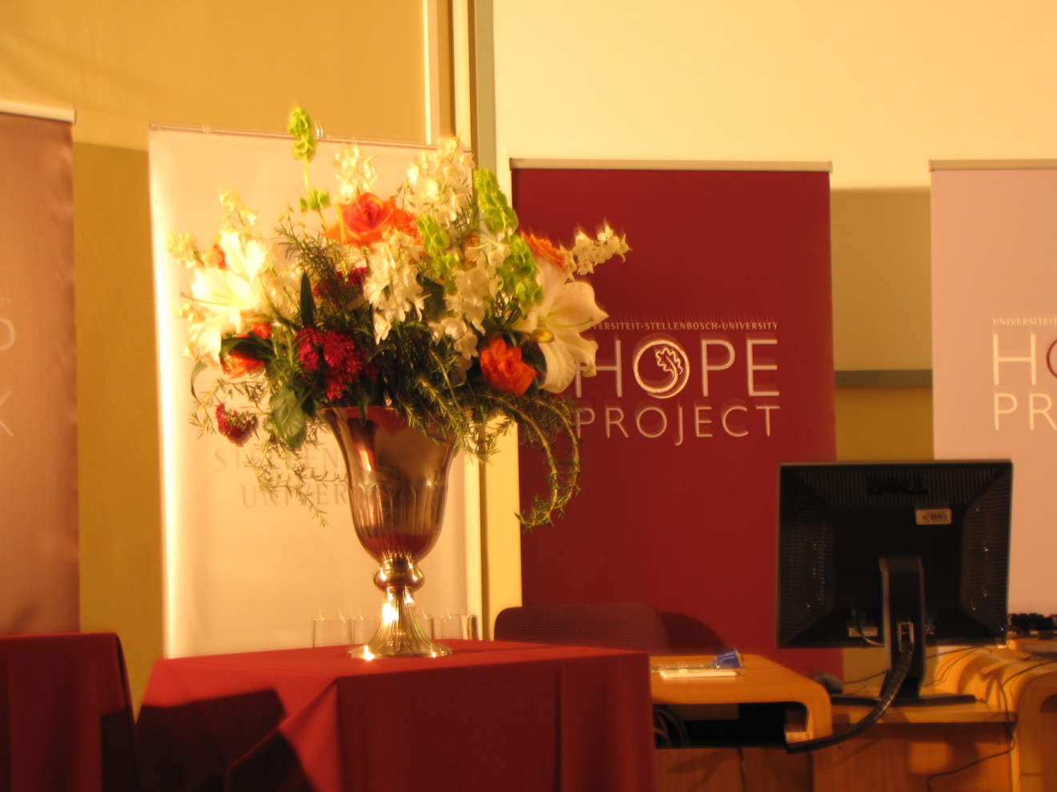

Slide 16
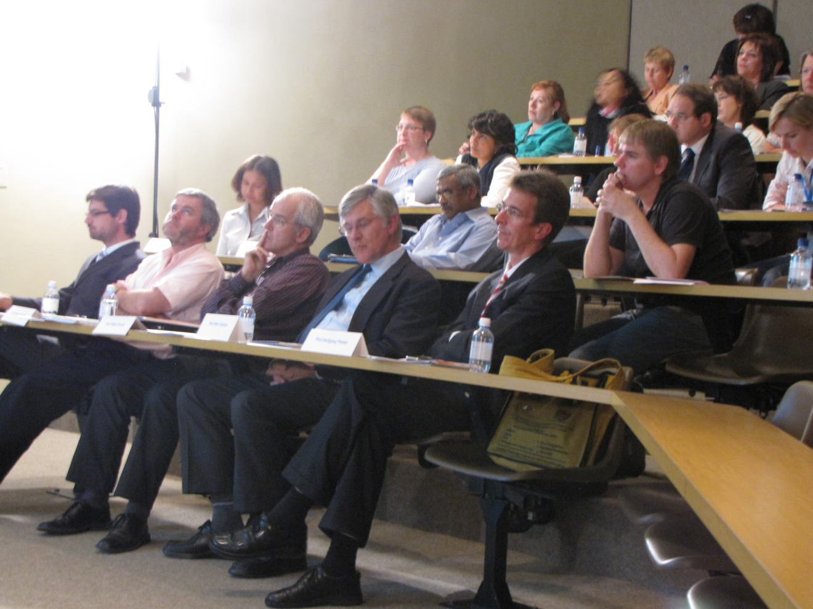

Slide 17
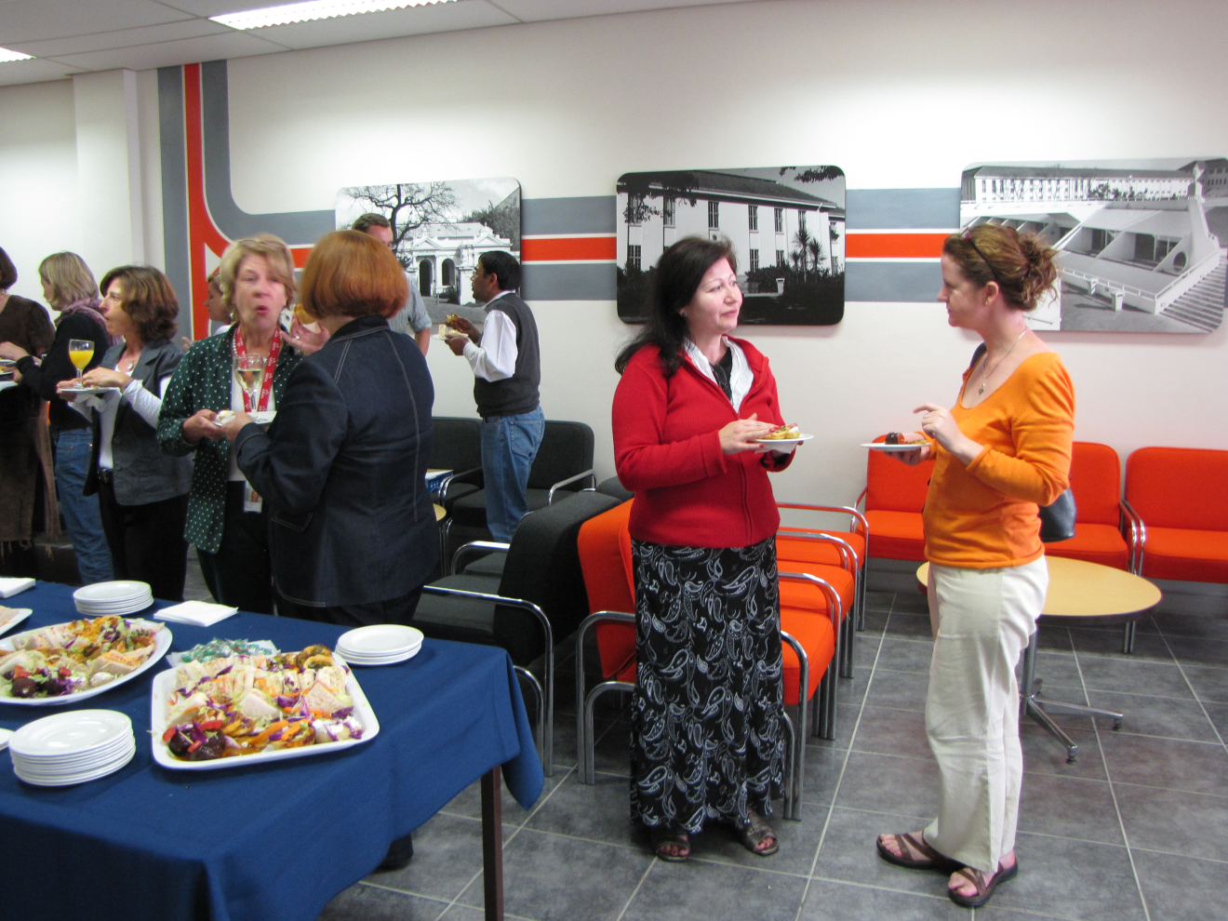

Slide 18
