Slide 1


Research @ University of Stellenbosch Business School
Cited more, Preserved forever
Presented to the University of Stellenbosch Business School
19 August 2010
Ina Smith, Paulette Talliard, Hilton Gibson, Henriëtte Swart

Slide 2
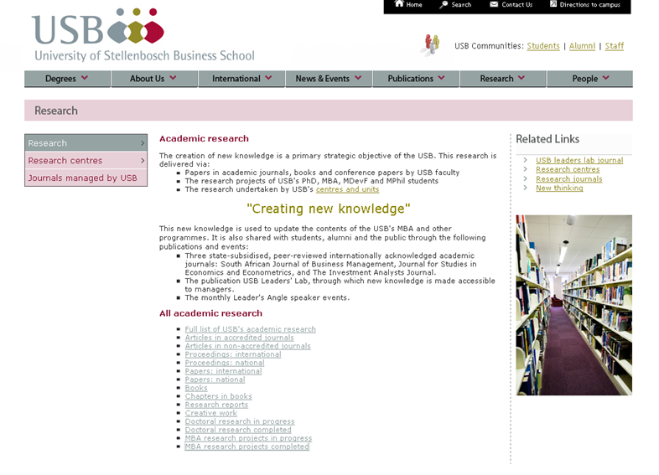

Slide 3

Open Access
“By "open access" to literature, we mean its free availability on the public internet, permitting any users to read, download, copy, distribute, print, search, or link to the full texts of these articles, crawl them for indexing, pass them as data to software, or use them for any other lawful purpose, without financial, legal, or technical barriers other than those inseparable from gaining access to the internet itself. The only constraint on reproduction and distribution, and the only role for copyright in this domain, should be to give authors control over the integrity of their work and the right to be properly acknowledged and cited.”
(Budapest-Bethesda-Berlin or BBB definition of open access
http://www.earlham.edu/~peters/fos/newsletter/09-02-04.htm )
Acknowledgement – image: http://openreflections.files.wordpress.com/2010/01/open20access-seal.gif

Slide 4


Two approaches to Open Access
Golden route - publish in Open Access journals
Green route – publish in an Institutional Repository
Acknowledgement image: http://lgimages.s3.amazonaws.com/data/imagemanager/7037/mllerustad.gif

Slide 5
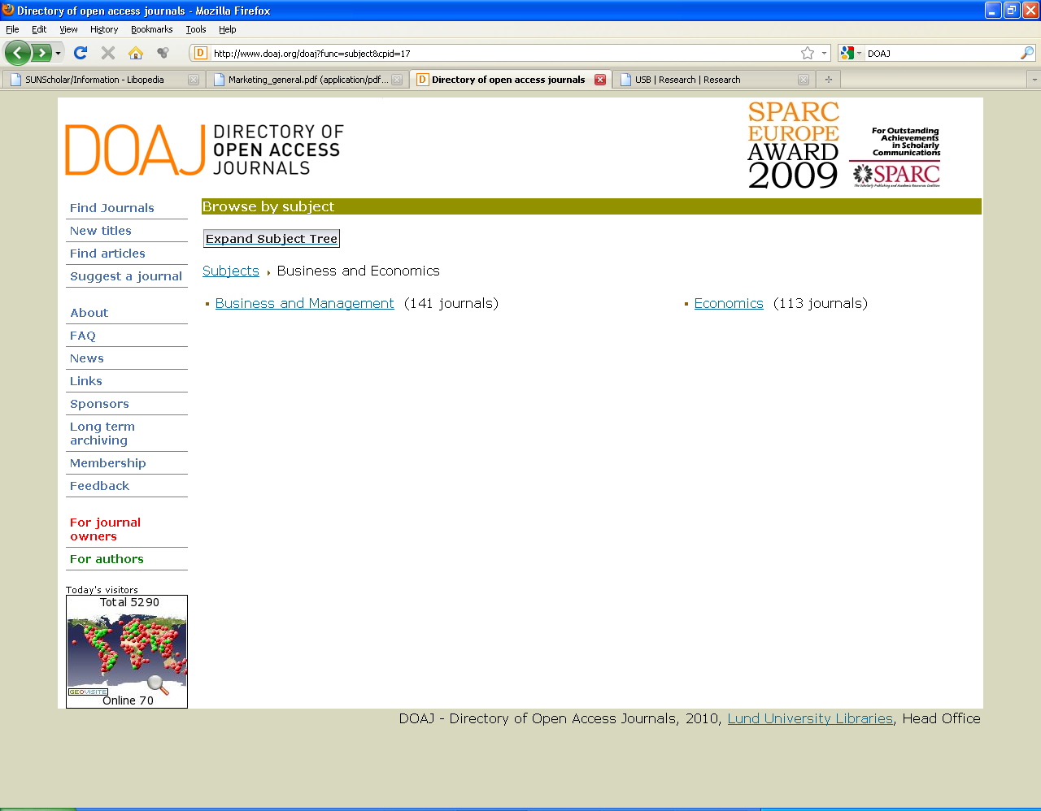


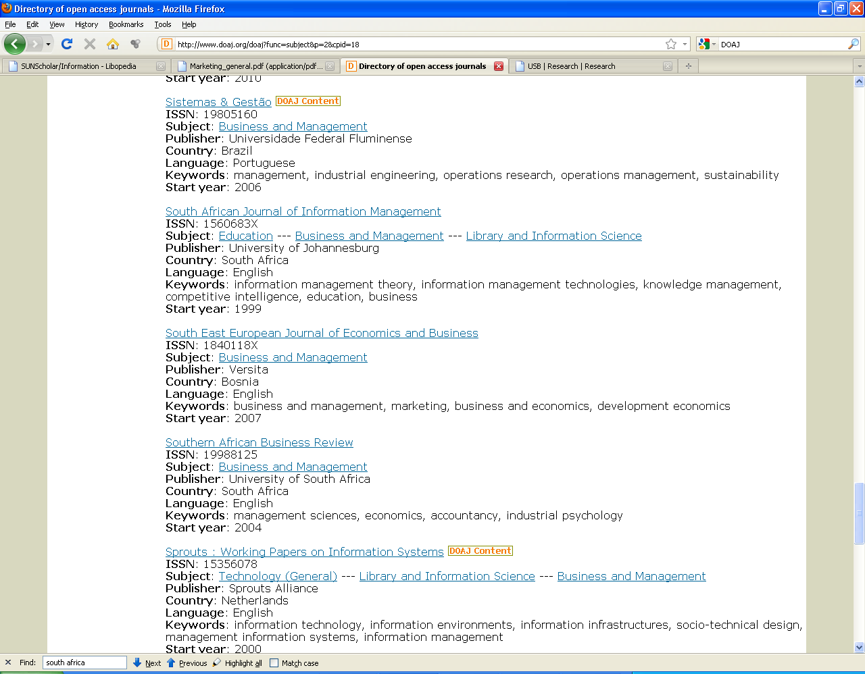

Slide 6
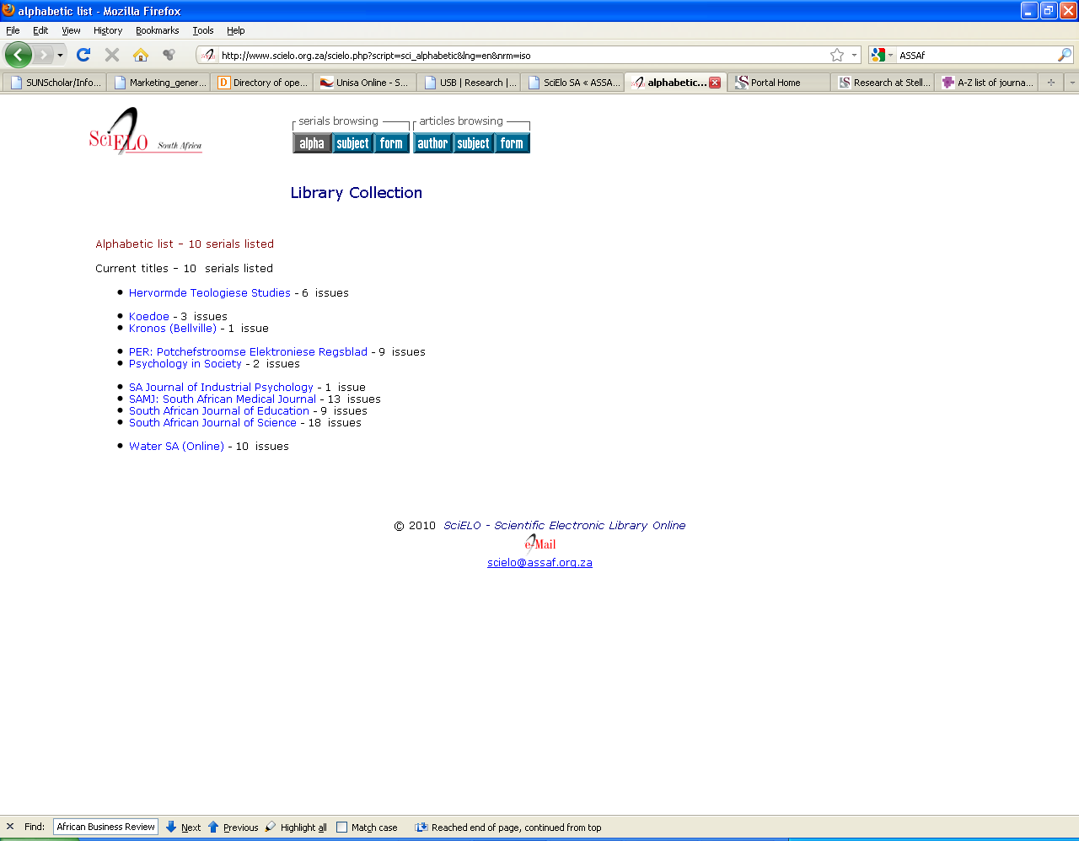

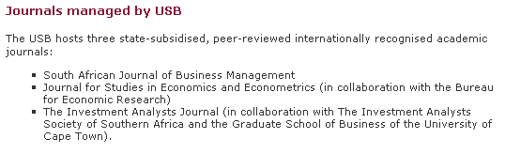

Slide 7
What is a research repository? (“green” route)
Set of services
Management & dissemination of digital materials
Organizational commitment
Stewardship
Long-term preservation
Organization
Open access/ distribution
(Clifford A. Lynch, "Institutional Repositories: Essential Infrastructure for Scholarship in the Digital Age" ARL, no. 226 (February 2003): 1-7)

Slide 8
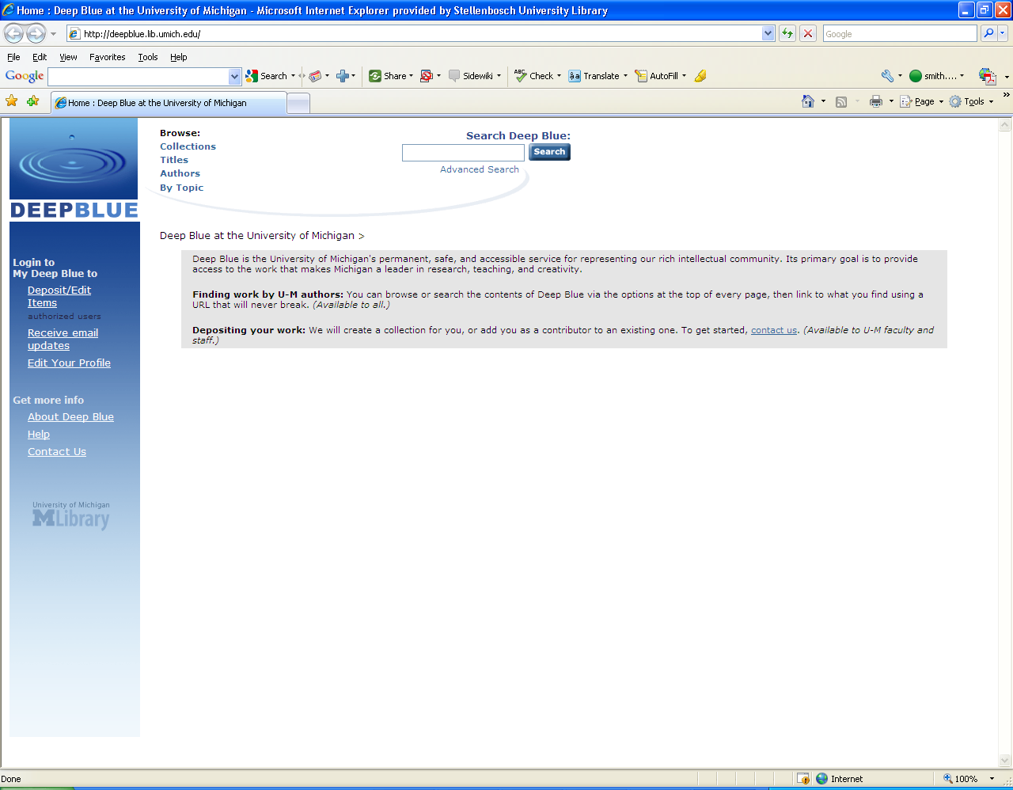
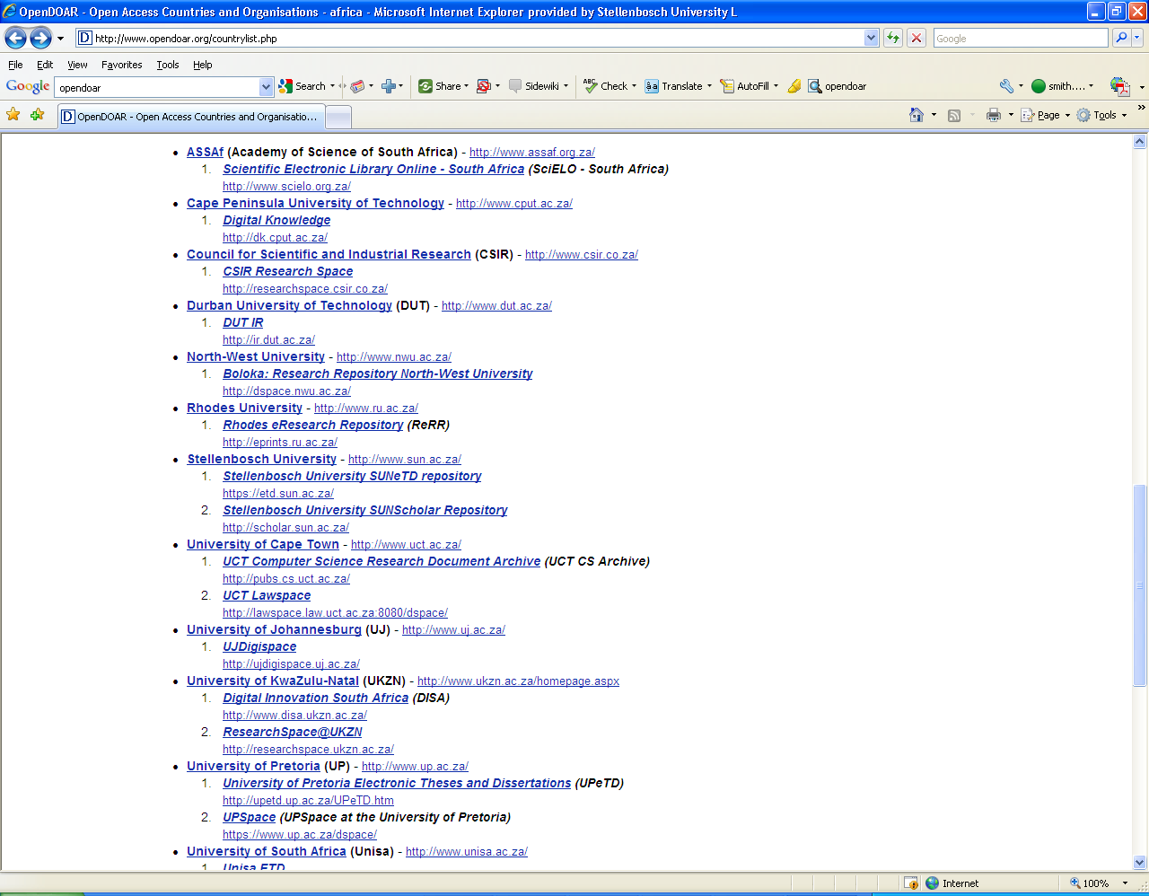
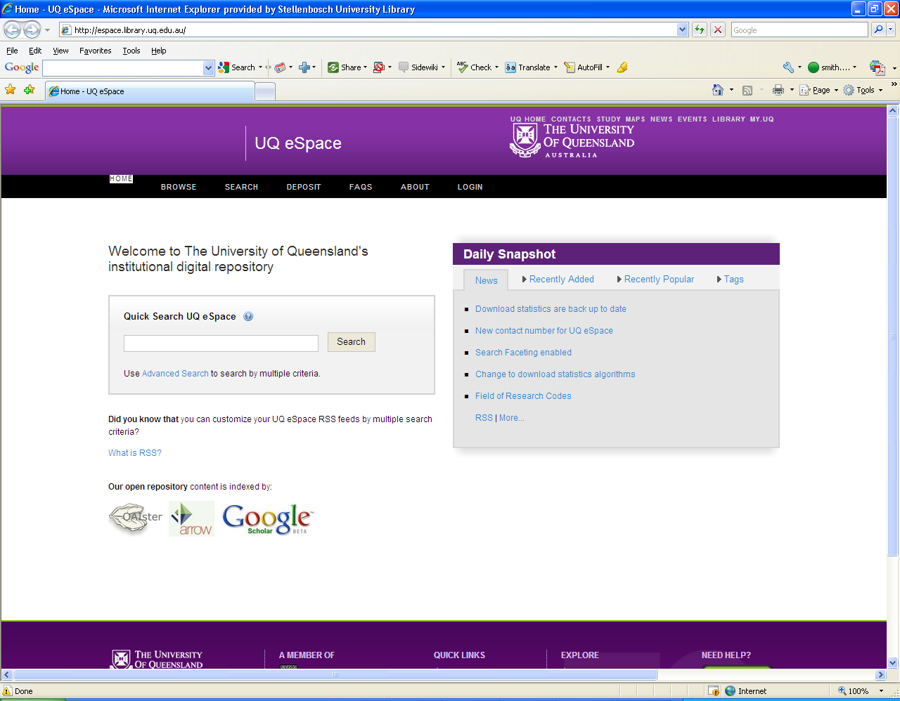
National & International Landscape
Africa (42)
South Africa (24)
1 705+ internationally

Slide 9
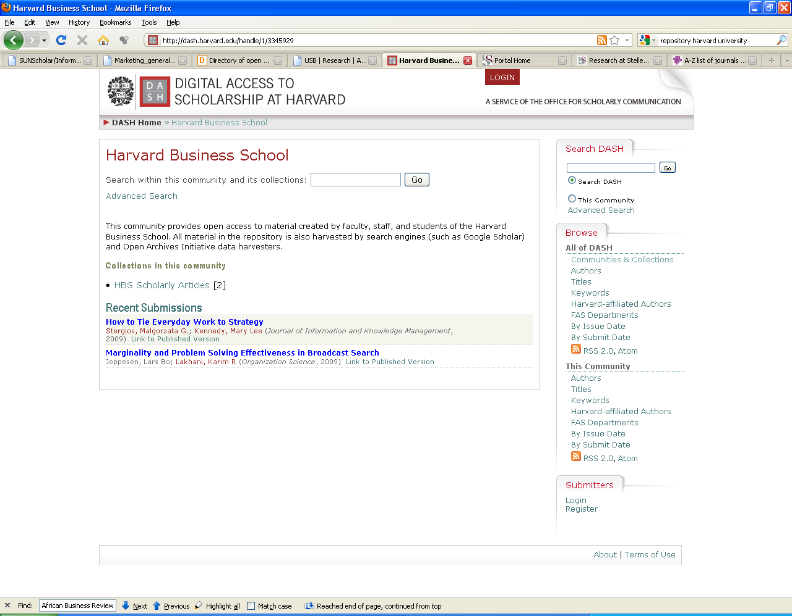
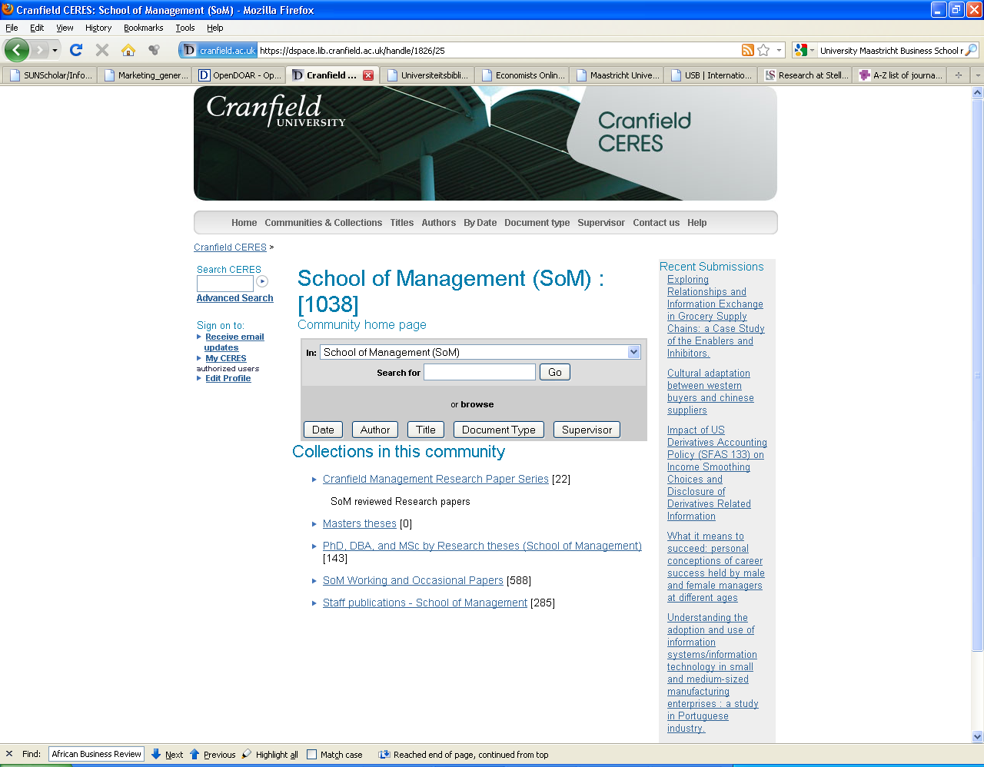

Slide 10
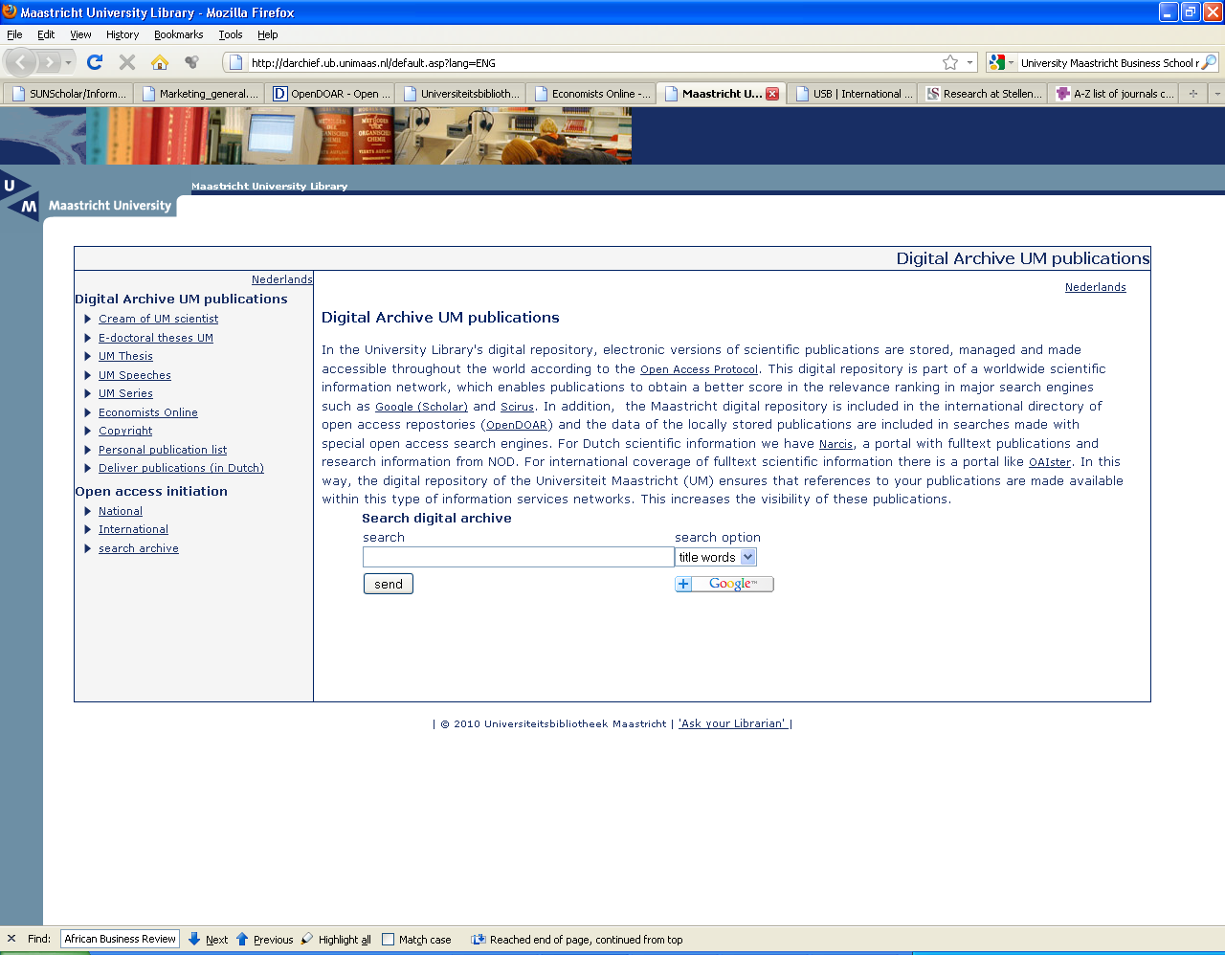
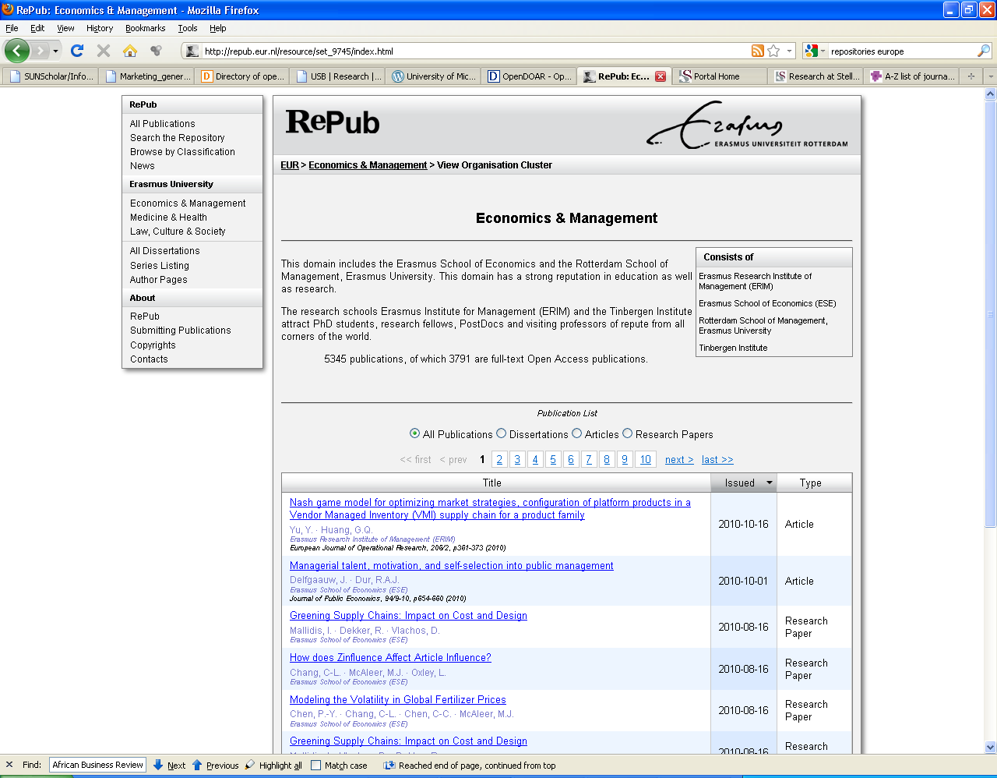

Slide 11
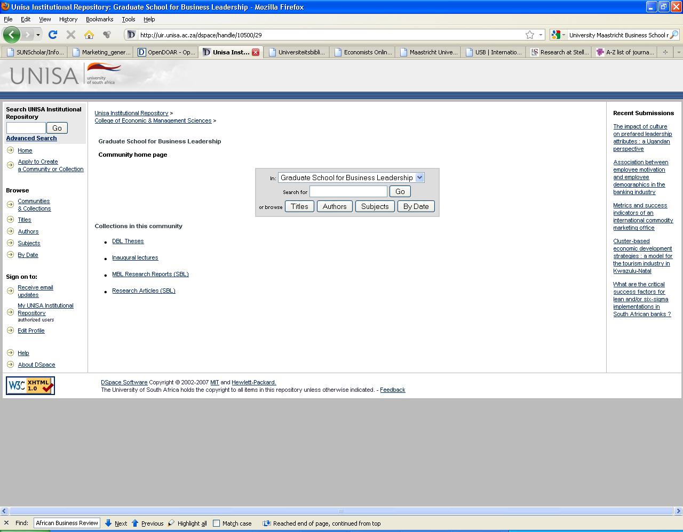
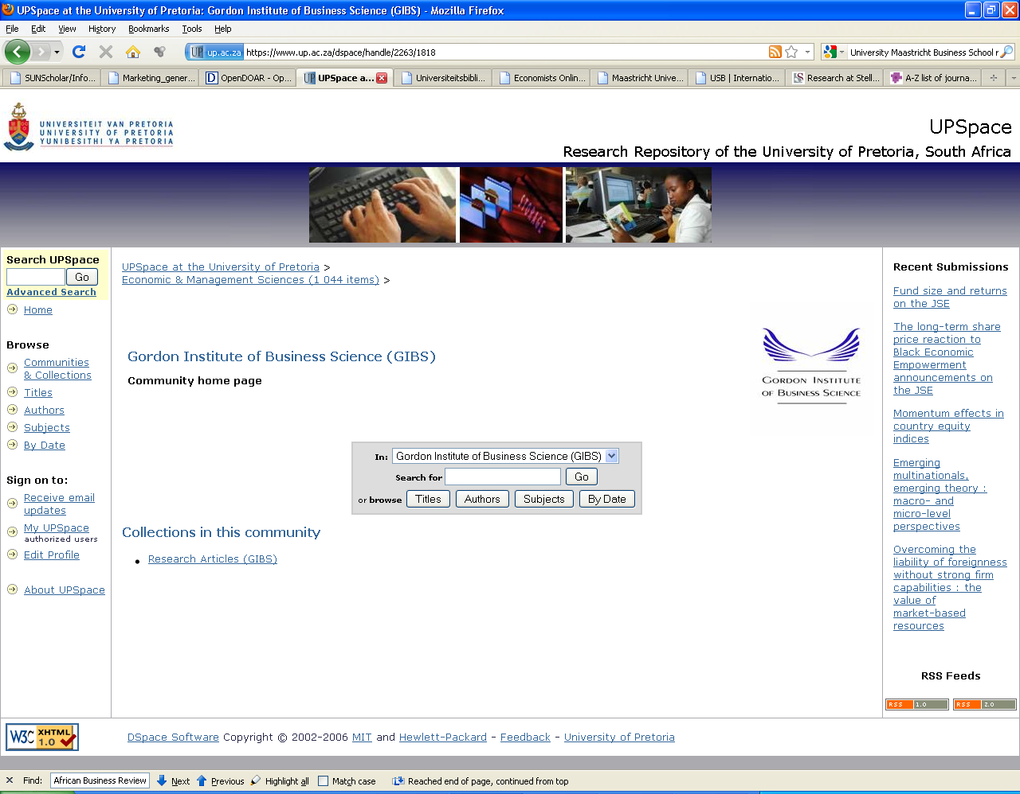

Slide 12
What is SUNScholar? http://scholar.sun.ac.za
Strategic objective of library: Support, develop and contribute to high-level scholarly publication output
Full text central digital research repository of the University of Stellenbosch
Provide open access where possible
Digitally preserve research output

Slide 13
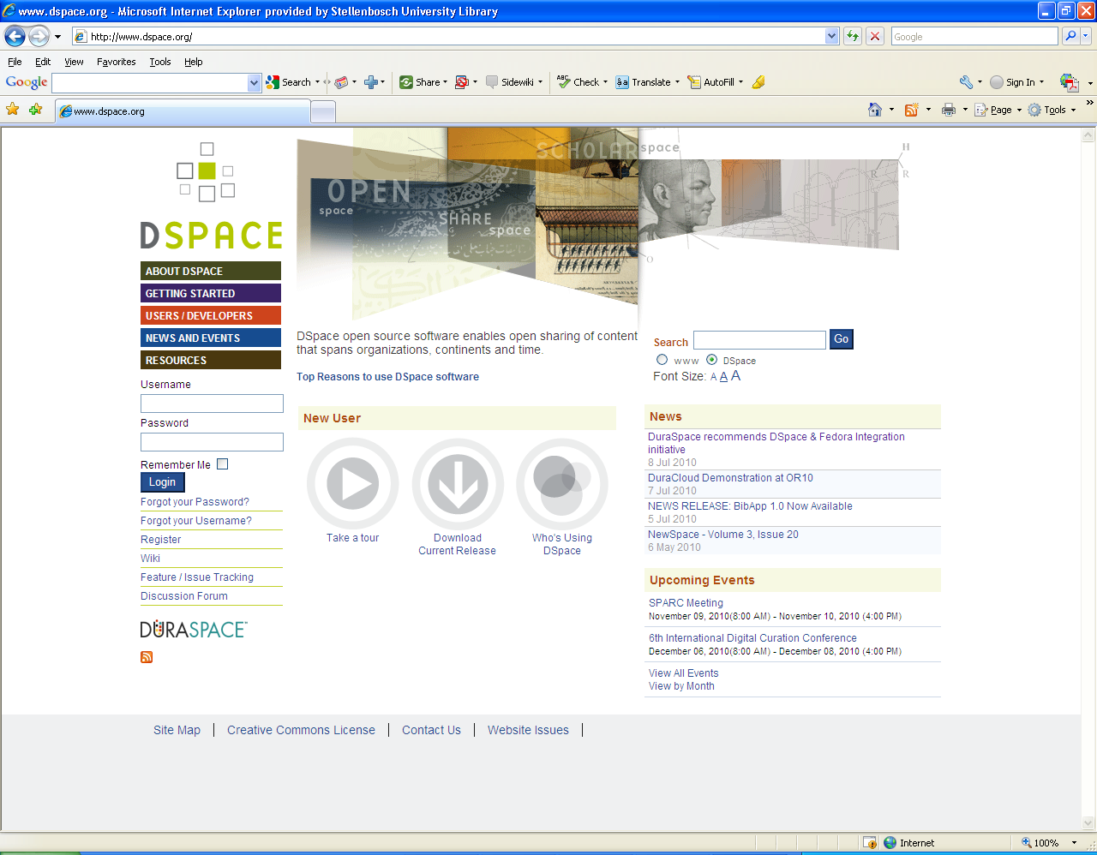
http://dspace.org
907 instances

Slide 14
Research Output
Primary:
  Research Articles, Chapters in Books, Books, Conference Proceedings, Theses, Dissertations
Secondary:
  Inaugural Addresses, Conference Presentations & Posters, Images, Audio- & Audiovisual Clips, Seminars/Open Lectures, Conferences, Experiments, Data sets, and many more!

Slide 15
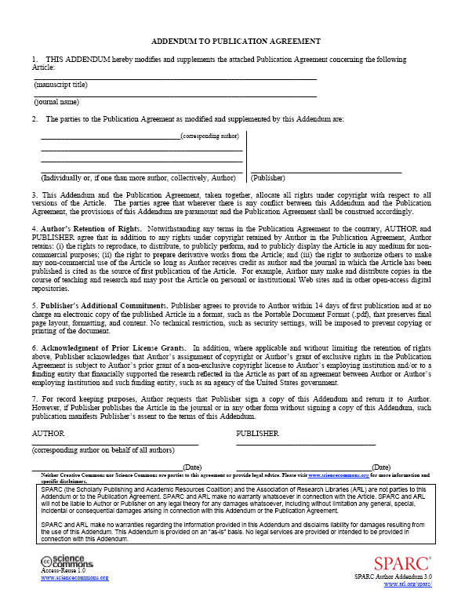
Research Articles
Clear copyright (SUNScholar Office)
  Negotiate pro-actively – 2nd copy on SUNScholar
  Add SPARC Addendum: http://www.arl.org/sparc/author/addendum.shtml
Digitize
Submit pdf file (or using other
open standard) to SUNScholar
More info: http://wiki.lib.sun.ac.za/index.php/SUNScholar

Slide 16
Research Articles Action Plan
Collect full text copies
Compile a list of journal titles
Forward list to SUNScholar – copyright clearance
Visit wiki: http://wiki.lib.sun.ac.za/index.php/Faculty_of_Economic_and_Management_Sciences/Journals
Start submitting to SUNScholar

Slide 17
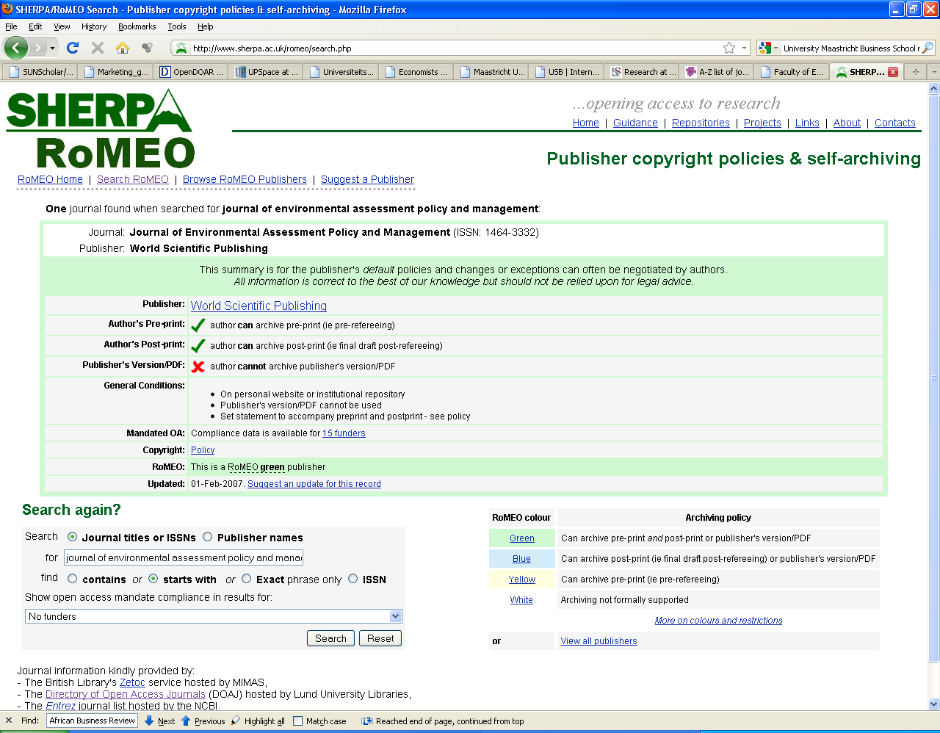

Slide 18
Workflow
Submit item
Reject
Review item
Notification to Submitter & Subscribers
Edit metadata
Available on IR

Slide 19
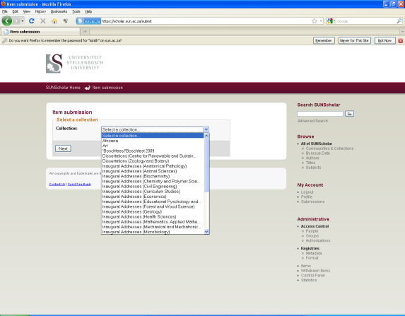
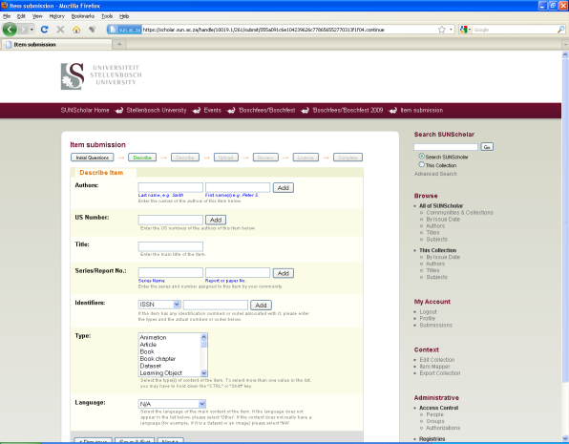
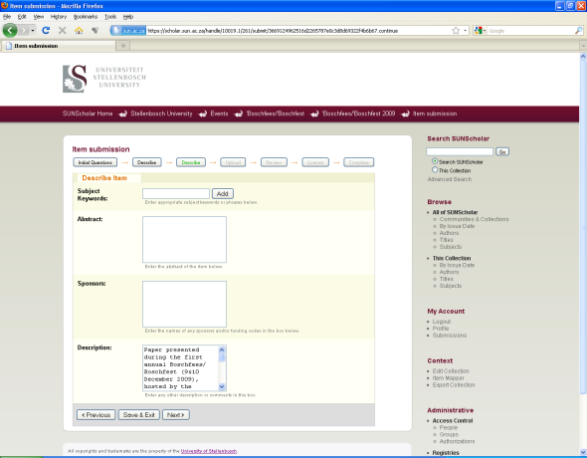
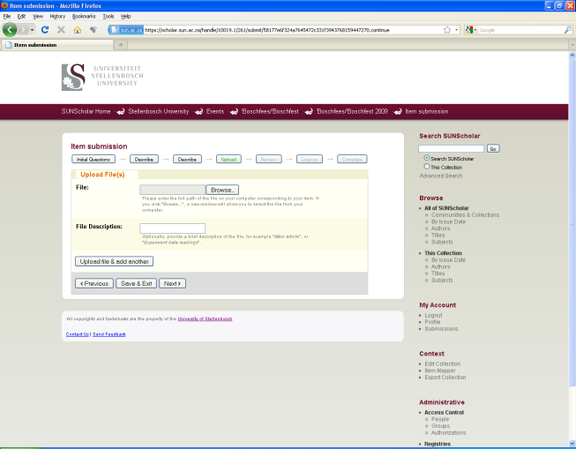
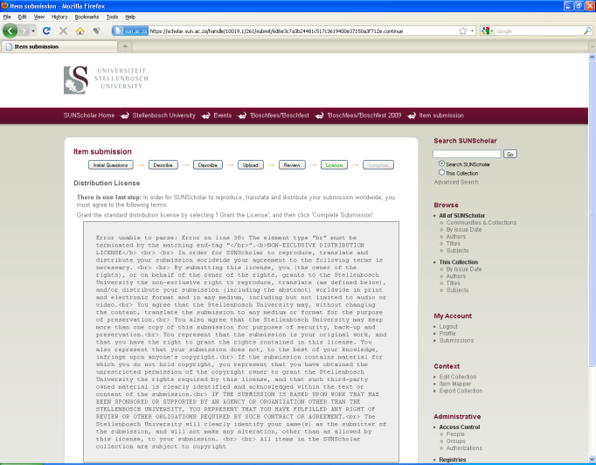
Submission Process
1
2
3
4
5

Slide 20
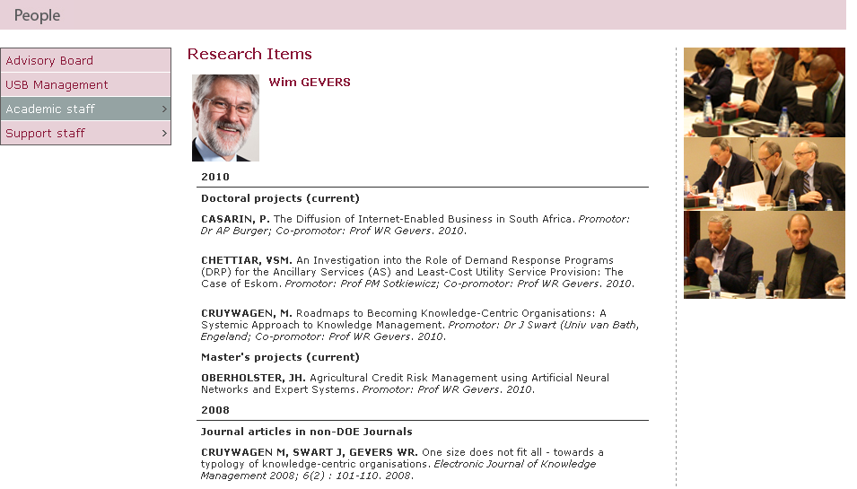
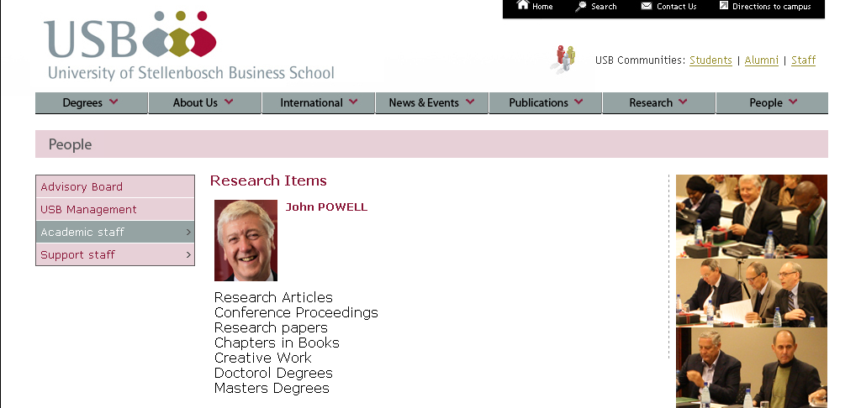
Links to items on SUNScholar
Links to Collections /search on SUNScholar

Slide 21
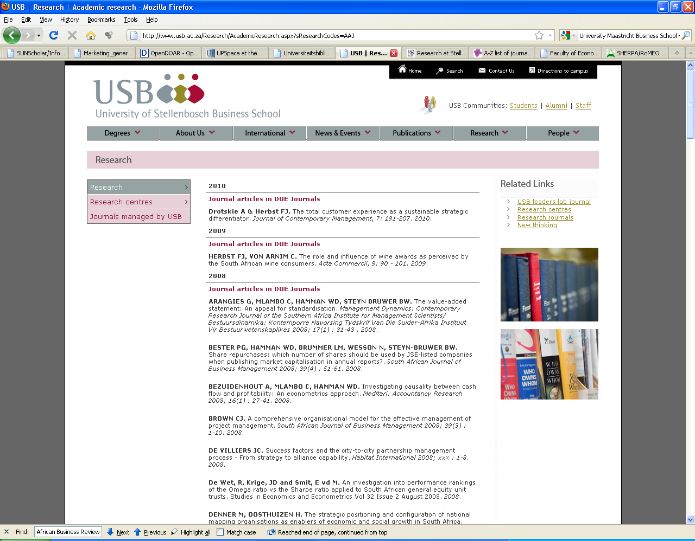
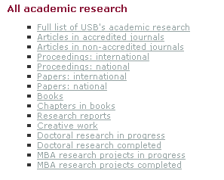
Links from web page to full text on SUNScholar

Slide 22
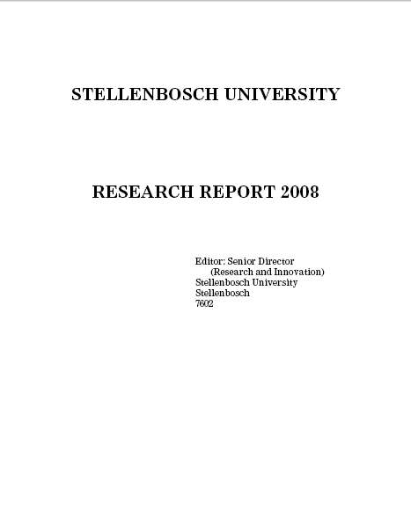
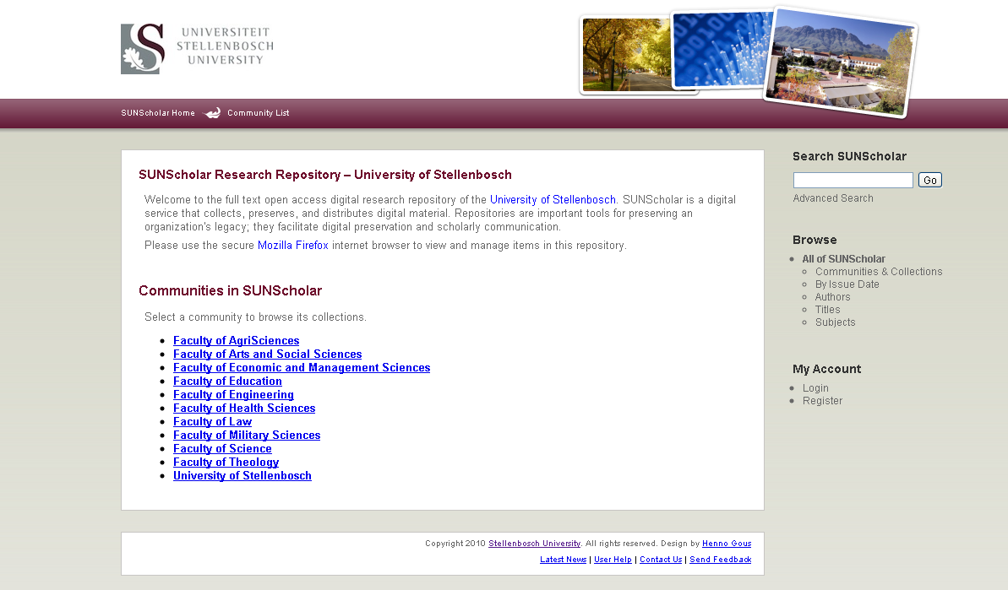
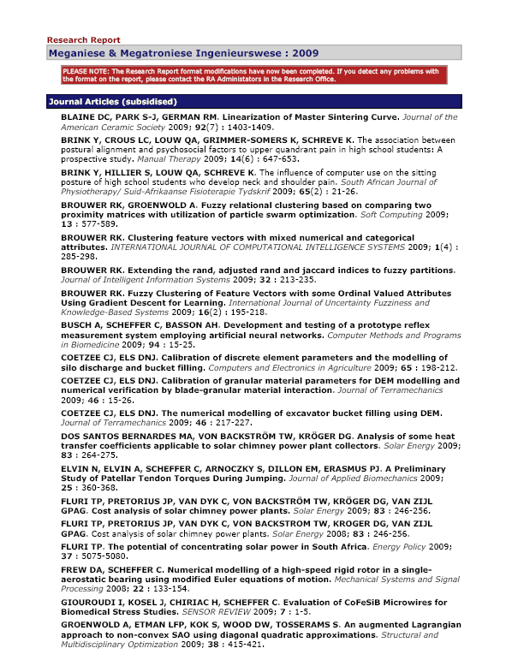
Research Output
Research Report System
With links to full text
Currently investigated

Slide 23
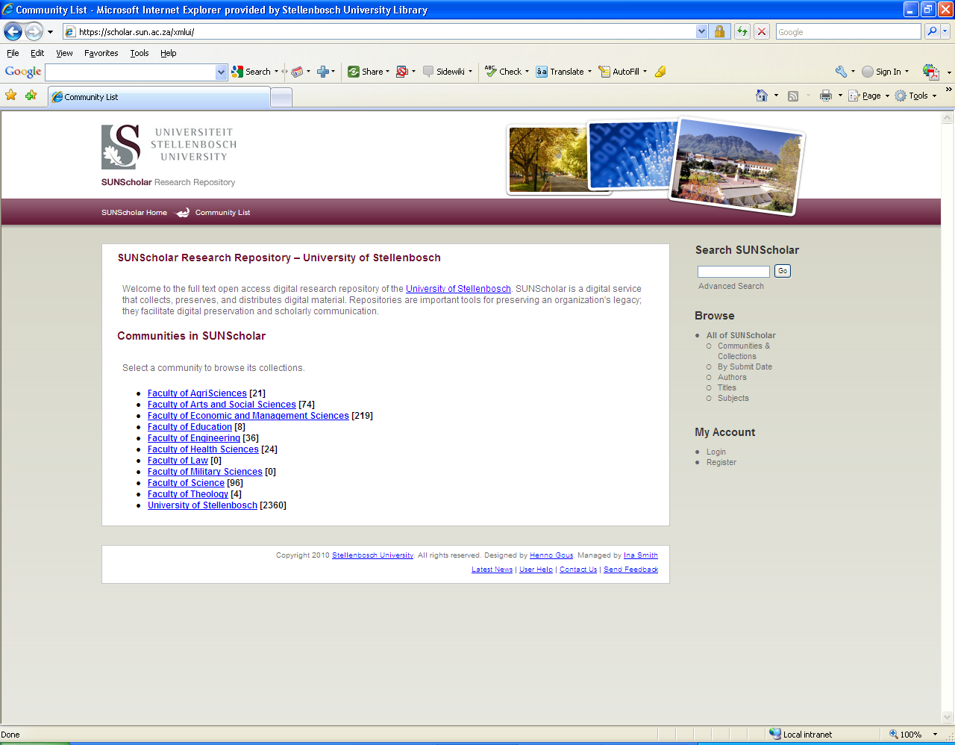
Top-Level Community:
Economic & Management Sciences

Slide 24
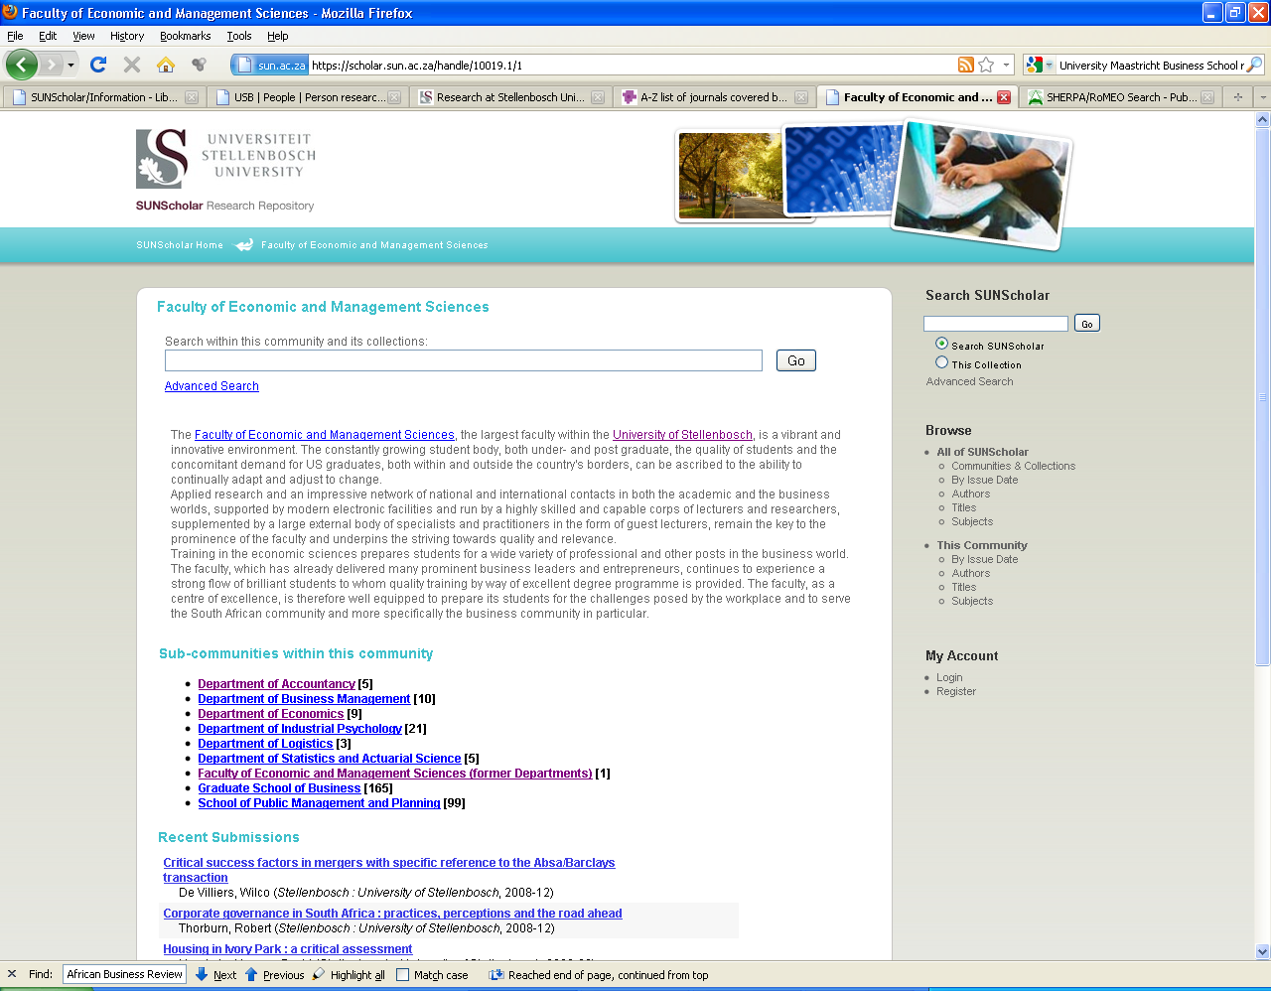
Sub-Communities:
Departments

Slide 25
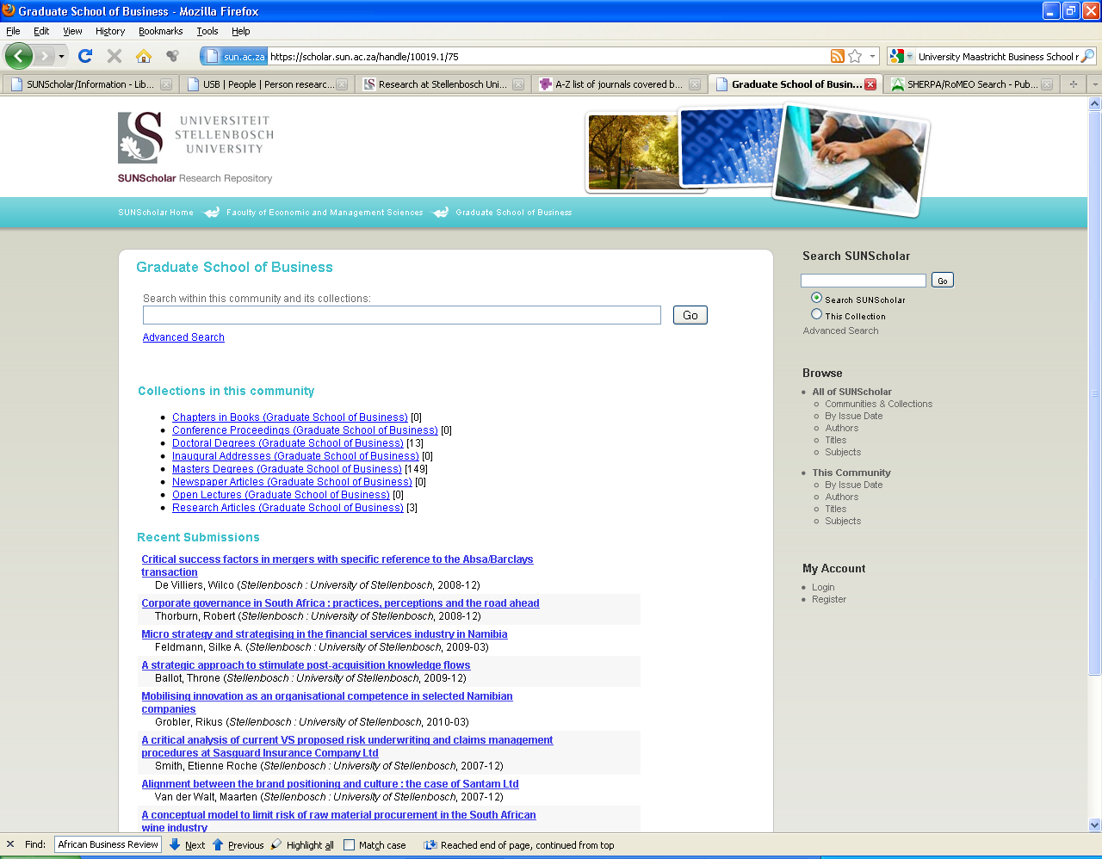
Customized according to Faculty
Search
Navigation
Collections for the Graduate School of Business

Slide 26
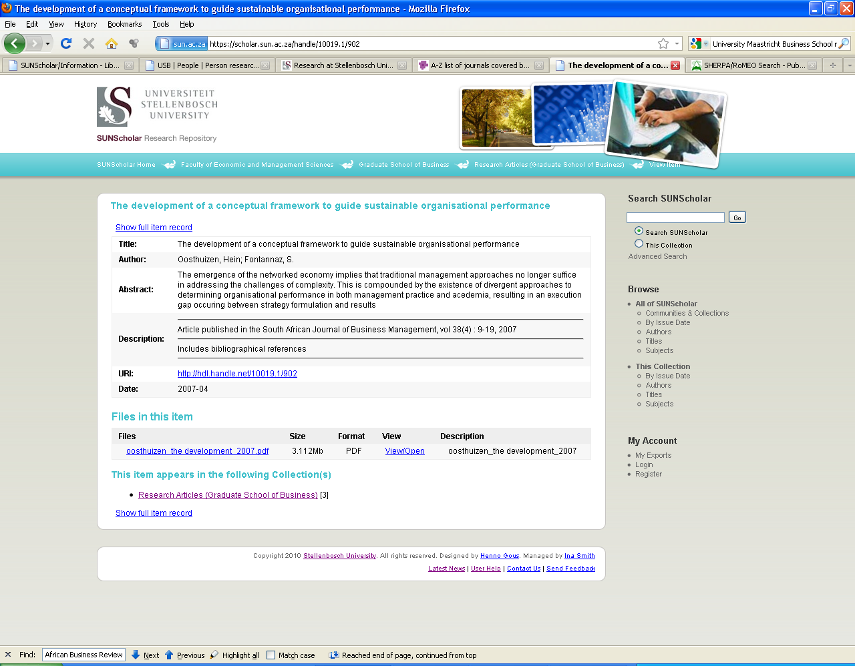
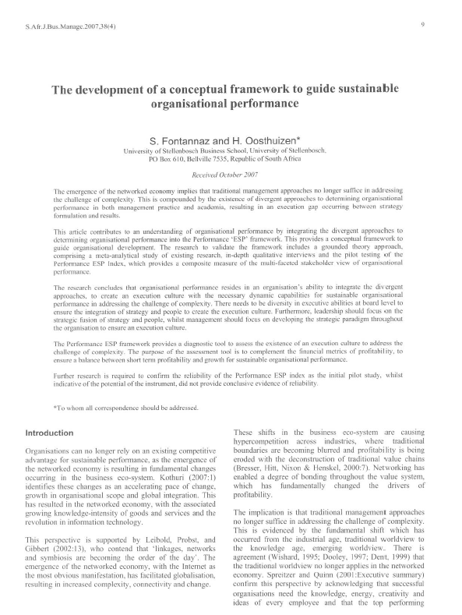
Open full text

Slide 27
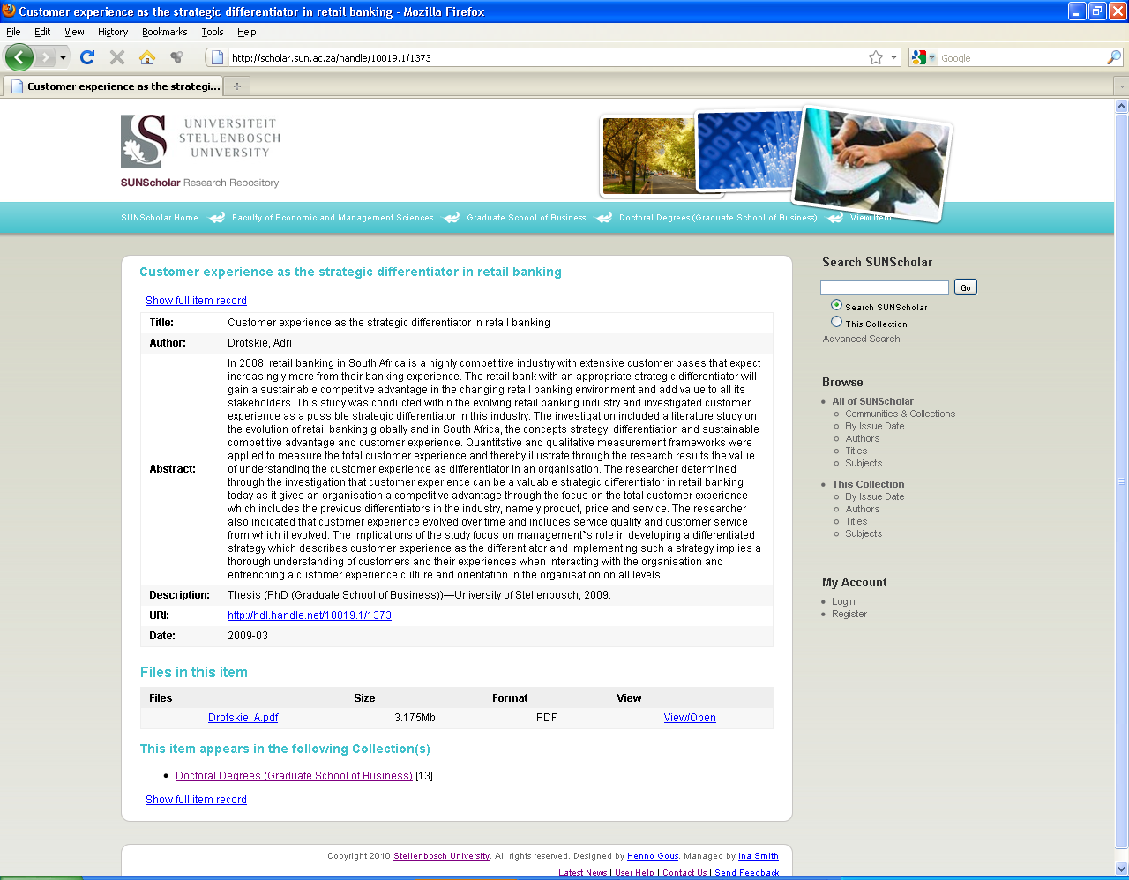
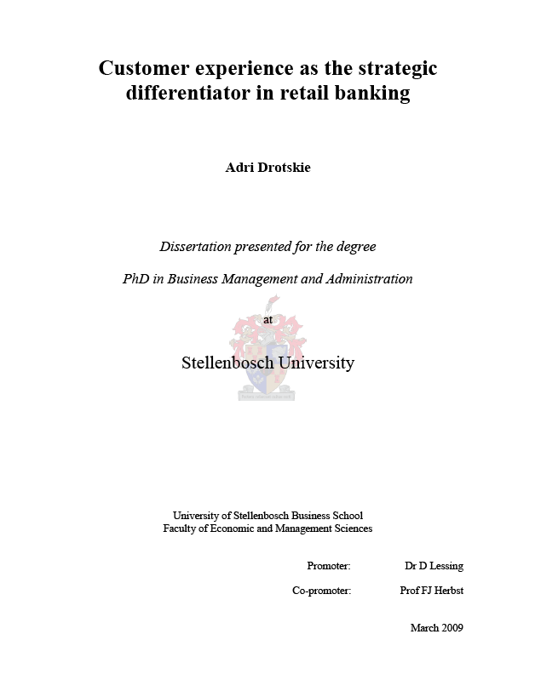

Slide 28
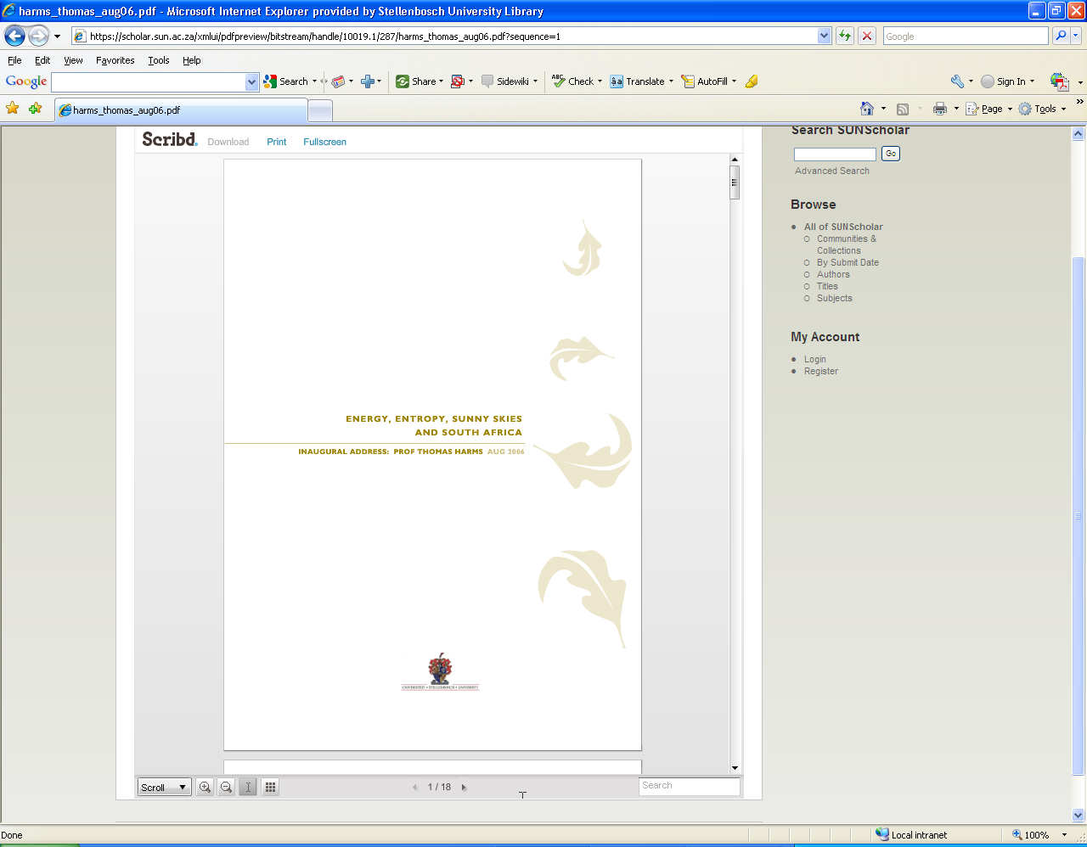
Document Streaming Module
Also: Audiovisual Streaming Module,
Image Zoom Module
Enables in-browser viewing of document files for a wide variety of document formats

Slide 29
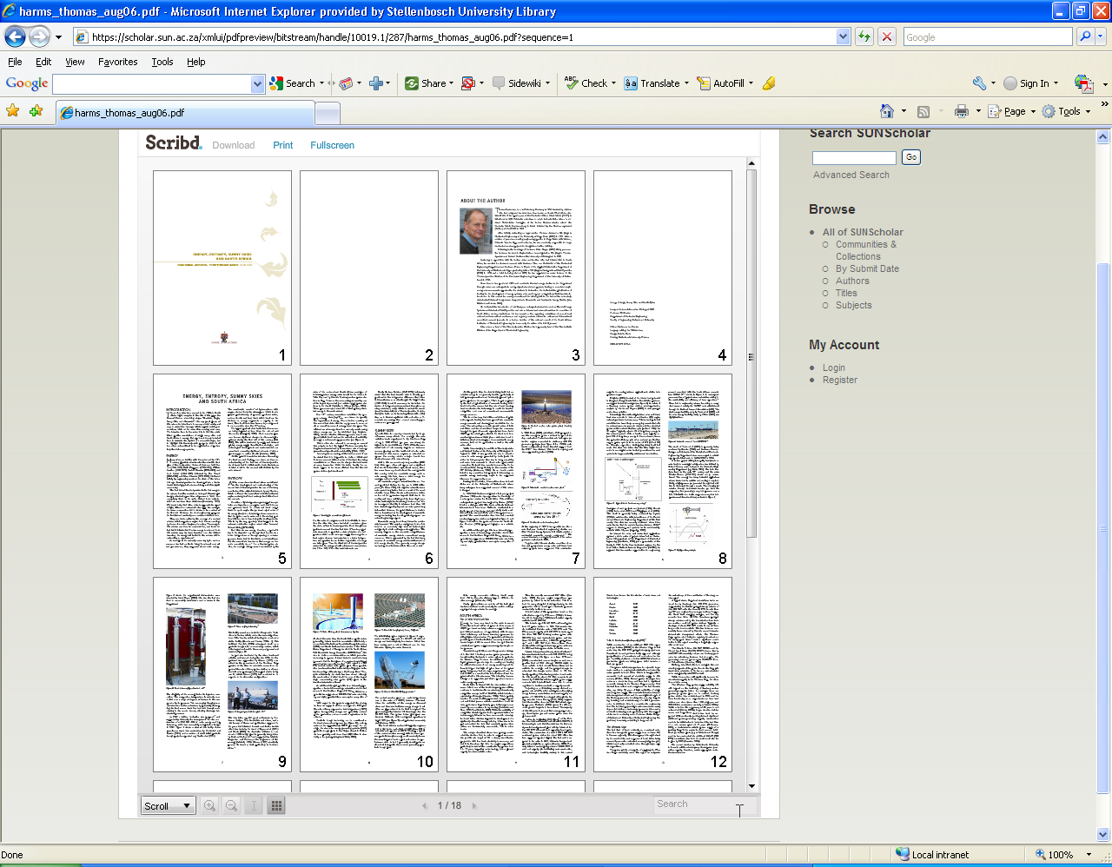

Slide 30
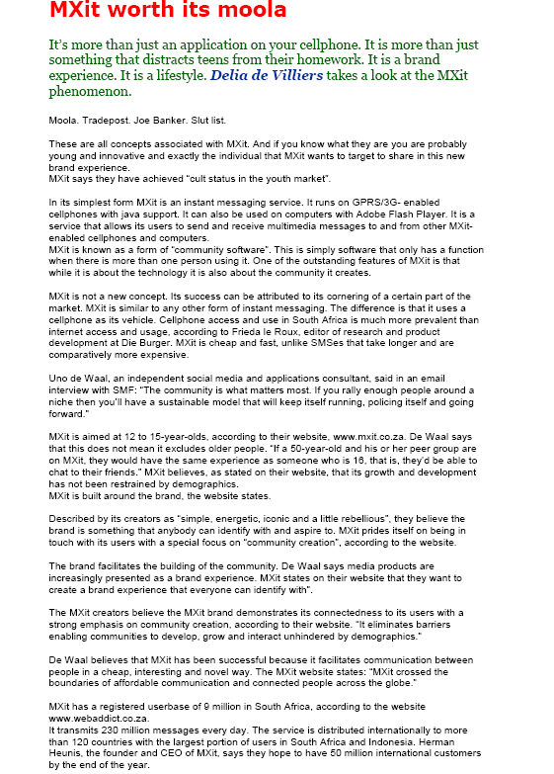
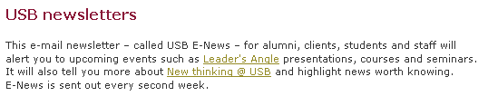
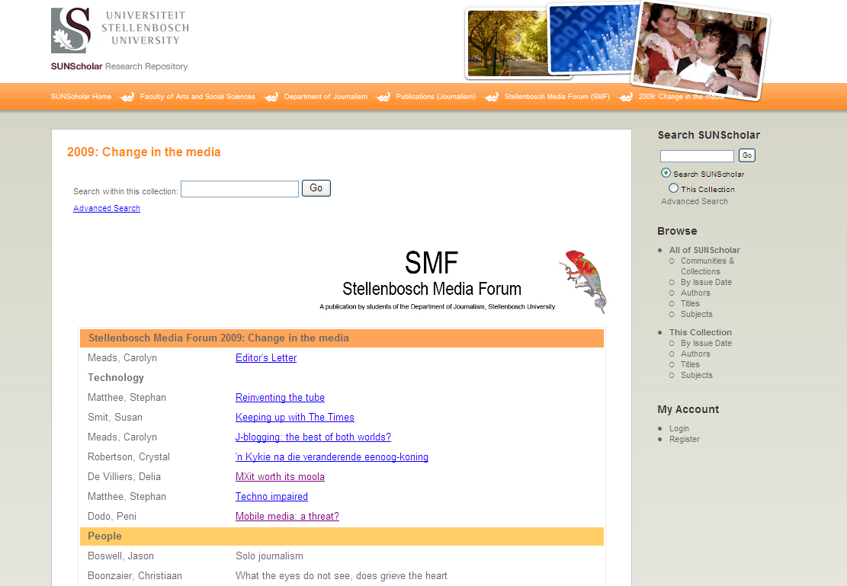

Slide 31
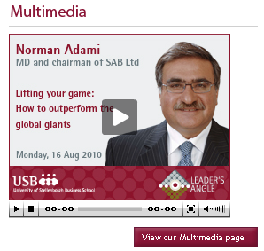
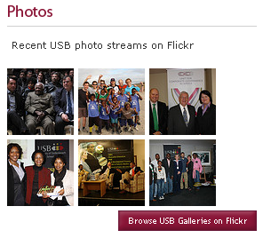
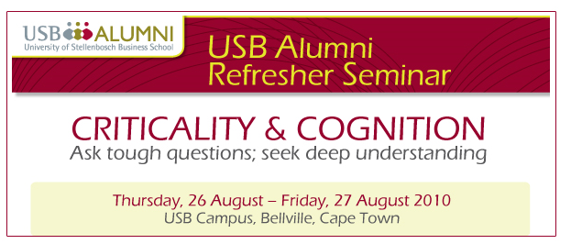
Research Articles
Images
Learning Objects
Technical Reports
Working Papers
E-mails
Web-pages
Conferences
Sound clips
Video clips
Books
Chapters from books
Conference proceedings
Data sets
Anything in digital format …

Slide 32
Benefits for Researchers
Research preserved – even after you have left US
Attracts researchers from other disciplines
May lead to better funding opportunities
Encourage dialogue between researchers
Presents complete research profile
Others can build on your research
Easier to detect plagiarism

Slide 33
Verify discoveries, discard ones that could not be replicated, avoid duplication of effort, integrate various lines of research (David 1998)
Research will be out in the open much sooner
Scholars worldwide read the latest research and enter the global economic conversation

Slide 34
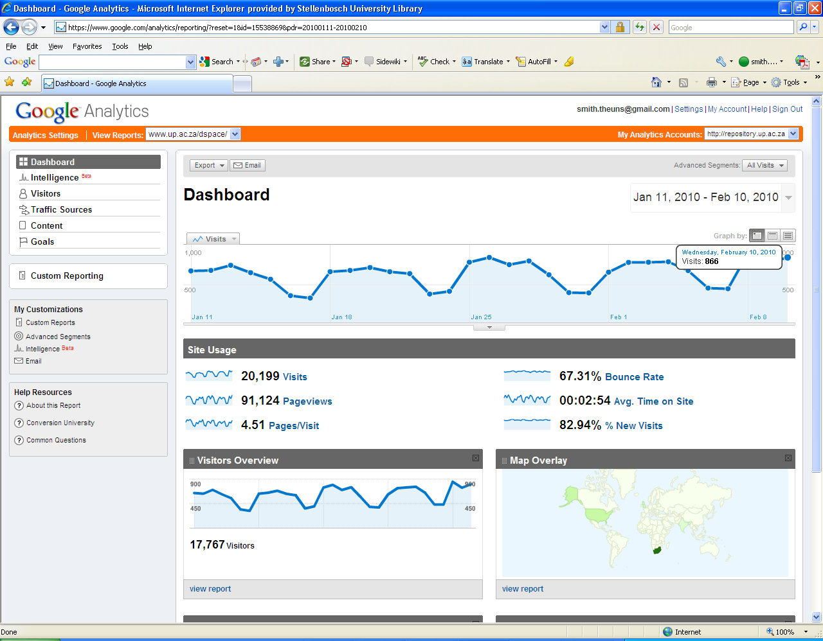
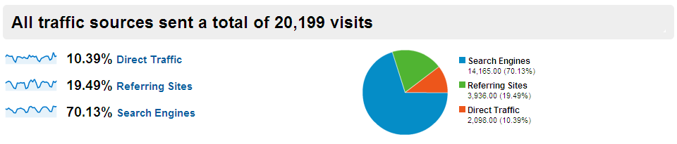
Vastly increases visibility, usage, impact of your research

Slide 35
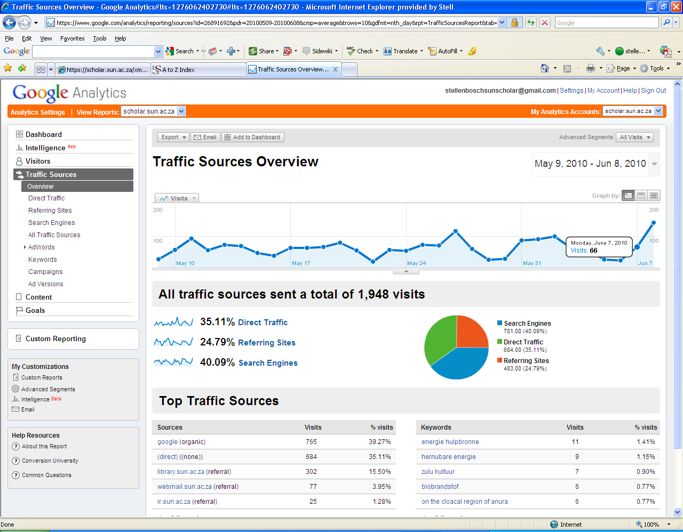

Slide 36
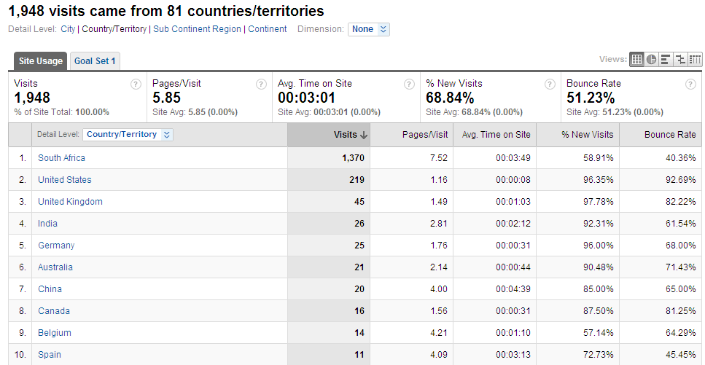

Slide 37
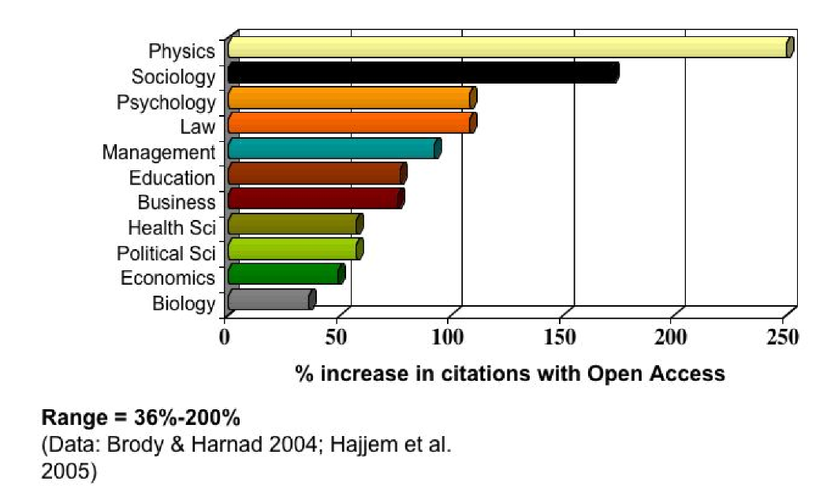
Open Access Increases Citations

Slide 38
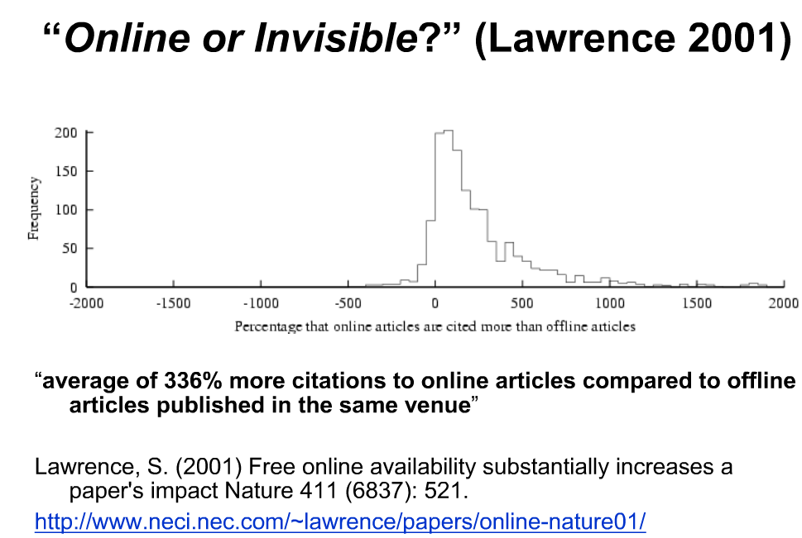

Slide 39

(Harnad, S 2009, ‘Mandates and metrics: how open repositories enable universities to manage, measure, and maximise their research assets)

Slide 40
Benefits for the Stellenbosch University
Central archive/digital library of all SU research – most important asset
Preserve all research for years to come
Persistent URL’s
All items – incl. full text pdf – fully searchable
Require uploading on IR at no extra expense
Increase research profile of SU even more
Increase ranking on international lists of top universities

Slide 41
Our Commitment
Negotiate for and provide server space
Management on technical & operational level
Maintain SUNScholar for the long term
Add value (library cataloguers)
Training & Support
Marketing
Advise on digital matters etc.
Conduct surveys & research – state-of-the-art repository
Register SUNScholar with other search engines & harvesters

Slide 42











International Harvesters & Registries
Currently negotiated

Slide 43
Become part of SUNScholar ….
Join our mailing list – e-mail: ismith@sun.ac.za
Attend training sessions
Collect full text of all research output
Future: obtain permission for 2nd copy on IR
Start populating Collections on SUNScholar!
ALL research output – work with faculty librarian

Slide 44

“The job of research is only half‐done if the results of that research cannot reach the widest audience.”
‐ Wellcome Trust ‐
SUNScholar: http://scholar.sun.ac.za
Contact Us: scholar@sun.ac.za
More info: http://wiki.lib.sun.ac.za/index.php/SUNScholar

Slide 45
Theses & Dissertations
Submission is mandatory
See guidelines on web: library.sun.ac.za/etd/index.htm
Nominations for December graduation ceremony – starts 1 September 2010
  Supervisor nominates
  Student receives an e-mail
  Student submits to SUNScholar

Slide 46
Theses & Dissertations
Paulette Talliard

Slide 47

Prepare thesis/dissertation

Slide 48


Slide 49


Slide 50


Slide 51


Slide 52


Slide 53


Slide 54


Slide 55


Slide 56
Thank you!

