Slide 1


Research @ Health Sciences
Cited more, preserved forever
Presented to the Pathology Research Committee
Ina Smith, Hilton Gibson, Linda Bellairs, Ingrid vd Westhuizen
9 June 2010

Slide 2

Two approaches to Open Access …
“By "open access" to literature, we mean its free availability on the public internet, permitting any users to read, download, copy, distribute, print, search, or link to the full texts of these articles, crawl them for indexing, pass them as data to software, or use them for any other lawful purpose, without financial, legal, or technical barriers other than those inseparable from gaining access to the internet itself. The only constraint on reproduction and distribution, and the only role for copyright in this domain, should be to give authors control over the integrity of their work and the right to be properly acknowledged and cited.”
(Budapest-Bethesda-Berlin or BBB definition of open access
http://www.earlham.edu/~peters/fos/newsletter/09-02-04.htm )
Acknowledgement – image: http://openreflections.files.wordpress.com/2010/01/open20access-seal.gif

Slide 3
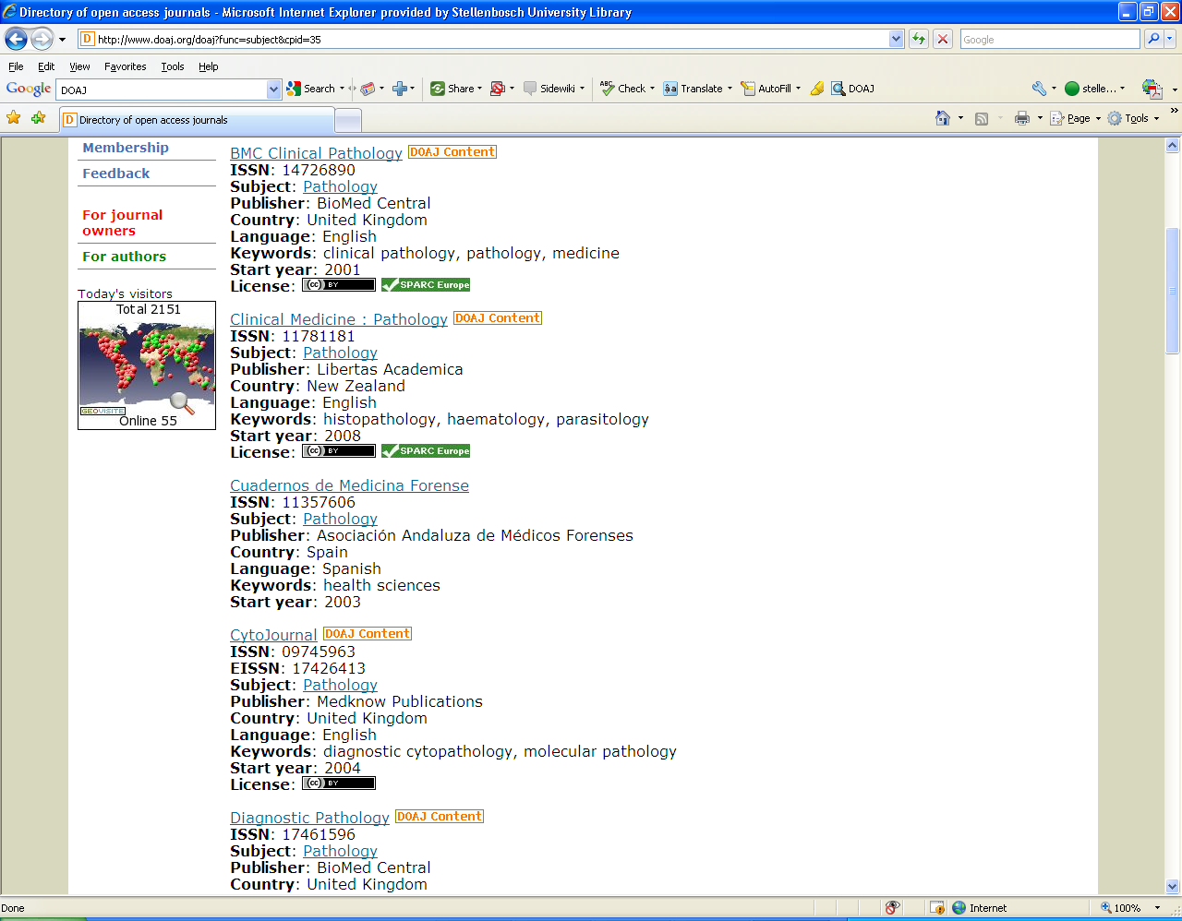

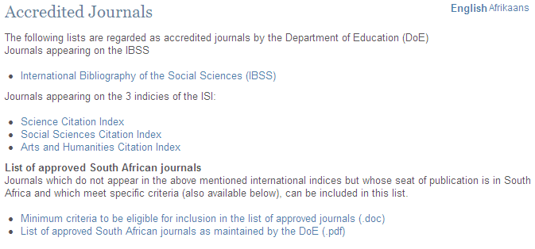
Open Access Journals(“golden” route)
http://www.doaj.org/
DoE Accredited Journals

Slide 4
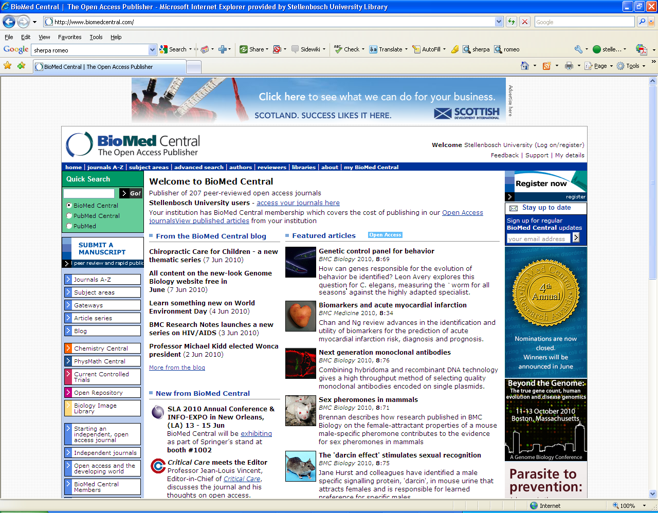

Slide 5
What is a research repository? (“green” route)
Set of services
Management & dissemination of digital materials
Organizational commitment
Stewardship
Long-term preservation
Organization
Open access/ distribution
(Clifford A. Lynch, "Institutional Repositories: Essential Infrastructure for Scholarship in the Digital Age" ARL, no. 226 (February 2003): 1-7)

Slide 6

What is SUNScholar?
Strategic objective of library: Support, develop and contribute to high-level scholarly publication output
Full text central digital research repository of the University of Stellenbosch
Provide open access where possible
Digitally preserve research output

Slide 7
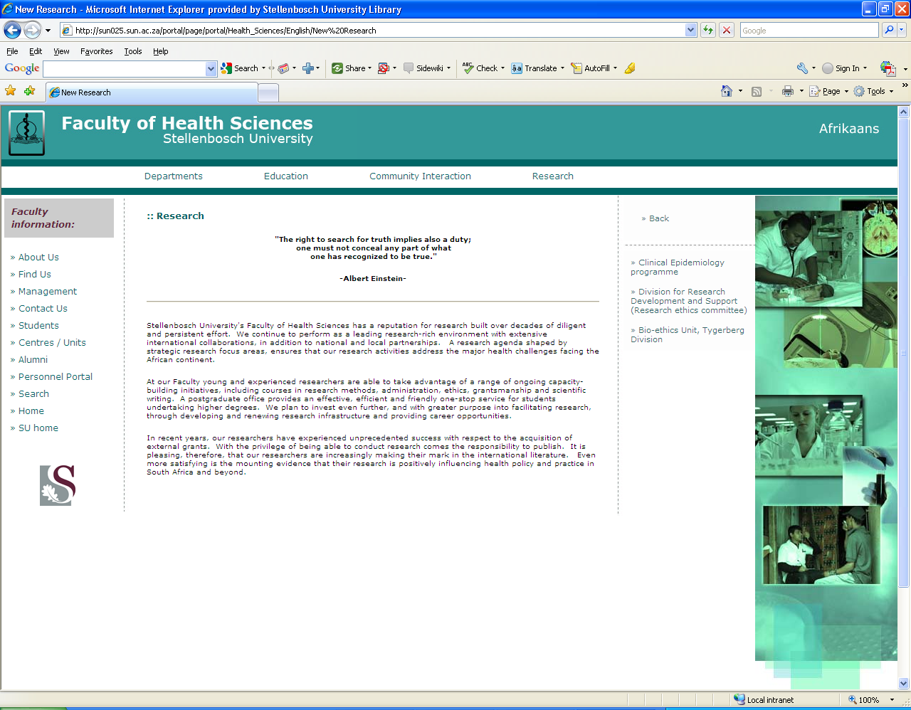
In recent years, our researchers have experienced unprecedented success with respect to the acquisition of external grants. With the privilege of being able to conduct research comes the responsibility to publish. It is pleasing, therefore, that our researchers are increasingly making their mark in the international literature. Even more satisfying is the mounting evidence that their research is positively influencing health policy and practice in South Africa and beyond.

Slide 8
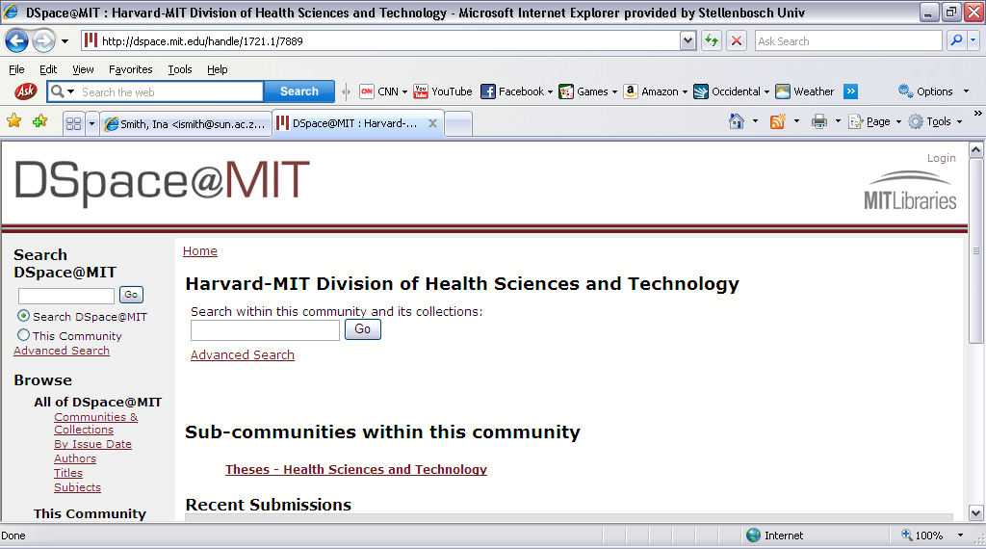

Slide 9
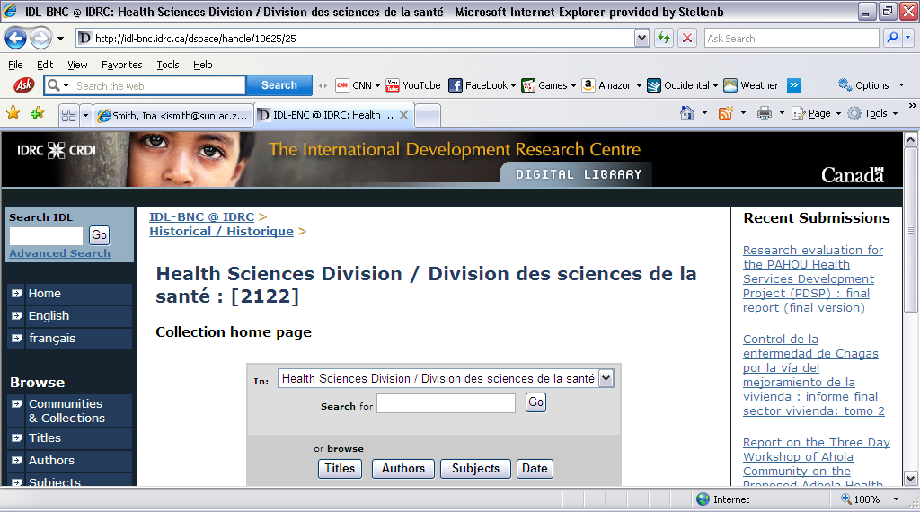

Slide 10
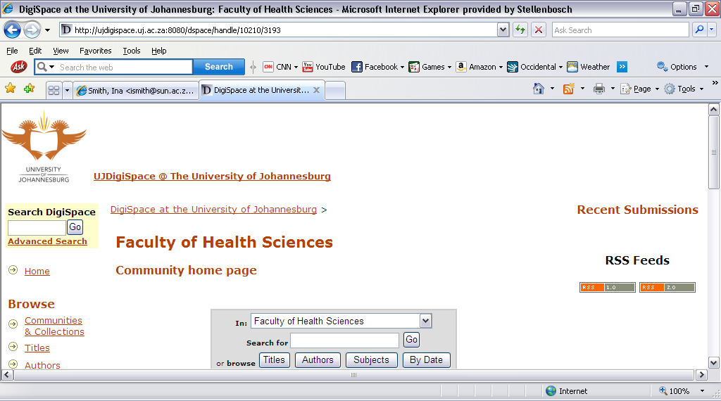

Slide 11
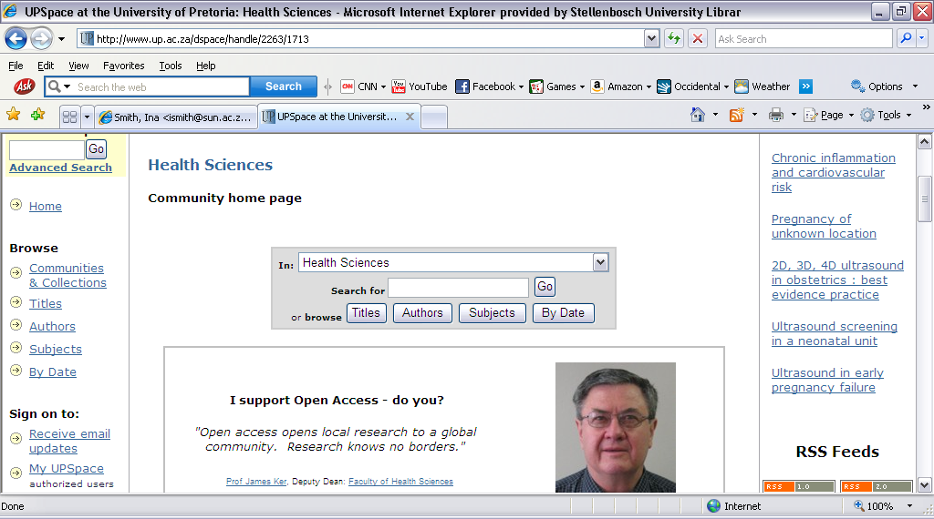

Slide 12
Research Output
Primary:
  Research Articles, Chapters in Books, Books, Conference Proceedings, Theses, Dissertations
Secondary:
  Inaugural Addresses, Conference Presentations & Posters, Images, Audio- & Audiovisual Clips, Seminars/Open Lectures, Conferences, Experiments, Data sets, and many more!

Slide 13
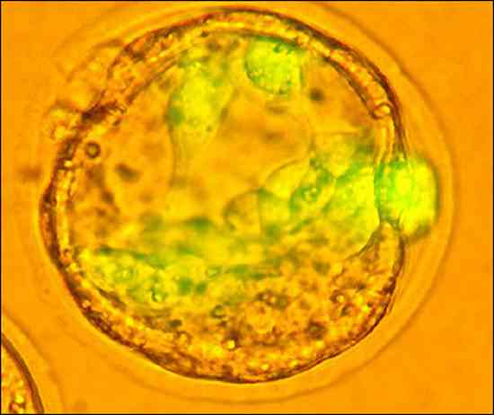
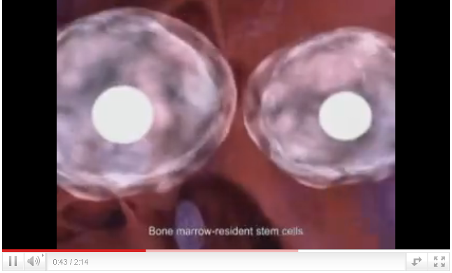
Acknowledgement: http://repairstemcell.files.wordpress.com/2009/04/embryonic-stem-cell.jpg
Acknowledgement: http://www.youtube.com/watch?v=1vBaFnp02MM&feature=related

Slide 14
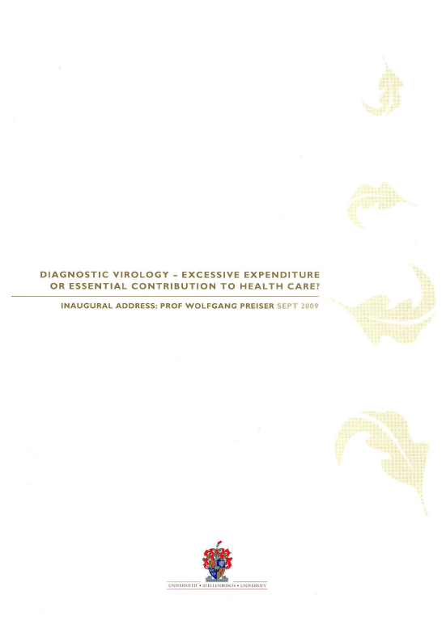
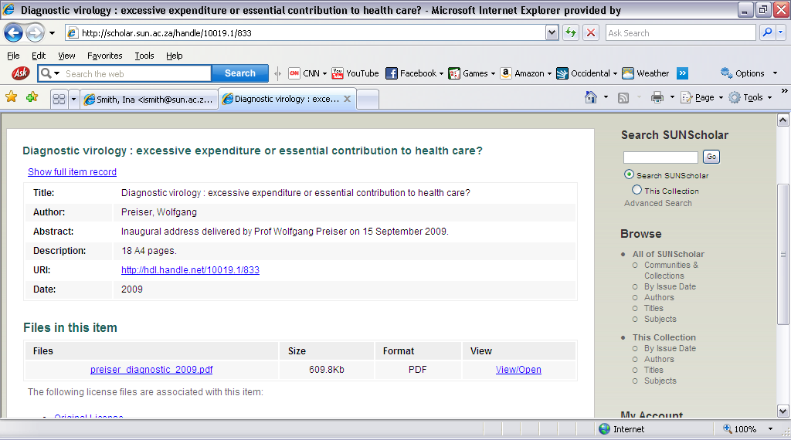
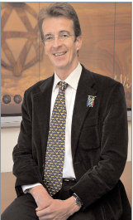

Slide 15
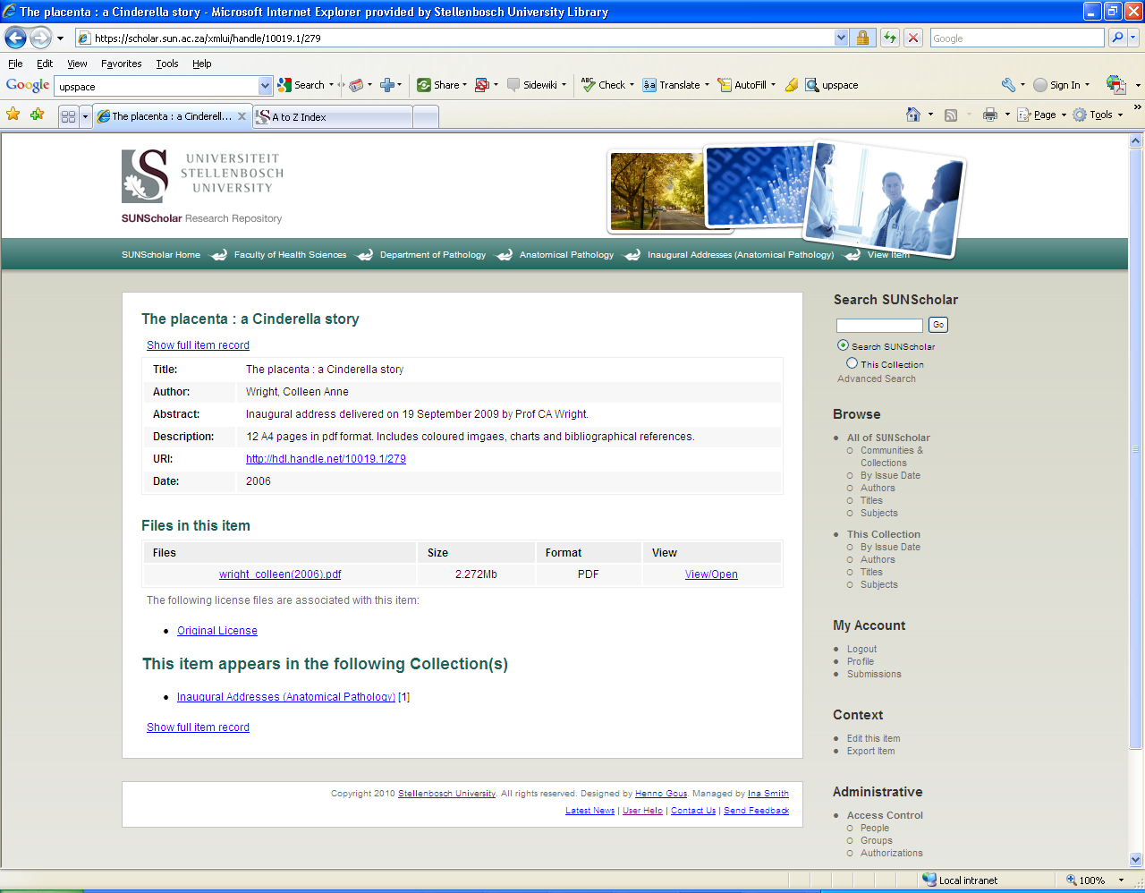

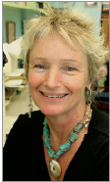

Slide 16
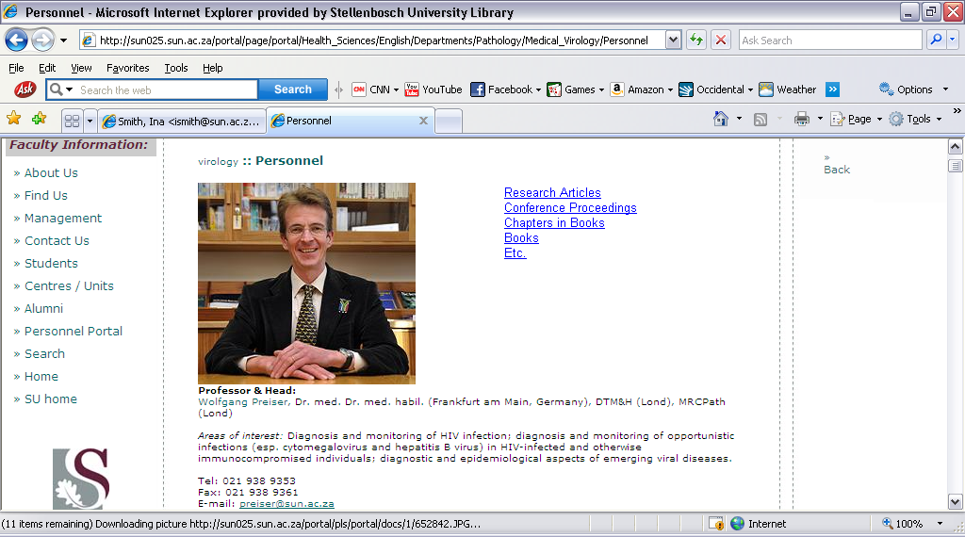
Links to full text in SUNScholar

Slide 17
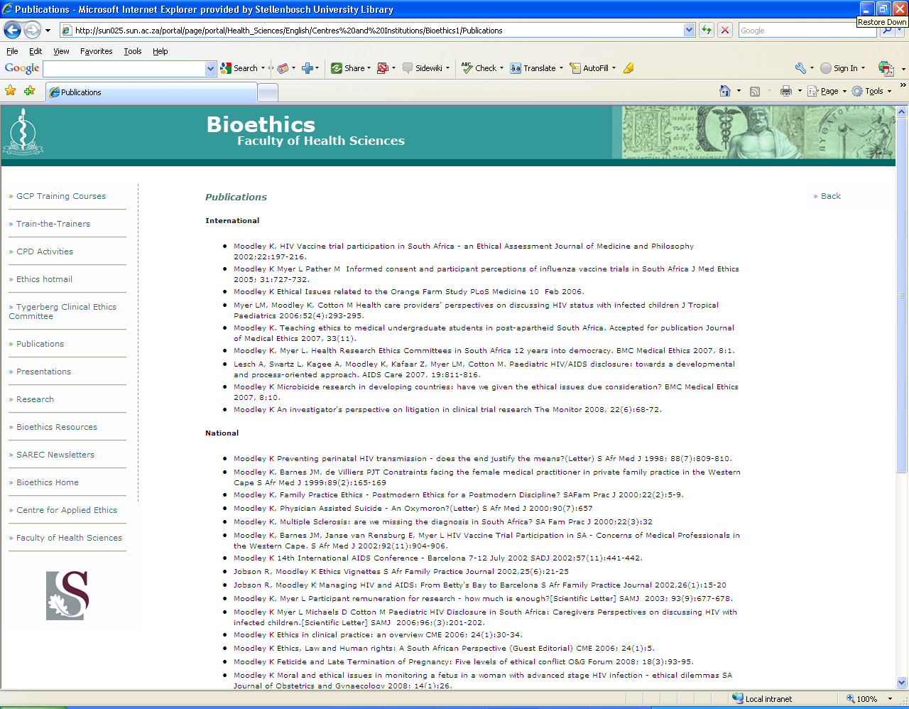
Links to full text in SUNScholar

Slide 18
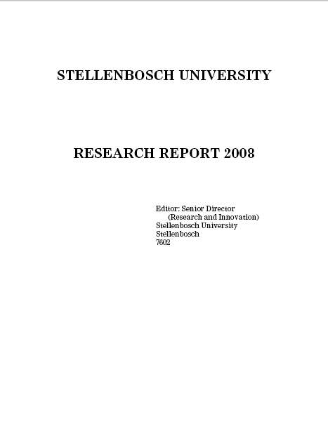
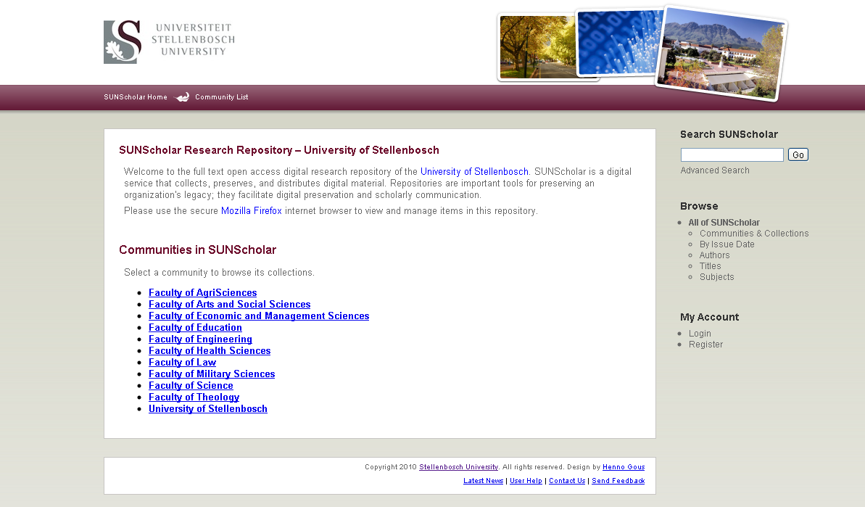
Research Output
Research Report System
With links to full text
Currently investigated

Slide 19
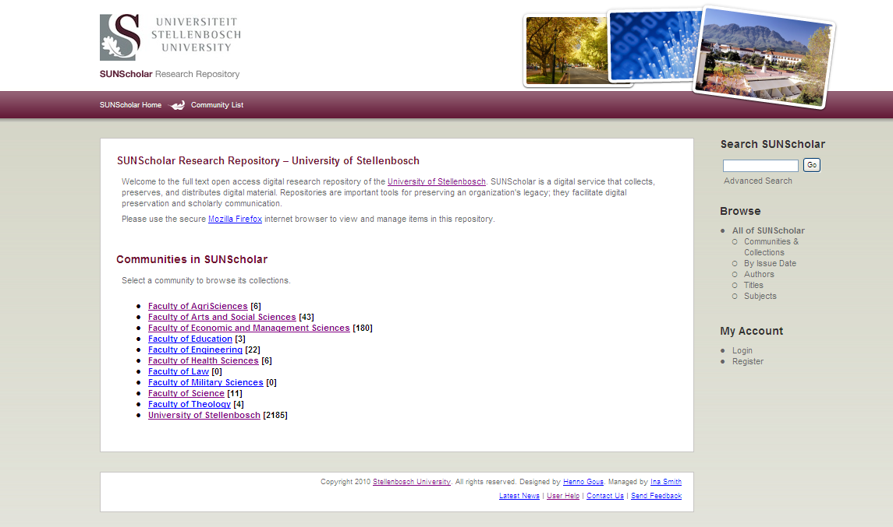
https://scholar.sun.ac.za
Top-Level Community:
Health Sciences

Slide 20
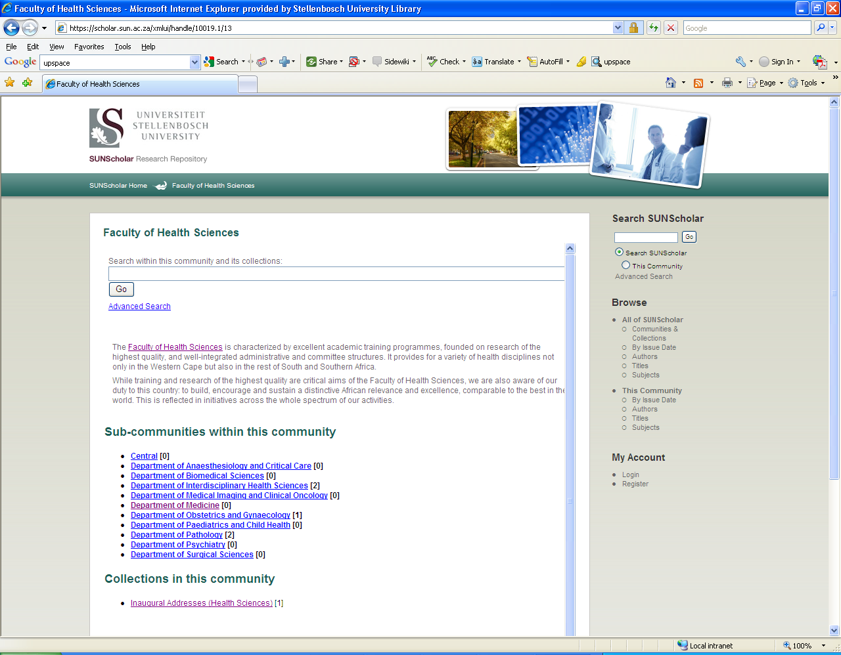
Customized per Faculty
Sub-Communities:
Departments

Slide 21
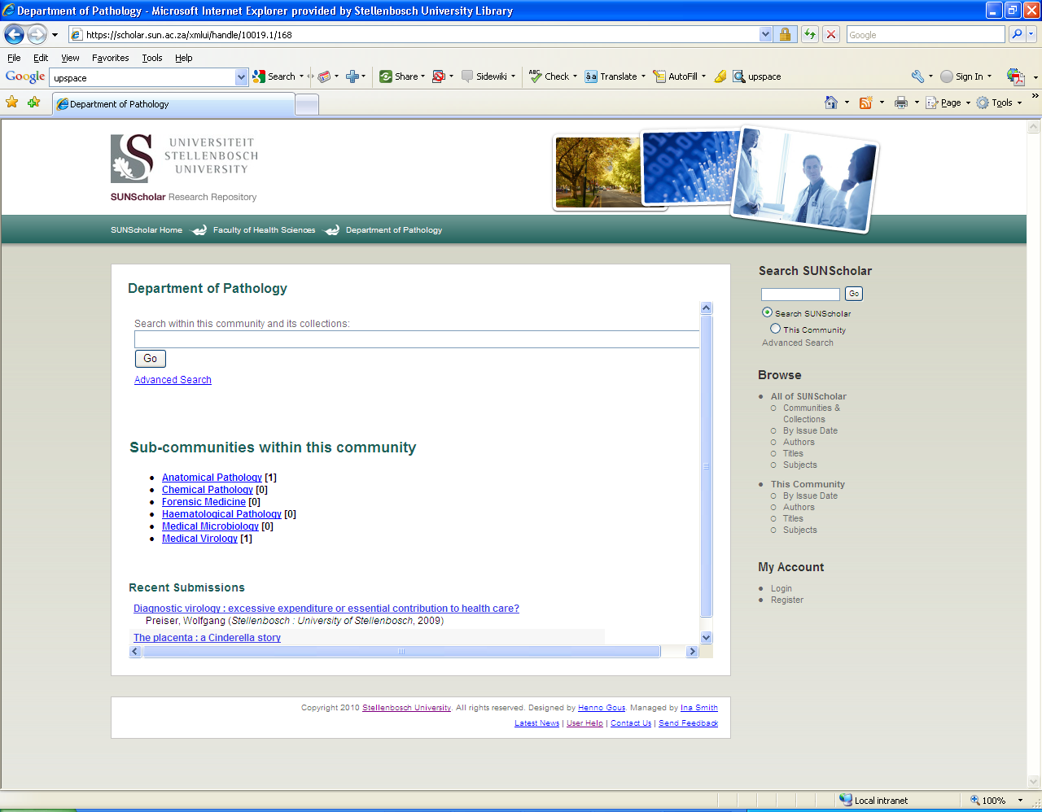
Sub-Communities within
Departments

Slide 22
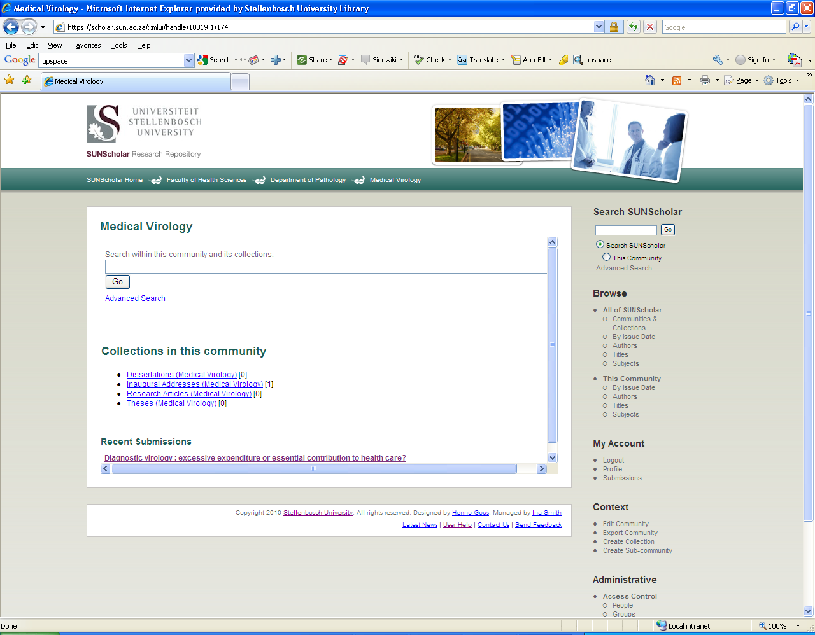
5 most recent submissions listed on Collection home page

Slide 23
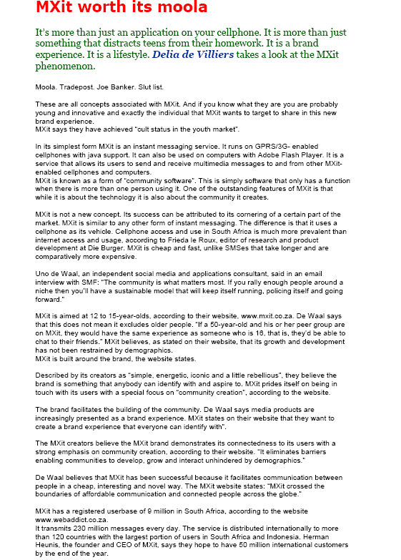
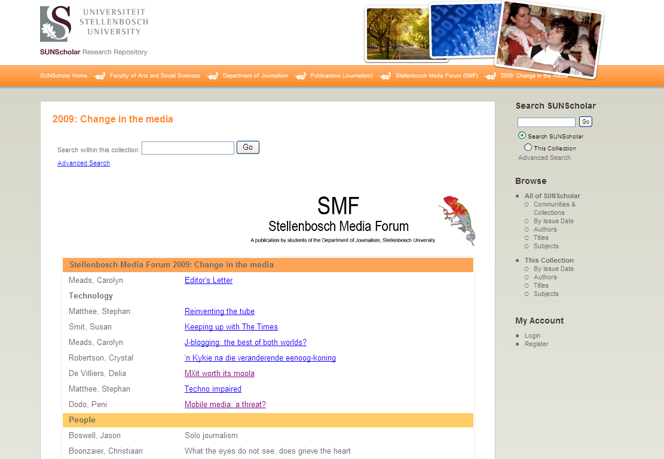

Slide 24
Benefits for Researchers
Research preserved – even after you have left US
Attracts researchers from other disciplines
May lead to better funding opportunities
Encourage dialogue between researchers
Presents complete research profile
Others can build on your research
Easier to detect plagiarism

Slide 25
Verify discoveries, discard ones that could not be replicated, avoid duplication of effort, integrate various lines of research (David 1998)
Research will be out in the open much sooner
Scholars worldwide read the latest research and enter the global economic conversation

Slide 26
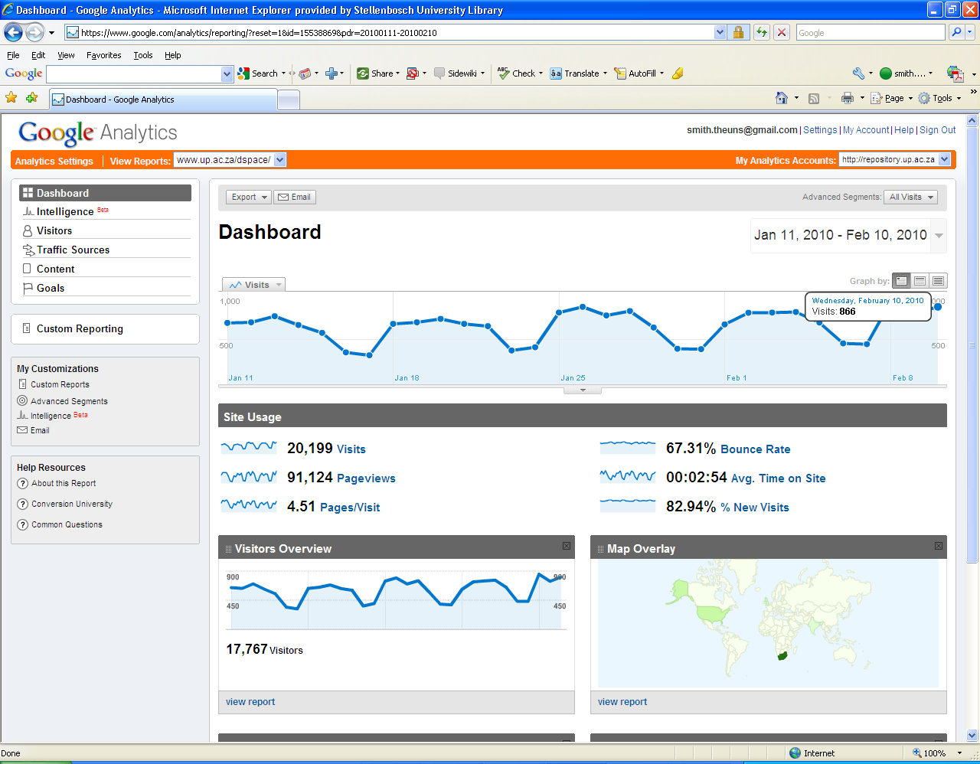
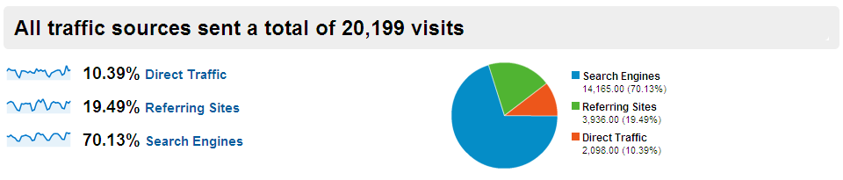
Vastly increases visibility, usage, impact of your research

Slide 27
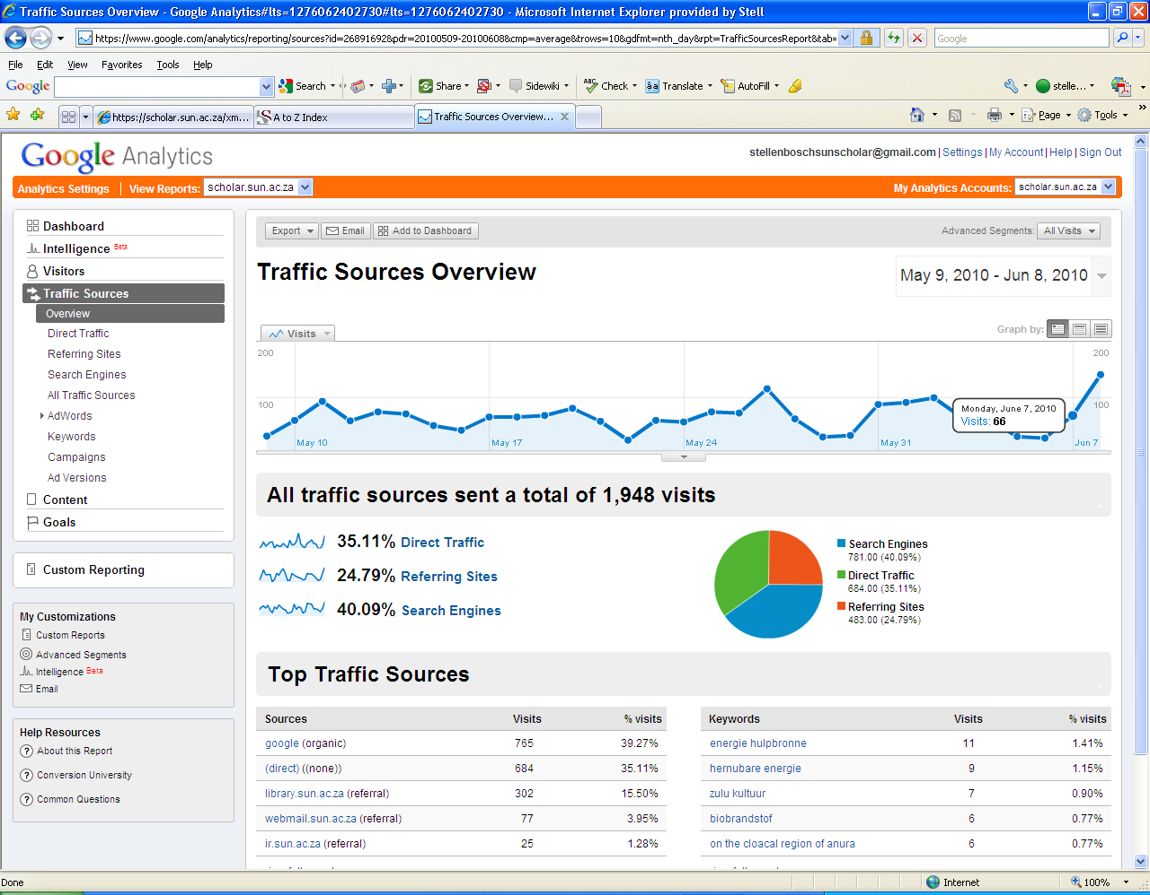

Slide 28
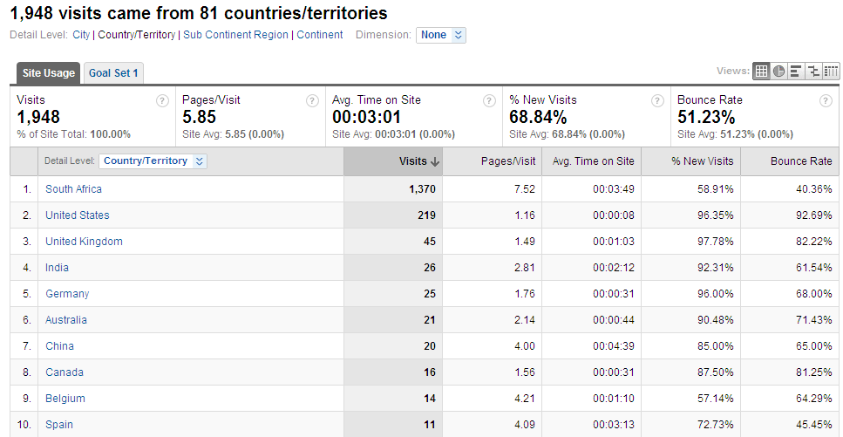

Slide 29
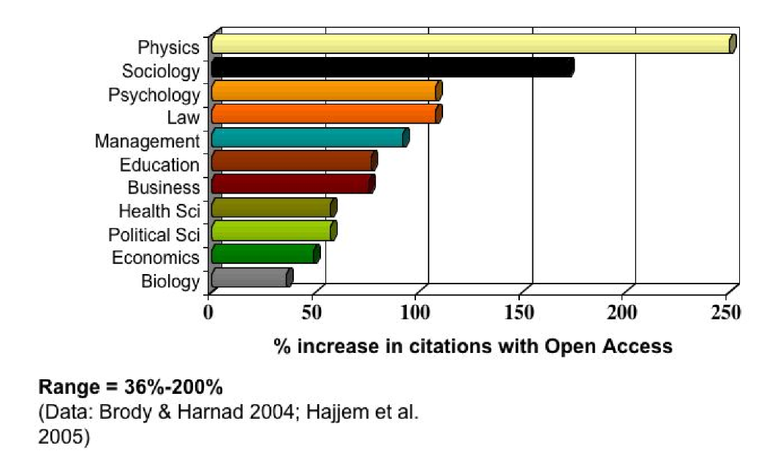
Open Access Increases Citations

Slide 30
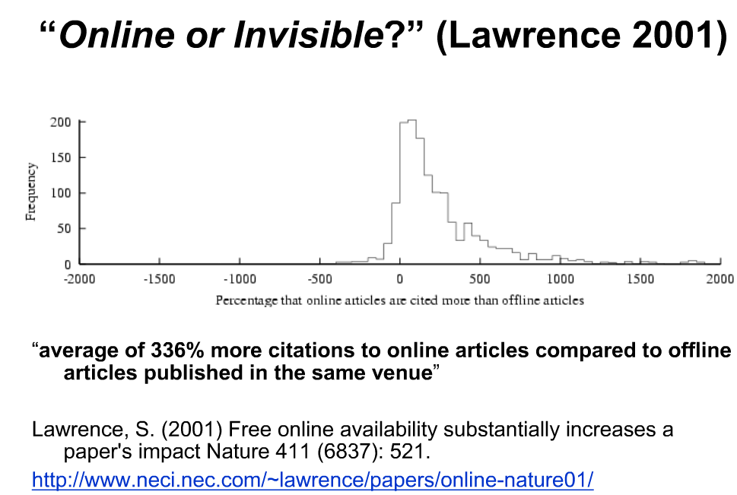

Slide 31
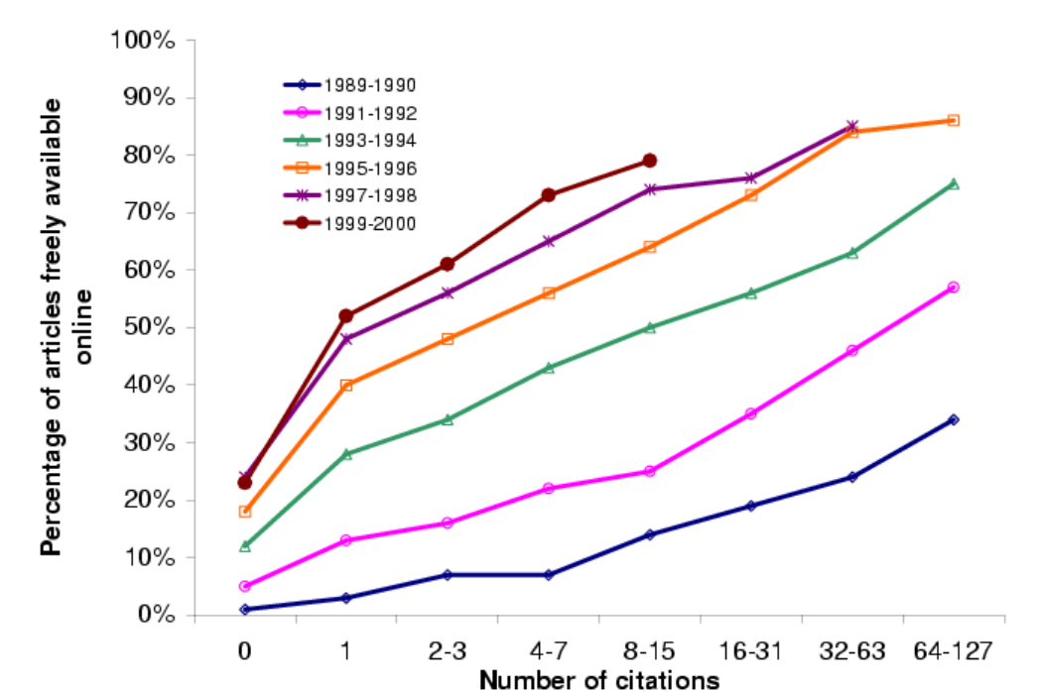
(Harnad, S 2009, ‘Mandates and metrics: how open repositories enable universities to manage, measure, and maximise their research assets)

Slide 32
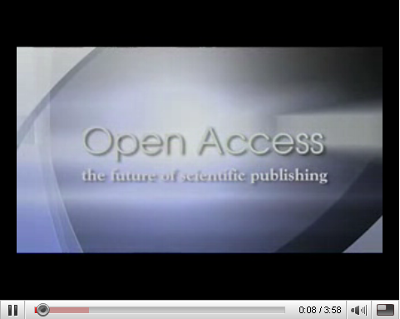
http://www.youtube.com/watch?v=g2JT23E1bRE
BioMed Central's authors and editors discuss the benefits of open access publishing

Slide 33
Benefits for the Stellenbosch University
Central archive/digital library of all SU research – most important asset
Preserve all research for years to come
Persistent URL’s
All items – incl. full text pdf – fully searchable
Require uploading on IR at no extra expense
Increase research profile of SU even more
Increase ranking on international lists of top universities

Slide 34
Our Commitment
Negotiate for and provide server space
Management on technical & operational level
Maintain SUNScholar for the long term
Add value (library cataloguers)
Training & Support
Marketing
Advise on digital matters etc.
Conduct surveys & research – state-of-the-art repository
Register SUNScholar with other search engines & harvesters

Slide 35
Workflow
Submit item
Reject
Review item
Notification to Submitter & Subscribers
Edit metadata
Available on IR

Slide 36
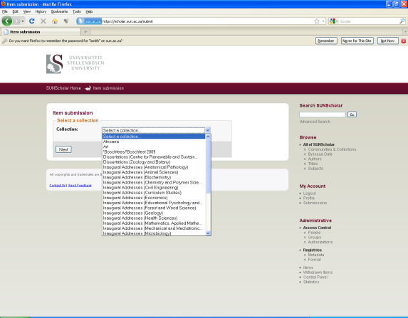
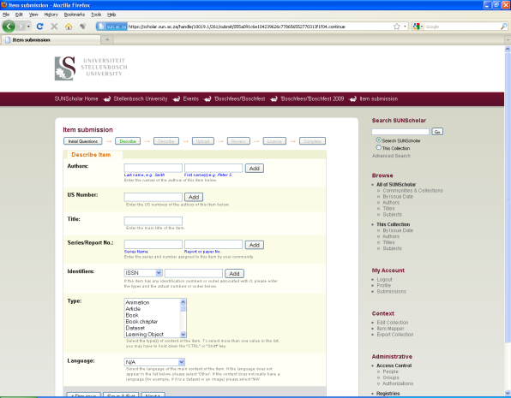
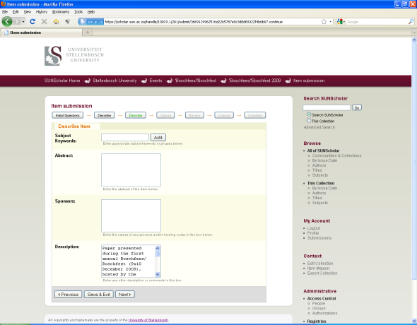
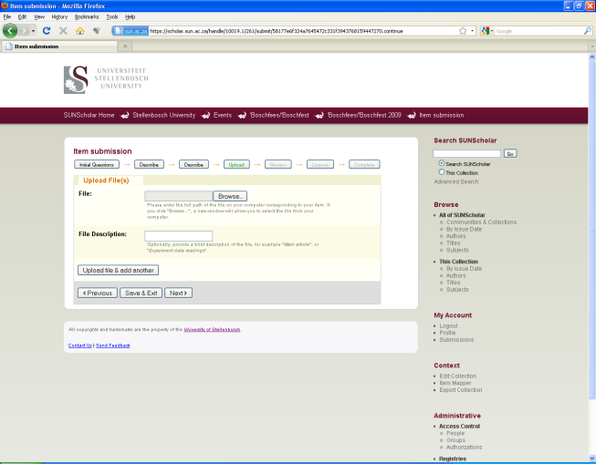
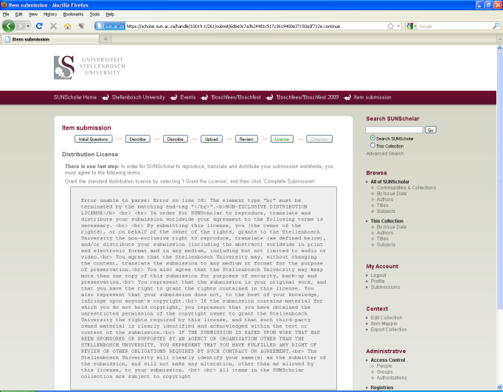
Submission Process
1
2
3
4
5

Slide 37
Become part of SUNScholar ….
Join our mailing list – e-mail: ismith@sun.ac.za
Attend training sessions
Collect full text of all research output
Future: obtain permission for 2nd copy on IR
Copyright clearance
Digitize if needed
Register as a Submitter
Submit in pdf
Start populating Arts & Social Sciences on SUNScholar!

Slide 38
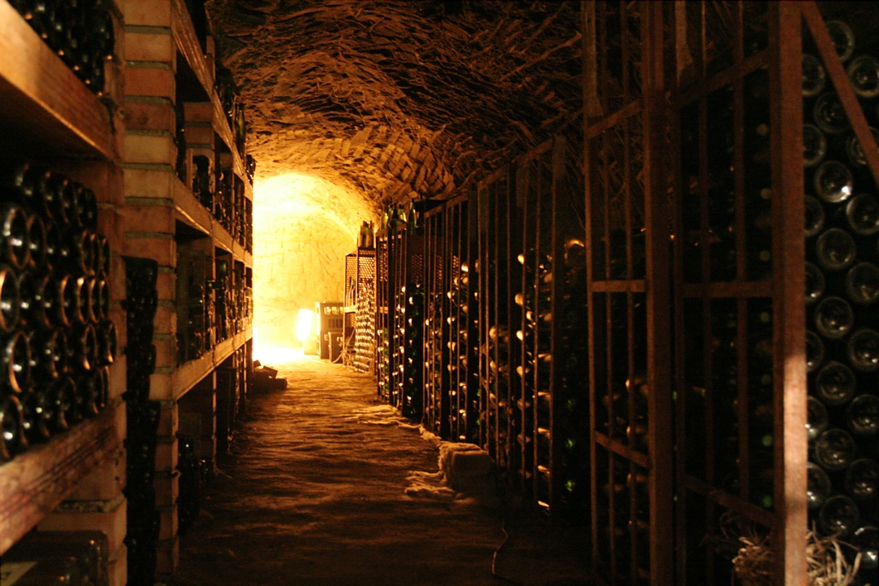
“The job of research is only half‐done if the results of that research cannot reach the widest audience.”
‐ Wellcome Trust ‐

